Slide 1
Simple UI Widgets

Slide 2
Contents
Views
ViewGroups
View hierarchy

Slide 3
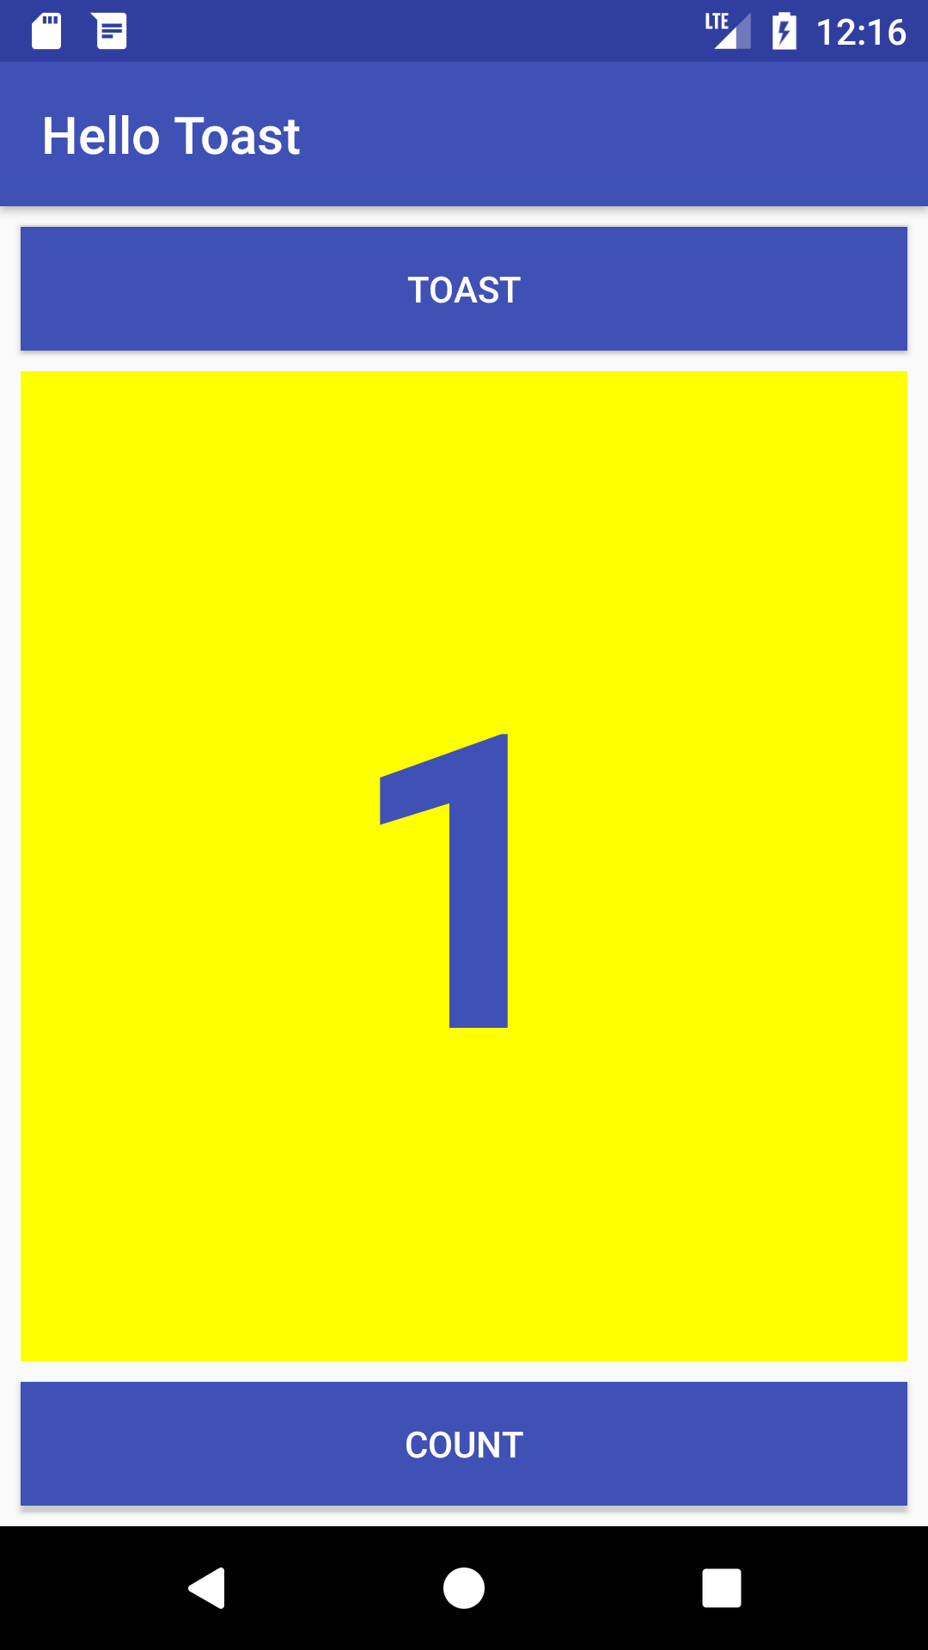


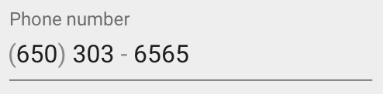

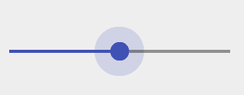
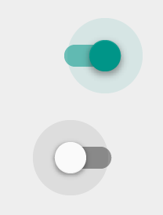
Views
Everything you see is a view
Examples of views
Views
Button
EditText
Slider
CheckBox
RadioButton
Switch

Slide 4
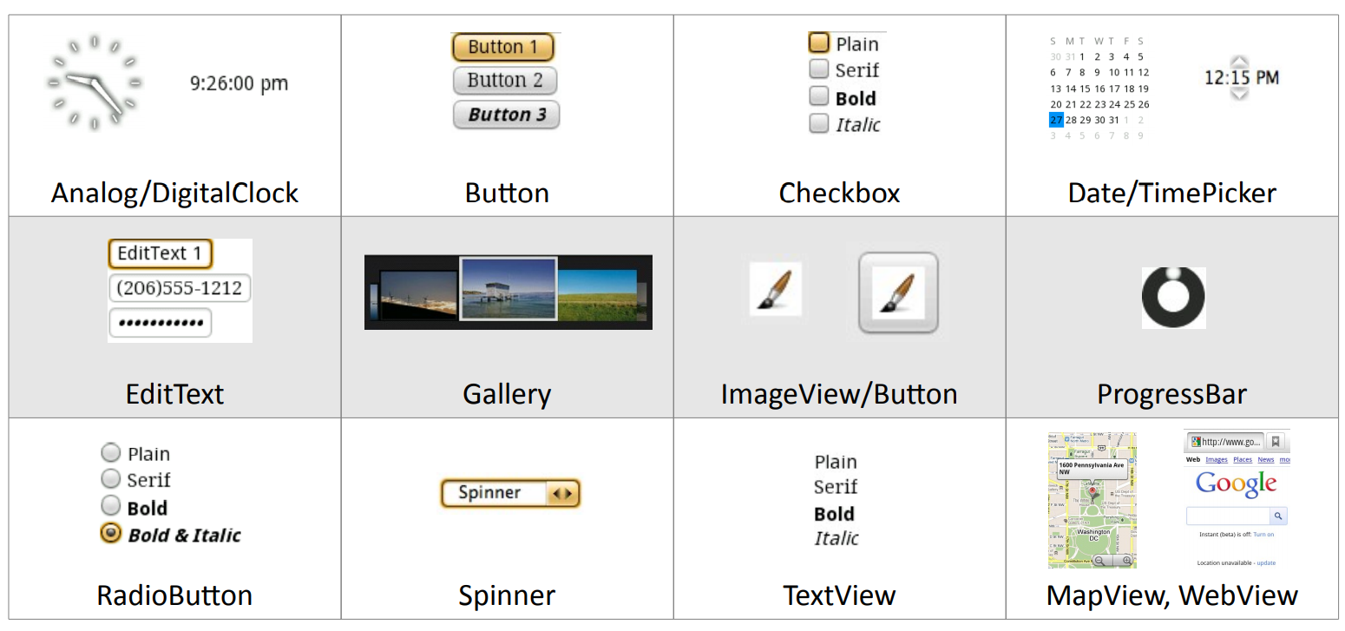
Android Widgets

Slide 5
Create views and layouts
Android Studio layout editor: visual representation of XML
XML editor
Java code

Slide 6
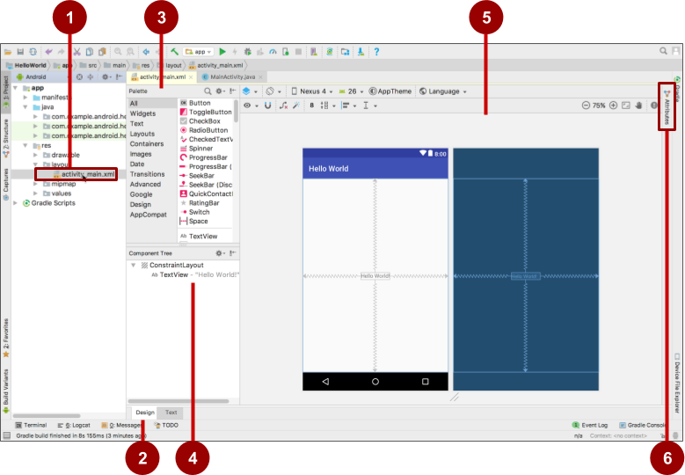
Android Studio layout editor
XML layout file
Design and Text tabs
Palette pane
Component Tree
Design and blueprint panes
Attributes tab

Slide 7
View defined in XML
<TextView
android:id="@+id/show_count"
android:layout_width="match_parent"
android:layout_height="wrap_content"
android:background="@color/myBackgroundColor"
android:text="@string/count_initial_value"
android:textColor="@color/colorPrimary"
android:textSize="@dimen/count_text_size"
android:textStyle="bold"
/>

Slide 8
View attributes in XML
android:<property_name>="<property_value>"
Example: android:layout_width="match_parent"
android:<property_name>="@<resource_type>/resource_id"
Example: android:text="@string/button_label_next"
android:<property_name>="@+id/view_id"
Example: android:id="@+id/show_count"

Slide 9
Create View in Java code
In an Activity:
TextView myText = new TextView(this);
myText.setText("Display this text!");

Slide 10
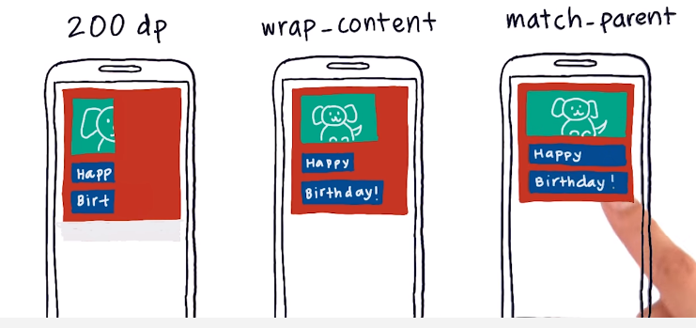
Views width

Slide 11
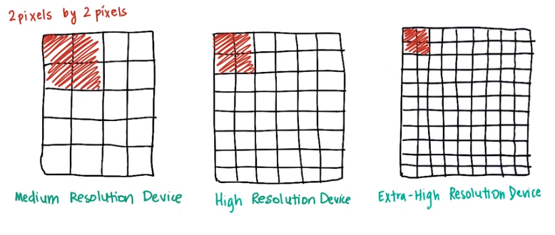
Density – independent pixels

Slide 12
Measurements
Density-independent Pixels (dp): for Views
Scale-independent Pixels (sp): for text
Don't use device-dependent or density-dependent units:
Actual Pixels (px)
Actual Measurement (in, mm)
Points - typography 1/72 inch (pt)

Slide 13
Common Widgets
Button
TextView
EditText
ImageView
CheckBox
RadioButton
WebView
AdapterView
- ListView
- Spinner
RecyclerView
…

Slide 14
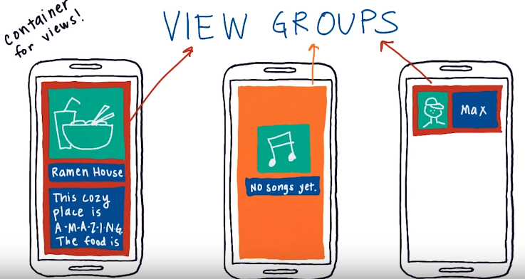
ViewGroups
ViewGroup contains "child" views

Slide 15
ViewGroups
Common Layout Classes
ConstraintLayout: Connect views with constraints
LinearLayout: Horizontal or vertical row
RelativeLayout: Child views relative to each other
TableLayout: Rows and columns
FrameLayout: Shows one child of a stack of children

Slide 16




ViewGroups
Common Layout Classes
LinearLayout
ConstraintLayout
GridLayout
TableLayout

Slide 17
Hierarchy of viewgroups and views
ViewGroup
Root view is always a ViewGroup
ViewGroup
View
View
View
View
View

Slide 18
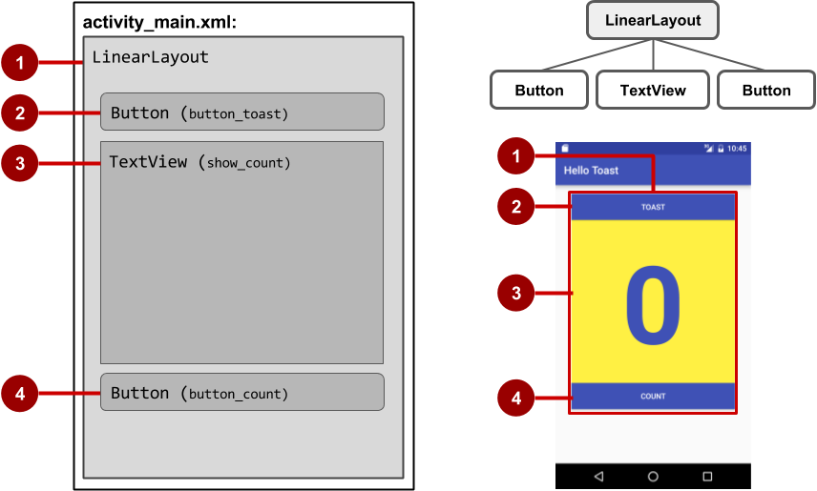
View hierarchy and screen layout

Slide 19
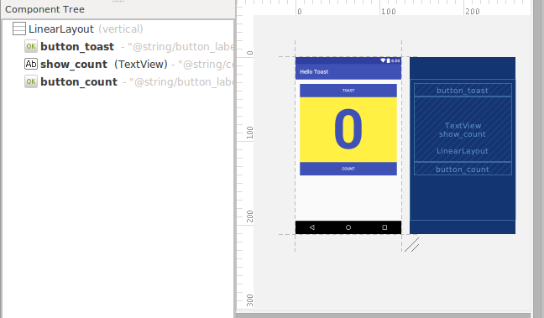
View hierarchy in the layout editor

Slide 20
Layout created in XML
<LinearLayout
android:orientation="vertical"
android:layout_width="match_parent"
android:layout_height="match_parent">
<Button
... />
<TextView
... />
<Button
... />
</LinearLayout

Slide 21
Layout created in Java Activity code
LinearLayout linearL = new LinearLayout(this);
linearL.setOrientation(LinearLayout.VERTICAL);
TextView myText = new TextView(this);
myText.setText("Display this text!");
linearL.addView(myText);
setContentView(linearL);

Slide 22
Set width and height in Java code
LinearLayout.LayoutParams layoutParams =
new Linear.LayoutParams(
LayoutParams.MATCH_PARENT, LayoutParams.MATCH_CONTENT);
myView.setLayoutParams(layoutParams);

Slide 23
LinearLayout
A box model – widgets or child containers are lined up in a column or row, one after the next.
Special attributes:
orientation: indicates whether the LinearLayout represents a row or a column
weight: indicates whether the LinearLayout represents a row or a column
gravity: is used to indicate how a control will align on the screen
LinearLayout

Slide 24
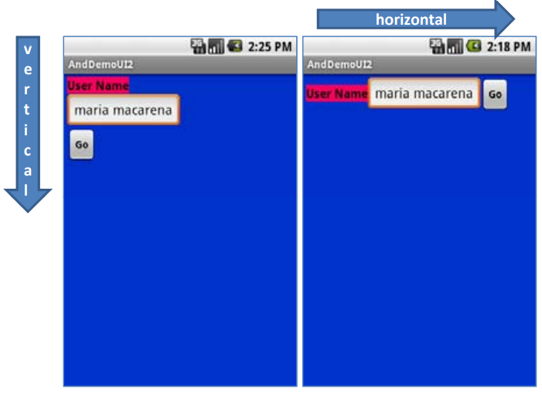
LinearLayout - Special attributes
orientation
Name: android:orientation
Value: vertical, horizontal

Slide 25
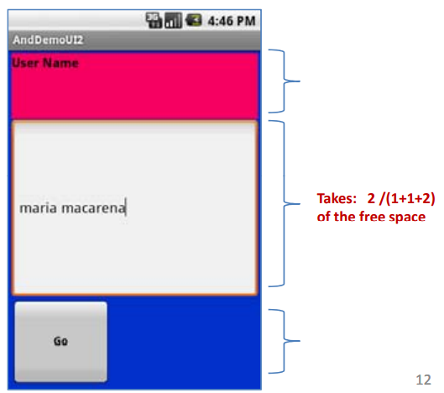
LinearLayout - Special attributes
weight
Name: android:layout_weight
Value: 1, 2, 3, …

Slide 26
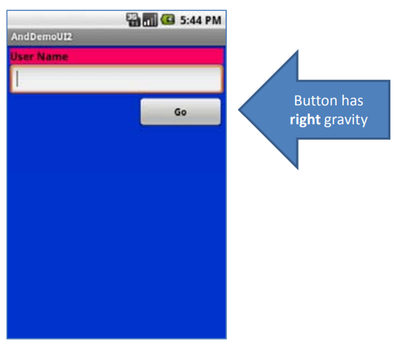
LinearLayout - Special attributes
gravity
Name: android:layout_gravity
Value: left, center, right, top, bottom, etc.

Slide 27
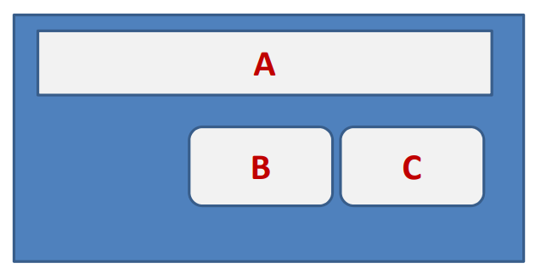
RelativeLayout
RelativeLayout places widgets based on their relationship to other widgets in the container and the parent container
Example:
A is by the parent’s top
C is below A, to its right
B is below A, to the left of C

Slide 28
RelativeLayout – Special attributes
Referring to the container
android:layout_alignParentTop: says the widget's top should align with the top of the container
android:layout_alignParentBottom: the widget's bottom should align with the bottom of the container
android:layout_alignParentLeft: the widget's left side should align with the left side of the container
android:layout_alignParentRight: the widget's right side should align with the right id f th t i 19 side of the container
android:layout_centerHorizontal: the widget should be positioned horizontally at the center of the container
android:layout_centerVertical: the widget should be positioned vertically at the center of the container
android:layout_centerInParent: the widget should be positioned both horizontally and vertically at the center of the container

Slide 29
RelativeLayout – Special attributes
Referring to other widgets
android:layout_above: indicates that the widget should be placed above the widget referenced in the property
android:layout_below: indicates that the widget should be placed below the widget referenced in the property
android:layout_toLeftOf: indicates that the widget should be placed to the left of the widget referenced in the property
android:layout_toRightOf: indicates that the widget should be placed to the right of the widget referenced in the property
android:layout_alignTop: indicates indicates that the widget s' top should be aligned with the top of the widget referenced in the property

Slide 30
RelativeLayout – Special attributes
Referring to other widgets (cont’d)
android:layout_alignBottom indicates that the widget's bottom should be aligned with the bottom of the widget referenced in the property
android:layout_alignLeft indicates that the widget's left should be aligned
with the left of the widget referenced in the property
android:layout_alignRight indicates that the widget's right should be aligned with the right of the widget referenced in the property
android:layout_alignBaseline indicates that the baselines of the two widgets should be aligned

Slide 31
ConstraintLayout
Self-study
https://developer.android.com/training/constraint-layout
https://developer.android.com/codelabs/constraint-layout#0

Slide 32
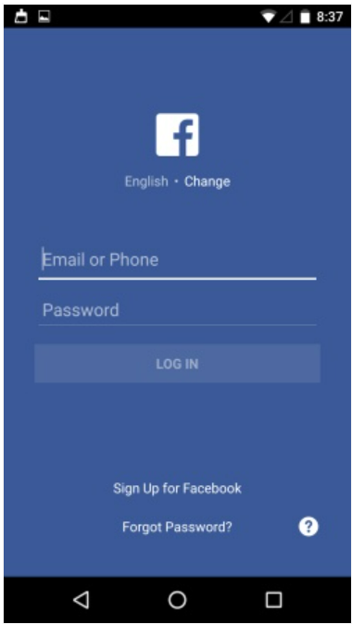
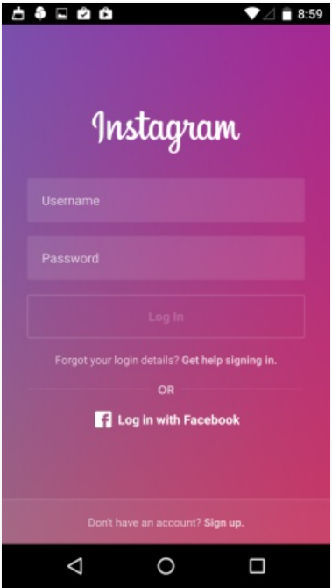
Classwork
Design one of Login Screens as below:

Slide 33
References
https://pttrns.com/android-patterns
https://google-developer-training.github.io/android-developer-fundamentals-course-concepts-v2/

