Slide 1
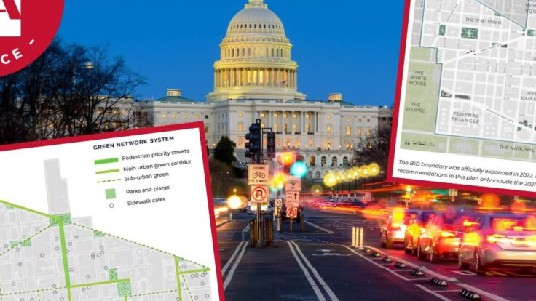

Beyond Premium Gaps: Roadway Exposure, Crash Concentration, and Spatial Equity in DC Auto Insurance
A Geospatial Analysis of Roadway Infrastructure, Crash Risk Exposure, and Demographic Context in Washington, DC
Notes:
Good morning everyone. Today I’m presenting my project: Beyond Premium Gaps — Roadway Exposure, Crash Concentration, and Spatial Equity in DC Auto Insurance.
This is a geospatial analysis of roadway infrastructure, crash risk exposure, and demographic context across Washington, DC census tracts.

Slide 2
Project Objective
Examines whether roadway conditions and roadway characteristics are associated with crash concentration in Washington, DC
Whether high-crash areas spatially overlap with census tracts that have higher Black or Hispanic population shares
Notes:
The main objective of this project is to examine whether roadway conditions and roadway characteristics are associated with crash concentration in Washington, DC.
I also examine whether high-crash areas spatially overlap with census tracts that have higher Black or Hispanic population shares.
So this project is not only about crashes. It is also about roadway exposure and spatial equity context.

Slide 3
Connection to Auto Insurance Bias Context
Group | Avg. Annual Premium | % Higher than White
White | $705 | Ref
Asian | $722 | +2%
Hispanic | $849 | +20%
Black | $1,031 | +46%
DISB Report: premium gap / pricing fairness
This Project: roadway exposure / crash concentration / spatial context
This project does not directly test insurance pricing bias. Instead, it provides geographic context by examining whether roadway exposure and crash concentration vary across communities, and whether high-crash areas spatially overlap with census tracts that have higher Black or Hispanic population shares
Source: DISB Unintentional Bias Report, 2019–2021 insurer data call; BIFSG-inferred race.
Notes:
This project is connected to the broader auto insurance bias discussion.
The DISB report on unintentional bias focused on racial premium gaps in private passenger auto insurance from January 1, 2019, through December 31, 2021. The key question was: after accounting for legitimate explanatory factors, why do Black drivers still pay higher premiums?
The table on the right shows the premium differences from the DISB report. For example, the average annual premium was about $705 for White drivers and $1,031 for Black drivers, which is about 46% higher.
My project does not directly test insurance pricing bias because I do not have individual policy premium data or insurance claim-level data.
Instead, this project provides geographic context by examining whether roadway exposure and crash concentration vary across communities, and whether high-crash areas overlap with higher Black-share or Hispanic-share census tracts.

Slide 4
Executive Summary
Roadway exposure is positively associated with expected crash counts.
Higher Black population share is also associated with higher expected crash counts after controlling for roadway exposure.
Hispanic population share is not statistically significant in the main model. No strong evidence that roadway exposure has an additional amplified effect by Black or Hispanic share.
Notes:
The main findings are:
1. roadway exposure is positively associated with expected crash counts. Census tracts with greater roadway exposure tend to have higher expected crash counts.
2. higher Black population share is also associated with higher expected crash counts after controlling for roadway exposure and other roadway characteristics. This should be interpreted as a tract-level spatial equity pattern, not an individual-level causal effect.
3. Hispanic population share is not statistically significant in the main model. In addition, the interaction model does not provide strong evidence that roadway exposure has an additional amplified effect by Black or Hispanic population share.
So the overall takeaway is that roadway exposure matters, and higher Black-share tracts show higher expected crash counts after controls. However, the model does not find strong evidence of a Hispanic-share effect or an amplified roadway exposure effect by Black or Hispanic share.

Slide 5
Data Sources
This project combines five main datasets:
Crash in DC
Census Tracts in 2020
Roadway Block
Roadway Block Intersection
Traffic Signal
Notes:
This project combines five main datasets.
The first is Crashes in DC, which provides point-level crash records.
The second is Census Tracts in 2020, which provides the spatial unit and tract boundaries.
The third is Roadway Block, which provides roadway characteristics.
The fourth is Roadway Block Intersection, which helps measure intersection exposure.
The fifth is Traffic Signal, which helps measure signal density and traffic control infrastructure.
All of these datasets come from Open Data DC.

Slide 6
Why Tract-Month Level?
Different data starts at different levels:
Dataset | Original Level
Crashes | Point-level records
Roadway variables | Census-tract level
Demographics | Census-tract level
Solution:
Spatially join crashes to census tracts, then aggregate by month.
Final unit:
1 row = 1 census tract × 1 year × 1 month
Notes:
This project is not focused on each individual crash record. Instead, I want to compare crash concentration across different census tracts and over time.
The challenge is that the datasets start at different levels. Crashes are point-level records, while roadway and demographic variables are measured at the census-tract level.
So I spatially joined crash records to census tracts, and then aggregated them by month.
The final unit is one census tract by one year-month.

Slide 7
Why Density Measures?
Raw counts are affected by census tract size. Larger tracts may naturally contain more crashes, road length, intersections, and signals.
To make census tracts comparable, key measures were normalized by land area:
  crash_density = crash_count / area_km2
  road_density = road_length_km / area_km2
  signal_density = signal_count / area_km2
  intersection_density = intersection_count / area_km2
This shifts the analysis from “how many” to “how concentrated.”
Notes:
I use density measures because raw counts can be misleading.
Census tracts are not the same size. A larger tract may naturally have more crashes, more road length, more intersections, and more traffic signals simply because it covers more land area.
So I normalized key variables by land area.
For example, crash density equals crash count divided by area in the unit of squared km. Road density, signal density, and intersection density follow the same idea.
This shifts the analysis from “how many” to “how concentrated.”

Slide 8
Feature Engineering and Variable Selection
Key variables: crash density, road density, signal density, intersection density, a roadway exposure index, and Black / Hispanic population share
Although the panel includes many roadway attributes, the regression uses a smaller theory-driven set of predictors to avoid data leakage, multicollinearity, and overfitting.
Notes:
After aggregation, I created key variables such as crash density, road density, signal density, intersection density, roadway exposure index, and Black and Hispanic population share.
The full dataset contains many roadway attributes, but I did not put all of them into the regression model.
The final regression uses a smaller theory-driven set of predictors to avoid data leakage, multicollinearity, and overfitting.
The goal is to make the model interpretable, not just to include every available variable.

Slide 9
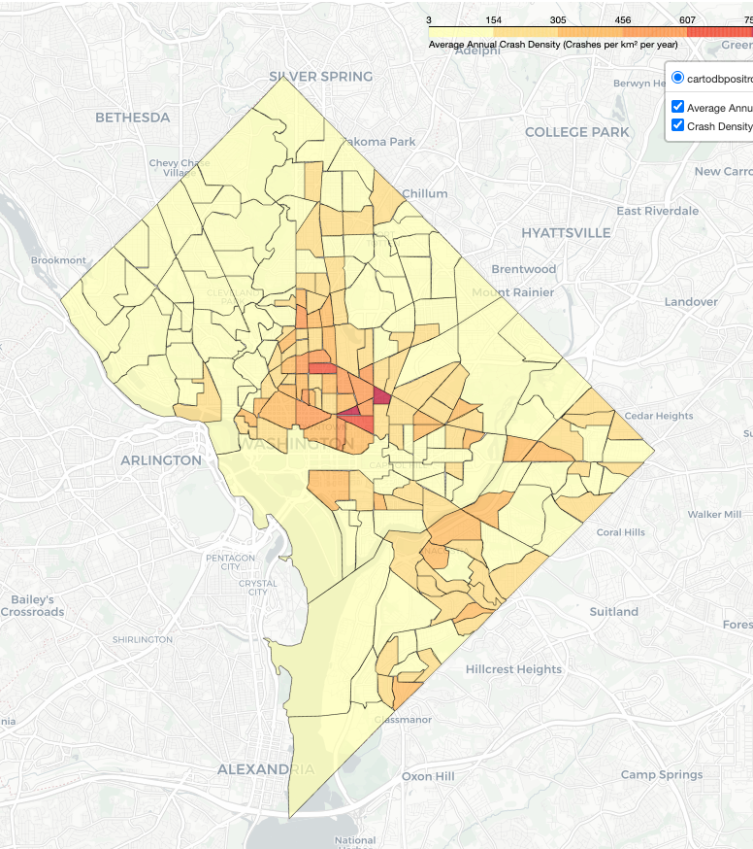
EDA 1: Crash Concentration Pattern
Crash density is not evenly distributed across DC.
Some census tracts consistently show higher crash concentration, suggesting that location and roadway environment matter.
Notes:
This first EDA section looks at crash concentration across DC.
The main point is that crash density is not evenly distributed.
Some census tracts consistently show higher crash concentration than others, especially the central area.
This suggests that location and roadway environment matter. Crashes are not randomly spread across the city.

Slide 10
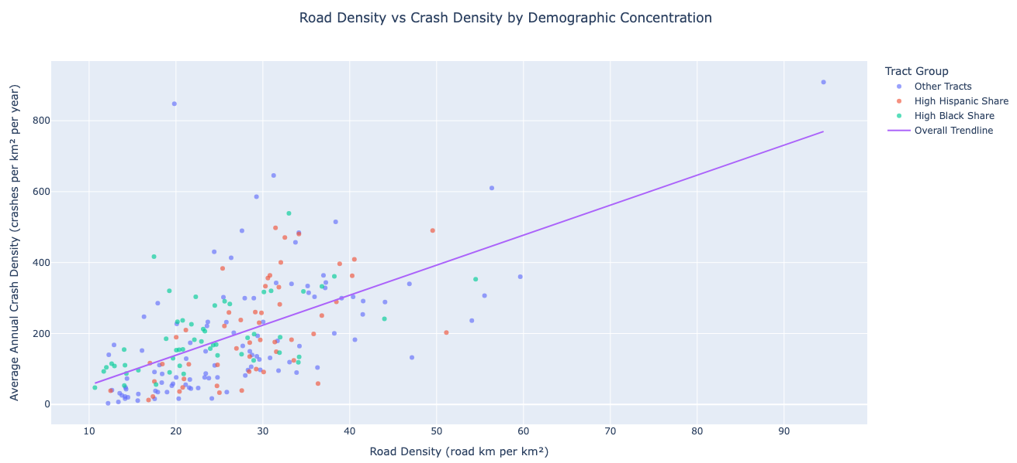
EDA 2: Roadway Exposure vs. Crash Density
Notes:
This scatter plot looks at the relationship between road density and average annual crash density.
The x-axis shows road density, and the y-axis shows average annual crash density. Each dot represents one census tract.
The upward trend line suggests that higher road density is generally associated with higher crash density.
The colors highlight high Black-share in blue and high Hispanic-share tracts in orange. These tracts appear within the broader roadway exposure pattern, rather than forming a completely separate pattern.
So I would not say this chart proves a racial effect. What it shows is that road density is associated with crash density, and some higher Black-share and Hispanic-share tracts are located within that broader roadway exposure pattern.
Q/A:
There are a few outliers. The upper-right point has both high road density and high crash density, which may reflect a very dense urban roadway tract. The upper-left point is different because crash density is very high even though road density is not extremely high. That suggests road density alone does not fully explain crash concentration. It may be due to a small tract area, a localized crash hotspot, or a data/spatial-join issue, so it should be reviewed in diagnostics.

Slide 11
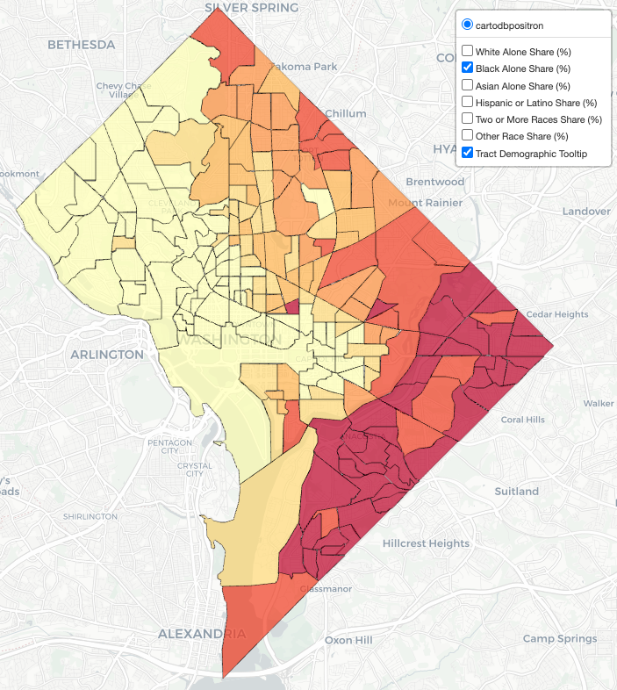
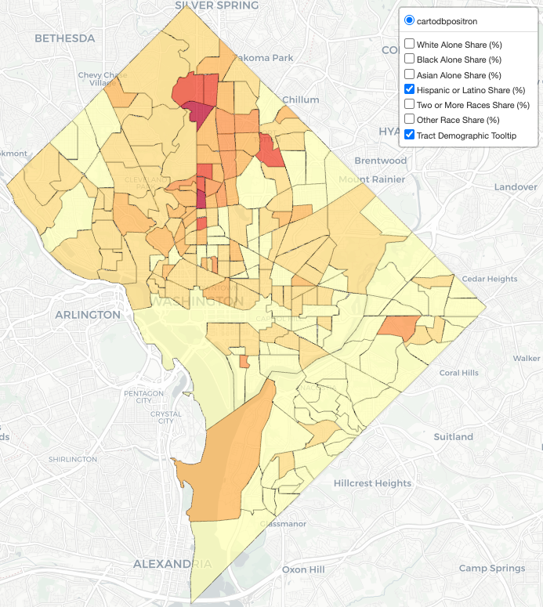
EDA 3: Demographic Spatial Context
Black-share Census Tract
Hispanic-share Census Tract
Notes:
This slide looks at demographic spatial patterns.
The maps show whether higher crash-density areas overlap with higher Black-share or higher Hispanic-share census tracts.
Darker colors indicate higher population share for the selected demographic group.
The map on the left indicates that higher Black-share tracts are more concentrated in eastern and southeastern DC, and some of these areas also show elevated crash density.
The map on the right indicates that Hispanic-share patterns are more spatially mixed.
So this slide helps frame the analysis as a spatial equity question, not just a traffic question.

Slide 12
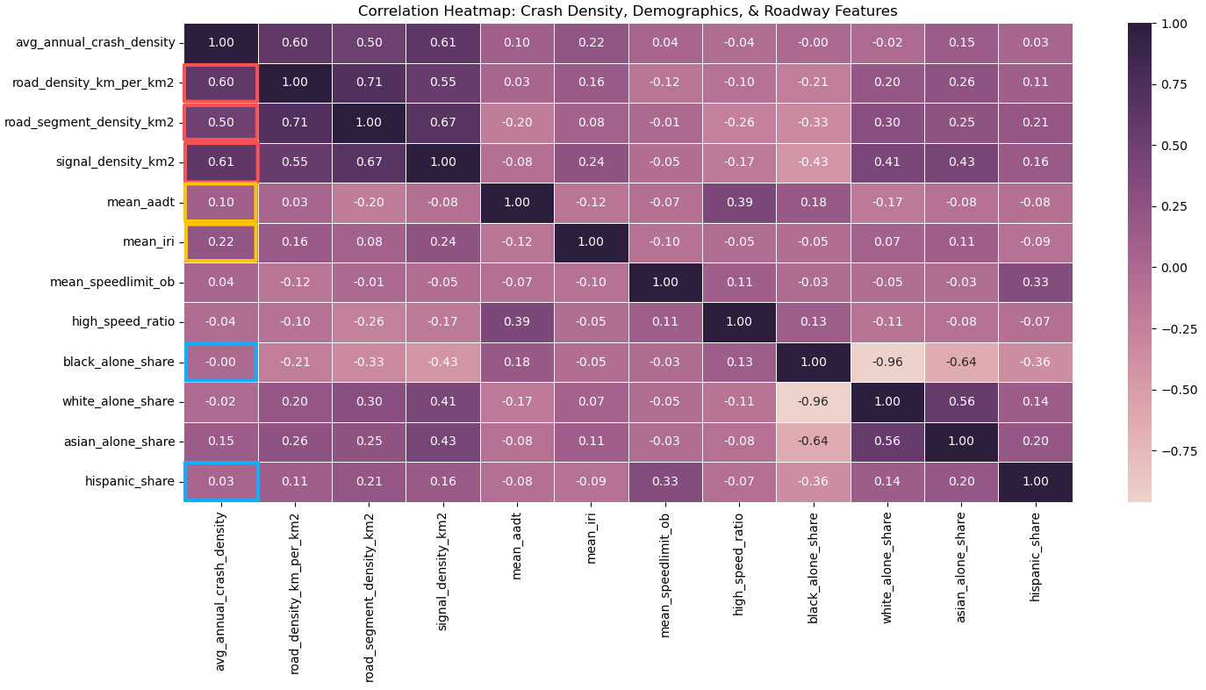
Notes:
This heatmap shows simple pairwise correlations between crash density, roadway variables, and demographic variables.
For example, road density has a correlation of about 0.60 with crash density, and signal density has a correlation of about 0.61 with crash density. These are among the strongest positive relationships in the heatmap, suggesting that roadway exposure matters.
By contrast, Black population share has almost no simple correlation with crash density, around 0.00, and Hispanic share is also very weak, around 0.03.
This is why simple correlation is not enough. Regression is needed to evaluate conditional relationships after controlling for roadway exposure and other variables.
The heatmap also shows that many roadway variables are correlated with each other, which supports using a smaller set of predictors in the regression model instead of including every roadway attribute.

Slide 13
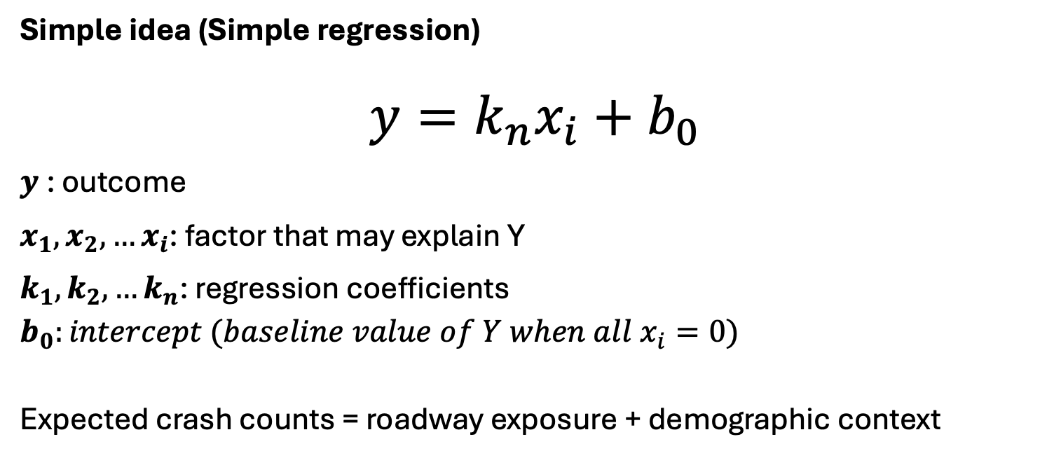
Why Regression Modeling?
Simple idea (Simple regression)
$$y=k_{n}x_{i}+b_{0}$$
$y$: outcome
$x_{1},x_{2}, …x_{i}$: factor that may explain Y
$k_{1},k_{2}, …k_{n}$: regression coefficients
$$b_{0}:intercept (baseline value of Y when all x_{i}=0)$$
Expected crash counts = roadway exposure + demographic context
Notes:
Before I show the regression results, I want to quickly explain the basic idea.
Regression is a way to estimate how different factors are related to an outcome.
Here, the outcome is expected crash counts. The factors include roadway exposure, like road density and signal density, and demographic context, like Black and Hispanic population share.
So instead of only asking “where are crashes higher,” the model helps ask: after accounting for roadway exposure and other factors, which variables are still associated with expected crash counts?

Slide 14
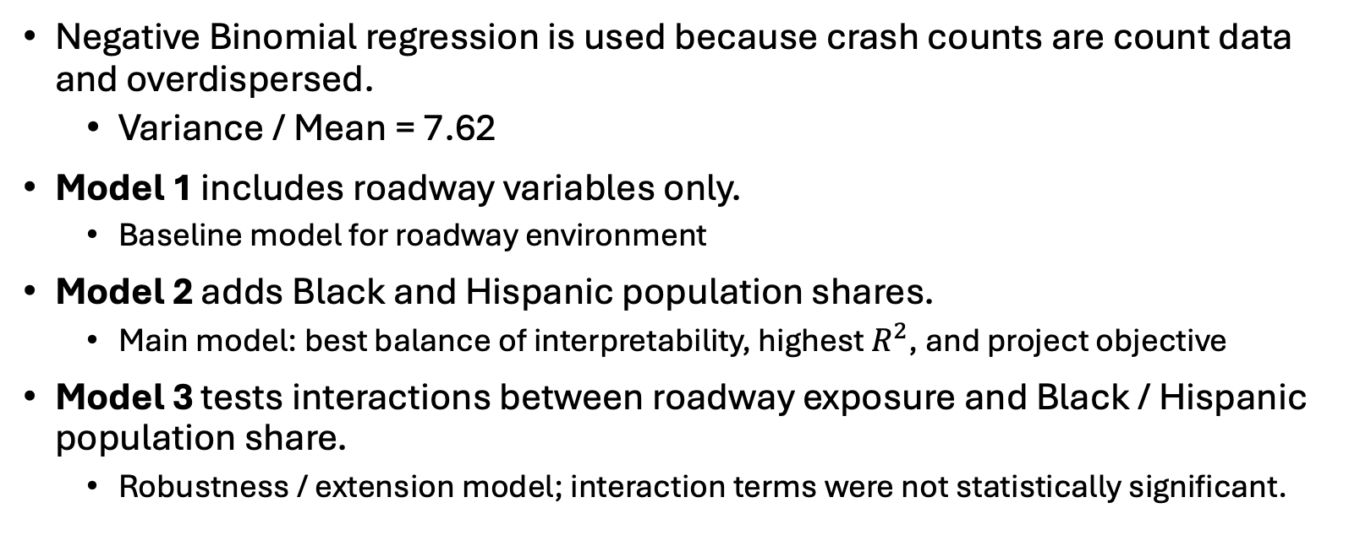
Modeling Strategy
Negative Binomial regression is used because crash counts are count data and overdispersed.
  Variance / Mean = 7.62
Model 1 includes roadway variables only.
  Baseline model for roadway environment
Model 2 adds Black and Hispanic population shares.
  Main model: best balance of interpretability, highest $R^{2}$, and project objective
Model 3 tests interactions between roadway exposure and Black / Hispanic population share.
  Robustness / extension model; interaction terms were not statistically significant.
Notes:
For modeling, I use Negative Binomial regression.
The reason is that crash counts are count data, and the data are overdispersed. The variance-to-mean ratio is about 7.62, which means the variance is much larger than the mean.
That makes Negative Binomial regression more appropriate than a simple Poisson model.
I built three models.
Model 1 includes roadway variables only. This is the baseline roadway environment model.
Model 2 adds Black and Hispanic population shares. This is my main model because it directly matches the project objective and gives the clearest balance between model fit and interpretation.
Model 3 adds interaction terms between roadway exposure and Black or Hispanic population share. This is more like an extension or robustness model. Compared with Model 2, the interaction terms were not statistically significant, so I do not use Model 3 as the main interpretation.

Slide 15
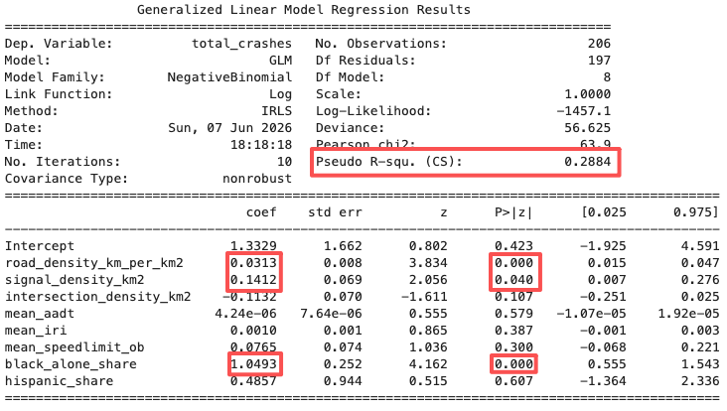
Regression Results and Interpretation
The model can be interpreted conceptually as:
log(expected total_crashes)
= β0
+ 0.0313 × road_density_km_per_km2
+ 0.1412 × signal_density_km2
+ 1.0493 × black_alone_share
+ other control variables
+ log_exposure_offset
Notes:
For the sake of time, I will focus on Model 2, which adds Black and Hispanic population shares to the roadway variables.
The main results are that road density and signal density are both positive and statistically significant. This means census tracts with denser roadway networks and more traffic signals tend to have higher expected crash counts.
Black population share is also positive and statistically significant after controlling for roadway exposure and other roadway characteristics. I interpret this carefully as a tract-level spatial equity finding, not as an individual-level causal effect.
Hispanic population share is not statistically significant in this model.
So the main takeaway from Model 2 is that roadway exposure matters, and higher Black-share tracts still show higher expected crash counts after roadway controls. However, the model does not show the same statistically significant relationship for Hispanic-share tracts.
The model also includes a log exposure offset to account for differences in census tract area, so the results are closer to comparing crash concentration rather than raw crash counts only.

Slide 16
Diagnostics / Robustness Checks
Model comparison：AIC / BIC / Log-likelihood
VIF / multicollinearity check
Predicted vs observed
Notes:
I have not completed all diagnostics yet, so this slide is a planned validation checklist.
These checks will help confirm whether the model is reasonably specified and whether the results are stable, rather than being driven by unstable variables or poor model fit.

Slide 17
Limitations and Final Takeaway
This is a tract-level association study, not a causal analysis.
Crash data is used as a proxy for insurance claim-risk exposure, not actual insurance claims.
Expected balanced panel: 206 tracts × 60 months
Some expected tract-month combinations are missing and were treated as zero-crash months; this assumption should be confirmed with DDOT or MPD.
Roadway and demographic variables are mostly static, synthetic, and modeled at the tract level, while crash counts vary monthly.
Results should not be interpreted as individual-level risk differences.
Final takeaway: Roadway exposure matters, and higher Black-share tracts show higher expected crash counts after controls. However, the model does not provide strong evidence that roadway exposure has an additional amplified effect by Black or Hispanic population share.
Notes:
There are several important limitations.
This is a tract-level association study, not a causal analysis. The model shows relationships across census tracts, but it does not prove that roadway exposure or demographic context directly causes crashes.
Crash data is used as a proxy for insurance claim-risk exposure. This project does not use actual insurance claims or policy-level data, so the results should be interpreted as crash-risk context rather than direct insurance pricing evidence.
The expected balanced panel is 206 census tracts over 60 months. Some expected tract-month combinations were missing and treated as zero-crash months. This is a reasonable working assumption, but it should be confirmed with DDOT or MPD.
Another limitation is that roadway and demographic variables are mostly static, synthetic, or modeled at the tract level, while crash counts vary monthly. So the model may not fully capture monthly changes in traffic patterns, construction, events, or local activity.
These results should not be interpreted as individual-level risk differences. The demographic variables describe census tract context, not individual drivers.
Overall, the final takeaway is that roadway exposure matters, and higher Black-share tracts show higher expected crash counts after controls. However, the model does not find strong evidence of a Hispanic-share effect or an amplified roadway exposure effect by Black or Hispanic share.

Slide 18
Next Step: Add Land Use / Zoning Context
Current Model
Roadway exposure + demographic context
→ expected crash counts
Add Context
Land use + zoning + activity centers
→ traffic activity patterns
Improved Interpretation
Better separate roadway infrastructure effects
from broader urban activity patterns
Notes:
As a next step, I would add land use and zoning context to the dataset.
Roadway exposure tells us where roadway infrastructure exists, but land use and zoning help explain where traffic activity is generated.
For example, commercial areas, employment centers, schools, and transit stations may naturally attract more vehicles and pedestrians.
So adding these variables would help separate roadway infrastructure effects from broader local traffic patterns.

Slide 19
Thank You

