Slide 1

StudyOnTime
TEAM 8 · THE 60-SECOND PITCH
Essey Beraki
THE PROBLEM
TARGET IMPACT
CORE TECH STACK
Course details, assignment instructions, and documents live in separate places. Students search manually to connect the pieces.
Link an assignment to the selected course sources. Ask a question, get a grounded answer, and follow its citation back to the source page.
Next.js · TypeScript· Canvas API · Prisma · MySql · Ingest · Private S3-compatible storage Retrieval + OpenAI
10
Notes:
Optional title card each team can show while the pitch is spoken. One speaker, sixty seconds.

Slide 2
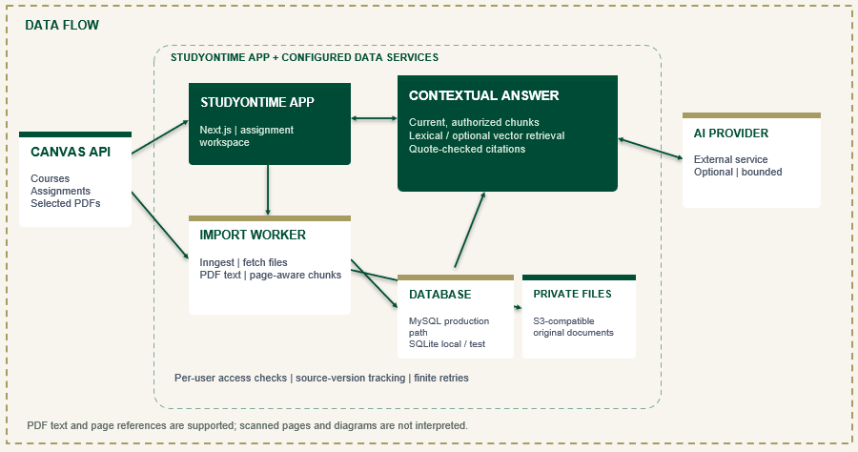

System architecture
TEAM 8 · DEMO
DEMO
GIT REPO
THEN SWITCH TO LIVE
Open assignment → Choose a PDF → Ask a question→ Open the cited page
[Paste architecture diagram here]
Sources → pipeline → storage → output
Canvas and AI require configured services
11
Notes:
Show the diagram for a few seconds, then cut to the working pipeline or query. Two minutes.

