Slide 1



TEAM 8 · THE 60-SECOND PITCH
UNC Charlotte Course Pilot
Cayman Powell, Mujtaba Khan, AlexisArenas-Villalba
THE PROBLEM
TARGET IMPACT
CORE TECH STACK
UNC Charlotte students navigate multiple sources for course requirements and degree planning, causing confusion and repeated advising requests.
Faster answers to academic questions, accurate source-backed guidance, and fewer routine advising requests. Metrics will be evaluated during testing.
Implemented: Python/FastAPI, React/Next.js, PostgreSQL, Docker
Planned: RAG, vector search, LLM integration
Team 8] · Minute 0:00–1:00
10

Slide 2
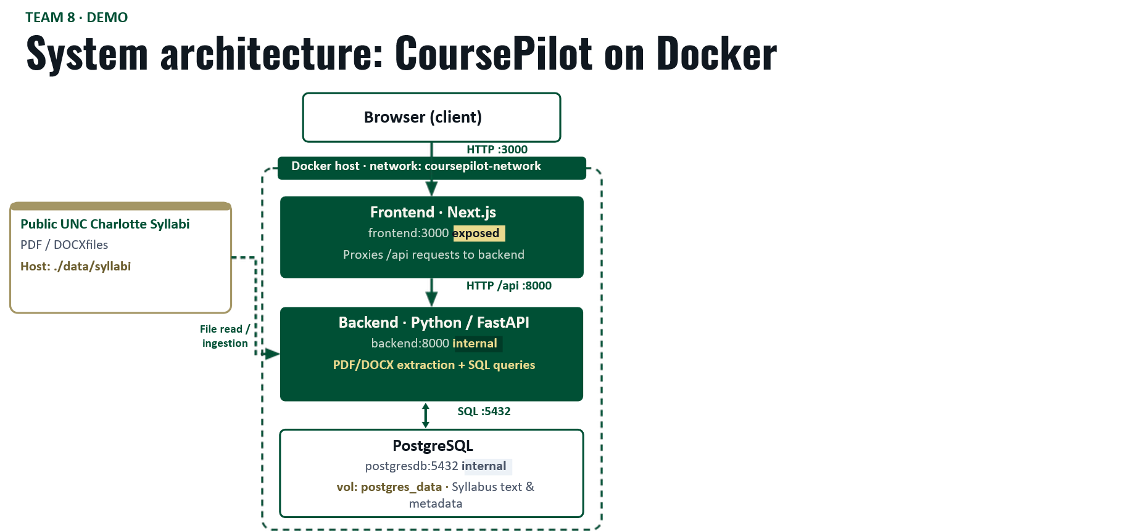
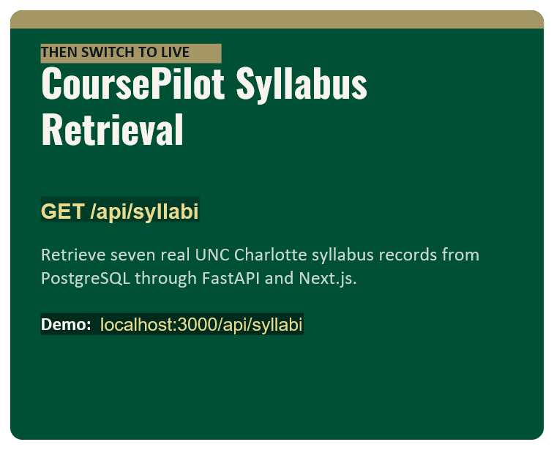
DEMO
GIT REPO
Notes:
ssh -L 13680:cci-cluster1-node0:13680 cci-jump

