Slide 1

RAEJ: Translating Languages No LLM Knows
TEAM 1 · THE 60-SECOND PITCH
Alec Pike · Ryan Brown · Eric Medlock · Justin MacCreery
THE PROBLEM
TARGET IMPACT
CORE TECH STACK
Thousands of low-resource languages and conlangs have a dictionary and a grammar but no parallel text, so standard machine translation can't serve them
Accuracy on a 25-sentence validated gold set, and prompt tokens per request: RAG vs. the full ~28k-token context.
Python · FastAPI · PostgreSQL + pgvector · LangChain · spaCy · Nomic Embed · LM Studio / Ollama / OpenAI API · Docker
Team 1 · Minute 0:00–1:00
10
Notes:
Optional title card each team can show while the pitch is spoken. One speaker, sixty seconds.

Slide 2
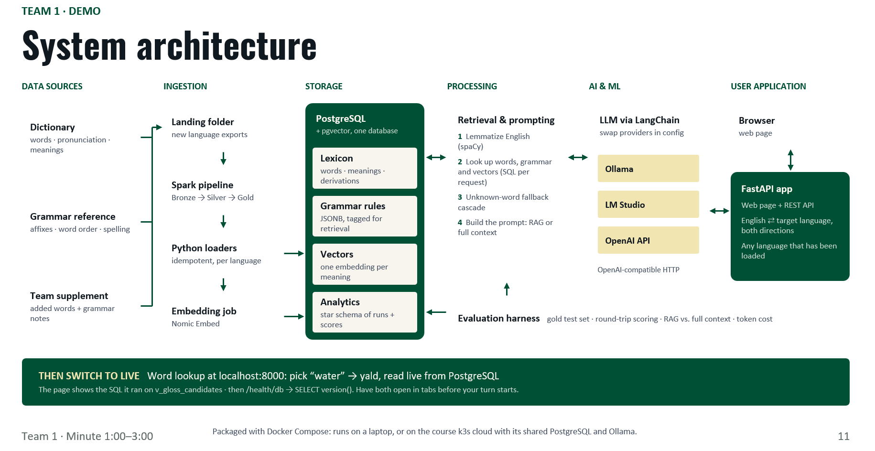
DEMO
GIT REPO
Notes:
Show the diagram for about 20 seconds. Two services run in Docker Compose on network app_net: python-app (FastAPI, port 8000, the only piece the browser talks to) and postgres (PostgreSQL 16 + pgvector, port 5432, data in the postgres_data volume). The app queries Postgres over SQL. Ingestion scripts load the Yopowi dictionary and grammar into Postgres. Dashed parts are Sprint 3: the evaluation harness and the LLM call, which goes over HTTP to one provider set in .env (Ollama, LM Studio on the Mac mini, or the OpenAI API). On the class k3s cloud, PostgreSQL/pgvector and Ollama map to the shared platform services. Then switch to the live lookup: pick 'water', show yald and the SQL that ran, then /health/db. Have both open in tabs before the turn starts.

