Slide 1

Financial Literacy Service
TEAM 4 · THE 60-SECOND PITCH
Josh Marsico, Himaja Goda, Jayden Parsons, Michael Simms
THE PROBLEM
TARGET IMPACT
CORE TECH STACK
Doing your own market research means pulling together news, price history, and the vocabulary to read it. For someone new to investing, that effort is the barrier.
Confident, informed new investors who understand what they’re looking at before they make a decision.
Python + FastAPI · PostgreSQL + pgvector · Docker · React
Team 5 · Minute 0:00–1:00
10
Notes:
Optional title card each team can show while the pitch is spoken. One speaker, sixty seconds.

Slide 2
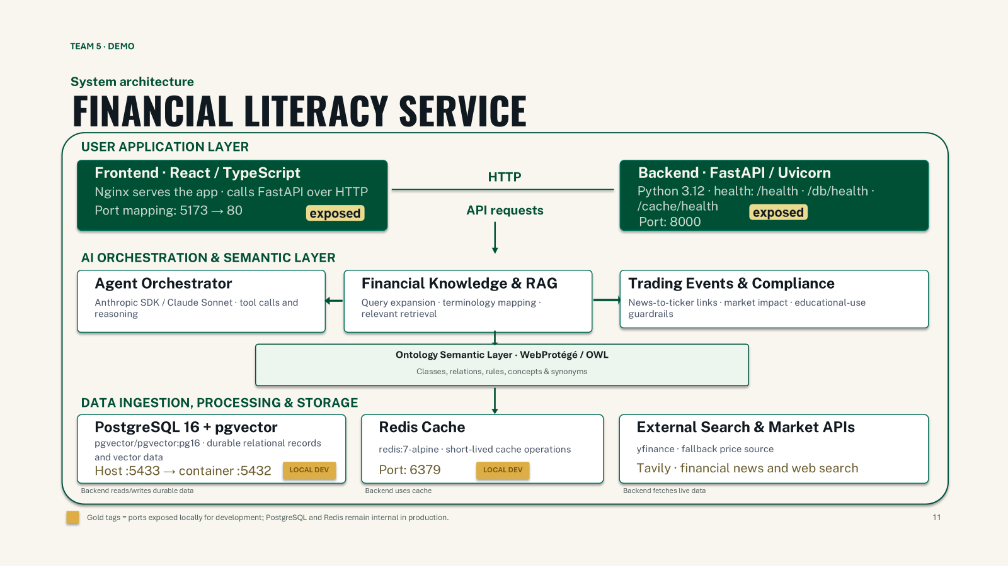
TEAM 4 · DEMO
DEMO
GIT REPO
11
Notes:
Show the diagram for a few seconds, then cut to the working pipeline or query. Two minutes.

