Slide 1

ClassWizard
TEAM 4 · THE 60-SECOND PITCH
Akshat Kumar, Caleb Richardson, Jackson Redman, Scott Do
THE PROBLEM
TARGET IMPACT
CORE TECH STACK
Students do not guidance for which classes give skills that link to their desired career
UNC Charlotte students graduate with career-ready skills
Python · Docker · Redis
PostgreSQL + pgvector
Open-Source LLM
Team 4 · Minute 0:00–1:00
10
Notes:
Optional title card each team can show while the pitch is spoken. One speaker, sixty seconds.

Slide 2
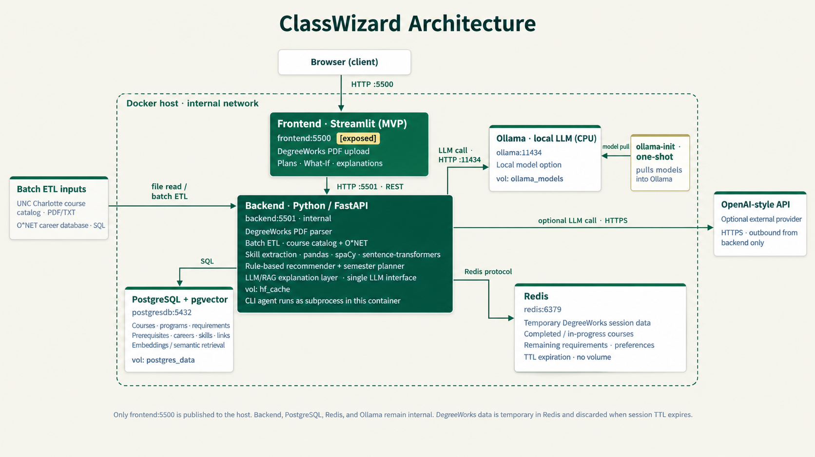

System architecture
TEAM 4 · DEMO
DEMO
GIT REPO
THEN SWITCH TO LIVE
Upload a Degreeworks PDF → select a career → view results
[Paste architecture diagram here]
Have it open in a tab before your turn starts.
Sources → pipeline → storage → output
Team 4 · Minute 1:00–3:00
11
Notes:
Show the diagram for a few seconds, then cut to the working pipeline or query. Two minutes.

