Slide 1
绘图

Slide 2



Slide 3
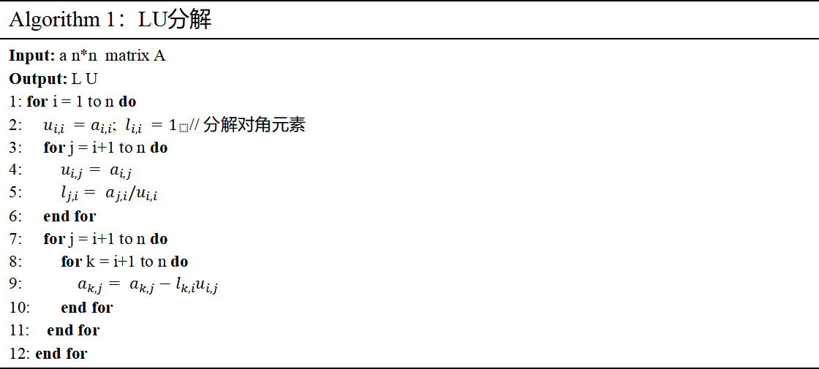
Algorithm 1：LU分解
Input: a n*n matrix A Output: L U 1: for i = 1 to n do 2: $u_{i,i} =a_{i,i}$; $l_{i,i} =1_{}$// 分解对角元素 3: for j = i+1 to n do 4: $u_{i,j}= a_{i,j}$ 5: $l_{j,i}= a_{j,i}/u_{i,i}$ 6: end for 7: for j = i+1 to n do 8: for k = i+1 to n do 9: $a_{k,j}= a_{k,j}−l_{k,i}u_{i,j}$ 10: end for 11: end for 12: end for

Slide 4
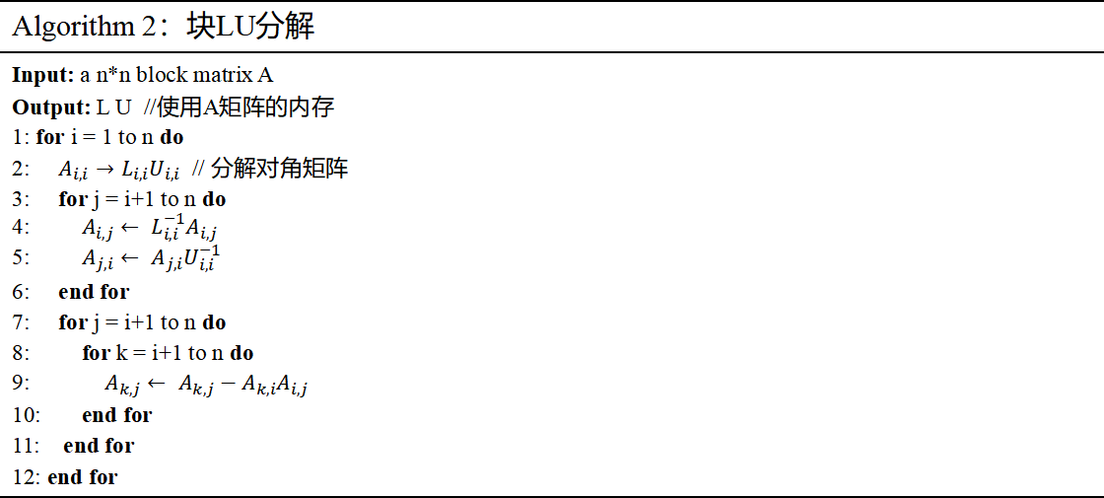
Algorithm 2：块LU分解
Input: a n*n block matrix A Output: L U //使用A矩阵的内存 1: for i = 1 to n do 2: $A_{i,i}→L_{i,i}U_{i,i}$ // 分解对角矩阵 3: for j = i+1 to n do 4: $A_{i,j}← L_{i,i}^{−1}A_{i,j}$ 5: $A_{j,i}← A_{j,i}U_{i,i}^{−1}$ 6: end for 7: for j = i+1 to n do 8: for k = i+1 to n do 9: $A_{k,j}← A_{k,j}−A_{k,i}A_{i,j}$ 10: end for 11: end for 12: end for

Slide 5
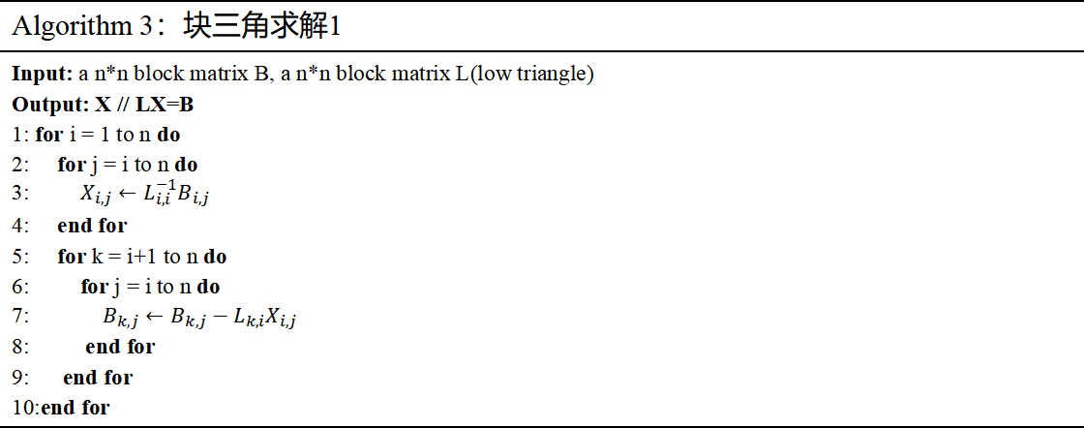
Algorithm 3：块三角求解1
Input: a n*n block matrix B, a n*n block matrix L(low triangle) Output: X // LX=B 1: for i = 1 to n do 2: for j = i to n do 3: $X_{i,j}←L_{i,i}^{−1}B_{i,j}$ 4: end for 5: for k = i+1 to n do 6: for j = i to n do 7: $B_{k,j}←B_{k,j}−L_{k,i}X_{i,j}$ 8: end for 9: end for 10:end for

Slide 6

Algorithm 4：块三角求解2
Input: a n*n block matrix B, a n*n block matrix U(upper triangle) Output: X // XU=B 1: for j = 1 to n do 2: for i = j to n do 3: $X_{i,j}←B_{i,j}U_{i,i}^{−1}$ 4: end for 5: for i = j+1 to n do 6: for k = j to n do 7: $B_{i,k}←B_{i,k}−X_{i,j}U_{j,k}$ 8: end for 9: end for 10:end for

Slide 7
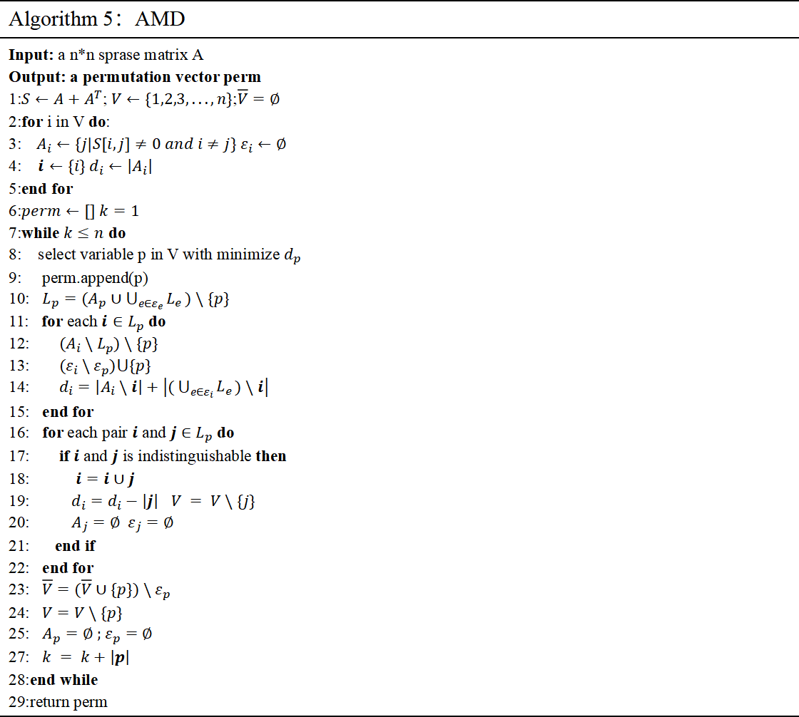
Algorithm 5：AMD
Input: a n*n sprase matrix A Output: a permutation vector perm 1:$S←A+A^{T}$; $V←\{1,2,3,...,n\}$;$\overline{V}=∅$ 2:for i in V do: 3:$A_{i}←\{j|S[i,j]≠0 and i≠j\} ε_{i}←∅$ 4: $i←\{i\} d_{i}←\left|A_{i}\right|$ 5:end for 6:$perm←[] k=1$ 7:while $k≤n$ do 8: select variable p in V with minimize $d_{p}$ 9: perm.append(p) 10: $L_{p}=(A_{p}∪\bigcup_{e∈ε_{e}}{L_{e}})\backslash \{p\}$ 11: for each $i∈L_{p}$ do 12: $(A_{i}\backslash L_{p})\backslash \{p\}$ 13: $(ε_{i}\backslash ε_{p})⋃\{p\}$ 14: $d_{i}=\left|A_{i}\backslash i\right|+\left|(\bigcup_{e∈ε_{i}}{L_{e}})\backslash i\right|$ 15: end for 16: for each pair $i$ and $j$ $∈$ $L_{p}$ do 17: if $i$ and $j$ is indistinguishable then 18: $i=i∪j$ 19: $d_{i}=d_{i}−\left|j\right|$ $V = V\backslash \{j\}$ 20: $A_{j}=∅ ε_{j}=∅$ 21: end if 22: end for 23: $\overline{V}=(\overline{V}∪\{p\})\backslash ε_{p}$ 24: $V=V\backslash \{p\}$ 25: $A_{p}=∅$ ; $ε_{p}=∅$ 27: $k = k+\left|p\right|$ 28:end while 29:return perm

Slide 8

i
1
2
3
4
5
6
7
8
9
a
 | b
 |  | c
 |  |  | d
 |  |  |  | e
 |  |  |  |  | f
 |  |  |  |  |  | g
 |  |  |  |  |  |  | h
 |  |  |  |  |  |  |  | i
h
g
f
a
d
e
b
c

Slide 9



当前节点前沿矩阵 F
pivot block / 当前节点待消去变量
coupling block
F11
F12
Block LU on $F_{11}$
$$U_{12}=L_{11}^{−1}F_{12}$$
$$L_{21} = F_{21}U_{11}^{−1}$$
F21
F22
Schur update: $F_{22}←F_{22}−L_{21}U_{12}$
coupling
block
remaining block / update source

Slide 10
Assembly
装配 A_local 与
child updates
Pivot / Block LU
主元选择与
主元块分解
TRSM
求解 F21U11^{-1}
与 L11^{-1}F12
Schur Update
(GEMM)
F22 ← F22 - F21F12
Output
factor writeback: L/U
update writeback
to parent
装配完成后确定 node-scale
高吞吐矩阵乘更新
每个 front 在本节点完成装配、块分解、TRSM 与 Schur 更新；因子写回本节点，贡献块继续上传父节点。

