Slide 1
绘图

Slide 2



Slide 3
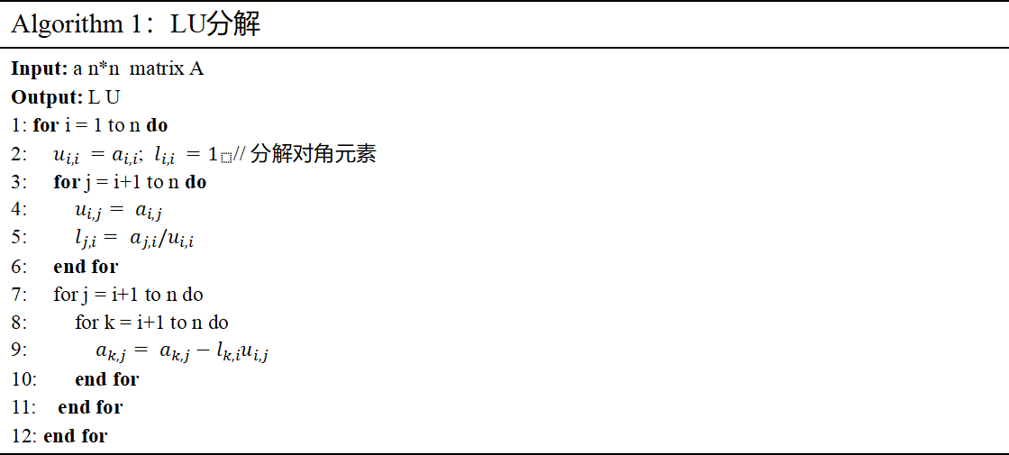
Algorithm 1：LU分解
Input: a n*n matrix A Output: L U 1: for i = 1 to n do 2: $u_{i,i} =a_{i,i}$; $l_{i,i} =1_{}$// 分解对角元素 3: for j = i+1 to n do 4: $u_{i,j}= a_{i,j}$ 5: $l_{j,i}= a_{j,i}/u_{i,i}$ 6: end for 7: for j = i+1 to n do 8: for k = i+1 to n do 9: $a_{k,j}= a_{k,j}−l_{k,i}u_{i,j}$ 10: end for 11: end for 12: end for

Slide 4
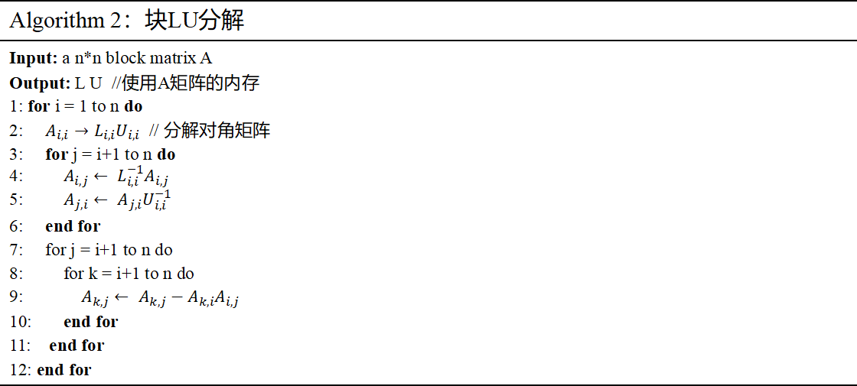
Algorithm 2：块LU分解
Input: a n*n block matrix A Output: L U //使用A矩阵的内存 1: for i = 1 to n do 2: $A_{i,i}→L_{i,i}U_{i,i}$ // 分解对角矩阵 3: for j = i+1 to n do 4: $A_{i,j}← L_{i,i}^{−1}A_{i,j}$ 5: $A_{j,i}← A_{j,i}U_{i,i}^{−1}$ 6: end for 7: for j = i+1 to n do 8: for k = i+1 to n do 9: $A_{k,j}← A_{k,j}−A_{k,i}A_{i,j}$ 10: end for 11: end for 12: end for

Slide 5

i
1
2
3
4
5
6
7
8
9
a
 | b
 |  | c
 |  |  | d
 |  |  |  | e
 |  |  |  |  | f
 |  |  |  |  |  | g
 |  |  |  |  |  |  | h
 |  |  |  |  |  |  |  | i
h
g
f
a
d
e
b
c

