Slide 1
绘图

Slide 2



Slide 3
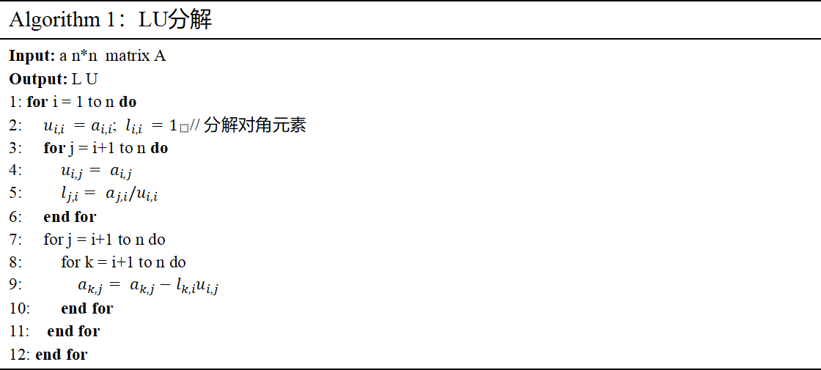
Algorithm 1：LU分解
Input: a n*n matrix A Output: L U 1: for i = 1 to n do 2: $u_{i,i} =a_{i,i}$; $l_{i,i} =1_{}$// 分解对角元素 3: for j = i+1 to n do 4: $u_{i,j}= a_{i,j}$ 5: $l_{j,i}= a_{j,i}/u_{i,i}$ 6: end for 7: for j = i+1 to n do 8: for k = i+1 to n do 9: $a_{k,j}= a_{k,j}−l_{k,i}u_{i,j}$ 10: end for 11: end for 12: end for

Slide 4
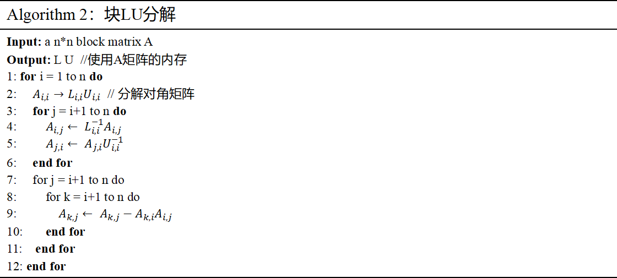
Algorithm 2：块LU分解
Input: a n*n block matrix A Output: L U //使用A矩阵的内存 1: for i = 1 to n do 2: $A_{i,i}→L_{i,i}U_{i,i}$ // 分解对角矩阵 3: for j = i+1 to n do 4: $A_{i,j}← L_{i,i}^{−1}A_{i,j}$ 5: $A_{j,i}← A_{j,i}U_{i,i}^{−1}$ 6: end for 7: for j = i+1 to n do 8: for k = i+1 to n do 9: $A_{k,j}← A_{k,j}−A_{k,i}A_{i,j}$ 10: end for 11: end for 12: end for

Slide 5

i
1
2
3
4
5
6
7
8
9
a
 | b
 |  | c
 |  |  | d
 |  |  |  | e
 |  |  |  |  | f
 |  |  |  |  |  | g
 |  |  |  |  |  |  | h
 |  |  |  |  |  |  |  | i
h
g
f
a
d
e
b
c

Slide 6
多前沿算法整体组织方式
原始稀疏矩阵 A
消去树 / Elimination Tree
完成最终节点分解
节点级 frontal matrix
one node → one front
assembly:
A_local + child updates
F11
F12
root
F21
F22
root front
update /
contribution
symbolic
analysis
N2
N3
F11
F12
F11
F12
F21
F22
F21
F22
child front
child front
update /
contribution
L1
L2
L3
L4
叶节点 → 内部节点 → 根节点
F11
F12
F11
F12
F21
F22
F21
F22
leaf front
leaf front
多前沿算法将全局稀疏分解转化为基于消去树的节点级 frontal matrix 装配、分解与更新过程

Slide 7
单个节点前沿矩阵的计算流程
node-level frontal matrix processing
Assembly
装配 A_local 与
child updates
Pivot / Block LU
主元选择与
主元块分解
TRSM
求解 F21U11^{-1}
与 L11^{-1}F12
Schur Update
(GEMM)
F22 ← F22 - F21F12
Output
factor writeback: L/U
update writeback
to parent
装配完成后确定 node-scale
高吞吐矩阵乘更新
每个 front 在本节点完成装配、块分解、TRSM 与 Schur 更新；因子写回本节点，贡献块继续上传父节点。

Slide 8
前沿矩阵的块划分及节点内计算关系
当前节点前沿矩阵 F
pivot block / 当前节点待消去变量
coupling block
Block LU on F11
F11
F12
U12 = L11^{-1}F12
coupling
block
F21
F22
L21 = F21U11^{-1}
Schur update: F22 ← F22 - L21U12
remaining block / update source
node 内统一 M_format；
乘子采用 QF_format

