Slide 1
Software check and Course concepts
Qiong (Joan) Xu
Class 1

Slide 2
Software Installation
Check that you have or get:
Text Editor
Multiple web browsers
FTP Software
“WinSCP”
“FileZilla”

Slide 3
IT Fluency
“..an understanding of the underlying concepts of technology and the critical thinking skills needed to select from multiple formats (hardware, software, and media) for optimized knowledge building.”

Slide 4
HCI
“… a discipline concerned with the design, evaluation and implementation of interactive computing systems for human use and with the study of major phenomena surrounding them. “

Slide 5
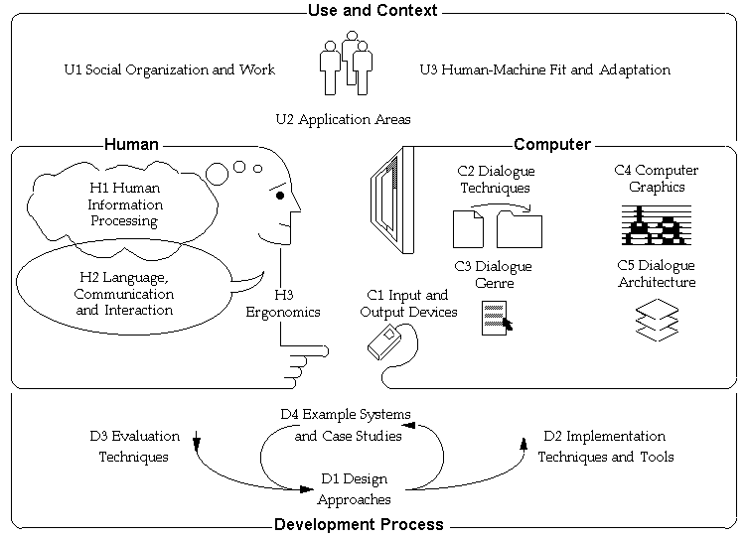
HCI in action

Slide 6
W W W
GUI
HTTP
Web site
-web pages
-home page
Server
-host

Slide 7
Browser
Interpreter
HTML
Hyperlink

Slide 8
HTML
Tags (markup)
Programming vs. Design
W3C
Versions
-HTML
-DHTML
-XML

Slide 9
HTML Editors
Text
WYSIWYG

Slide 10
Lab Skills Examine Code of a Webpage
Open Text Editor
See there is HTML code and the Basic Tags
HTML <HTML>
HEAD <HEAD>
Title <TITLE>
Body <BODY>

