Slide 1
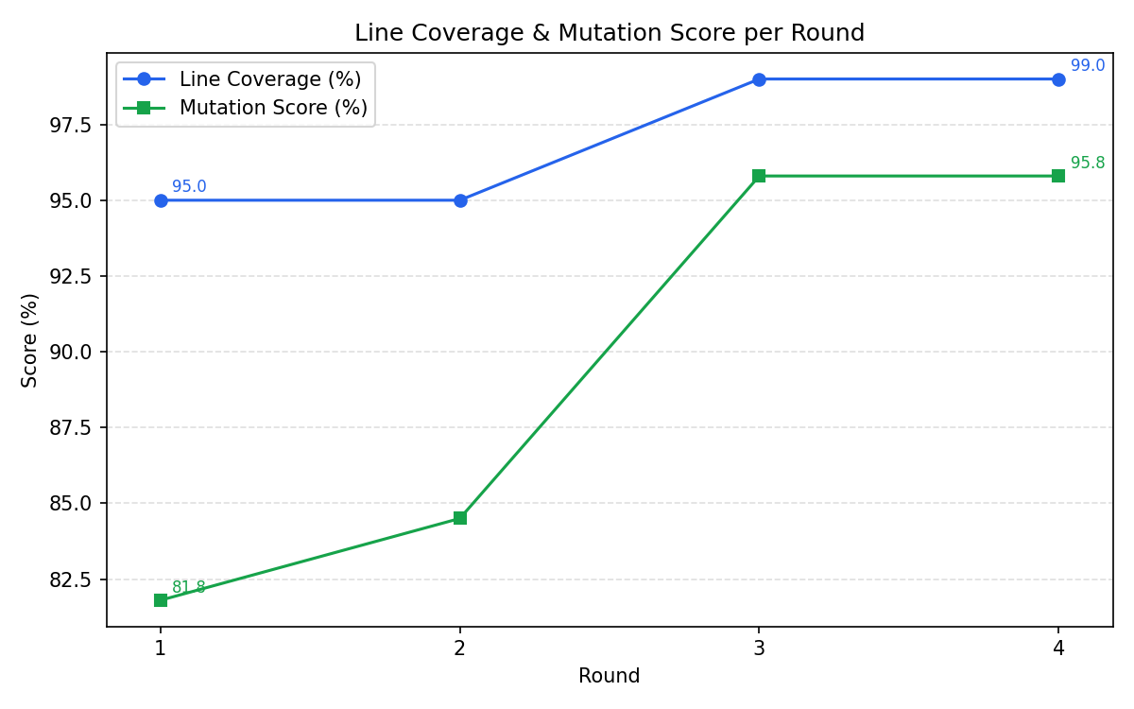
IBM Bob 2.0 Hackathon · HWDevelopNerds
Mutation-Testing
Improvement Loop
IBM Bob's mutation-climb skill drives an automated PIT loop that turns surviving mutants into precise test targets, lifting the mutation score from 82% to 95.8%.
82%
95.8%
48 → 11
Mutation score before
Mutation score after
Surviving mutants
Made with IBM Bob

Slide 2
MUTATION-TESTING IMPROVEMENT LOOP · HWDEVELOPNERDS
The Problem: Line Coverage Lies
A Java utility library ships with a 95% line-coverage score — green across the board. But line coverage only proves a line was executed, not that any assertion actually validates the outcome.
FILE | LINE | WHY IT SURVIVES
MoneyUtils.java | 26 | Test covers the line but never hits the exact boundary value
Validators.java | 128 | Overload is never called — marked NO_COVERAGE
SimpleCache.java | 142 | Happy-path test never exercises the expiry branch
Running PIT mutation testing reveals the real picture: each mutant is a deliberately broken variant of the code. If the test suite doesn't notice, the mutation survives. At baseline: 82% of mutants were killed. 18% slipped through.
The gap: 95% line coverage · 82% mutation score.
Roughly 1 in 5 logic mutations survives undetected — the lines execute, but nothing asserts the outcome tightly enough.
264
48
82%
MUTANTS GENERATED
SURVIVORS (BASELINE)
MUTATION SCORE
1 / 5

Slide 3
MUTATION-TESTING IMPROVEMENT LOOP · HWDEVELOPNERDS
The Approach: Automated Kill Loop
Each round is driven by a single shell command. IBM Bob's mutation-climb skill runs the loop autonomously — reading survivors, writing targeted tests, and re-running PIT until the score plateaus or the target is reached.
Why this works:
PIT survivors are not vague "untested paths" — they are exact file, line, and mutation-type tuples. Bob can read the tuple, read the source, and write the one assertion that kills it. No guesswork, no redundant tests.
1
Run PIT via sh run_round.sh
Compiles the project, executes mutation analysis, writes raw XML to pit-output.txt and copies it to toolkit/mutations.xml.
2
Parse survivors
FILE | ROUND-BY-ROUND OUTPUT
survivors.md | Ranked list of still-alive mutants with file, line, and type
rounds.csv | Append-only log of line coverage and mutation score per round
chart.png | Visual progress curve across all rounds; regenerated by chart.py
report.py converts mutations.xml into survivors.md and appends a row to rounds.csv.
3
Bob reads survivors and writes targeted tests
Each surviving mutant is a concrete, precise test target — boundary assertion, missing overload call, or time-advance test for expiry logic.
4
Repeat until score plateaus or target is reached
Every round survivors.md shrinks and chart.png updates. Goal: mutation score ≥ 90%.
2 / 5

Slide 4
MUTATION-TESTING IMPROVEMENT LOOP · HWDEVELOPNERDS
How IBM Bob Is Used
Three Bob capabilities work together to make the loop autonomous: a domain skill, a custom mode, and parallel subagents.
SKILL
CUSTOM MODE
SUBAGENTS
mutation-climb
Test Engineer mode
Parallel survivor analysis
A Bob skill stored at .bob/skills/mutation-climb/SKILL.md. It encodes the domain knowledge: how to read survivors.md, how to rank mutants by kill probability, and which test patterns map to which mutation types (conditional-boundary, negated-conditional, return-value substitution).
Activated at the start of a session — Bob loads the full protocol and proceeds without further prompting.
A lean Bob mode that restricts the tool palette to exactly what mutation testing needs: file reads, grep, test edits, and the Maven command runner. It prevents Bob from touching production code or files outside src/test/java/.
The mode sets a role definition that primes Bob to think like a test author focused on assertion quality, not coverage percentage.
When a round produces a large survivor list, Bob spawns independent subagents — one per class under test (MoneyUtils, Validators, SimpleCache, etc.). Each subagent reads its class, reads the surviving mutants for that class, and returns a list of targeted test patches.
The parent agent merges the results and writes a single coherent test file — parallel analysis, serial commit.
/mutation-climb
mode: test-engineer
spawn_subagent
3 / 5

Slide 5
MUTATION-TESTING IMPROVEMENT LOOP · HWDEVELOPNERDS
Results: 4 Rounds, +14.0 pp Gain
All numbers sourced from rounds.csv (round 4) and survivors.md. Mutant total held constant at 264 throughout — the library code never changed, only the tests. Every figure reproduces from a clean clone.
BASELINE
ROUND 4
Line coverage
95%
99%
Mutation score
82%
95.8%
Mutants generated
264
264
Survivors
48
11
+14.0 pp mutation score improvement over 4 measured rounds. More than 77% of previously surviving mutants are now killed (48 → 11). Line coverage climbed from 95% to 99%.
4 / 5

Slide 6
MUTATION-TESTING IMPROVEMENT LOOP · HWDEVELOPNERDS
What Is Next
The loop proved the concept on a small utility library. The following steps scale it to real-world projects and make the skill generally reusable.
Close the last killable gaps
Publish mutation-climb as a shared Bob skill
Seven of the 11 remaining survivors are equivalent mutants that no test can kill. The other four, including two NO_COVERAGE methods in Validators, are the next targets.
Package the skill with a generic run_round.sh template so any Java Maven project can adopt the loop with a single copy-paste.
Extend to other languages
CI integration
The skill protocol is language-agnostic at the Bob layer. Swap PIT for Stryker (JS/TS) or mutmut (Python) and the loop runs unchanged — only the run_round.sh adapter differs.
Add a GitHub Actions workflow that runs PIT on every pull request, comments the mutation delta, and blocks merge if score regresses below the previous round's baseline.
Survivor-based PR review mode
Benchmark Bob models on test quality
A Bob custom mode that reads the diff of an incoming PR and flags any new code path not covered by a mutation-killing assertion — catching test-coverage debt at review time, not post-merge.
Use the reproducible rounds.csv metric as a cross-model benchmark — run the same survivor list through multiple models and compare how many mutants each kills per round.
Made with IBM Bob
5 / 5

