Slide 1
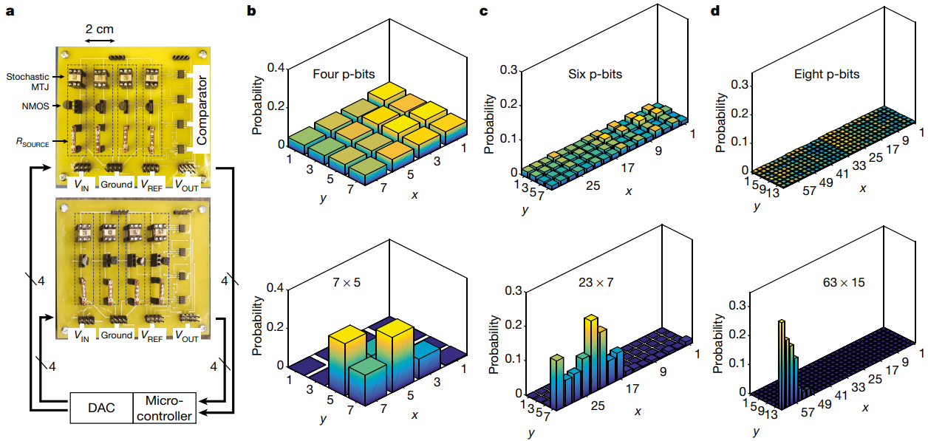
Integer Factorization
Nature, 2019

Slide 2
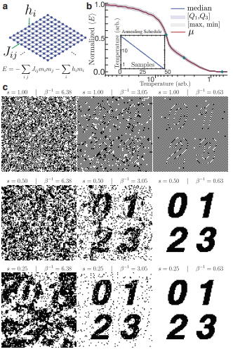
Combinatorial
Optimization
IEEE Access, 2020

Slide 3
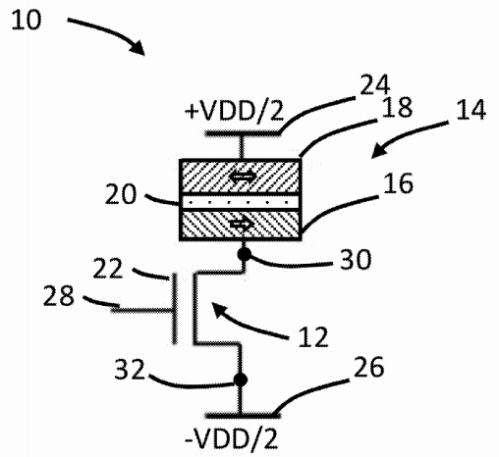
P-bit
US Patent, 2019

Slide 4
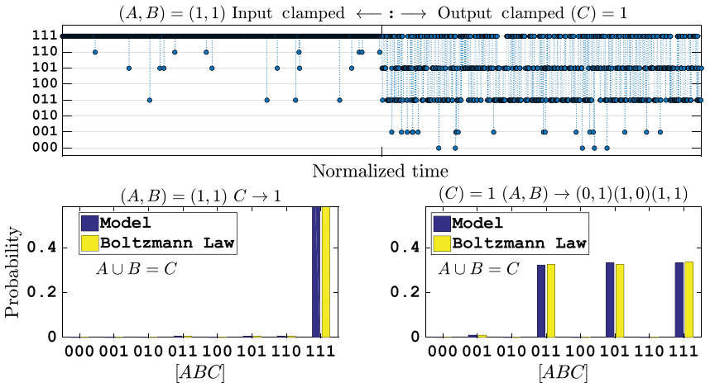
Invertible Logic
Phys Rev. X, 2017

Slide 5
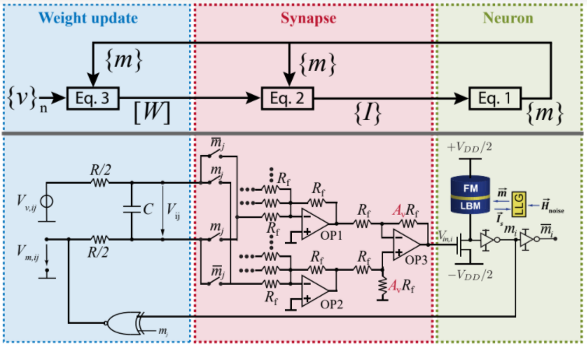
Machine Learning
Front. in Neuroscience, 2020

Slide 6
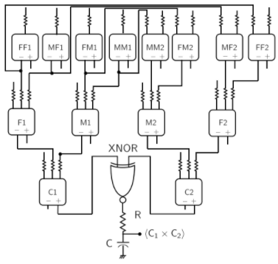
Bayesian Inference
AIP
Advances
2018

Slide 7
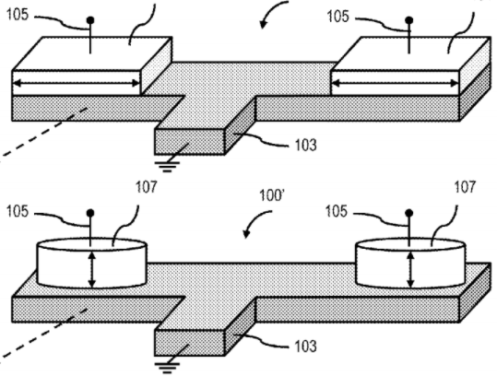
Magnetic Networks for Optimization
US Patent, 2014

Slide 8
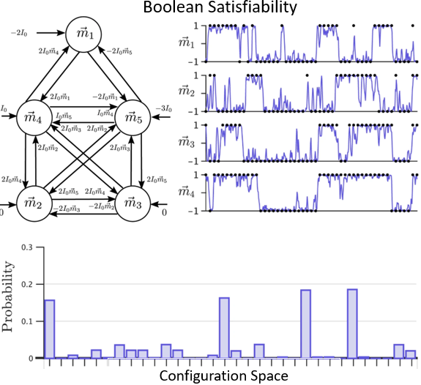
Probabilistic Circuits
Scientific Reports, 2017

Slide 9
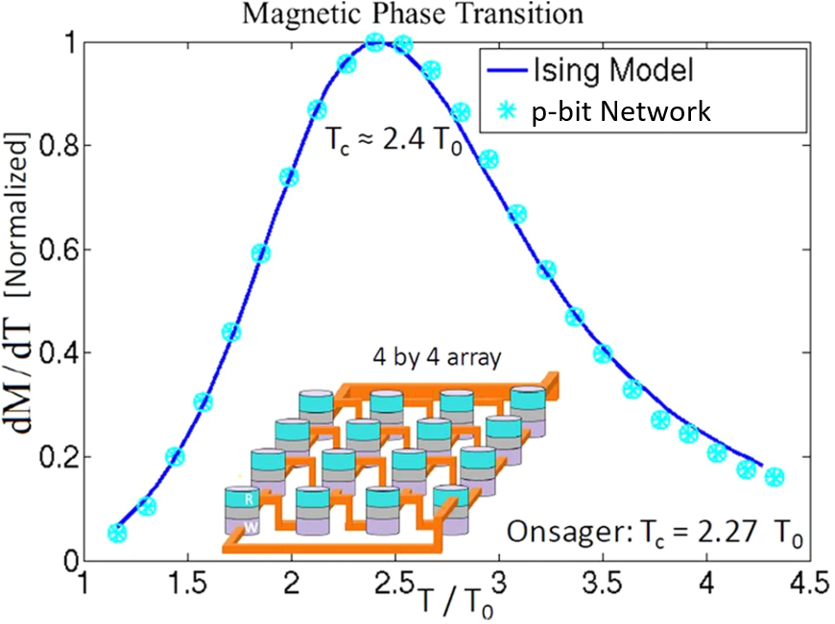
Probability as it Occurs in Nature
Scientific Reports, 2016

Slide 10
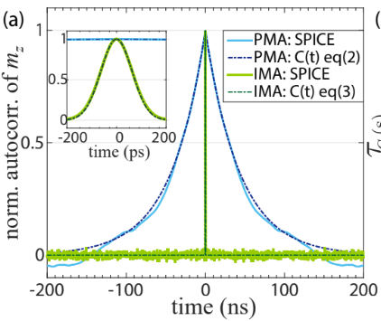
Low Barrier Magnet Design
IEEE Magnetics Letters, 2019

Slide 11
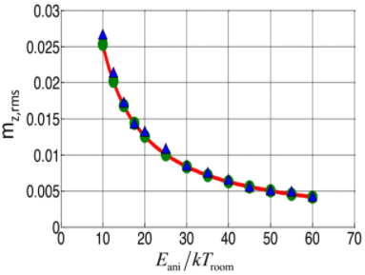
Natural Fluctuations
Nature Nanotechnology, 2010

Slide 12
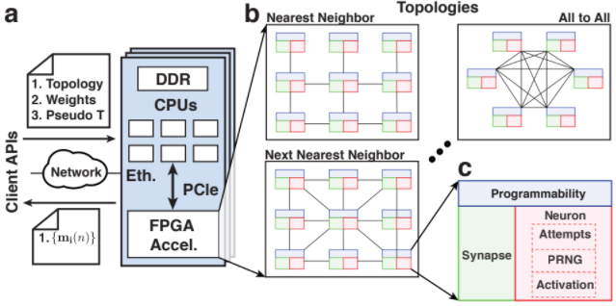
Cloud Accessible FPGA-based Emulation of the P-Computer
IEEE Access, 2020

Slide 13
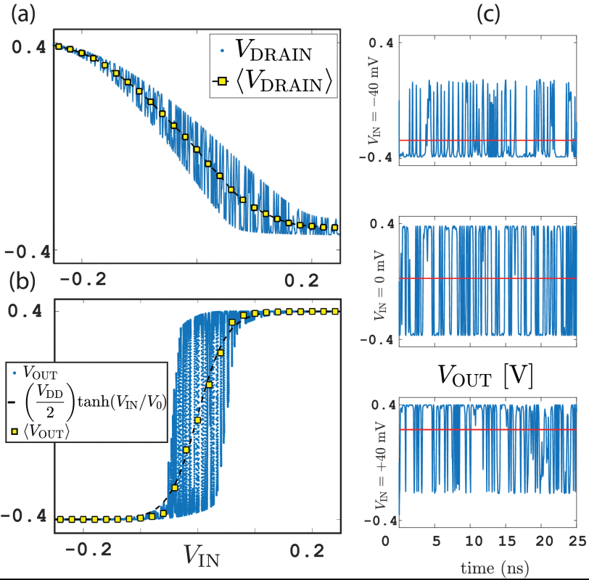
P-bit Characteristic
IEEE EDL, 2017

