Slide 1
WIDESCREEN PRESENTATION
Tips and tools for creating and presenting wide format slides

Slide 2
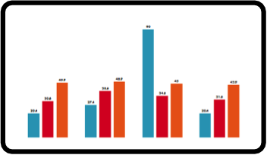
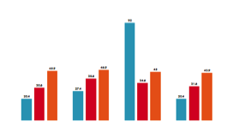
Widescreen Presentation
This template is formatted with a 16:9 “widescreen” aspect ratio. It’s a great way to take advantage of computers, televisions, and projectors equipped with widescreen displays.
Even if you do not have a widescreen display, you can still create and present 16:9 slides. When you click Slide Show, PowerPoint always resizes your slides to fit any screen.

Slide 3

Widescreen Advantages
  Side-by-side material fits more naturally.
  Widescreen adds drama to graphics and images.

