Slide 1
PITCH BOOK

Slide 2
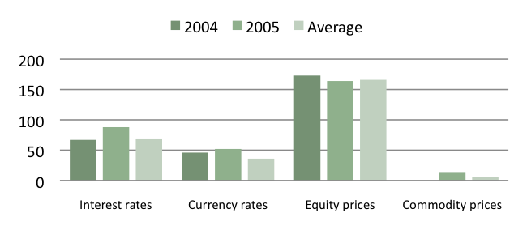
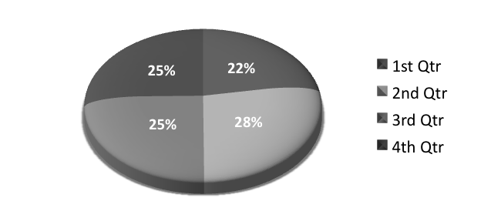
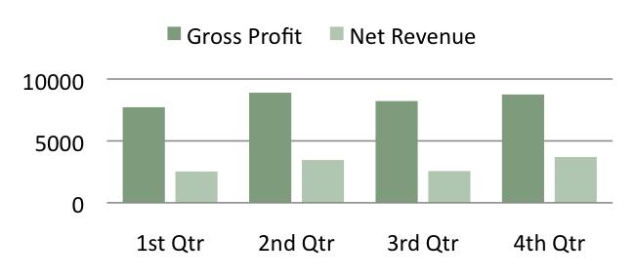
ANNUAL REPORT
Market Risk
Fiscal Year 2005 Annual Report
Quarter Ended | 1st Qtr. | 2nd Qtr. | 3rd Qtr. | 4th Qtr. | Total
Fiscal year 2003
Revenue | $7,746 | $8,541 | $7,835 | $8,065 | $32,187
Gross profit | 6,402 | 6,404 | 6,561 | 6,761 | 26,128
Net income | 2,041 | 1,865 | 2,142 | 1,483 | 7,531
Basic earnings per share | 0.19 | 0.17 | 0.2 | 0.14 | 0.7
Diluted earnings per share | 0.19 | 0.17 | 0.2 | 0.14 | 0.69
Fiscal year 2004
Revenue | $8,215 | $10,153 | $9,175 | $9,292 | $36,835
Gross profit | 6,735 | 7,809 | 7,764 | 7,811 | 30,119
Net income | 2,614 | 1,549 | 1,315 | 2,690 | 8,168
Basic earnings per share | 0.24 | 0.14 | 0.12 | 0.25 | 0.76
Diluted earnings per share | 0.24 | 0.14 | 0.12 | 0.25 | 0.75
Fiscal year 2005
Revenue | $9,189 | $10,818 | $9,620 | $10,161 | $39,788
Gross profit | 7,720 | 8,896 | 8,221 | 8,751 | 33,588
Net income | 2,528 | 3,463 | 2,563 | 3,700 | 12,254
Basic earnings per share | 0.23 | 0.32 | 0.24 | 0.34 | 1.13
Diluted earnings per share | 0.23 | 0.32 | 0.23 | 0.34 | 1.12
Includes charges totaling $750 million (pre-tax) related to the Fabrikam settlement and $1.15 billion in impairments of investments. Includes stock-based compensation charges totaling $2.2 billion for the employee stock option transfer program. Includes charges totaling $756 million (pre-tax) related to Contoso subsidiaries and other matters.
Fiscal Year 2004

