Slide 1
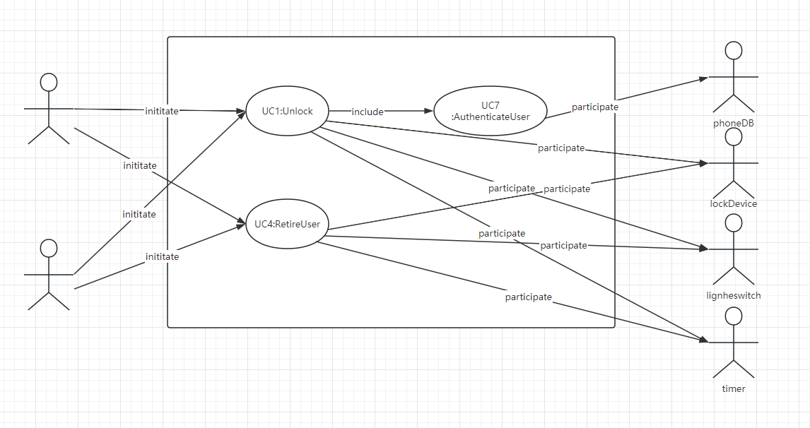

Slide 2
Use Case 1: Unlock
REQ1: Keep door locked and auto-lock
REQ2: Lock when “LOCK” pressed
REQ3: Unlock when valid key provided
REQ4: Allow mistakes but prevent dictionary attacks
REQ5: Maintain a history log
REQ6: Adding/removing users at runtime
REQ7: Configuring the device activation preferences
REQ8: Inspecting the access history
REQ9: Filing inquiries
Use Case UC-1: |  |  | Unlock
Related Requirem’ts: |  |  | REQ1, REQ3, REQ4, and REQ5 stated in the table of REQs
Initiating Actor: |  |  | Any of: Tenant, Landlord
Actor’s Goal: |  |  | To disarm the lock and enter, and get space lighted up automatically.
Participating Actors: |  |  | LockDevice, LightSwitch, Timer
Preconditions: |  |  | • The set of phone machine code stored in the system database is non-empty. • The system displays the menu of available functions; at the door keypad the menu choices are “Lock” and “Unlock.”
Postconditions: |  |  | The auto-lock timer has started countdown from autoLockInterval.
Flow of Events for Main Success Scenario:
→ | 1. | Tenant/Landlord arrives at the door and selects the menu item “Unlock”
 | 2. | include::AuthenticateUser (UC-7)
← | 3. | System (a) signals to the Tenant/Landlord the lock status, e.g., “disarmed,” (b) signals to LockDevice to disarm the lock, and (c) signals to LightSwitch to turn the light on
← | 4. | System signals to the Timer to start the auto-lock timer countdown
→ | 5. | Tenant/Landlord opens the door, enters the home [and shuts the door and locks]

Slide 3
Subroutine «include» Use Case
Use Case UC-7: |  |  |  | AuthenticateUser (sub-use case)
Related Requirements: |  |  |  | REQ3, REQ4 stated in the table of REQs
Initiating Actor: |  |  |  | Any of: Tenant, Landlord
Actor’s Goal: |  |  |  | To be positively identified by the system (at the door interface).
Participating Actors: |  |  |  | AlarmBell, Police,phoneDB
Preconditions: |  |  |  | • The set of phone machine code stored in the system database is non-empty. • The counter of authentication attempts equals zero.
Postconditions: |  |  |  | None worth mentioning.
Flow of Events for Main Success Scenario:
← | 1. | System prompts the actor for using the Bluetooth network to connect user’s phone
→ | 2. | Tenant/Landlord turn on the bluetooth of phone and place it close to the sensing area on the screen.
← | 3. | System (a) verifies that the phone machine code mate through phoneDB successfully , and (b) signals to the actor the phone mate successfully.
Flow of Events for Extensions (Alternate Scenarios):
2a. Tenant/Landlord faild to mate.
← | 1. | System (a) detects error, (b) marks a failed attempt, and (c) signals to the actor
← |  | 1.a | System (a) detects that the count of failed attempts exceeds the maximum allowed number, (b) signals to sound AlarmBell, and (c) notifies the Police actor of a possible break-in
→ | 2. | Tenant/Landlord mate successfully.
 | 3. | Same as in Step 3 above
Notes:
添加了手机匹配，uc-1 unlock应该不怎么需要修改，主要修改sub use case UC-7 authenticateUser

Slide 4
Use Case 4: RetireUser
REQ1: Keep door locked and auto-lock
REQ2: Lock when “LOCK” pressed
REQ3: Unlock when valid key provided
REQ4: Allow mistakes but prevent dictionary attacks
REQ5: Maintain a history log
REQ6: Adding/removing users at runtime
REQ7: Configuring the device activation preferences
REQ8: Inspecting the access history
REQ9: Filing inquiries
Use Case UC-4: |  |  | RetireUser
Related Requirem’ts: |  |  | REQ6
Initiating Actor: |  |  | Landlord
Actor’s Goal: |  |  | remove departing residents during runtime
Participating Actors: |  |  | Tennant
Preconditions: |  |  | none
Postconditions: |  |  | The modified data has been saved in the db.
Flow of Events for Main Success Scenario:
→ | 1. | Landlord select the "Manage Users" option.
 | 2. | Landlord permission authentication: Include UC-8
← | 3. | Display the available actions for the landlord, including "Add User" and "Retire User," and prompt the landlord to make a selection.
→ | 4. | Landlord selects the action “Retire User," and delete the user that he/she want to delete.
← | 5. | delete the data about the user on a persistent storage(SSD etc), and notification to the landlord successful.

Slide 5
Acceptance Test Case for UC-1 Unlock
Test-case Identifier: | TC-1
Use Case Tested: | UC-1, main success scenario, and UC-7
Pass/fail Criteria: | The test passes if the user mate the phone machine code that is contained in the database, with less than a maximum allowed number of unsuccessful attempts
Input Data: | phone, door identifier
Test Procedure: |  | Expected Result:
Step 1. use a wrong phone and a valid door identifier |  | System beeps to indicate failure; records unsuccessful attempt in the database; prompts the user to try again
Step 2. use a available phone and door identifier |  | System flashes a green light to indicate success; records successful access in the database; disarms the lock device

Slide 6
Acceptance Test Case for UC-4 RetireUser
Test-case Identifier: | TC-4
Use Case Tested: | UC-1, main success scenario
Pass/fail Criteria: | The test passes if the deleted tenant is unable to unlock the previous lock and the number of attempts is less than the maximum allowed number of unsuccessful attempts
Input Data: | door identifier,The deleted tenant's phone
Test Procedure: |  | Expected Result:
use the deleted tenant's phone and a valid door identifier |  | System beeps to indicate failure; records unsuccessful attempt in the database; prompts the user to try again

