Slide 1
CNN Base Line Model

Slide 2
Data
3 Features are used: ‘Pupil Diameter’, ‘Pupil X’, and ‘Pupil Y’
‘Pupil Diameter’ is interpolated. No missing data
‘Pupil X’ and ‘Pupil Y’ are not interpolated. Have missing data
Missing data will be drop

Slide 3
Missing data
Total number of data : 157,740,011
Total number of missing data : 29,124,939
Consecutive missing data:
Mean: 728.6144
Std : 2,694.344
Min : 1
25th % : 32
50th % : 143
75th % : 659
Max : 71,997

Slide 4
Sampling
Time interval for each sample is 1s
Sampling 3 samples after every stimulus onset. The first sample is label as 1, the second and third samples are label as 0
Example, If the stimulus onset is at 4 second:
First sample: 4s -> 5s. Label as 1
Second sample: 5s -> 6s. Label as 0
Third sample: 6s -> 7s. Label as 0
1/3 of data is 1, and 2/3 of data is 0

Slide 5



Preprocessing
Normalizing features using Stander Scaler
For 1 second, there will be 250 elements. 3 features: ‘Pupil Diameter’, ‘Pupil X’, and ‘Pupil Y’
The shape: (_ , 250, 3)
Cut into 10 channels, the shape: ( _, 25, 3, 10)

Slide 6
Training, Validating and Testing set
Subject 0 -> 52: training and validating data. Shuffled, then split into 80/20
Subject 53 -> 57: test data
Number of sample:
Train data: 132,710
Validate data: 33,178
Test data: 17,789

Slide 7
CNN base line model
Input: (_, 25, 3, 10)
Con2D: 64, (3 ,3)
Max pool: (2,1)
Output: 1
Drop out: 0.3
Dense: 32
Con2D: 128, (3 ,3)
Drop out: 0.3
Max pool: (2,1)
Max pool: (2,1)
Drop out: 0.3
Con2D: 256, (3 ,3)

Slide 8
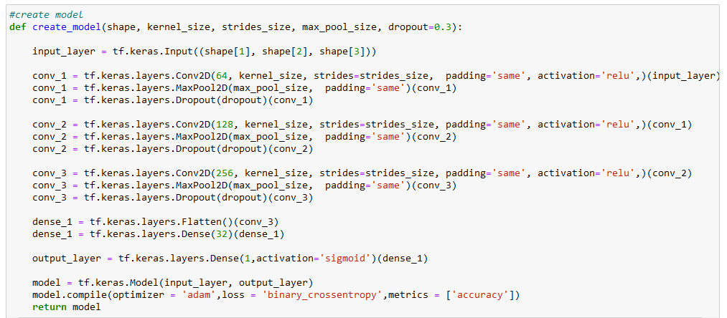
CNN base line model

Slide 9
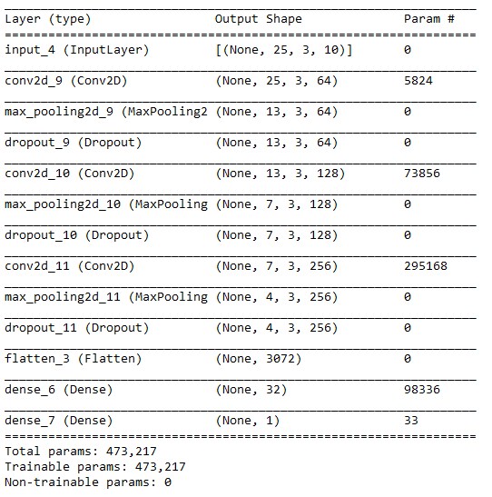
Output shape

Slide 10
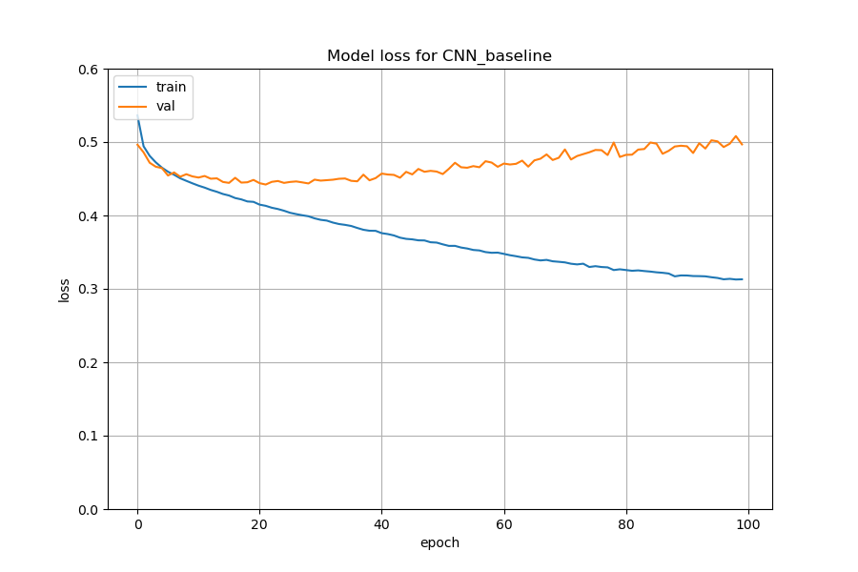
Training Loss

Slide 11
Performance
Threshold 0.0: Accuracy: 0.38 ,F1: 0.55
Threshold 0.1: Accuracy: 0.48 ,F1: 0.59
Threshold 0.2: Accuracy: 0.56 ,F1: 0.61
Threshold 0.3: Accuracy: 0.64 ,F1: 0.61
Threshold 0.4: Accuracy: 0.69 ,F1: 0.59
Threshold 0.5: Accuracy: 0.71 ,F1: 0.57
Threshold 0.6: Accuracy: 0.72 ,F1: 0.53
Threshold 0.7: Accuracy: 0.71 ,F1: 0.50
Threshold 0.8: Accuracy: 0.71 ,F1: 0.45
Threshold 0.9: Accuracy: 0.69 ,F1: 0.37
Threshold 1.0: Accuracy: 0.62 ,F1: 0.00

Slide 12
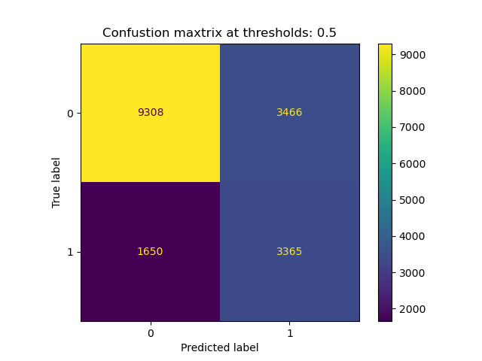
Confusion matrix

Slide 13
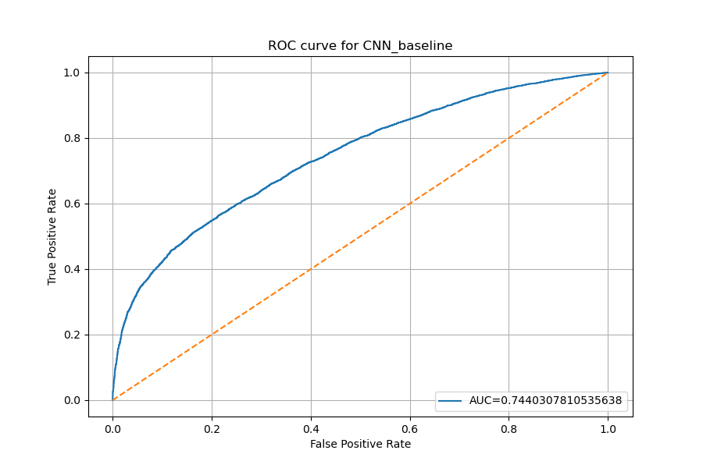
ROC curve

Slide 14
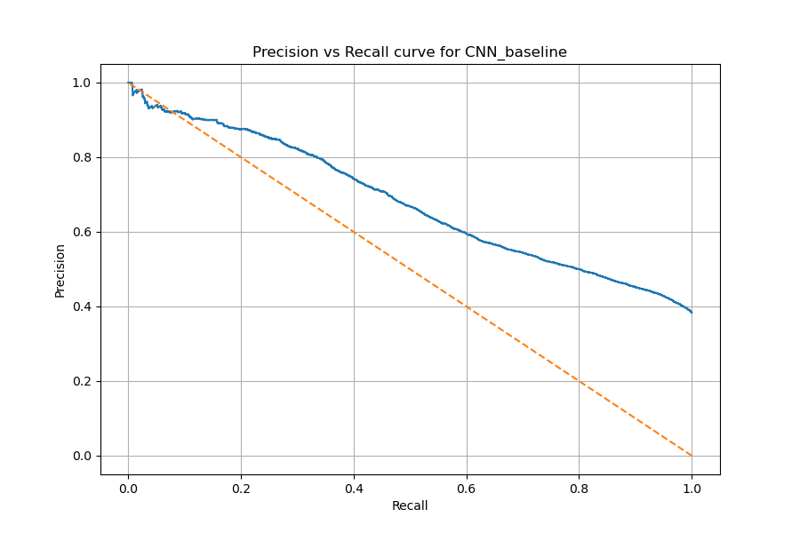
Precision vs Recall

