Slide 1
Overview

Slide 2
Overview
5 Data set:
All Tasks
DPT
MA
PVT
VWM
3 Models:
1D Convolution, 3 features (250, 3)
2D Convolution, 1 channel (250, 3, 1)
2D Convolution, 10 channel (25, 3, 10)
Metrics:
Primary: Matthew's correlation coefficient (MCC)
Secondary: Accuracy
F1

Slide 3
All Tasks

Slide 4
0/1 Label ratio
Training set:
Number of positive element: 57234
The ratio: 0.4312711928264637
Validation set:
Number of positive element: 14274
The ratio: 0.4302248477907047
Testing set:
Number of positive element: 6831
The ratio: 0.3840013491483501

Slide 5
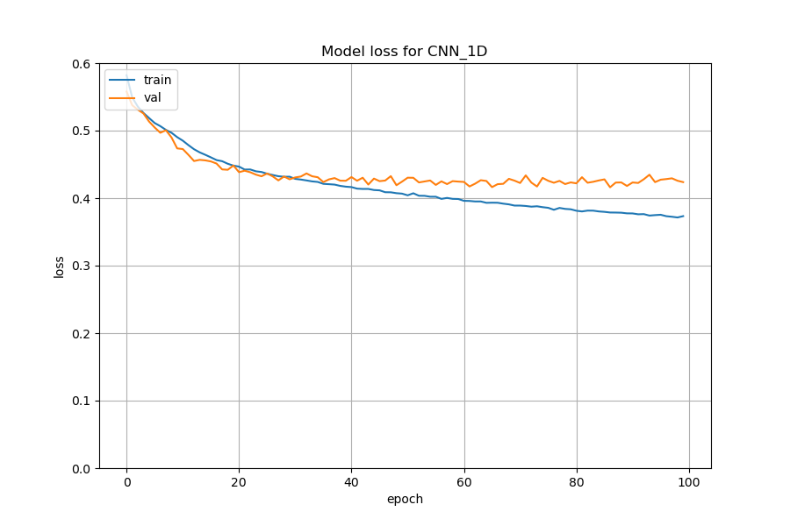
Training Loss
1D (250,3)

Slide 6
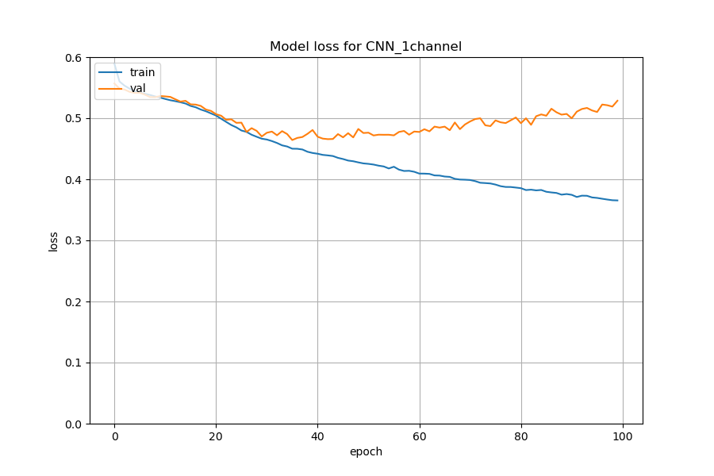
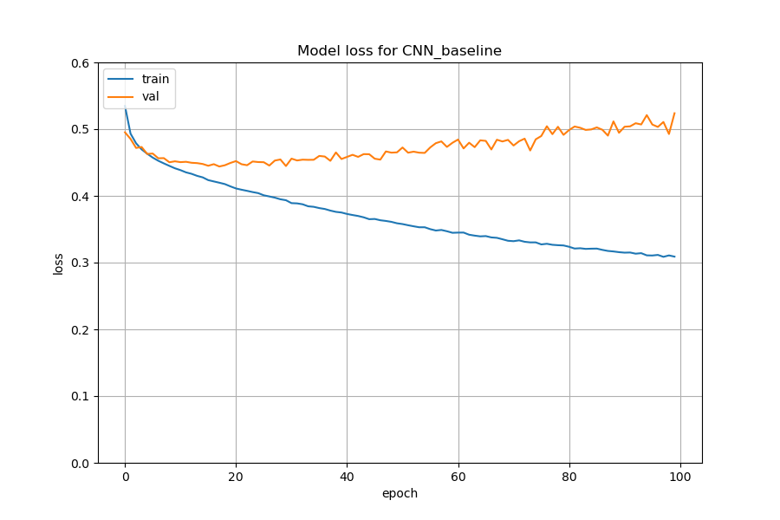
Training Loss
1 Channel (250,3,1)
10 Channel (25,3,10)

Slide 7
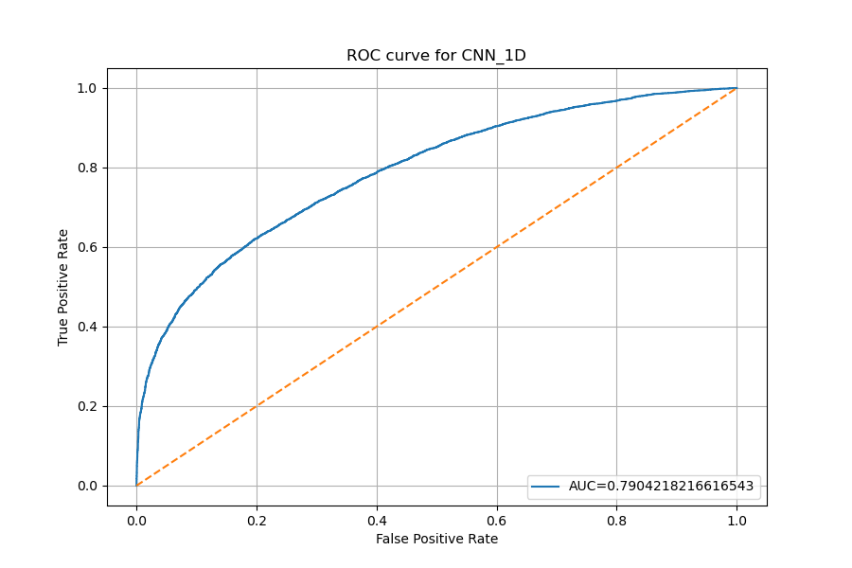
ROC Curve
1D (250,3)

Slide 8
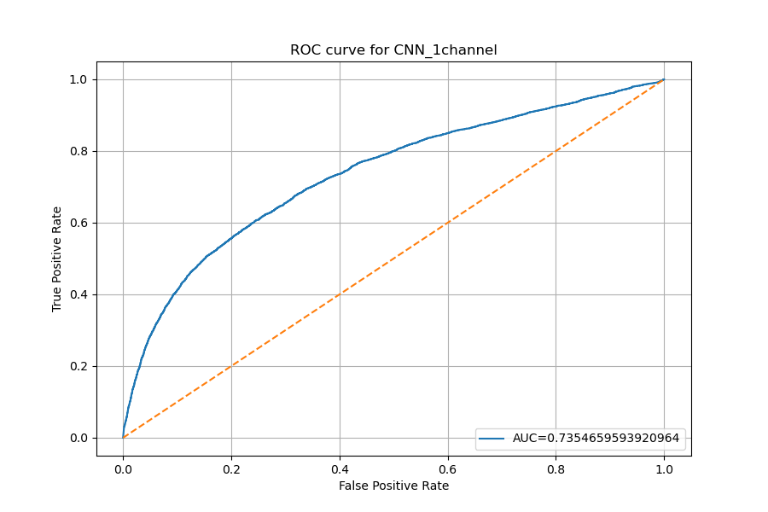
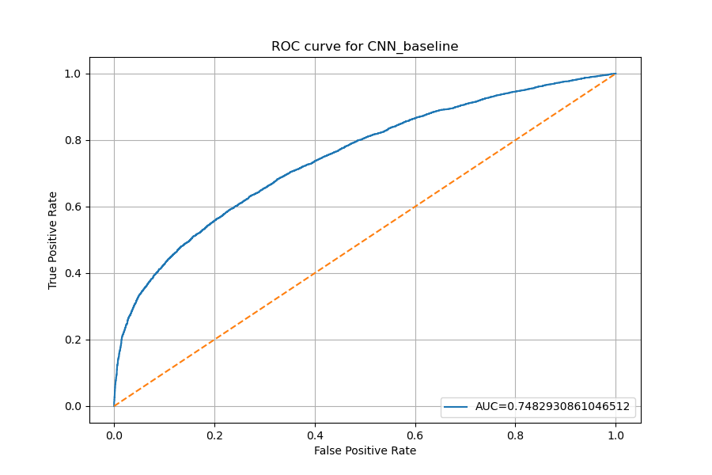
ROC Curve
1 Channel (250,3,1)
10 Channel (25,3,10)

Slide 9
The best performance base on Matthews Correlation
1D (250,3)
Threshold 0.5
Accuracy: 0.74
F1: 0.60
MCC: 0.44
1 Channel (250,3,1)
Threshold 0.5
Accuracy: 0.71
F1: 0.58
MCC: 0.38
10 Channel (25,3,10)
Threshold 0.6
Accuracy: 0.72
F1: 0.54
MCC: 0.38

Slide 10
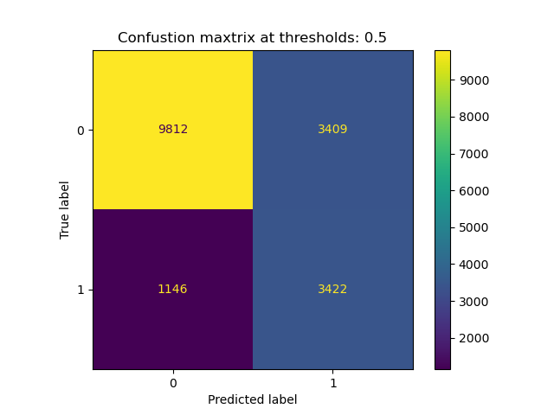
Confusion Matrix
1D (250,3)

Slide 11
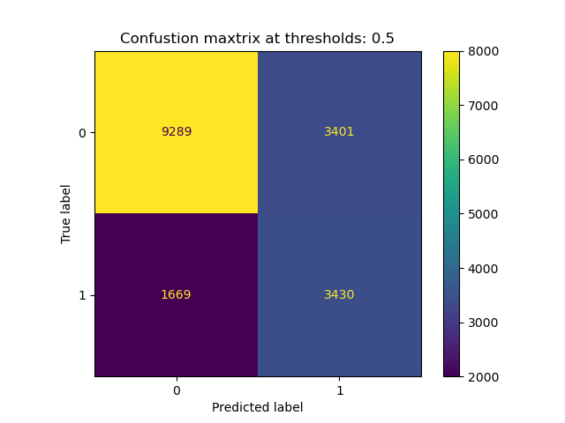
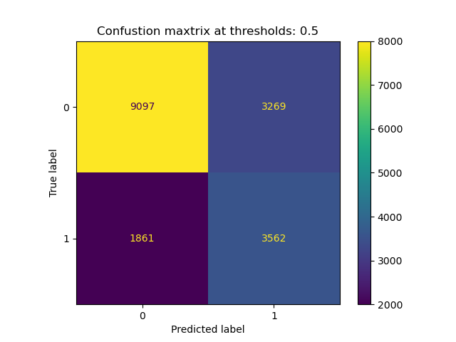
Confusion Matrix
1 Channel (250,3,1)
10 Channel (25,3,10)

Slide 12
DPT

Slide 13
0/1 Label ratio
Training set:
Number of positive element: 21156
The ratio: 0.44478082623777987
Validation set:
Number of positive element: 5276
The ratio: 0.4436596030945173
Testing set:
Number of positive element: 2487
The ratio: 0.40099967752337956

Slide 14
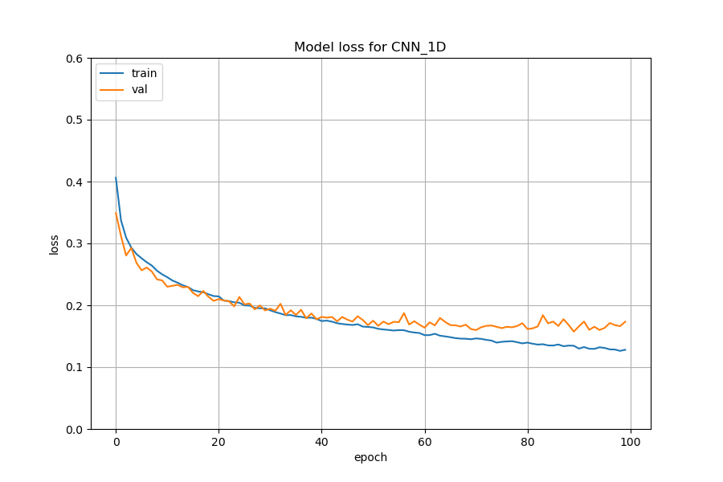
Training Loss
1D (250,3)

Slide 15
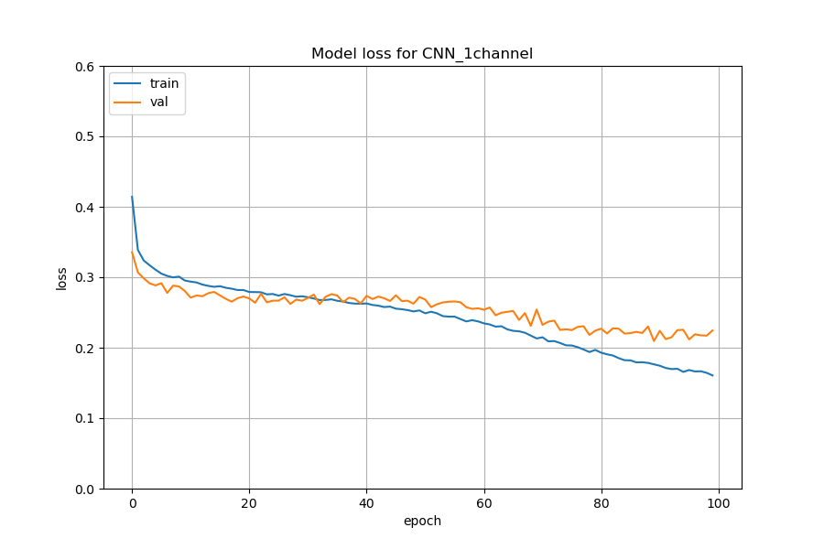
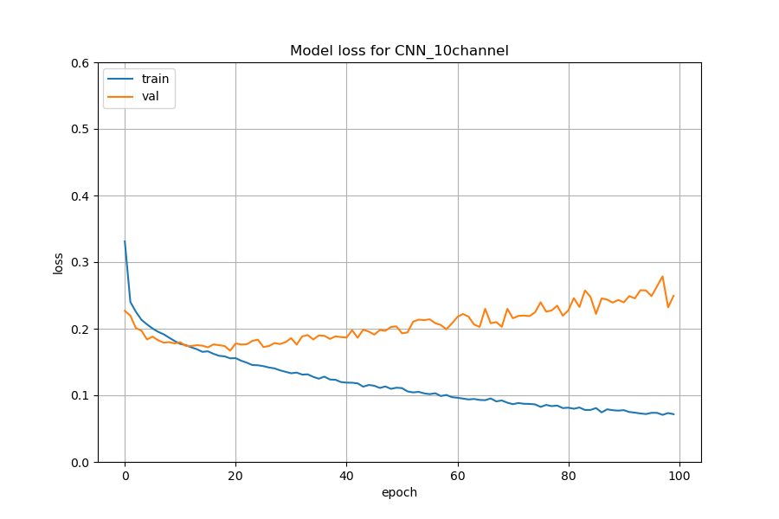
Training Loss
1 Channel (250,3,1)
10 Channel (25,3,10)

Slide 16
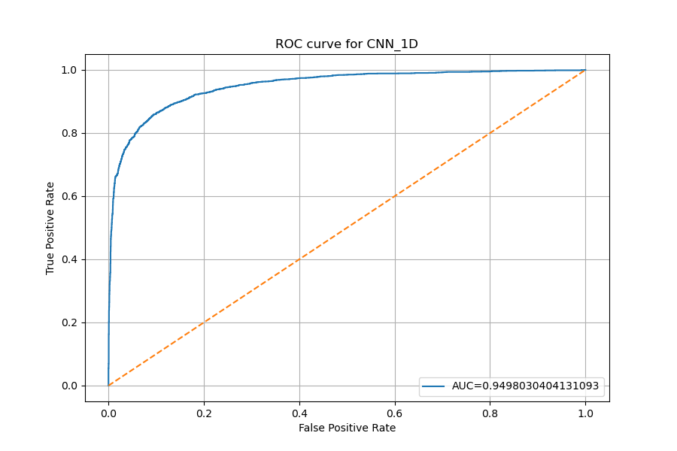
ROC Curve
1D (250,3)

Slide 17
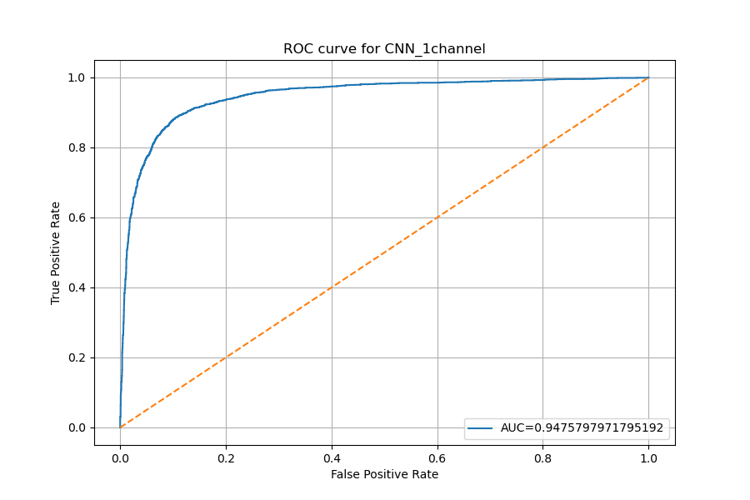
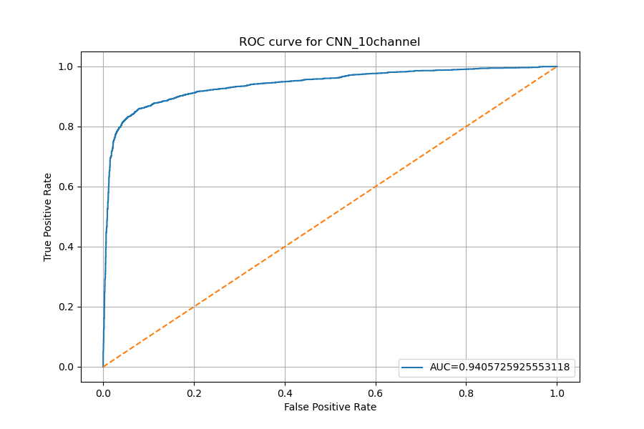
ROC Curve
1 Channel (250,3,1)
10 Channel (25,3,10)

Slide 18
The best performance base on Matthews Correlation
1D (250,3)
Threshold 0.5
Accuracy: 0.89
F1: 0.86
MCC: 0.76
1 Channel (250,3,1)
Threshold 0.5
Accuracy: 0.89
F1: 0.86
MCC: 0.77
10 Channel (25,3,10)
Threshold 0.7
Accuracy: 0.90
F1: 0.87
MCC: 0.79

Slide 19
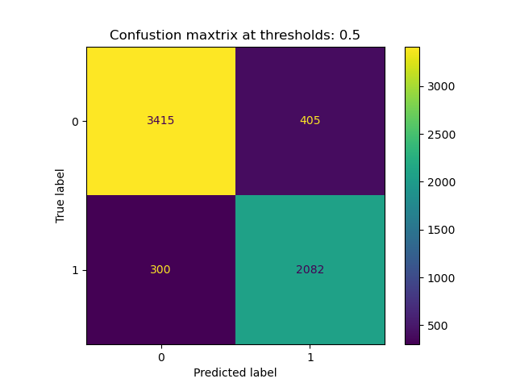
Confusion Matrix
1D (250,3)

Slide 20
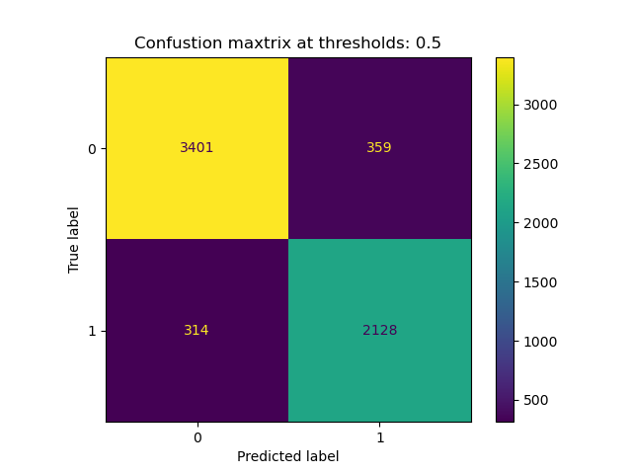

Confusion Matrix
1 Channel (250,3,1)
10 Channel (25,3,10)

Slide 21
MA

Slide 22
0/1 Label ratio
Training set:
Number of positive element: 5291
The ratio: 0.37171561051004637
Validation set:
Number of positive element: 1327
The ratio: 0.3728575442540039
Testing set:
Number of positive element: 642
The ratio: 0.37303893085415457

Slide 23
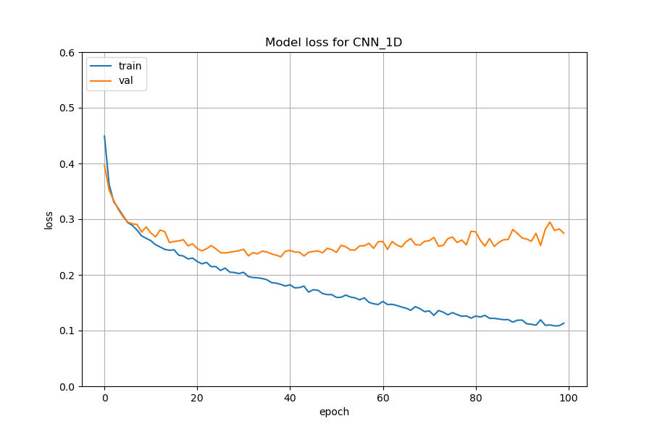
Training Loss
1D (250,3)

Slide 24
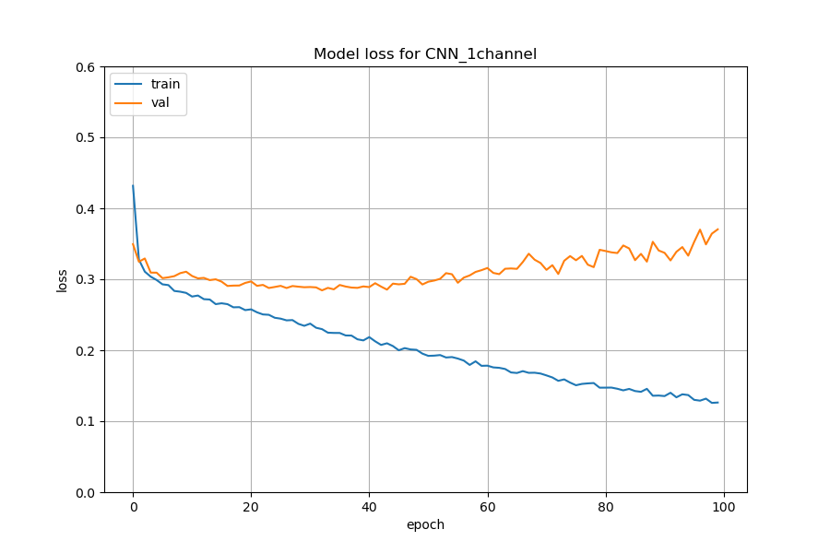
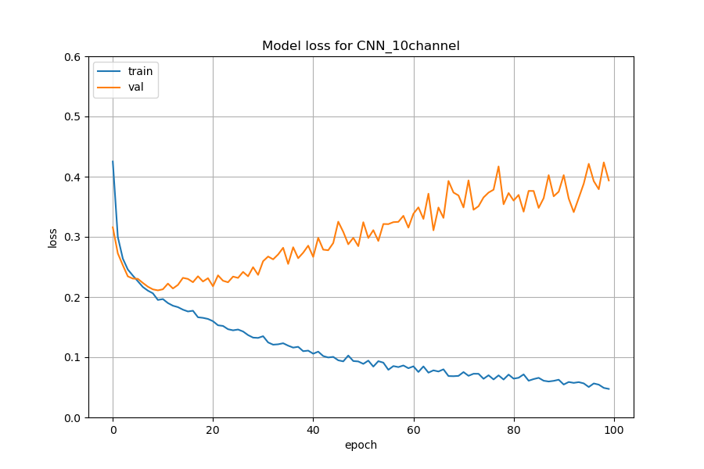
Training Loss
1 Channel (250,3,1)
10 Channel (25,3,10)

Slide 25
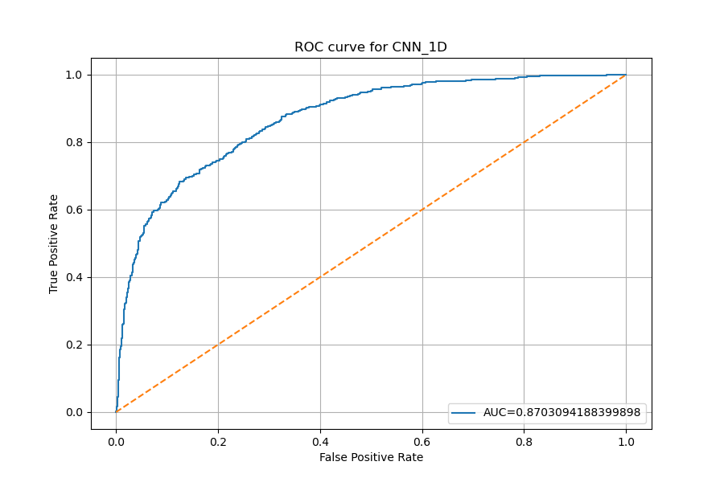
ROC Curve
1D (250,3)

Slide 26
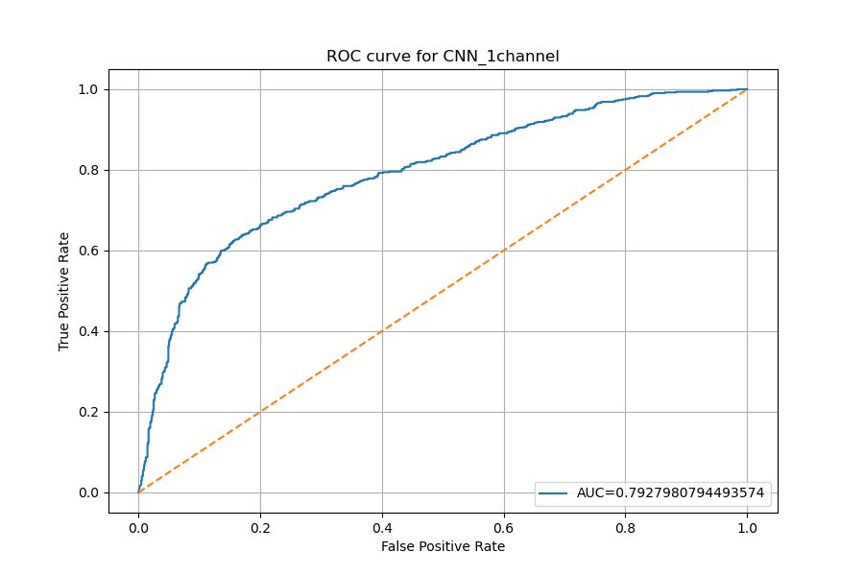
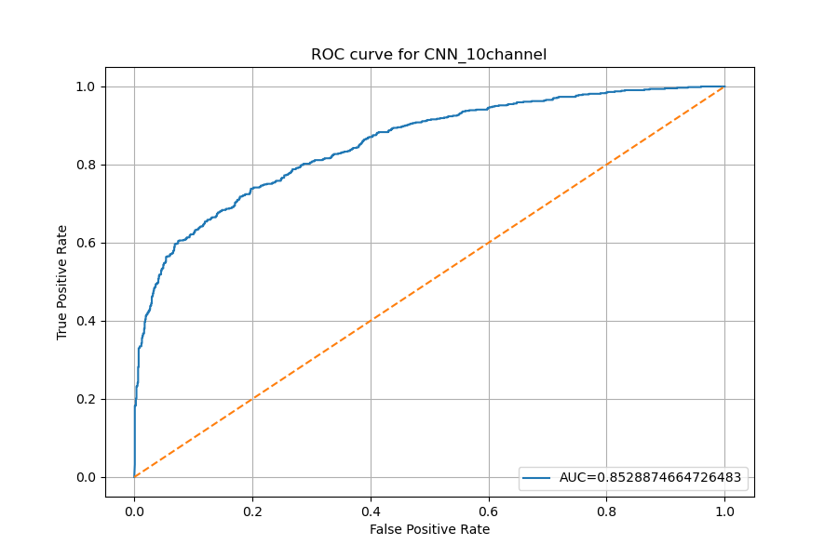
ROC Curve
1 Channel (250,3,1)
10 Channel (25,3,10)

Slide 27
The best performance base on Matthews Correlation
1D (250,3)
Threshold 0.4
Accuracy: 0.80
F1: 0.69
MCC: 0.57
1 Channel (250,3,1)
Threshold 0.4
Accuracy: 0.77
F1: 0.64
MCC: 0.48
10 Channel (25,3,10)
Threshold 0.5
Accuracy: 0.81
F1: 0.70
MCC: 0.58

Slide 28
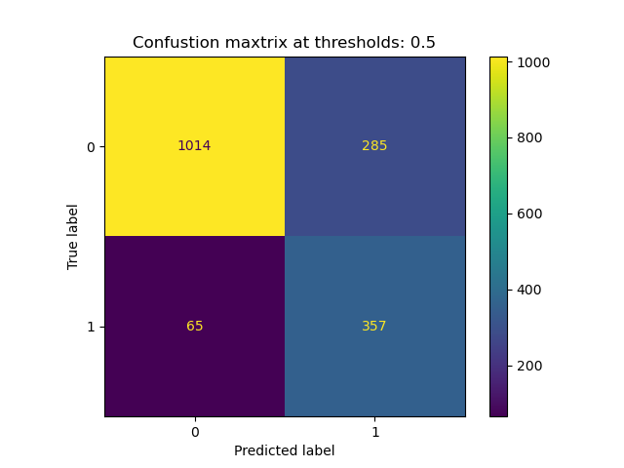
Confusion Matrix
1D (250,3)

Slide 29
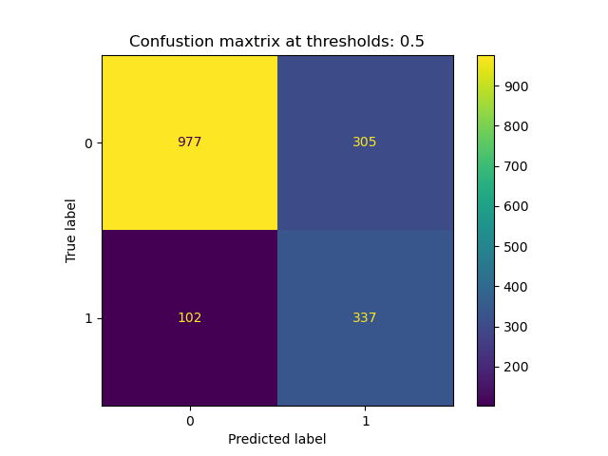

Confusion Matrix
1 Channel (250,3,1)
10 Channel (25,3,10)

Slide 30
PVT

Slide 31
0/1 Label ratio
Training set:
Number of positive element: 10395
The ratio: 0.46740107913669066
Validation set:
Number of positive element: 2673
The ratio: 0.48066894443445424
Testing set:
Number of positive element: 1300
The ratio: 0.37496394577444475

Slide 32
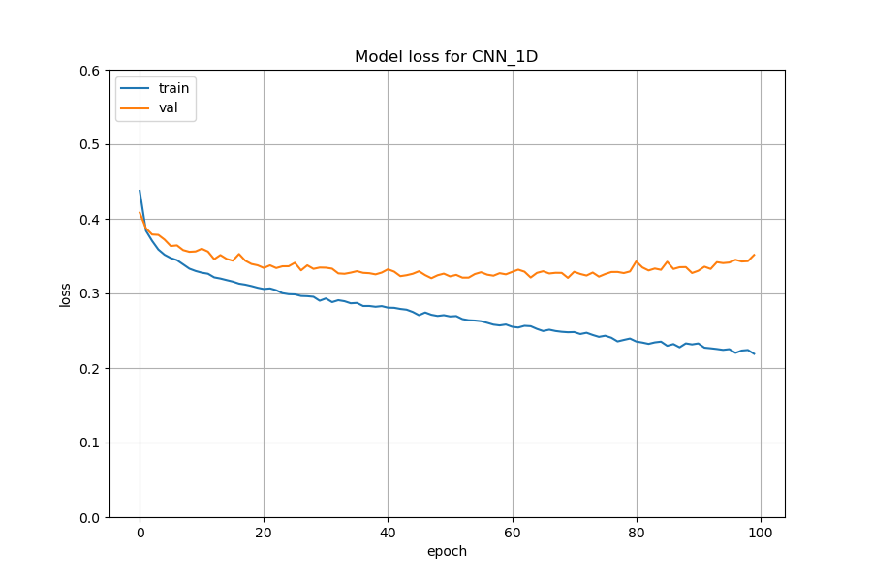
Training Loss
1D (250,3)

Slide 33
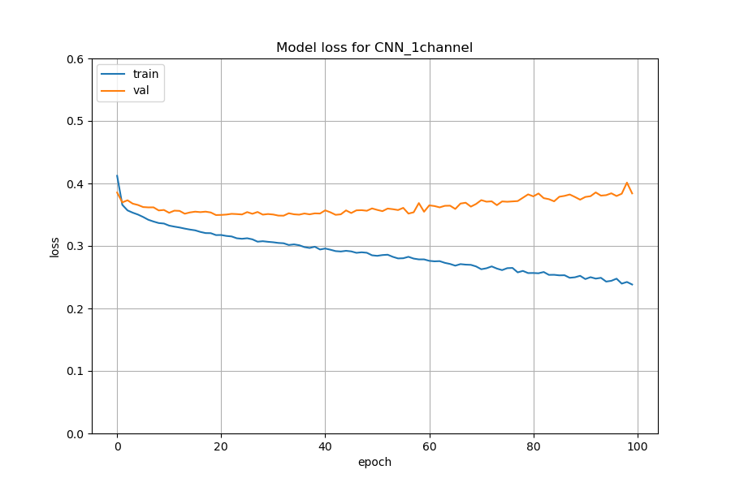
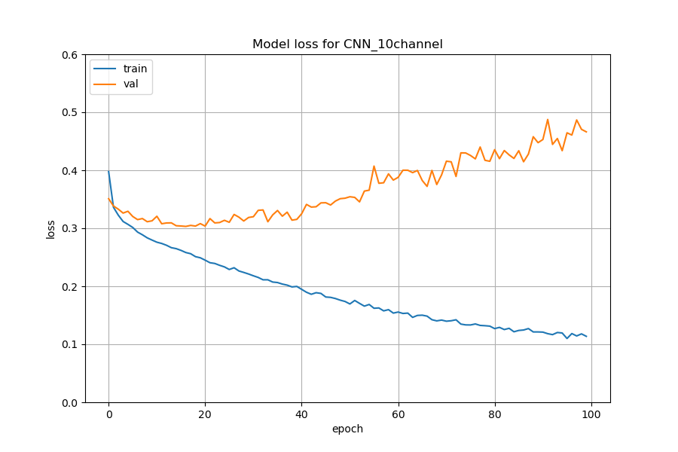
Training Loss
1 Channel (250,3,1)
10 Channel (25,3,10)

Slide 34
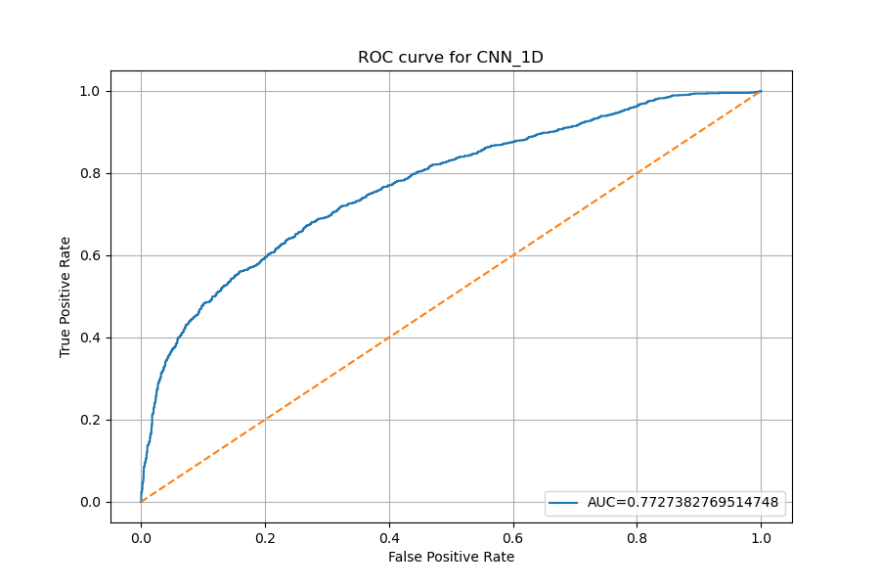
ROC Curve
1D (250,3)

Slide 35
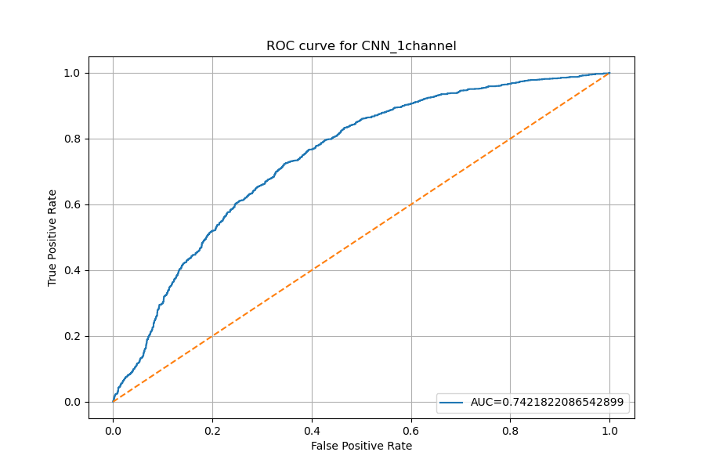
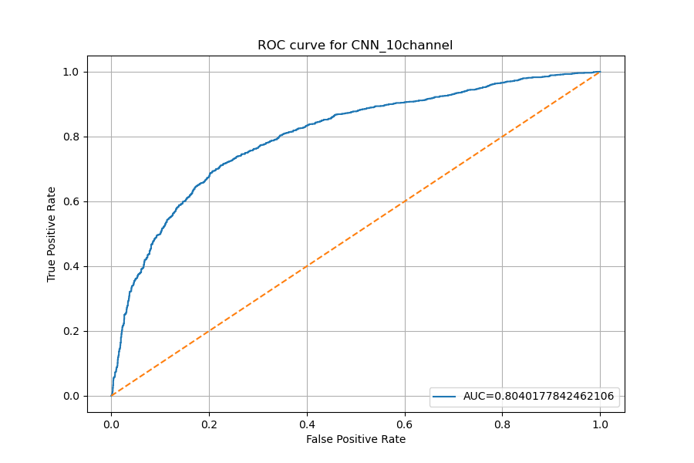
ROC Curve
1 Channel (250,3,1)
10 Channel (25,3,10)

Slide 36
The best performance base on Matthews Correlation
1D (250,3)
Threshold 0.6
Accuracy: 0.74
F1: 0.59
MCC: 0.43
1 Channel (250,3,1)
Threshold 0.3
Accuracy: 0.68
F1: 0.63
MCC: 0.37
10 Channel (25,3,10)
Threshold 0.4
Accuracy: 0.76
F1: 0.68
MCC: 0.48

Slide 37
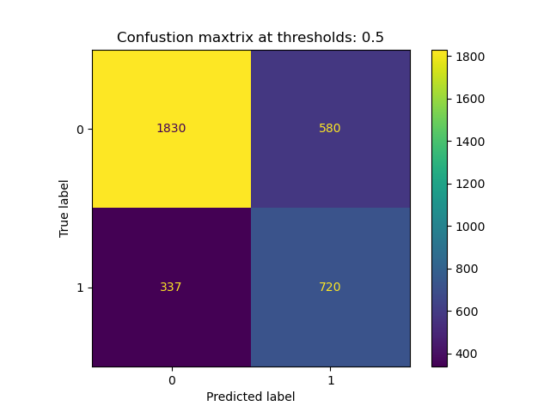
Confusion Matrix
1D (250,3)

Slide 38

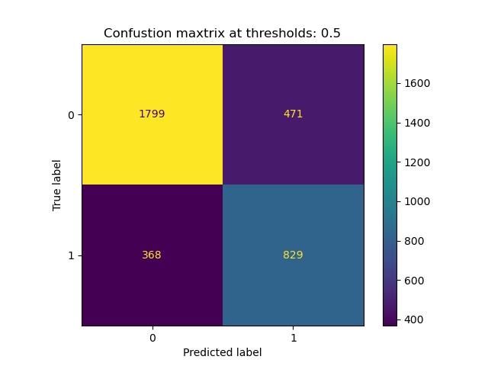
Confusion Matrix
1 Channel (250,3,1)
10 Channel (25,3,10)

Slide 39
VWM

Slide 40
0/1 Label ratio
Training set:
Number of positive element: 20300
The ratio: 0.4171032895683084
Validation set:
Number of positive element: 5090
The ratio: 0.418310322156476
Testing set:
Number of positive element: 2402
The ratio: 0.3753711517424598

Slide 41
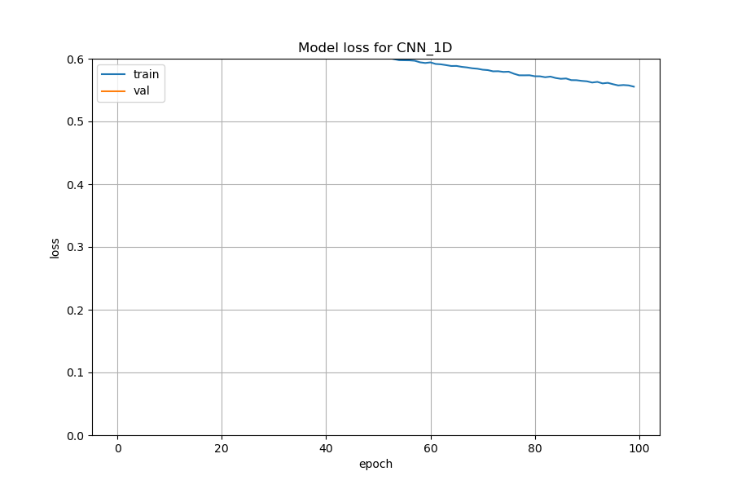
Training Loss
1D (250,3)

Slide 42
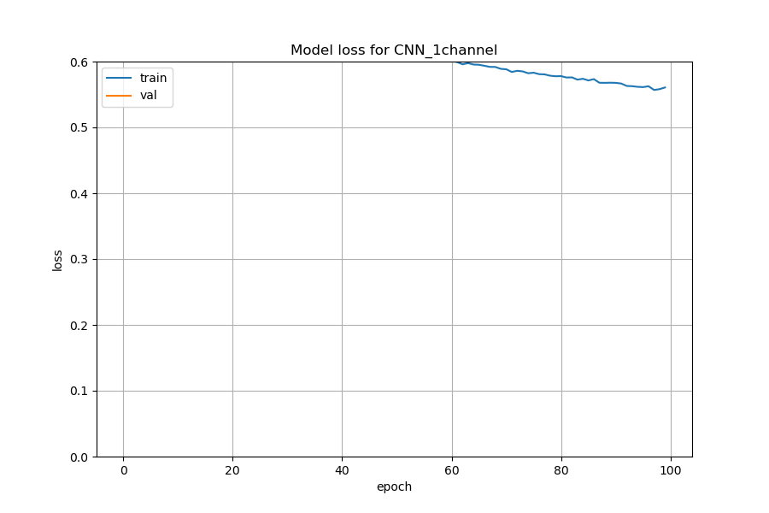
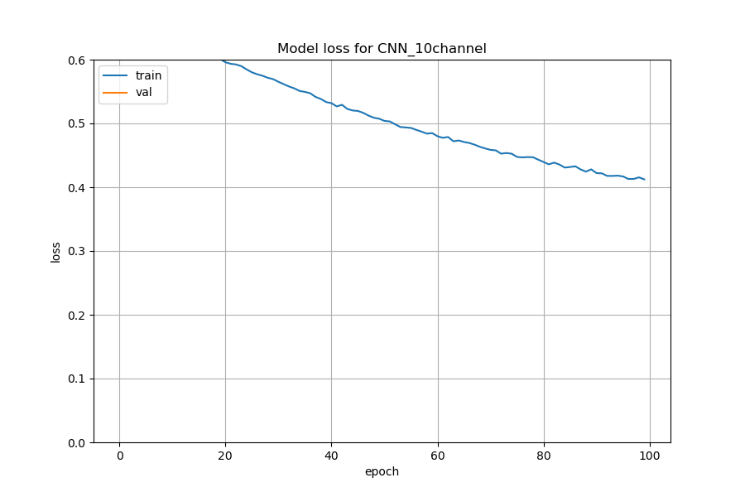
Training Loss
1 Channel (250,3,1)
10 Channel (25,3,10)

Slide 43
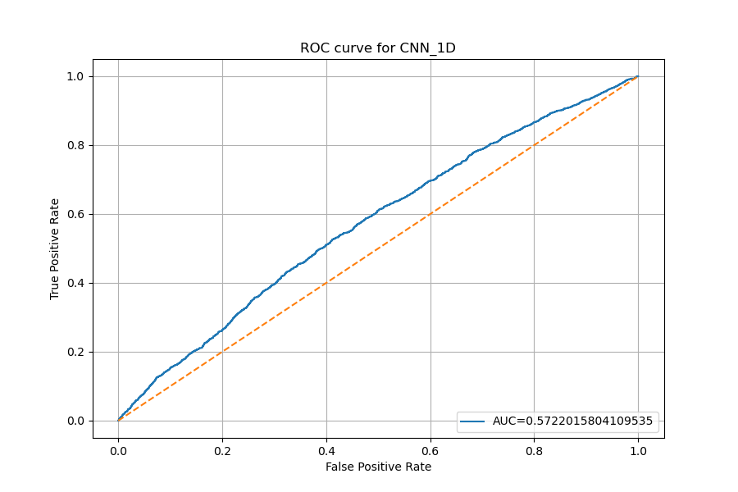
ROC Curve
1D (250,3)

Slide 44
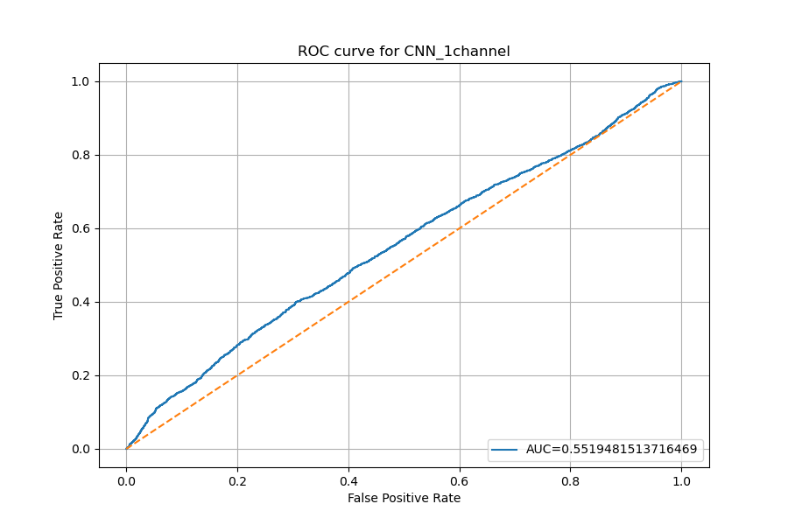
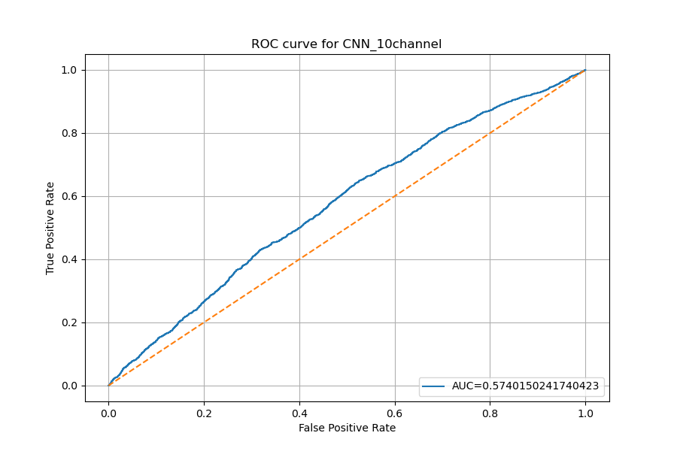
ROC Curve
1 Channel (250,3,1)
10 Channel (25,3,10)

Slide 45
The best performance base on Matthews Correlation
1D (250,3)
Threshold 0.4:
Accuracy: 0.55
F1: 0.49
MCC: 0.11
1 Channel (250,3,1)
Threshold 0.6
Accuracy: 0.63
F1: 0.16
MCC: 0.09
10 Channel (25,3,10)
Threshold 0.3
Accuracy: 0.50
F1: 0.53
MCC: 0.10

Slide 46
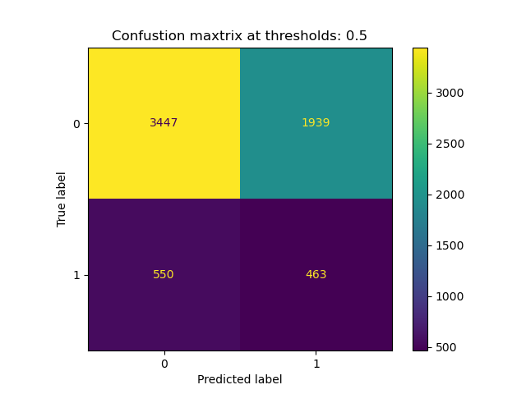
Confusion Matrix
1D (250,3)

Slide 47

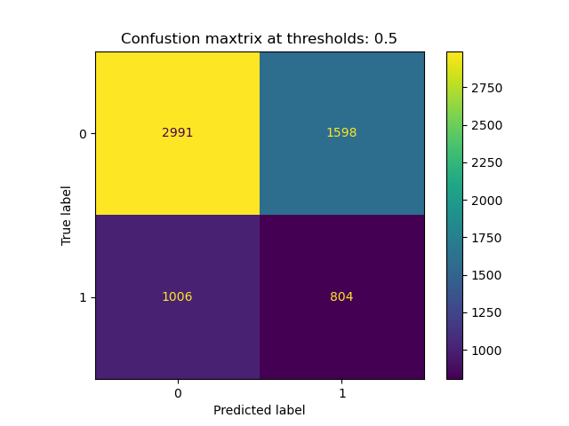
Confusion Matrix
1 Channel (250,3,1)
10 Channel (25,3,10)

Slide 48
Summary

Slide 49
Summary
 | Percent of label 0 | 1D (250, 3) |  | 1 channel (250,3,1) |  | 10 channels (25,3,10)
 |  | Accuracy | MCC | Accuracy | MCC | Accuracy | MCC
All Tasks | 0.62 | 0.74 | 0.44 | 0.71 | 0.38 | 0.72 | 0.38
DPT | 0.60 | 0.89 | 0.79 | 0.89 | 0.77 | 0.90 | 0.79
MA | 0.63 | 0.80 | 0.57 | 0.77 | 0.48 | 0.81 | 0.58
PVT | 0.63 | 0.74 | 0.43 | 0.68 | 0.37 | 0.76 | 0.48
VWM | 0.63 | 0.55 | 0.11 | 0.63 | 0.09 | 0.50 | 0.10

Slide 50
Average pupil for each Task

Slide 51
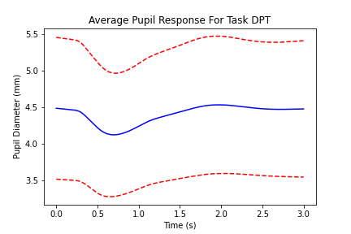
DPT

Slide 52
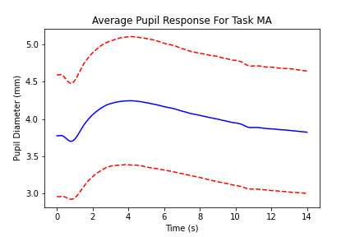
MA

Slide 53
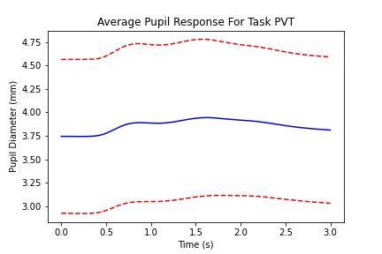
PVT

Slide 54
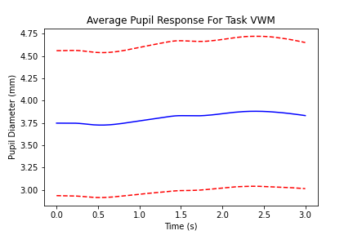
VWM

