Slide 1
Overview

Slide 2
Overview
5 Data set:
All Tasks
DPT
MA
PVT
VWM
2 Models:
1D Convolution, 3 features (250, 3)
1D Convolution, pupil only (250, 1)
Metrics:
Primary: Matthew's correlation coefficient (MCC)
Secondary: Accuracy
F1

Slide 3
Fold 0:
Train_subjests: index=[12 13 14 15 16 17 18 19 20 21 22 23 24 25 26 27 28 29 30 31 32 33 34 35 36 37 38 39 40 41 42 43 44 45 46 47 48 49 50 51 52 53 54 55 56 57]
Test_subjests: index=[ 0 1 2 3 4 5 6 7 8 9 10 11]
Fold 1:
Train_subjests: index=[ 0 1 2 3 4 5 6 7 8 9 10 11 24 25 26 27 28 29 30 31 32 33 34 35 36 37 38 39 40 41 42 43 44 45 46 47 48 49 50 51 52 53 54 55 56 57]
Test_subjests: index=[12 13 14 15 16 17 18 19 20 21 22 23]
Fold 2:
Train_subjests: index=[ 0 1 2 3 4 5 6 7 8 9 10 11 12 13 14 15 16 17 18 19 20 21 22 23 36 37 38 39 40 41 42 43 44 45 46 47 48 49 50 51 52 53 54 55 56 57]
Test_subjests: index=[24 25 26 27 28 29 30 31 32 33 34 35]
Fold 3:
Train_subjests: index=[ 0 1 2 3 4 5 6 7 8 9 10 11 12 13 14 15 16 17 18 19 20 21 22 23 24 25 26 27 28 29 30 31 32 33 34 35 47 48 49 50 51 52 53 54 55 56 57]
Test_subjests: index=[36 37 38 39 40 41 42 43 44 45 46]
Fold 4:
Train_subjests: index=[ 0 1 2 3 4 5 6 7 8 9 10 11 12 13 14 15 16 17 18 19 20 21 22 23 24 25 26 27 28 29 30 31 32 33 34 35 36 37 38 39 40 41 42 43 44 45 46]
Test_subjests: index=[47 48 49 50 51 52 53 54 55 56 57]

Slide 4
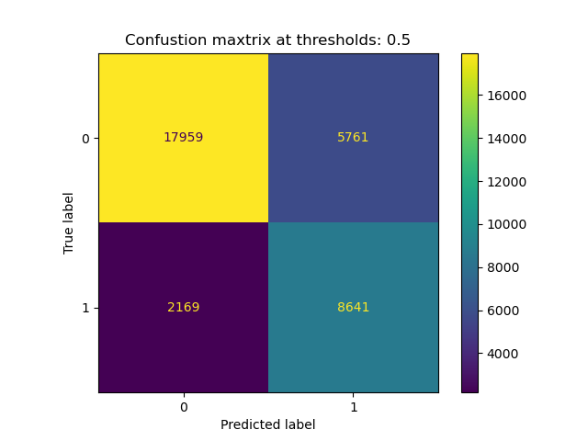
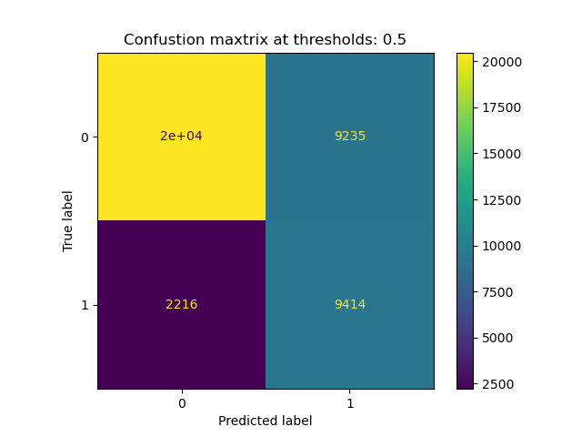

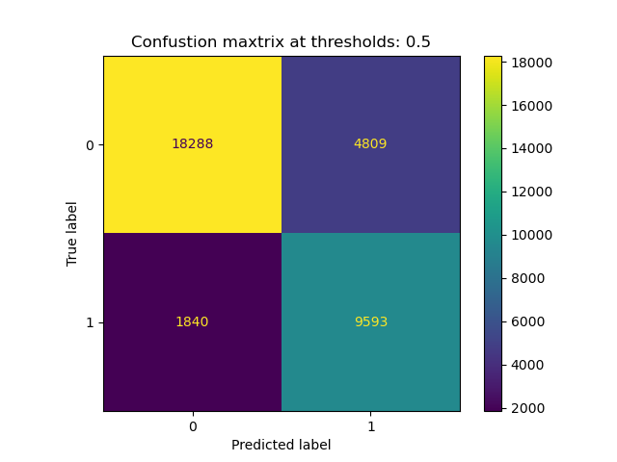
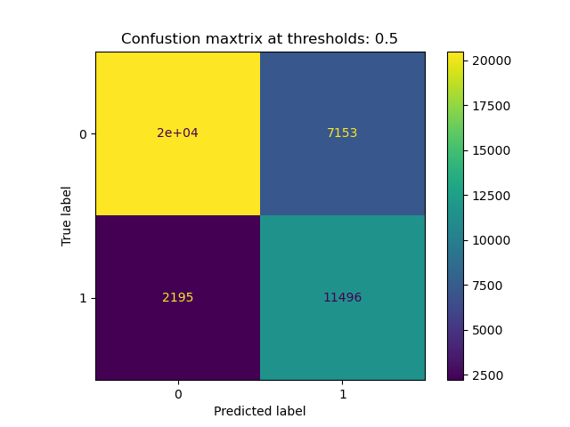
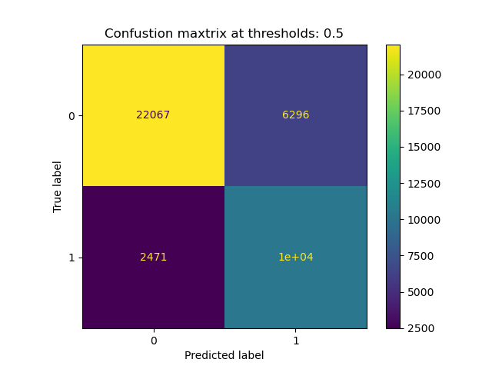
Pupil
Only
Pupil +
X + Y

Slide 5
All Tasks

Slide 6
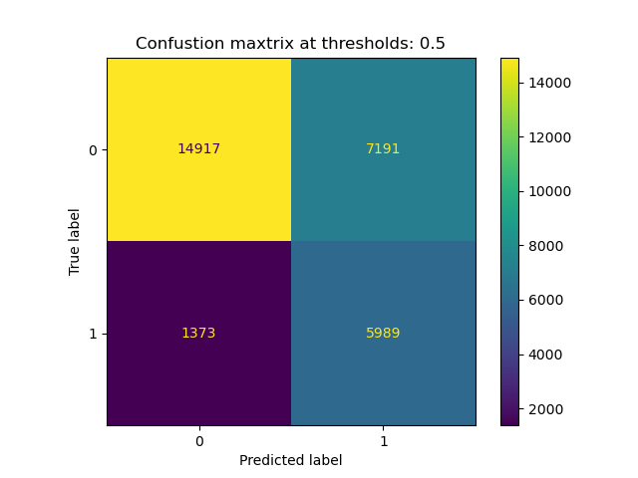
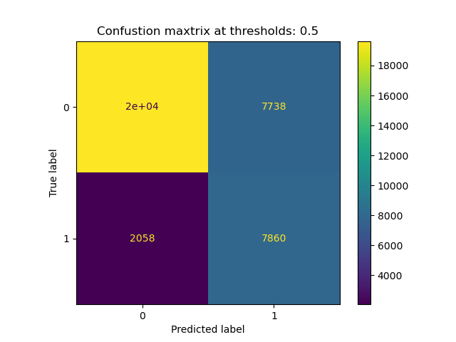


Pupil
Only
Pupil +
X + Y

Slide 7
DPT

Slide 8
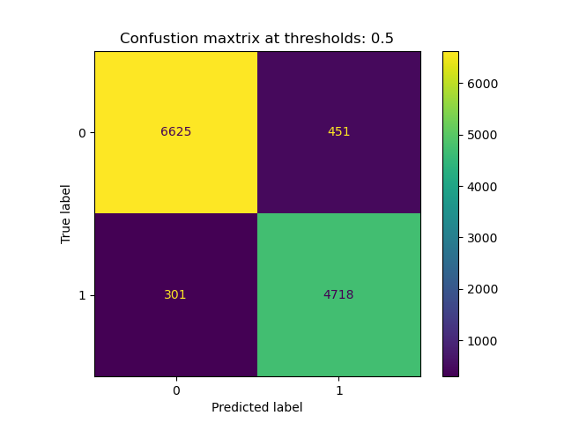
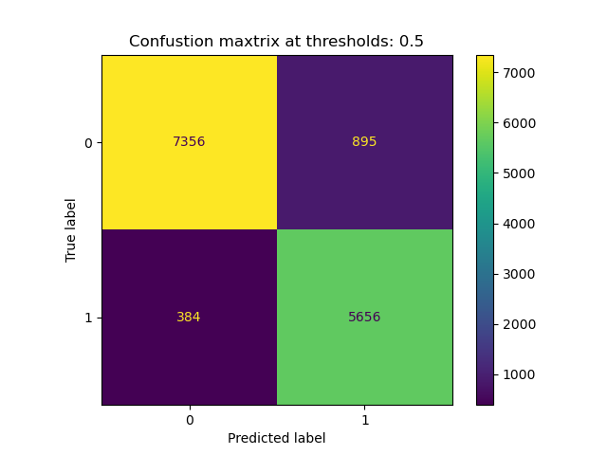
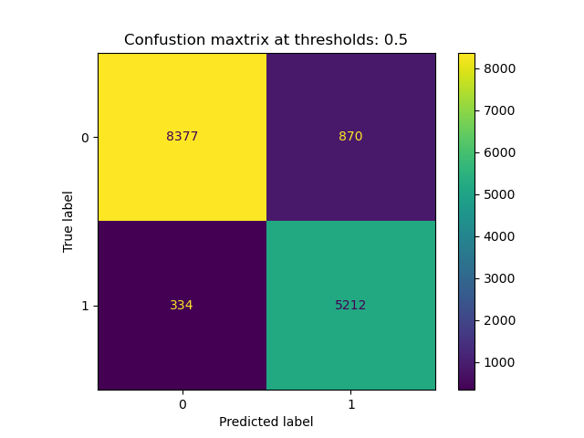


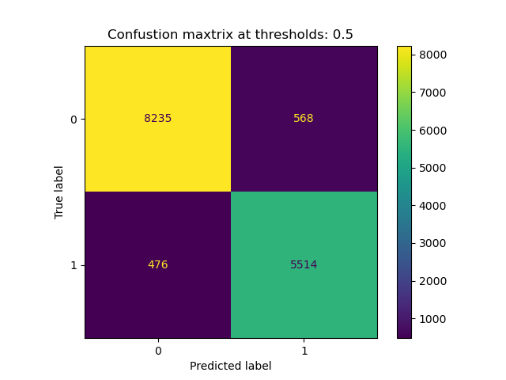
Pupil
Only
Pupil +
X + Y

Slide 9
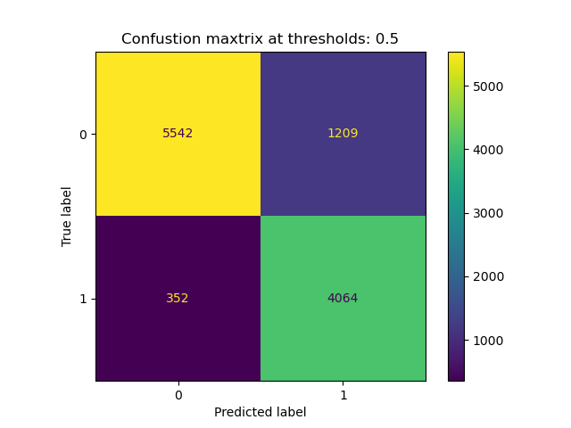

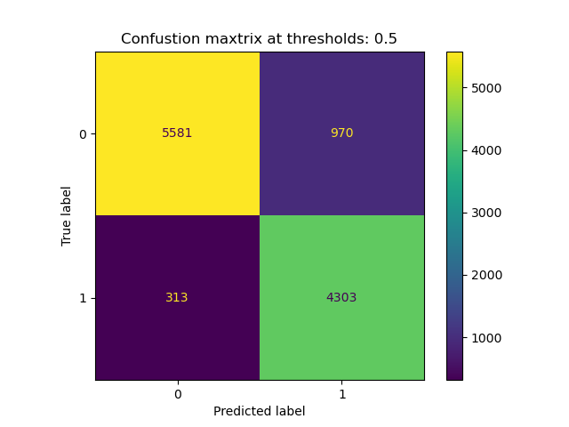
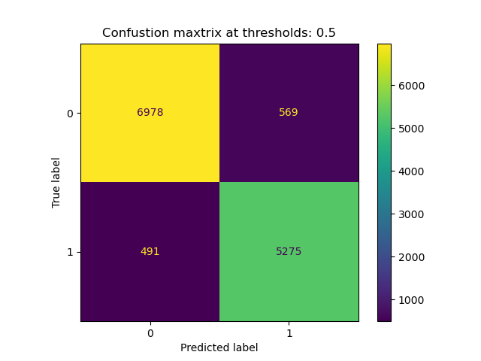
Pupil
Only
Pupil +
X + Y

Slide 10
MA

Slide 11
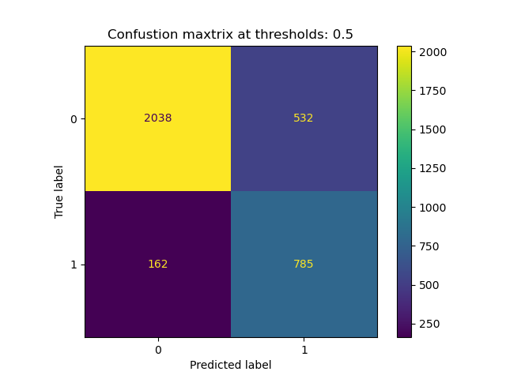
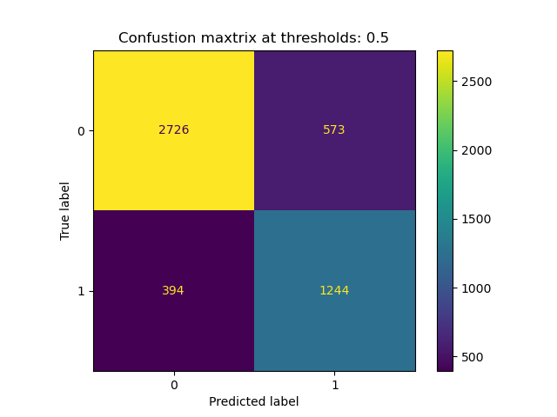
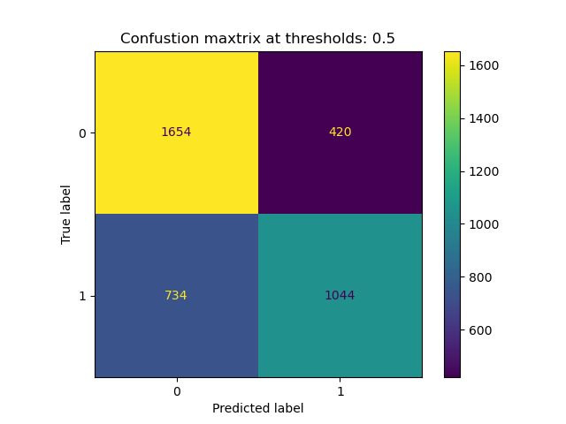



Pupil
Only
Pupil +
X + Y

Slide 12

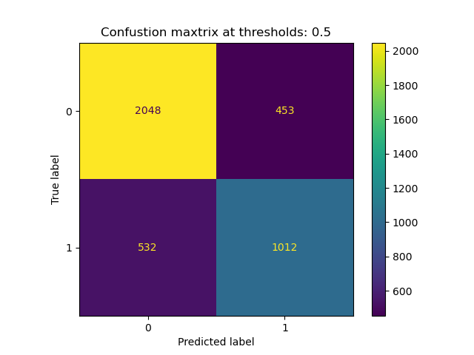

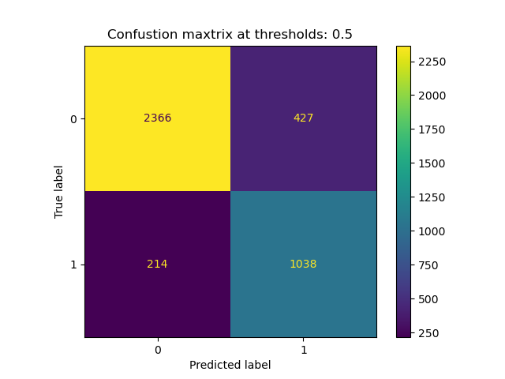
Pupil
Only
Pupil +
X + Y

Slide 13
PVT

Slide 14
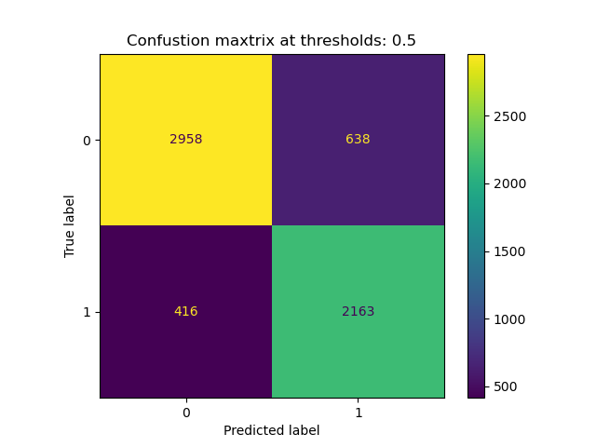
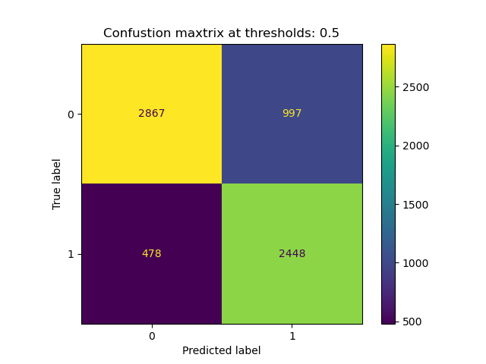


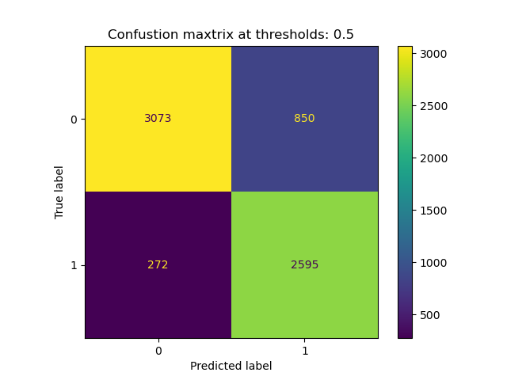

Pupil
Only
Pupil +
X + Y

Slide 15




Pupil
Only
Pupil +
X + Y

Slide 16
VWM

Slide 17
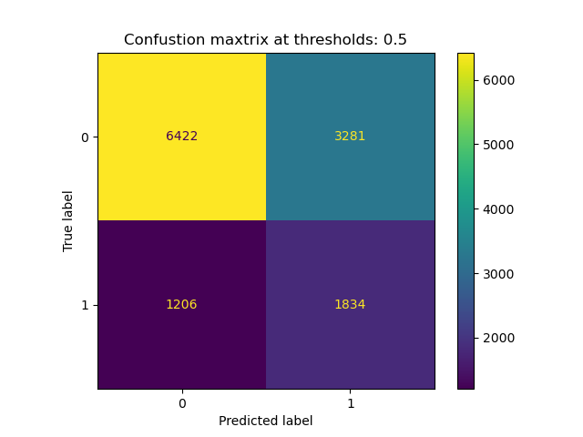
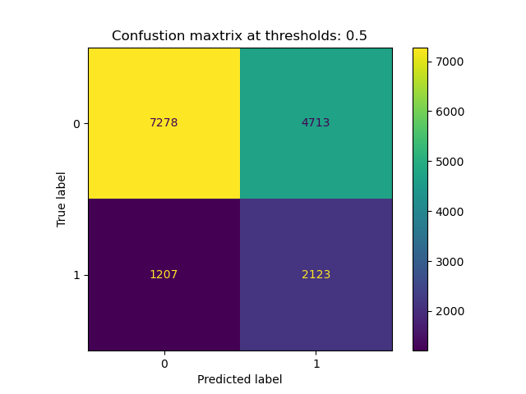
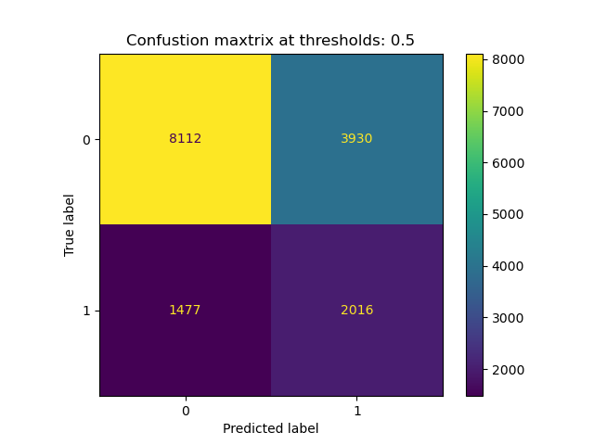
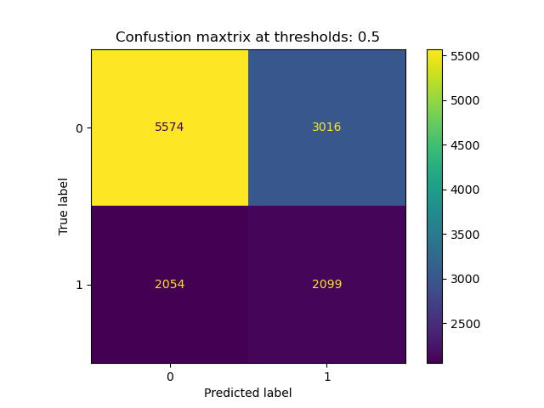

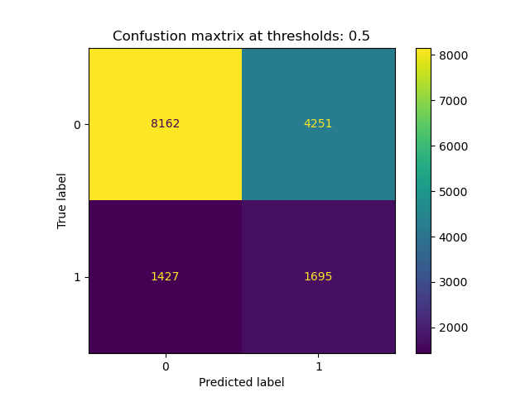
Pupil
Only
Pupil +
X + Y

Slide 18
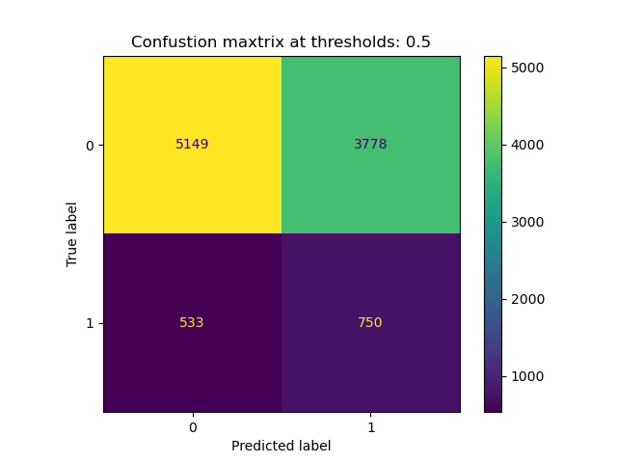
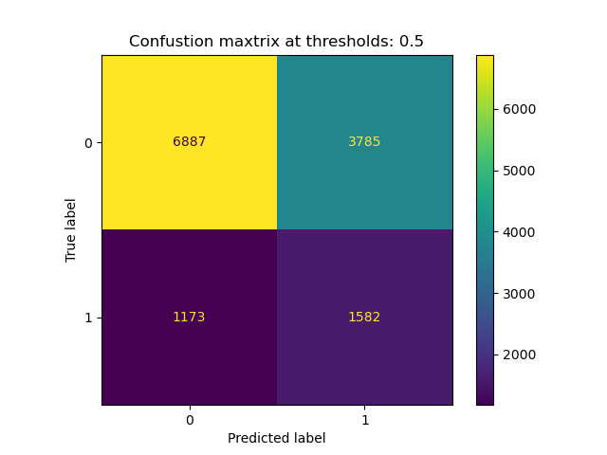
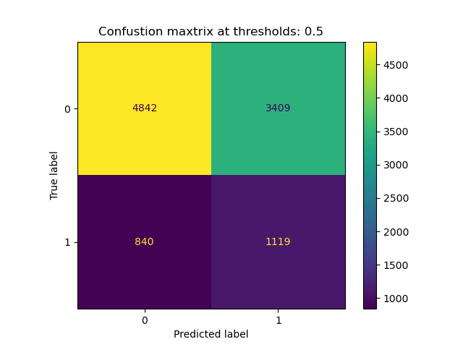

Pupil
Only
Pupil +
X + Y

