Slide 1
Overview

Slide 2
Overview
5 Data set:
All Tasks
DPT
MA
PVT
VWM
2 Models:
1D Convolution, 1 seconds (250, 3)
1D Convolution, 2 seconds (500, 3). Stimulus time is at the middle.
Metrics:
Primary: Matthew's correlation coefficient (MCC)
Secondary: Accuracy
F1

Slide 3
DPT Only. 2 seconds' model
Because the distance between two stimulus time in DPT can be as small as 3 second.
I can only sample one “0” sample for each one “1” sample.

Slide 4
DPT: 1 second
DPT: 2 seconds
Training set:
Number of positive element: 18495
The ratio: 0.441661094660426
Validation set:
Number of positive element: 4580
The ratio: 0.437440305635148
Testing set:
Number of positive element: 5844
The ratio: 0.43896942837827685
Training set:
Number of positive element: 14938
The ratio: 0.6759276018099547
Validation set:
Number of positive element: 3834
The ratio: 0.6939366515837104
Testing set:
Number of positive element: 4657
The ratio: 0.6593515503327199

Slide 5
All Tasks

Slide 6
ALL: 1 second
ALL: 2 seconds
Training set:
Number of positive element: 50243
The ratio: 0.4290276579938348
Validation set:
Number of positive element: 12498
The ratio: 0.42687342031559533
Testing set:
Number of positive element: 15598
The ratio: 0.4182890855457227
Total samples: 38,044
Training set:
Number of positive element: 39354
The ratio: 0.49525559386876744
Validation set:
Number of positive element: 9740
The ratio: 0.49028490888956006
Testing set:
Number of positive element: 11967
The ratio: 0.47306004664584733
Total samples: 25,300

Slide 7
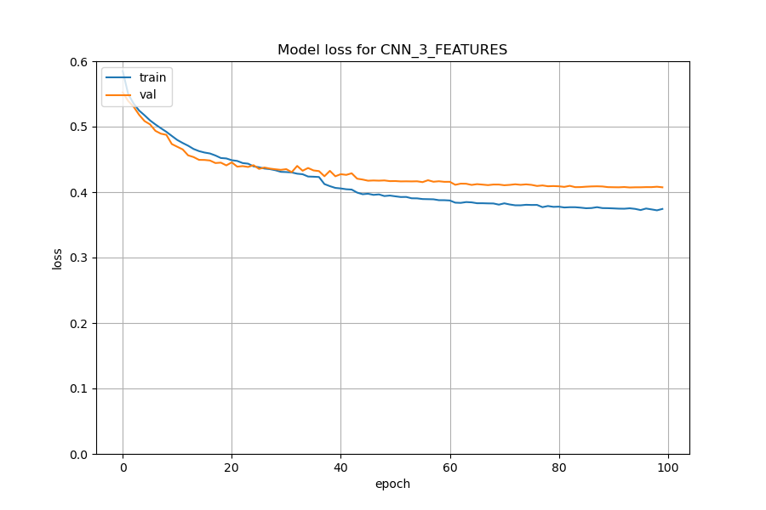
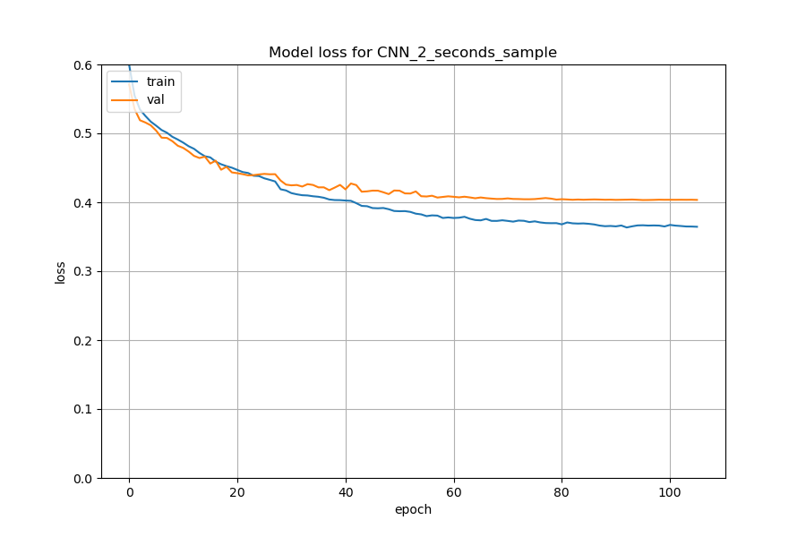
Training Loss
1 Second (250, 3)
2 Seconds (500, 3)

Slide 8
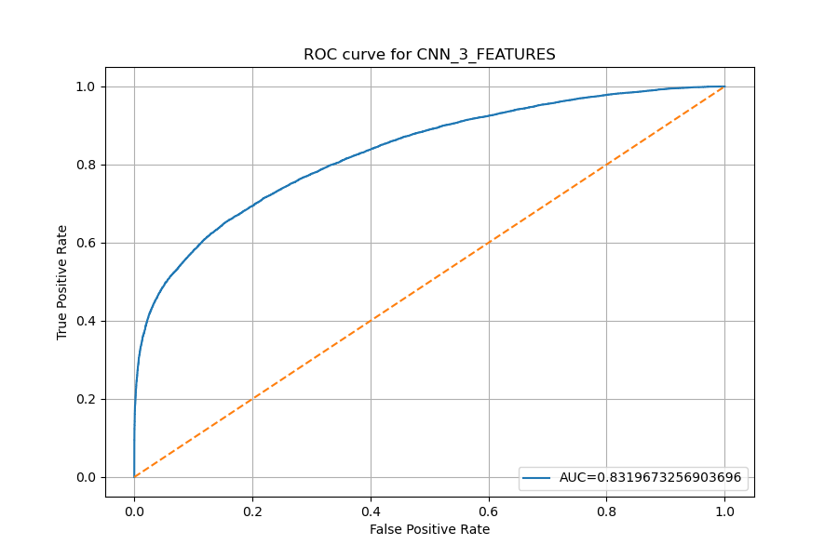
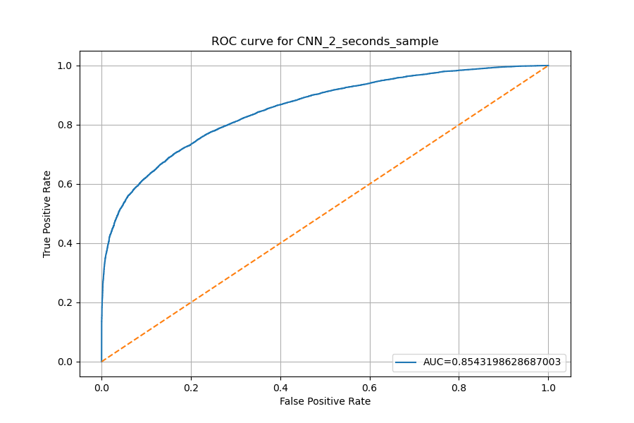
ROC Curve
1 Second (250, 3)
2 Seconds (500, 3)

Slide 9
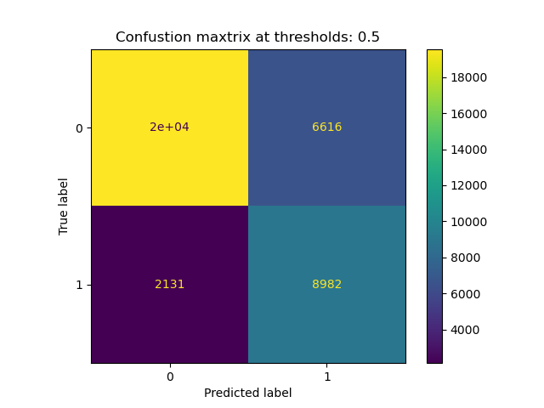
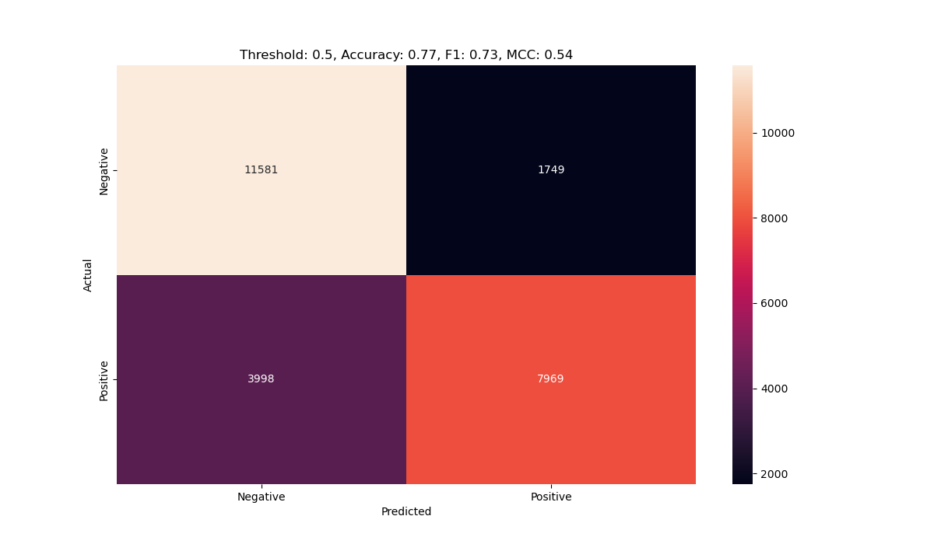
Confusion Matrix
1 Second (250, 3)
2 Seconds (500, 3)
Threshold 0.5: Accuracy: 0.77 ,F1: 0.67, MCC: 0.52
Threshold 0.5: Accuracy: 0.77 ,F1: 0.73, MCC: 0.55

Slide 10
DPT (Special)

Slide 11
DPT: 1 second
DPT: 2 seconds
Training set:
Number of positive element: 18495
The ratio: 0.441661094660426
Validation set:
Number of positive element: 4580
The ratio: 0.437440305635148
Testing set:
Number of positive element: 5844
The ratio: 0.43896942837827685
Training set:
Number of positive element: 14938
The ratio: 0.6759276018099547
Validation set:
Number of positive element: 3834
The ratio: 0.6939366515837104
Testing set:
Number of positive element: 4657
The ratio: 0.6593515503327199

Slide 12
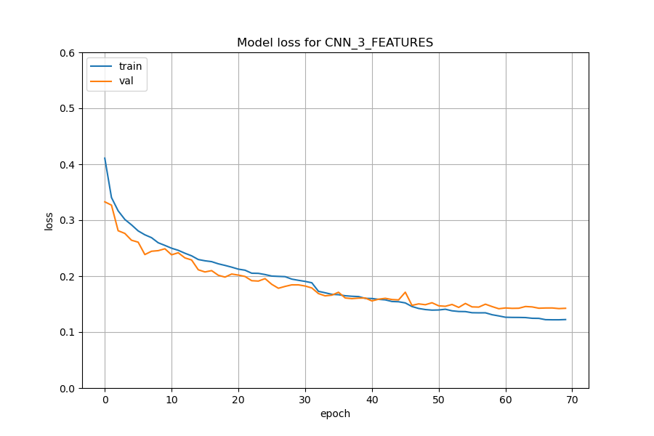
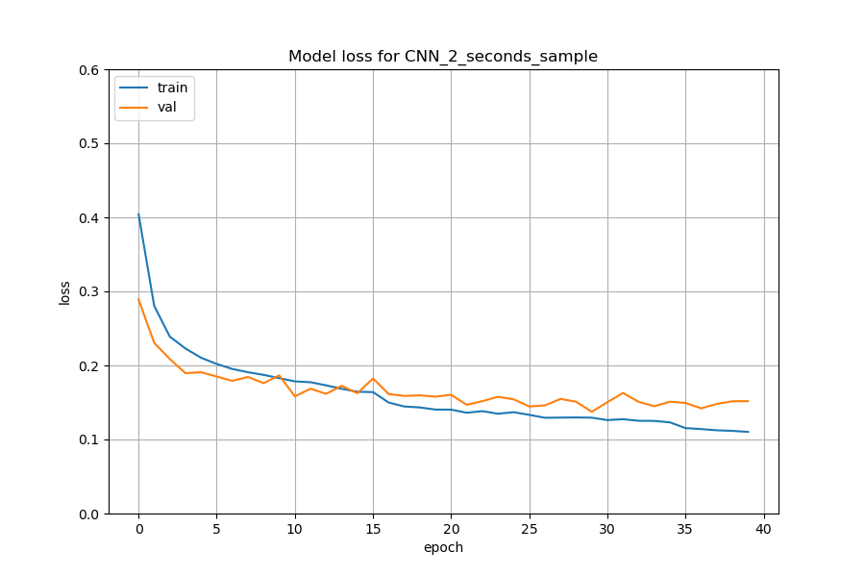
Training Loss
1 Second (250, 3)
2 Seconds (500, 3)

Slide 13
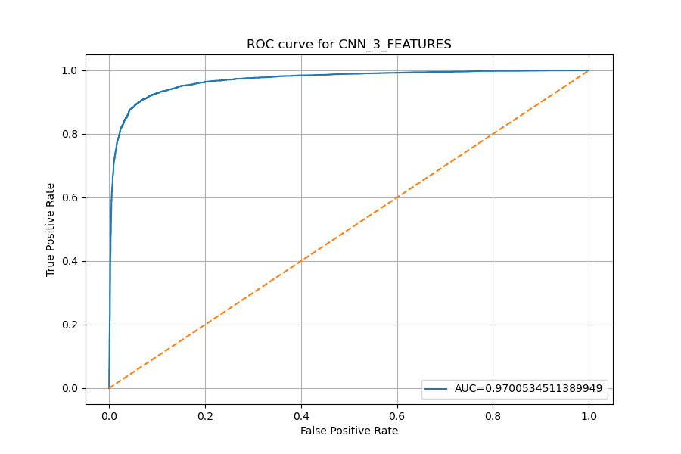
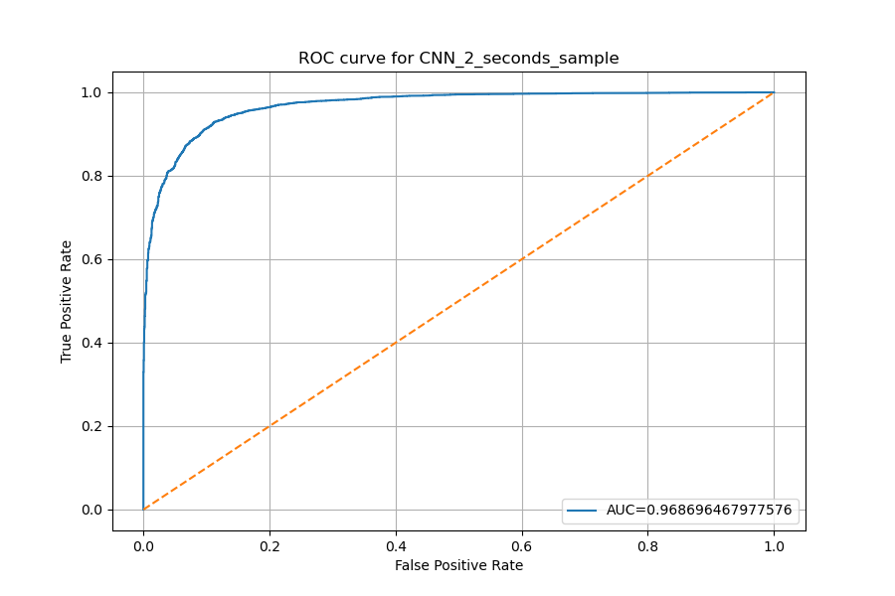
ROC Curve
1 Second (250, 3)
2 Seconds (500, 3)

Slide 14
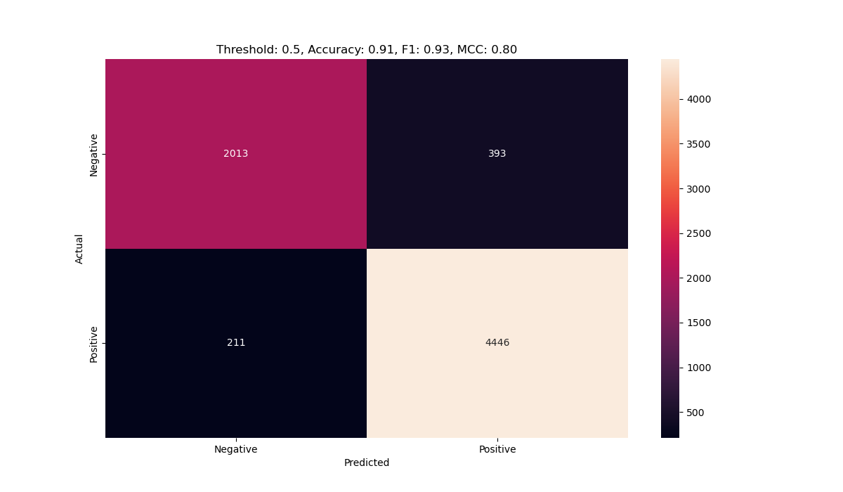
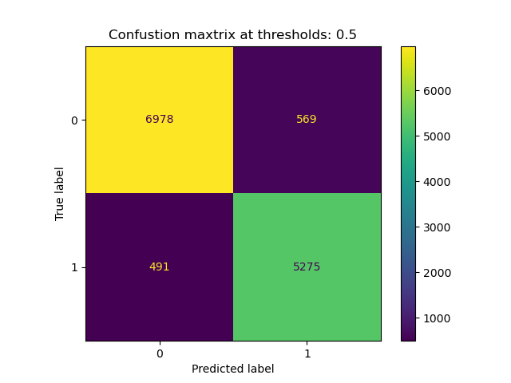
Confusion Matrix
1 Second (250, 3)
2 Seconds (500, 3)
Threshold 0.5: Accuracy: 0.92 ,F1: 0.91, MCC: 0.84
Threshold 0.5: Accuracy: 0.91 ,F1: 0.94, MCC: 0.81

Slide 15
MA

Slide 16
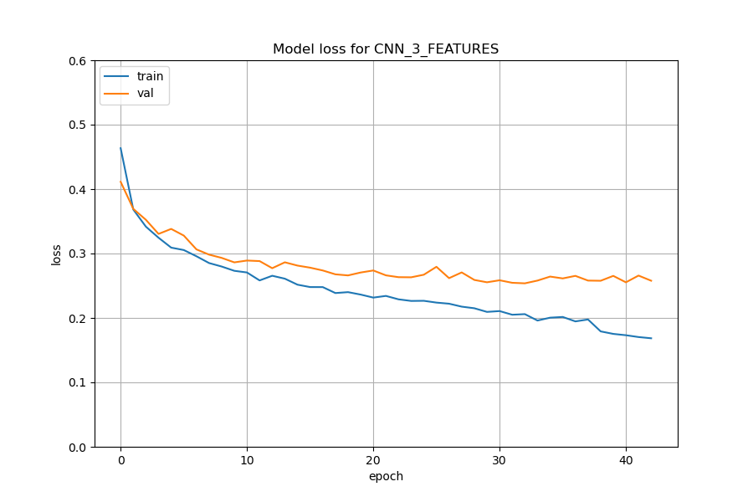
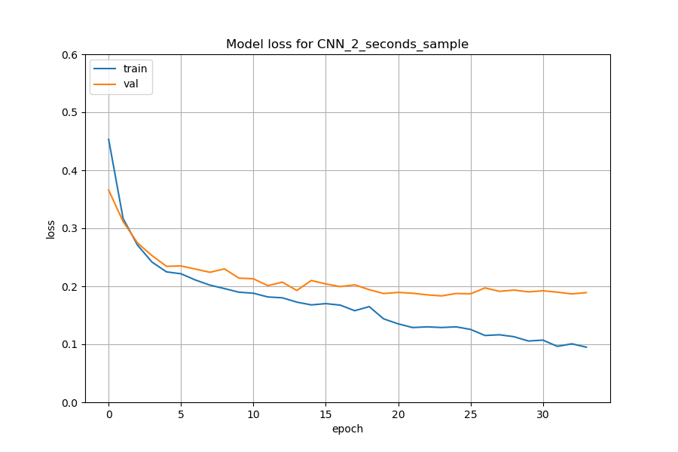
Training Loss
1 Second (250, 3)
2 Seconds (500, 3)

Slide 17
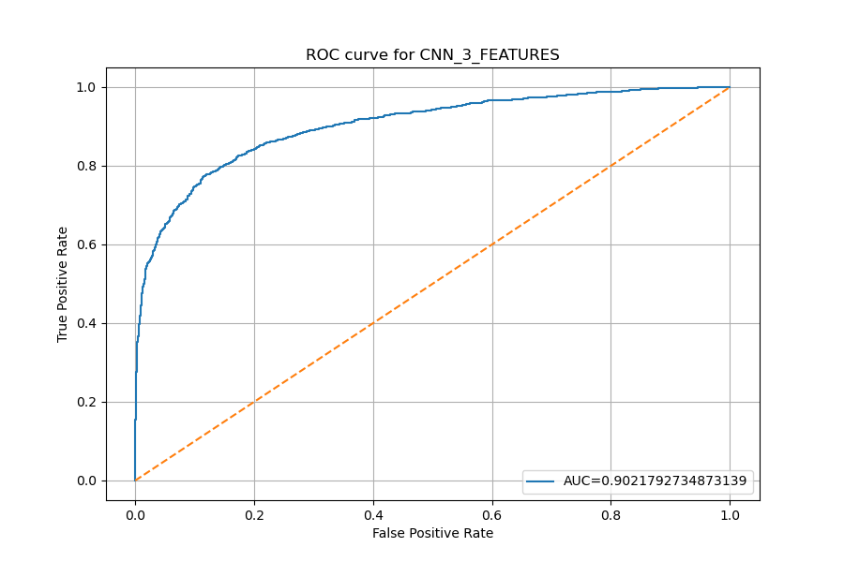
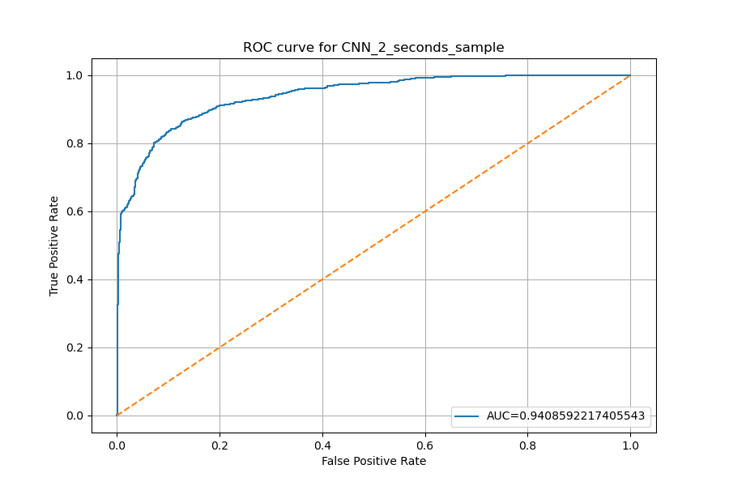
ROC Curve
1 Second (250, 3)
2 Seconds (500, 3)

Slide 18
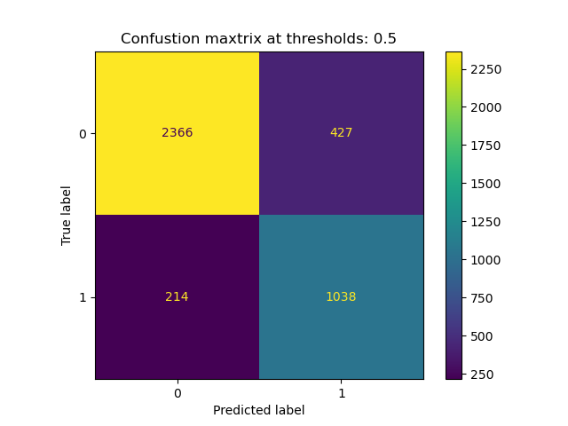
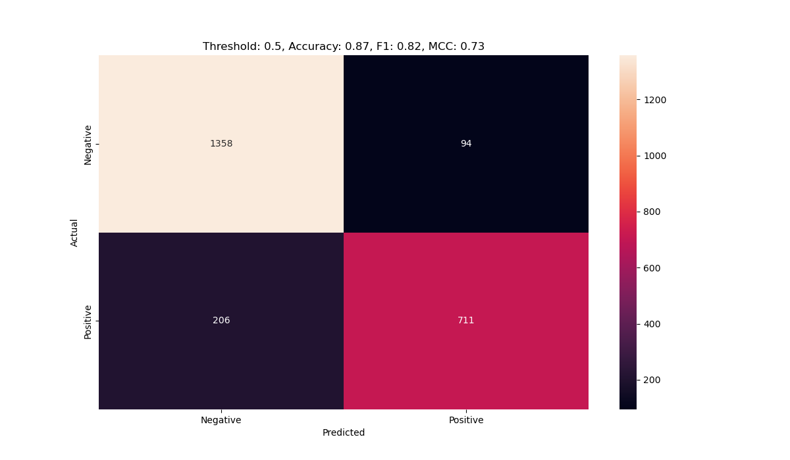
Confusion Matrix
1 Second (250, 3)
2 Seconds (500, 3)
Threshold 0.5: Accuracy: 0.84 ,F1: 0.76, MCC: 0.65
Threshold 0.5: Accuracy: 0.87 ,F1: 0.83, MCC: 0.73

Slide 19
PVT

Slide 20
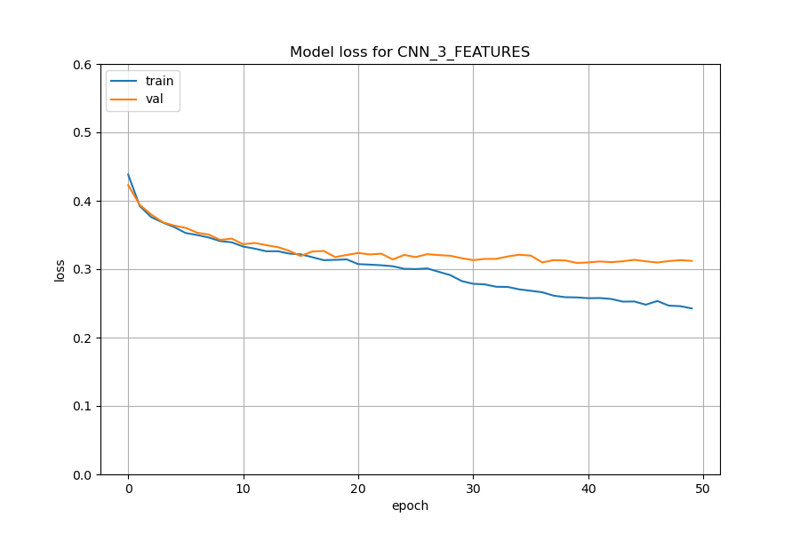
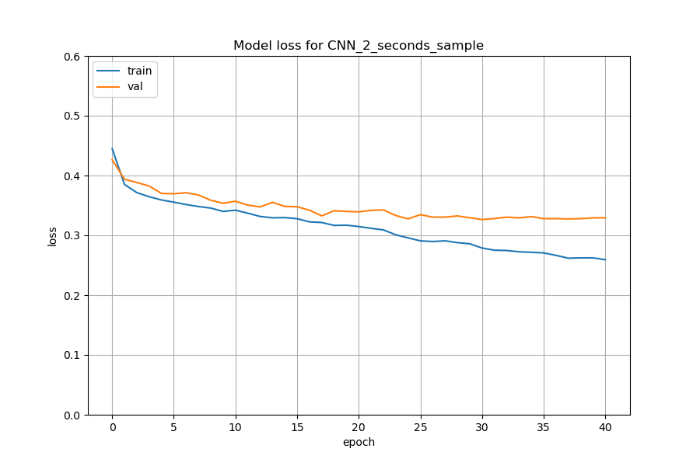
Training Loss
1 Second (250, 3)
2 Seconds (500, 3)

Slide 21
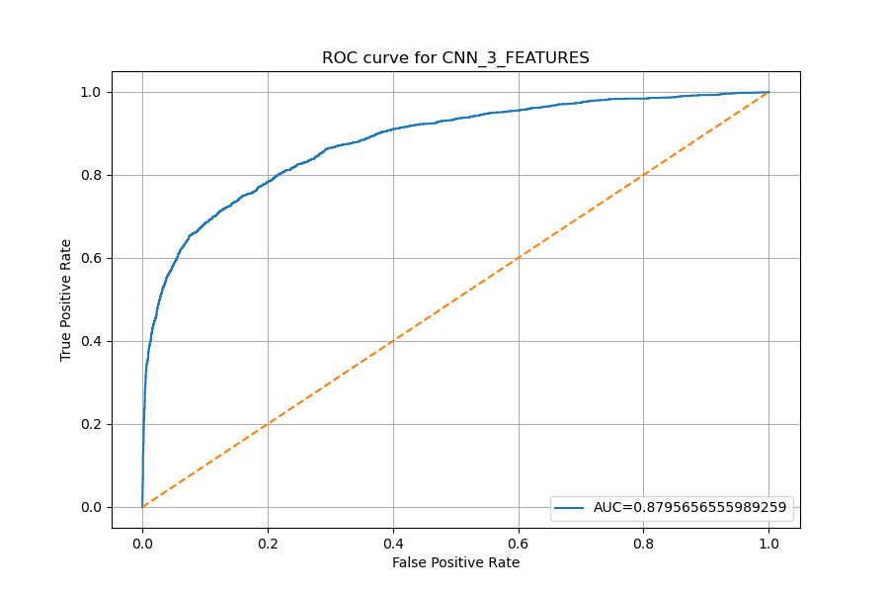
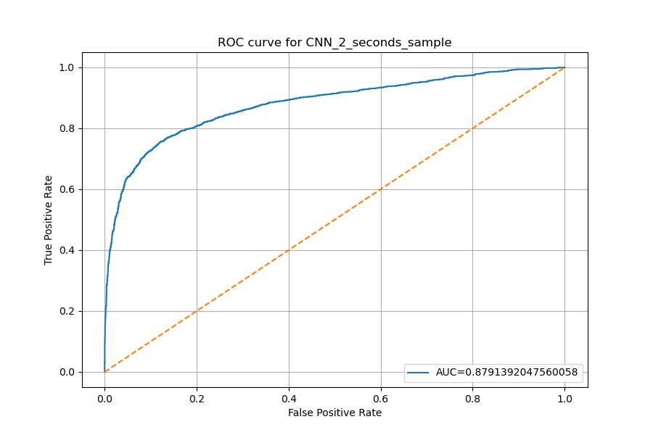
ROC Curve
1 Second (250, 3)
2 Seconds (500, 3)

Slide 22

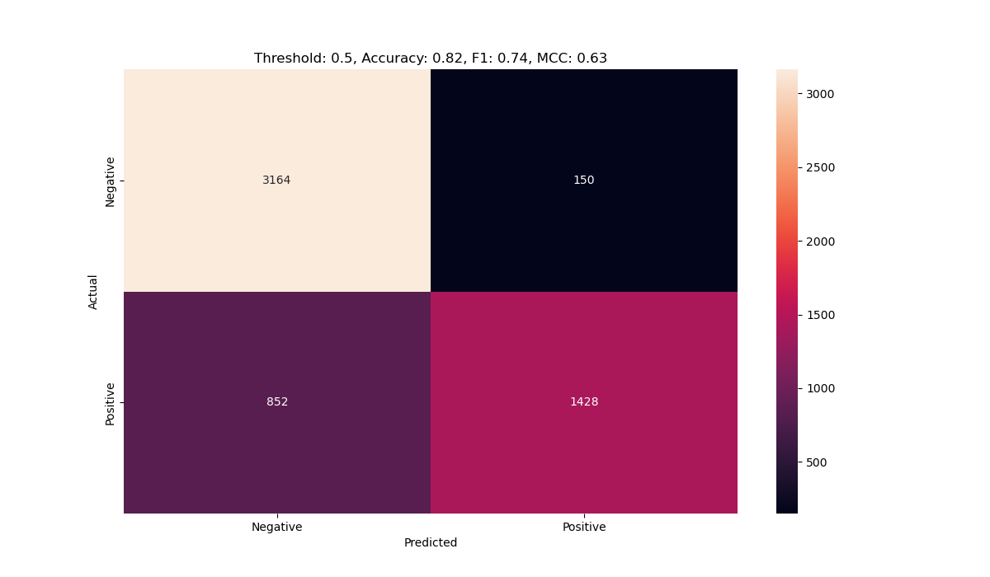
Confusion Matrix
1 Second (250, 3)
2 Seconds (500, 3)
Threshold 0.5: Accuracy: 0.80 ,F1: 0.76, MCC: 0.60
Threshold 0.5: Accuracy: 0.82 ,F1: 0.74, MCC: 0.63

Slide 23
VWM

Slide 24
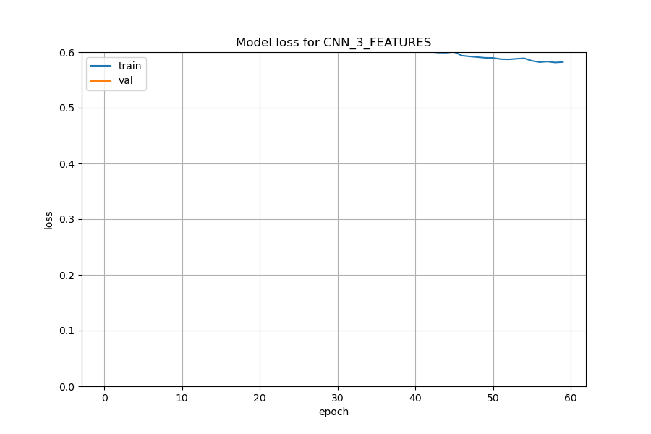
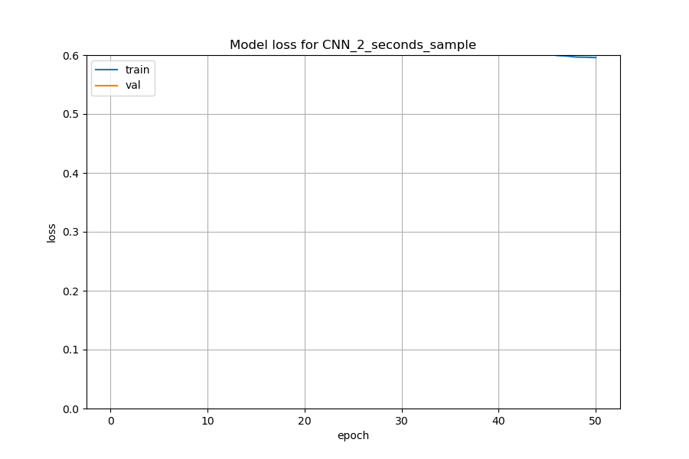
Training Loss
1 Second (250, 3)
2 Seconds (500, 3)

Slide 25
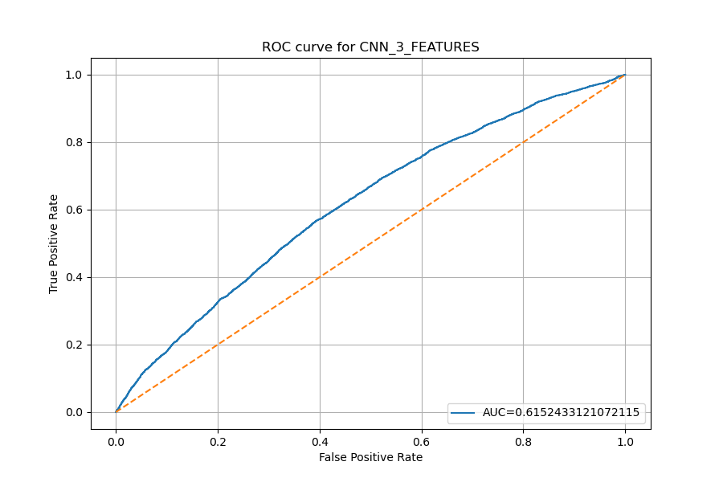
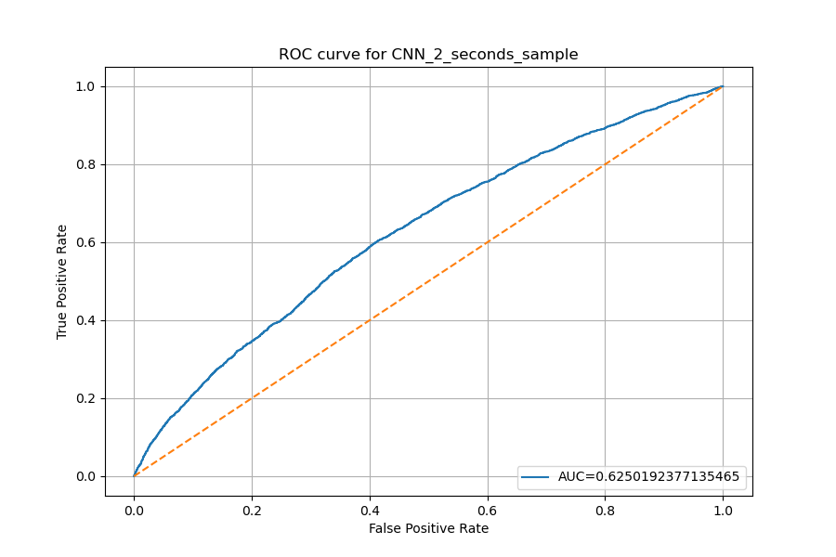
ROC Curve
1 Second (250, 3)
2 Seconds (500, 3)

Slide 26
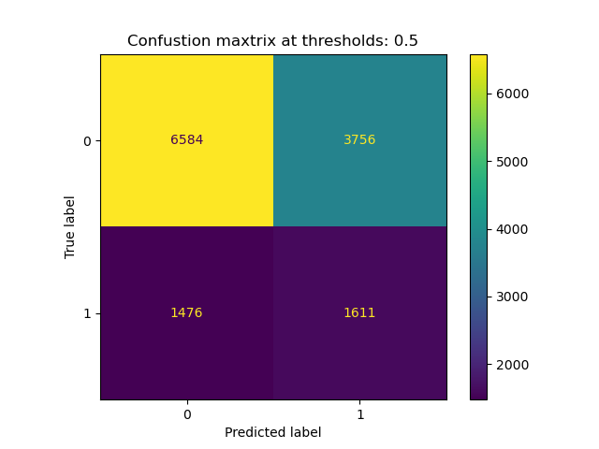
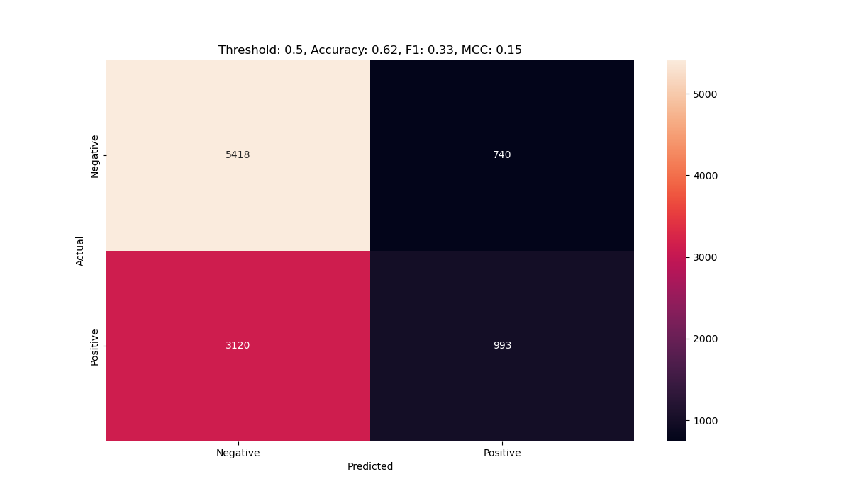
Confusion Matrix
1 Second (250, 3)
2 Seconds (500, 3)
Threshold 0.5: Accuracy: 0.61 ,F1: 0.38, MCC: 0.14
Threshold 0.5: Accuracy: 0.62 ,F1: 0.34, MCC: 0.16

Slide 27
Summary

Slide 28
Hypothesis
MA is the only improvement.
Other tasks mostly the same.

