Slide 1
Overview

Slide 2
Overview
5 Data set:
All Tasks
DPT
MA
PVT
VWM
2 Models:
1D Convolution, 3 features (250, 3)
1D Convolution, pupil only (250, 1)
Metrics:
Primary: Matthew's correlation coefficient (MCC)
Secondary: Accuracy
F1

Slide 3
Fold 0:
Train_subjests: index=[12 13 14 15 16 17 18 19 20 21 22 23 24 25 26 27 28 29 30 31 32 33 34 35 36 37 38 39 40 41 42 43 44 45 46 47 48 49 50 51 52 53 54 55 56 57]
Test_subjests: index=[ 0 1 2 3 4 5 6 7 8 9 10 11]
Fold 1:
Train_subjests: index=[ 0 1 2 3 4 5 6 7 8 9 10 11 24 25 26 27 28 29 30 31 32 33 34 35 36 37 38 39 40 41 42 43 44 45 46 47 48 49 50 51 52 53 54 55 56 57]
Test_subjests: index=[12 13 14 15 16 17 18 19 20 21 22 23]
Fold 2:
Train_subjests: index=[ 0 1 2 3 4 5 6 7 8 9 10 11 12 13 14 15 16 17 18 19 20 21 22 23 36 37 38 39 40 41 42 43 44 45 46 47 48 49 50 51 52 53 54 55 56 57]
Test_subjests: index=[24 25 26 27 28 29 30 31 32 33 34 35]
Fold 3:
Train_subjests: index=[ 0 1 2 3 4 5 6 7 8 9 10 11 12 13 14 15 16 17 18 19 20 21 22 23 24 25 26 27 28 29 30 31 32 33 34 35 47 48 49 50 51 52 53 54 55 56 57]
Test_subjests: index=[36 37 38 39 40 41 42 43 44 45 46]
Fold 4:
Train_subjests: index=[ 0 1 2 3 4 5 6 7 8 9 10 11 12 13 14 15 16 17 18 19 20 21 22 23 24 25 26 27 28 29 30 31 32 33 34 35 36 37 38 39 40 41 42 43 44 45 46]
Test_subjests: index=[47 48 49 50 51 52 53 54 55 56 57]

Slide 4
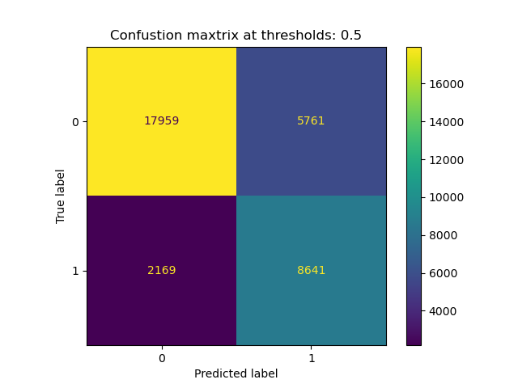
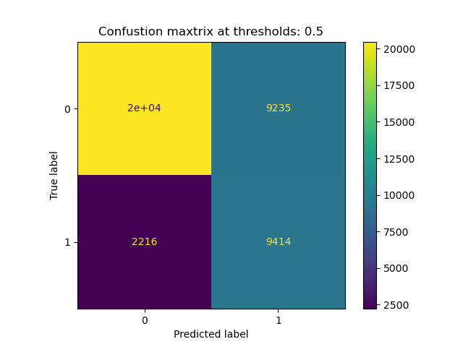

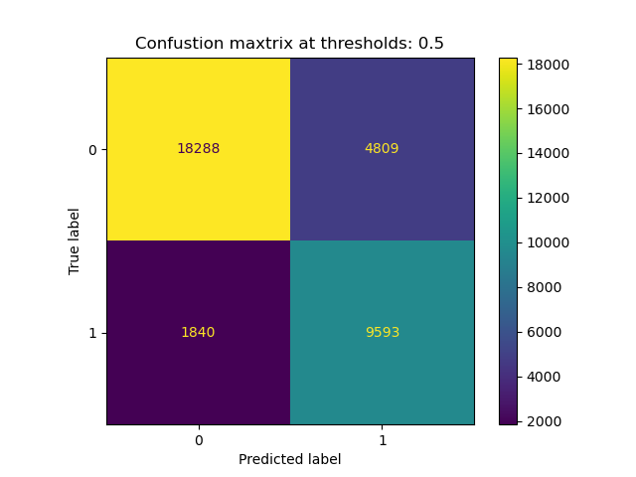
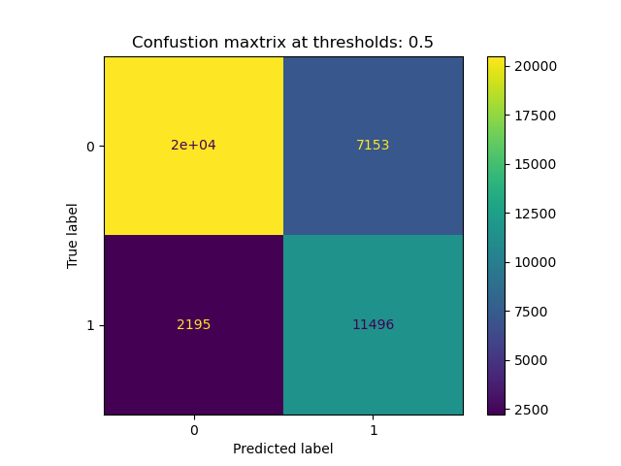
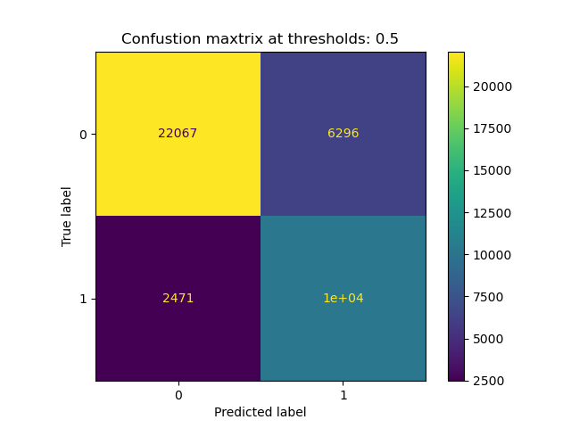
Pupil
Only
Pupil +
X + Y

Slide 5
All Tasks

Slide 6
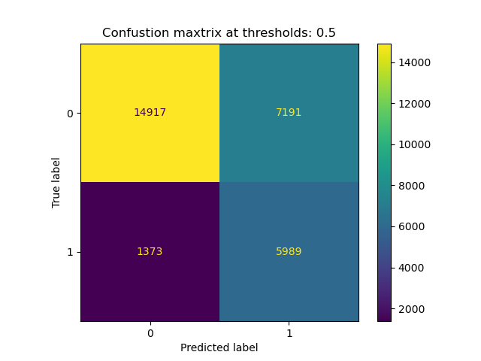
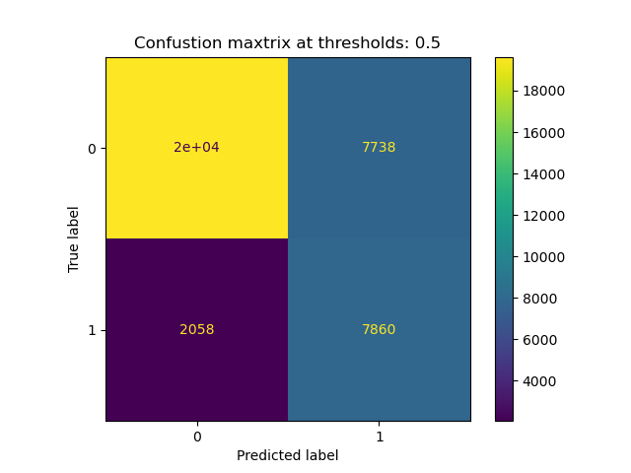


Pupil
Only
Pupil +
X + Y

Slide 7
DPT

Slide 8
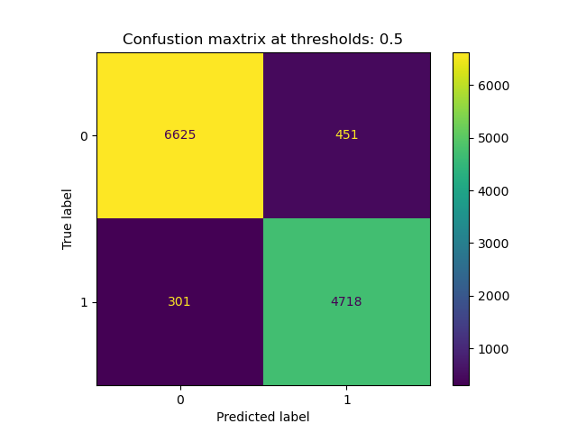
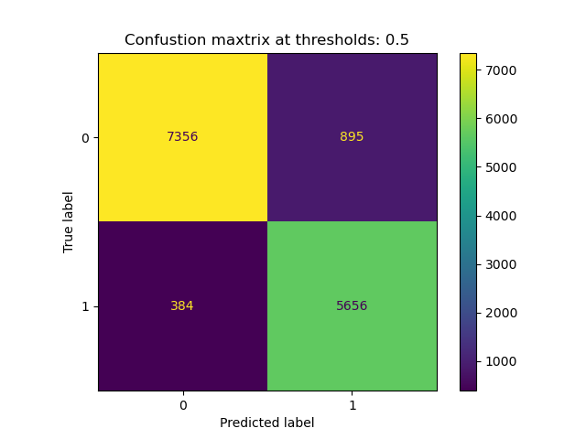
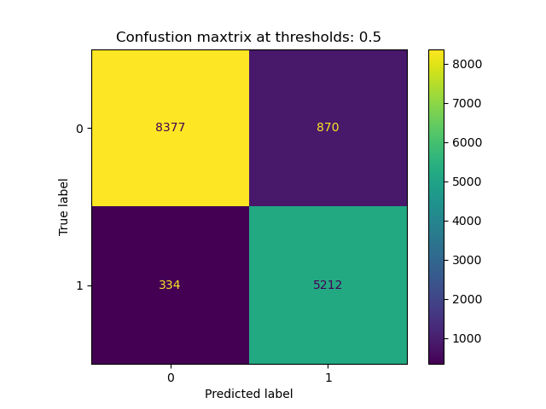


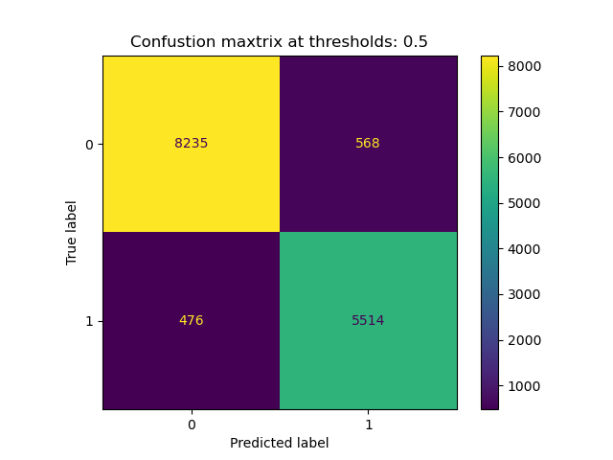
Pupil
Only
Pupil +
X + Y

Slide 9
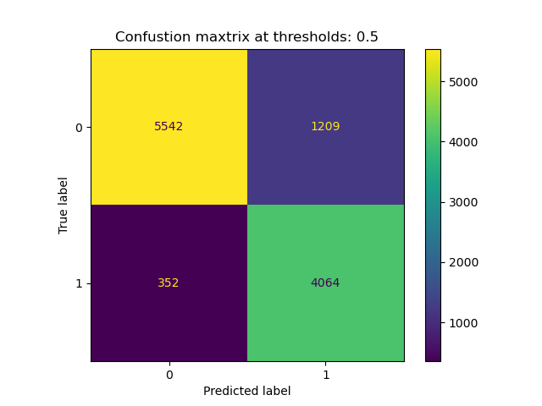

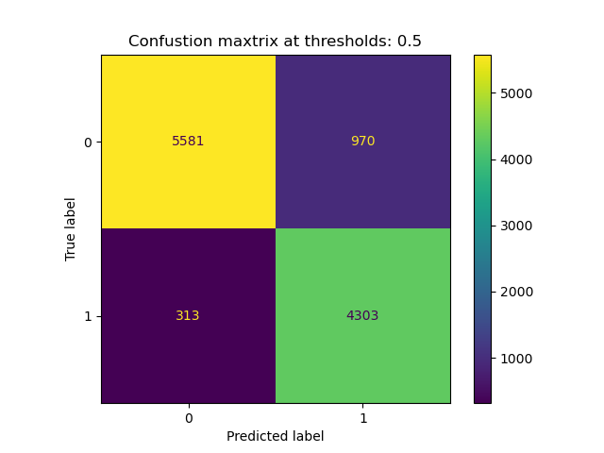
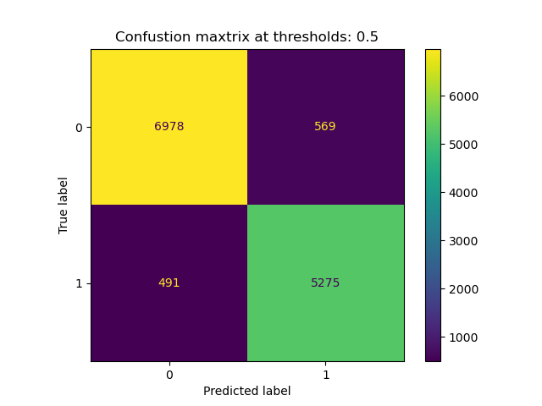
Pupil
Only
Pupil +
X + Y

Slide 10
MA

Slide 11
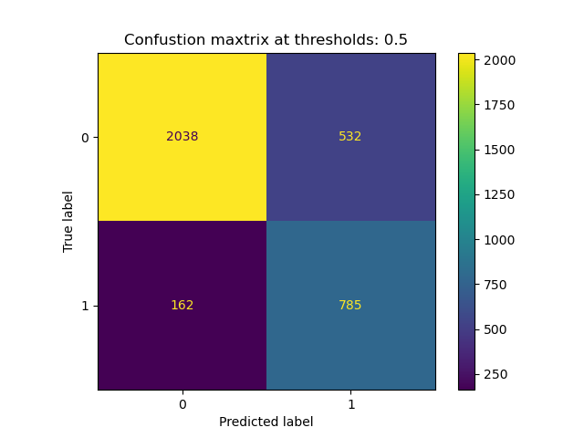
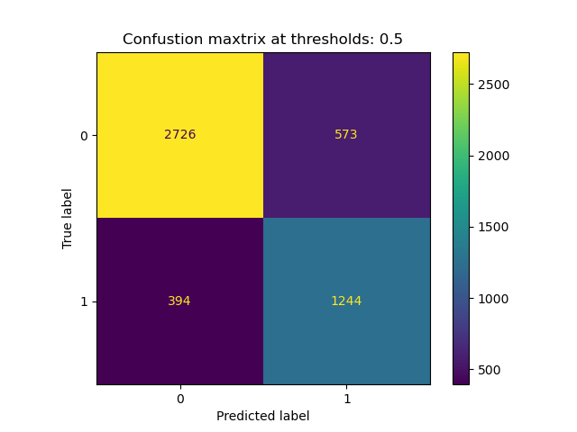
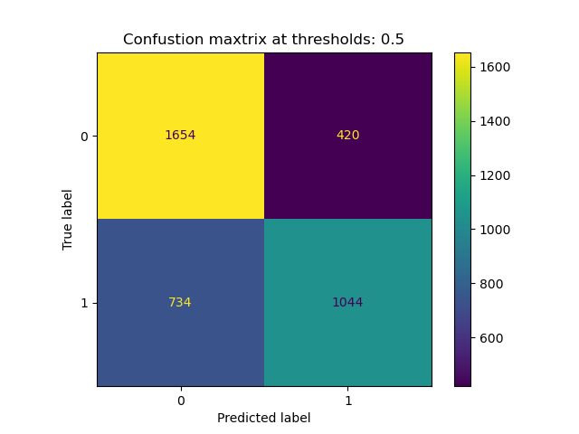



Pupil
Only
Pupil +
X + Y

Slide 12

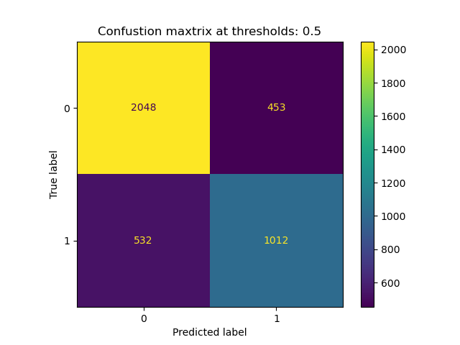

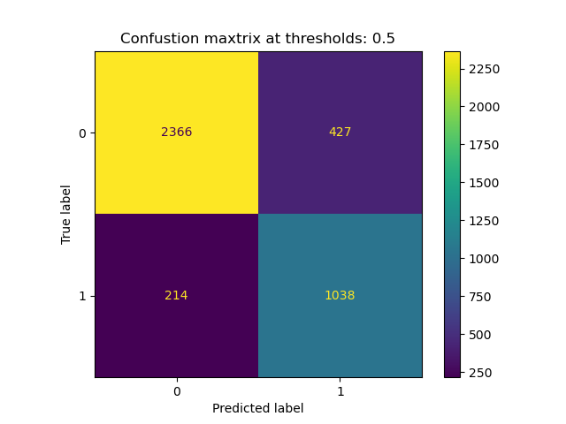
Pupil
Only
Pupil +
X + Y

Slide 13
PVT

Slide 14
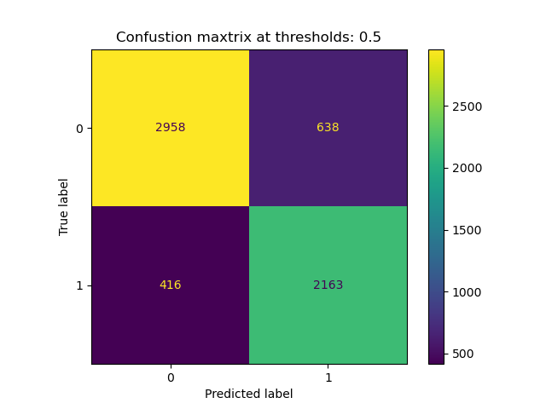
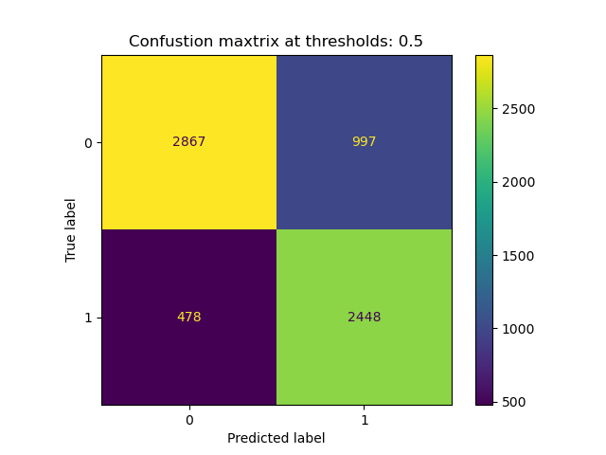


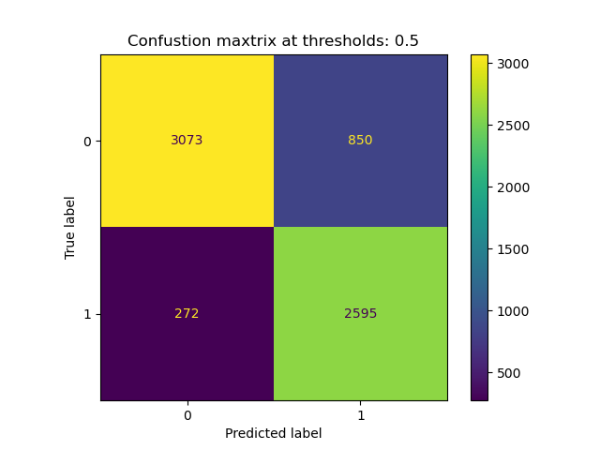

Pupil
Only
Pupil +
X + Y

Slide 15




Pupil
Only
Pupil +
X + Y

Slide 16
VWM

Slide 17
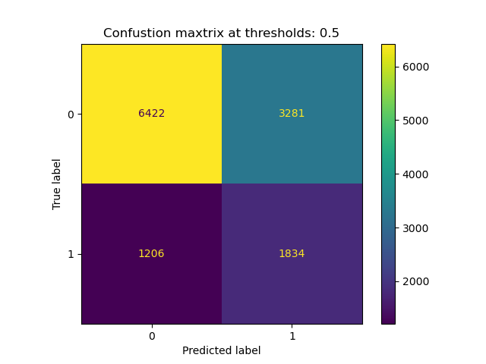
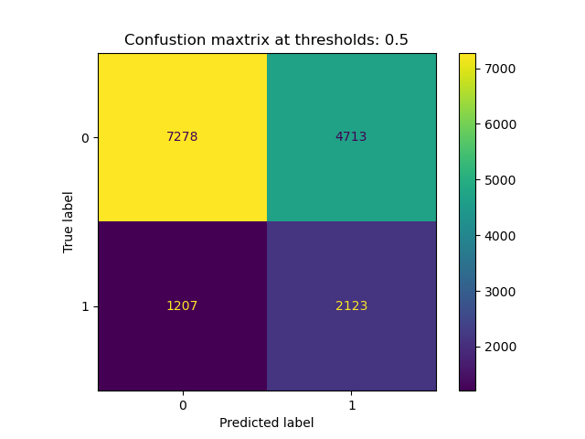
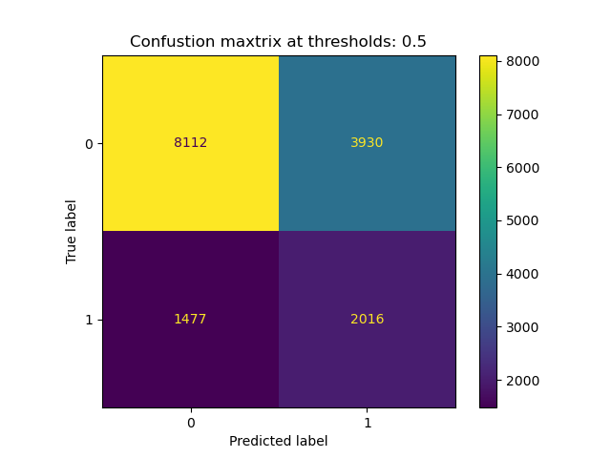
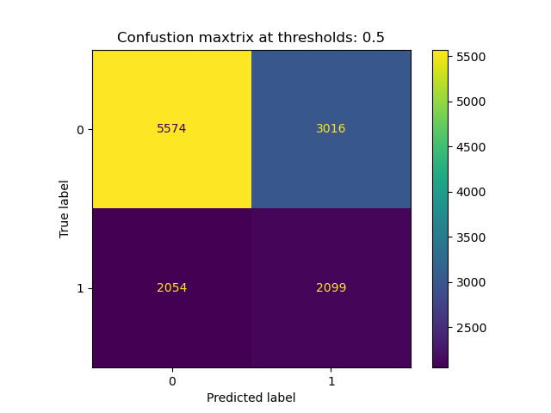

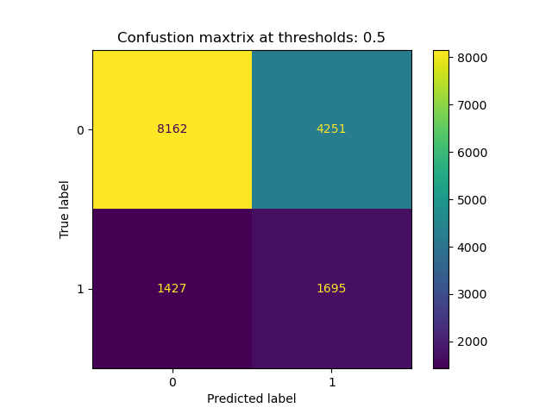
Pupil
Only
Pupil +
X + Y

Slide 18
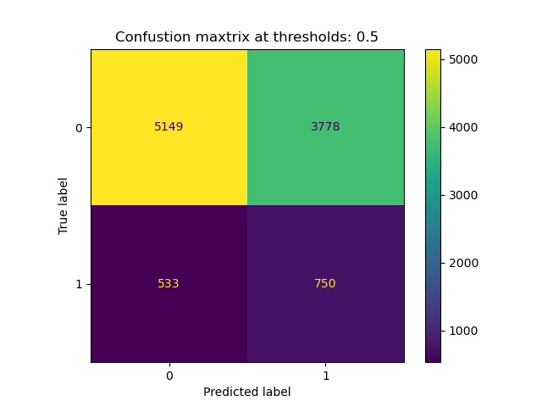
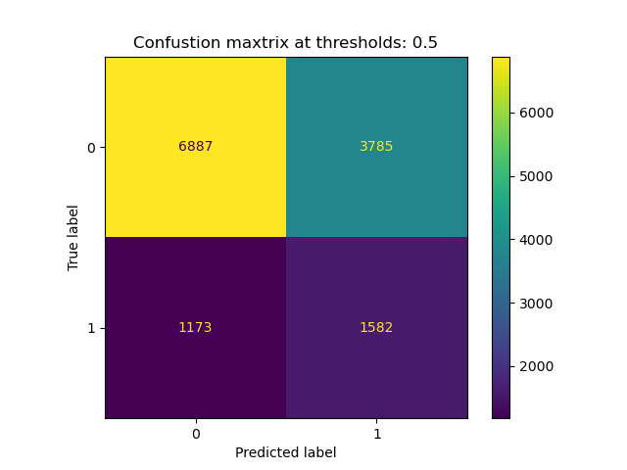
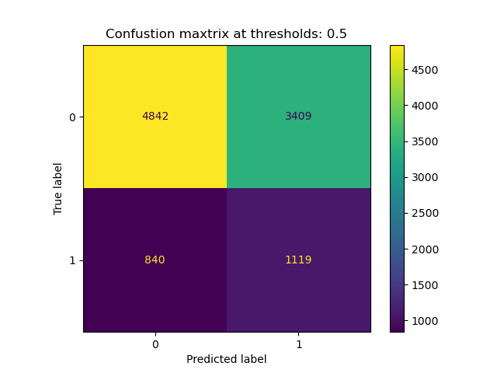

Pupil
Only
Pupil +
X + Y

Slide 19
F1 Score Comparison.
Run | Task | Pupil Only | Pupil + X + Y | Run | Task | Pupil Only | Pupil + X + Y | Run | Task | Pupil Only | Pupil + X + Y
0 | DPT | 0.93 | 0.94 | 0 | PVT | 0.80 | 0.87 | 0 | All Tasks | 0.69 | 0.74
1 | DPT | 0.91 | 0.92 | 1 | PVT | 0.77 | 0.82 | 1 | All Tasks | 0.62 | 0.71
2 | DPT | 0.92 | 0.91 | 2 | PVT | 0.75 | 0.76 | 2 | All Tasks | 0.64 | 0.70
3 | DPT | 0.84 | 0.87 | 3 | PVT | 0.74 | 0.80 | 3 | All Tasks | 0.58 | 0.69
4 | DPT | 0.89 | 0.91 | 4 | PVT | 0.77 | 0.76 | 4 | All Tasks | 0.62 | 0.67
Ave | DPT | 0.90 | 0.91 | Ave | PVT | 0.77 | 0.80 | Ave | All Tasks | 0.63 | 0.70
0 | MA | 0.69 | 0.83 | 0 | VWM | 0.45 | 0.45
1 | MA | 0.72 | 0.84 | 1 | VWM | 0.42 | 0.43
2 | MA | 0.64 | 0.80 | 2 | VWM | 0.43 | 0.37
3 | MA | 0.71 | 0.85 | 3 | VWM | 0.26 | 0.34
4 | MA | 0.67 | 0.76 | 4 | VWM | 0.39 | 0.38
Ave | MA | 0.69 | 0.82 | Ave | VWM | 0.39 | 0.39 | Ave | Total | 0.67 | 0.72

