Slide 1
Histogram for ECG features

Slide 2
Overview
Resting baseline: 4 mins
Samples: 30 seconds

Slide 3
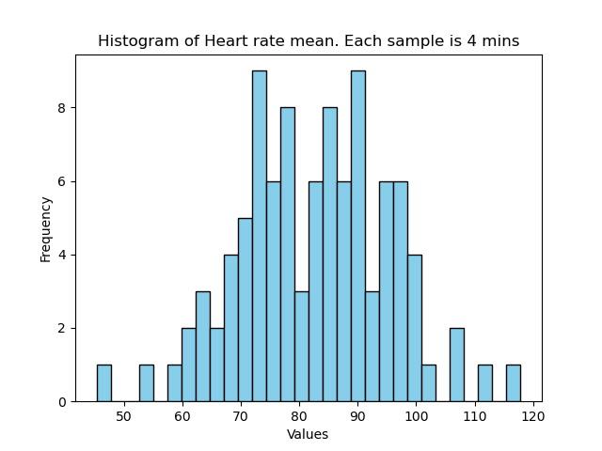
Heart Rate mean

Slide 4
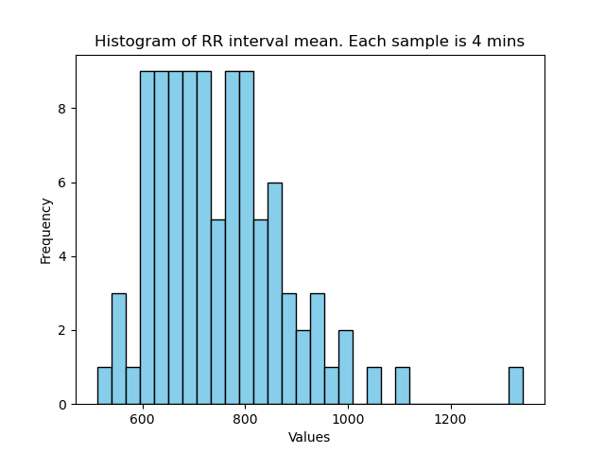
Mean RR interval

Slide 5
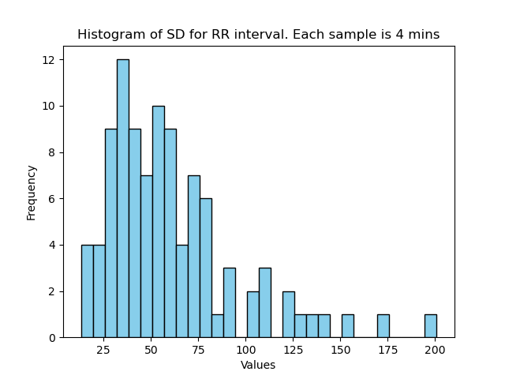
Standard Deviation RR interval

Slide 6
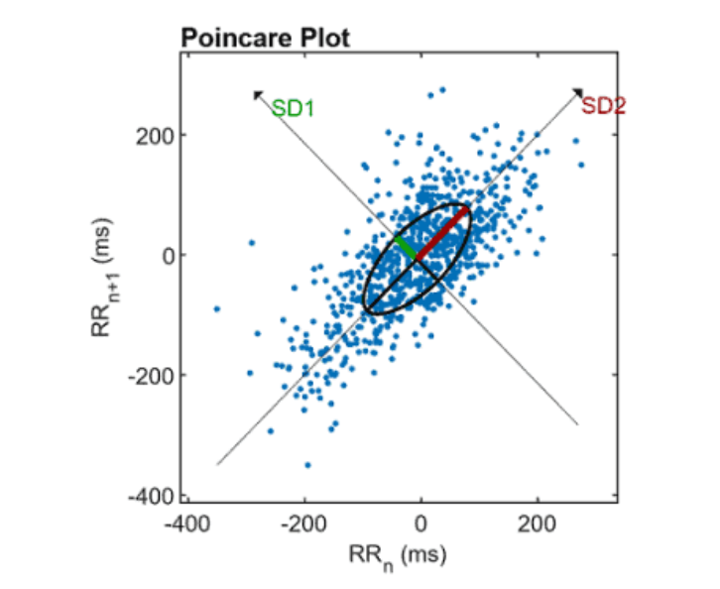
SD1 and SD2

Slide 7
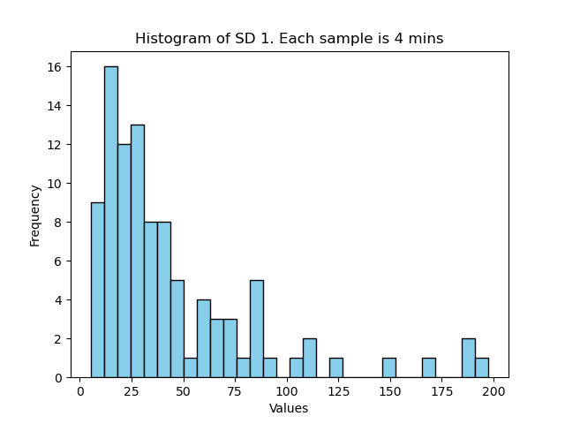
SD1

Slide 8
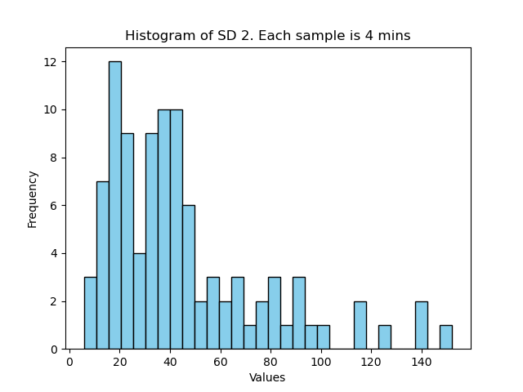
SD2

Slide 9
Frequency Power
VLF power: 0.0033 – 0.04 Hz
LF power: 0.04 - 0.15 Hz
HF power: 0.15 – 0.5 Hz

Slide 10
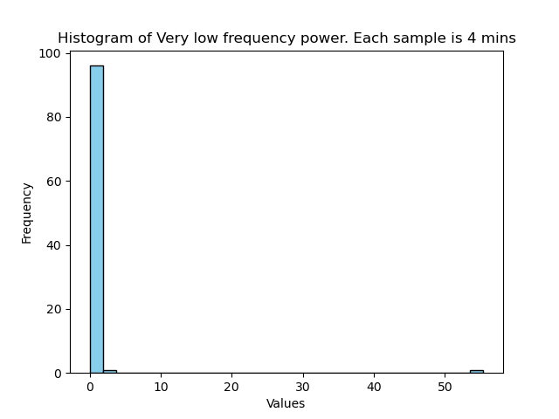
Very low Frequency power

Slide 11
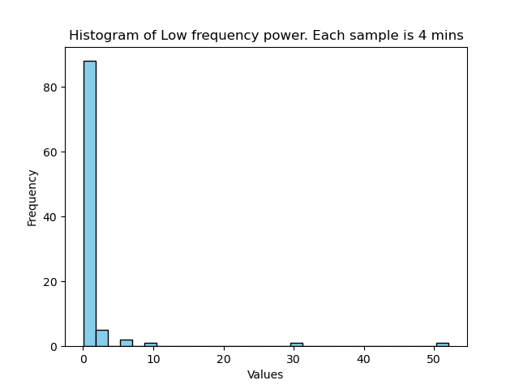
Low Frequency Power

Slide 12
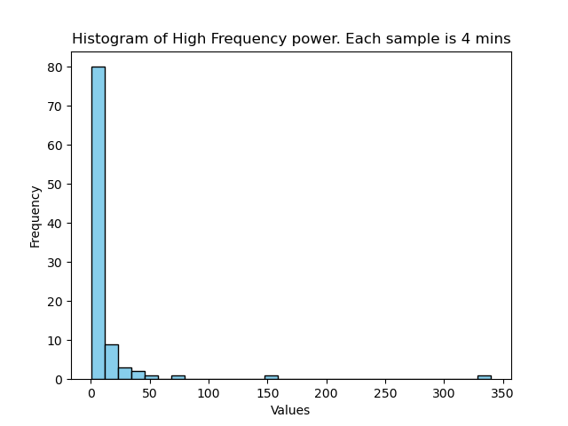
High Frequency power

Slide 13
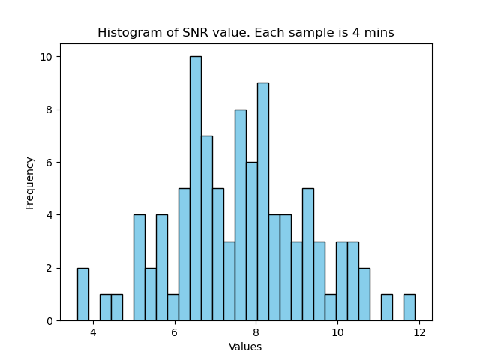
SNR value

Slide 14
Samples: 30 seconds

Slide 15
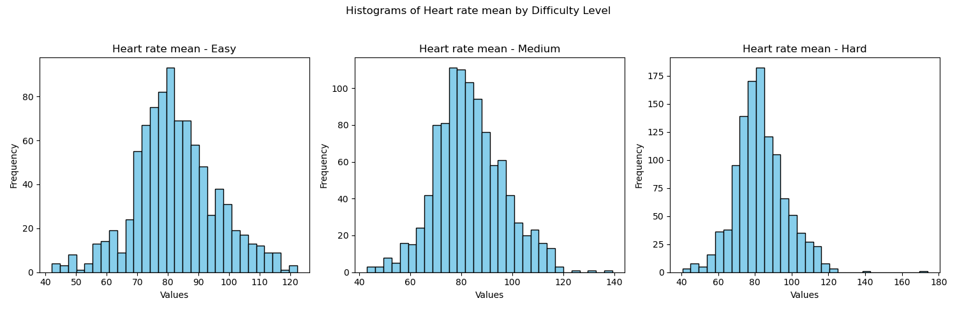
Heart Rate mean

Slide 16
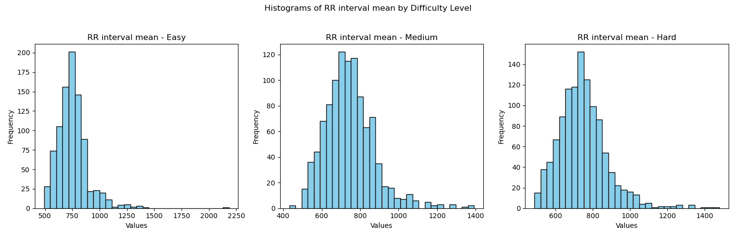
Mean RR interval

Slide 17
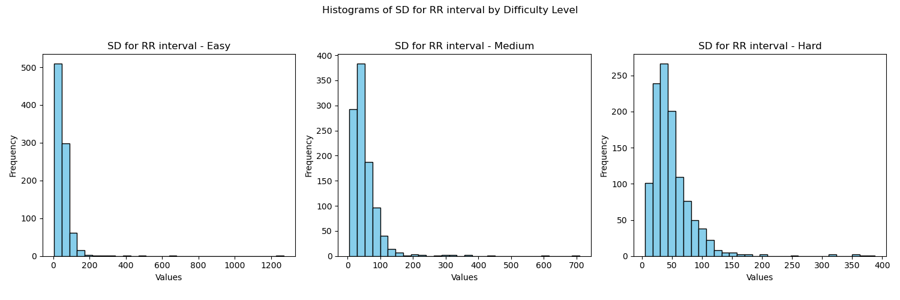
Standard Deviation RR interval

Slide 18
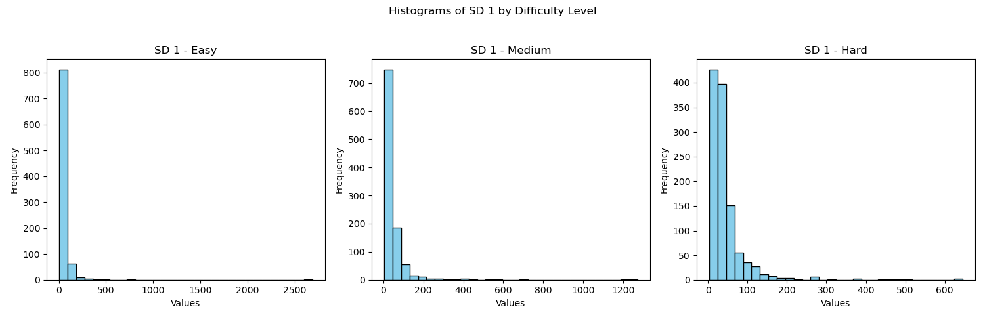
SD1

Slide 19
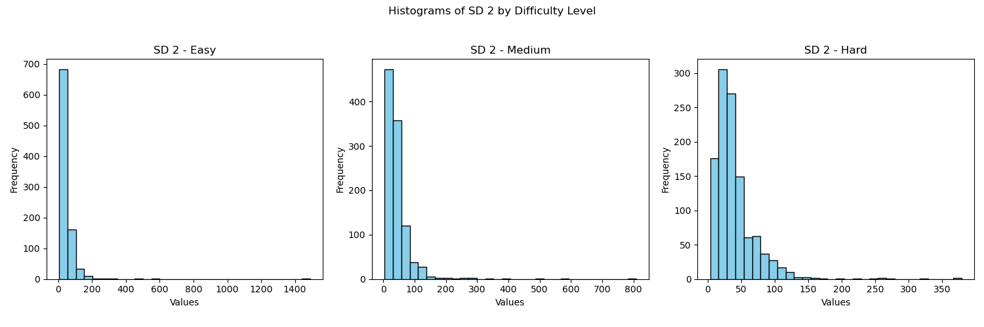
SD2

Slide 20
Frequency Power
VLF power: 0.0033 – 0.04 Hz
LF power: 0.04 - 0.15 Hz
HF power: 0.15 – 0.5 Hz

Slide 21
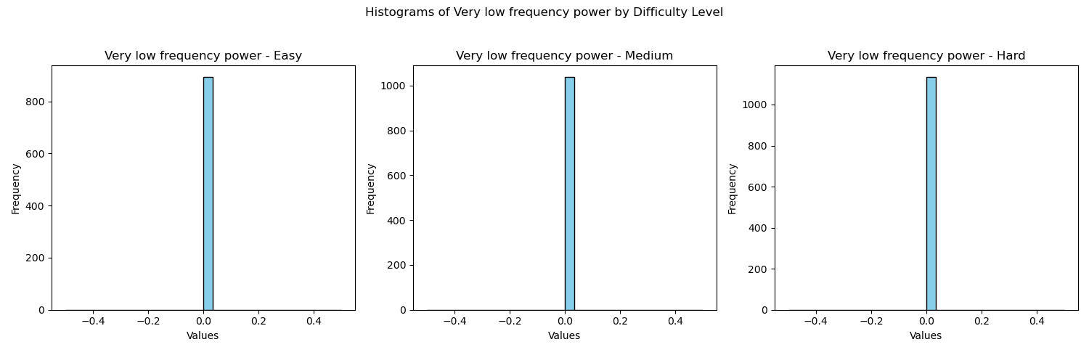
Very low Frequency power

Slide 22
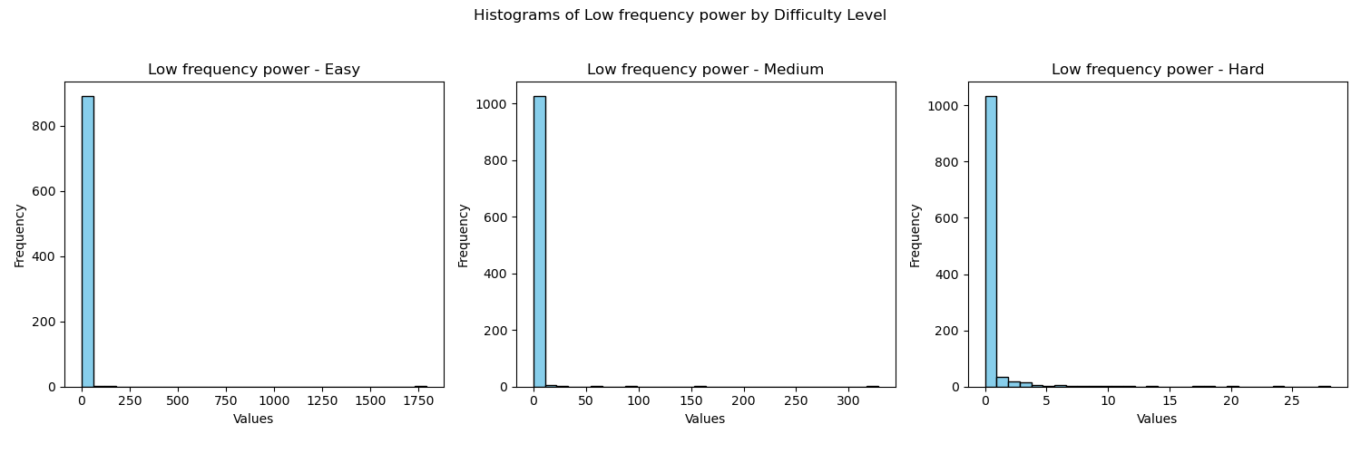
Low Frequency Power

Slide 23
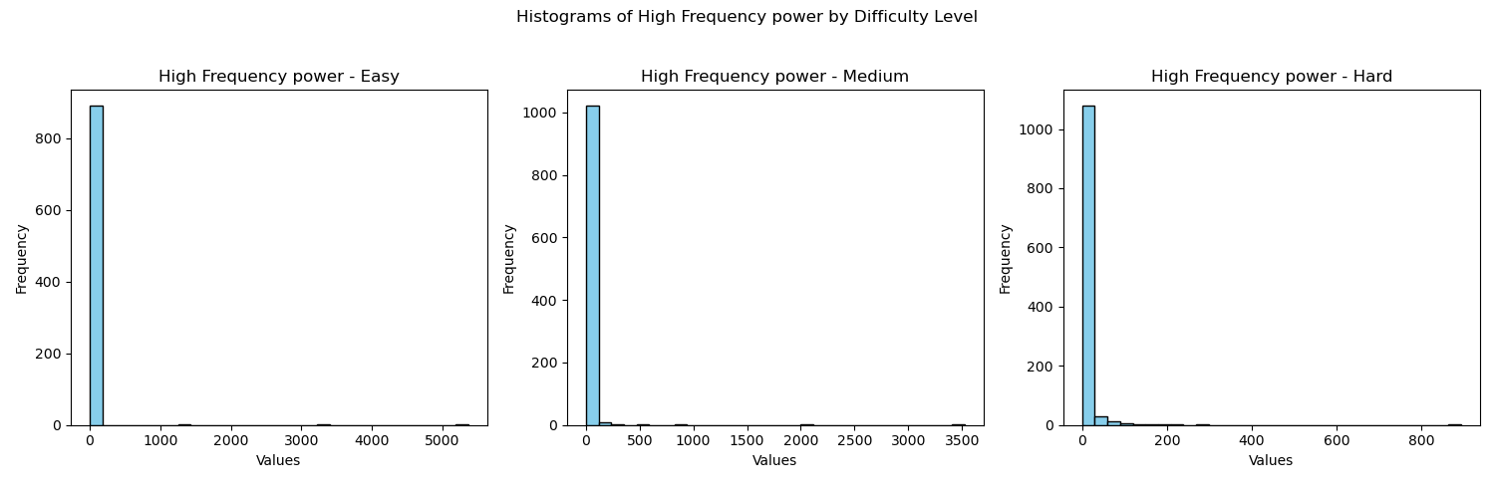
High Frequency power

Slide 24
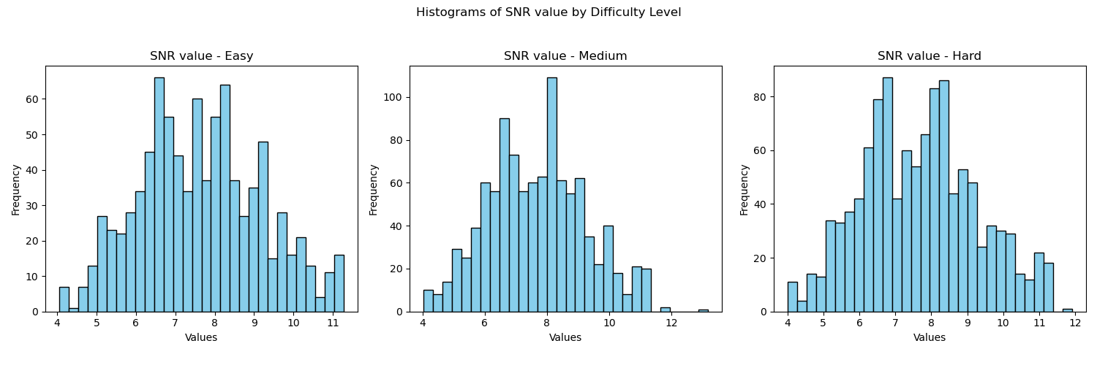
SNR value

