Slide 2
ML model
Demographic:
Age, sex, occupation,…
REST ECG/EYE:
4 mins
Sample: ECG/EYE
10 seconds
3 input data:
Demographic: individual unchanged.
Rest data: unique per day per individual
Physio data: the key to predict output. Most dynamic.
ML model
Output:
Difficulty
Trial: Correct/Wrong

Slide 3
Input
Participants Demographic
REST baseline: 4 mins
EYE
ECG list data:
ECG feature:
Sample: 10 seconds
EYE:
ECG: list data
ECG feature

Slide 4
Input
Participants Demographic: = ['Age', 'Gender', 'Race', 'Education', 'Smote_frequently', 'Caffeine_Consumption', 'Q2_How long played games', 'Q3_how often video games?', 'Q4_how many hours playing video games?', 'Q5_When you play video games how many hours', 'Q6_How skilled', 'Q7_your experience playing video games.', 'Q8_First-person shooter', 'Q9_Realistic military', 'Q10_Driving or Racing', 'Q11_Strategy', 'Q12_Role-playing']
Baseline: 4 mins
EYE
ECG list of feature
ECG feature
Sample: 10 seconds
EYE
ECG list of feature
ECG feature

Slide 5
Input
Participants Demographic
Baseline: 4 mins
EYE: ['Pupil_left','Pupil_right','Gaze_X','Gaze_Y','missing_percentage']
ECG list of feature
ECG feature
Sample: 10 seconds
EYE: ['Pupil_left','Pupil_right','Gaze_X','Gaze_Y’]
ECG list of feature
ECG feature

Slide 6
Input
Participants Demographic
Baseline: 4 mins
EYE
ECG list of feature: ['Heart_rate', 'RR_interval', 'Different in RR_interval']
ECG feature: ['Heart Rate mean', 'RR interval mean', 'RR interval SD', 'HRV', 'SD1', 'SD2', 'Ratio_sd1_sd2', 'Proportion_Next_R_peaks_greater_50_ms_', 'SNR', 'Very Low frequency power', 'Low frequency power', 'High frequency power', 'ratio_lf_hf']
Sample: 10 seconds
EYE
ECG list of feature: Same
ECG feature: Same

Slide 7
Output
Difficulty:
Accuracy:

Slide 8
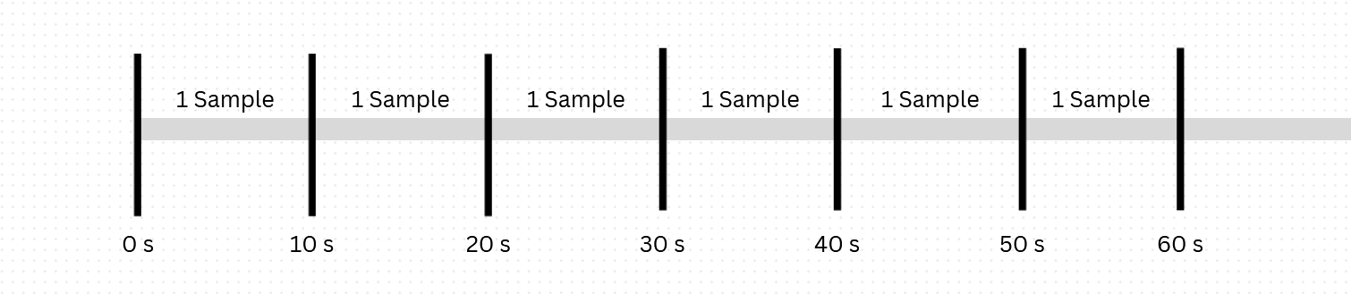
Output
Difficulty:
Predict: [Easy, Medium, Hard]
Predict: [Easy, Hard]
Accuracy:

Slide 9
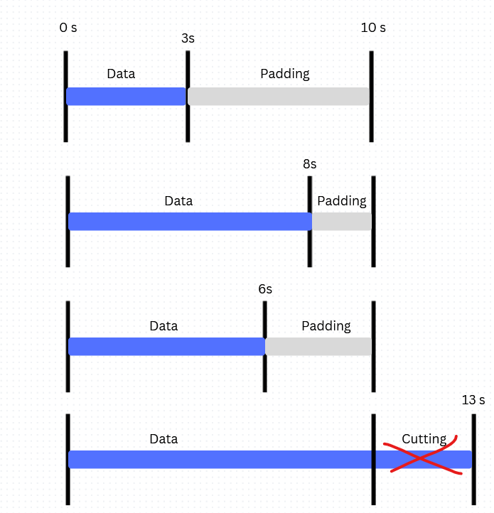
Output
Difficulty:
Accuracy:
Only: Enumeration, and Working Memory
Remove: Task-switching because the trail is too short
Correct: 1, Wrong: 0
Imbalance Dataset: 70% corrects vs 30% wrongs

Slide 10
 | Model and output
Input |  | CNN + LSTM Difficulty: [Easy, Medium, Hard] | CNN + LSTM Difficulty: [Easy, Hard] | Transformer Difficulty: [Easy, Hard] | CNN + LSTM Accuracy: [Enumeration, WM] | Transformer Accuracy: [Enumeration, WM]
 | All: 7 Inputs | X | X |  | X
 | Sample Eye: 10 seconds |  |  | X |  | X
 | Sample ECG: 10 seconds |  |  |  |  | X
 | Sample Eye: 10 seconds Rebalancing Accuracy |  |  |  |  | X

Slide 11
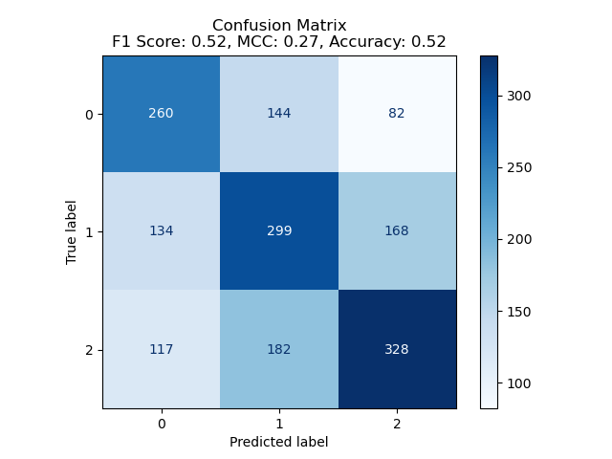
CNN + LSTM Difficulty: [Easy, Medium, Hard]

Slide 12
CNN + LSTM Difficulty: [Easy, Medium, Hard]
Feature importances.

Slide 13
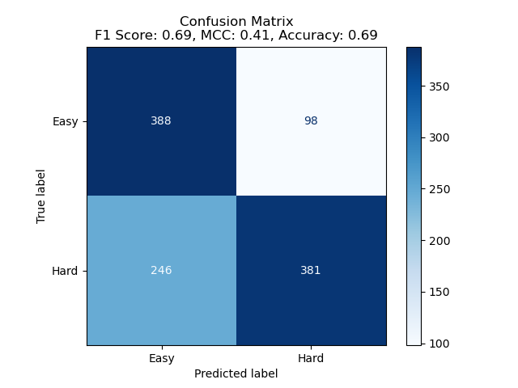
CNN + LSTM Difficulty: [Easy, Hard]

Slide 14
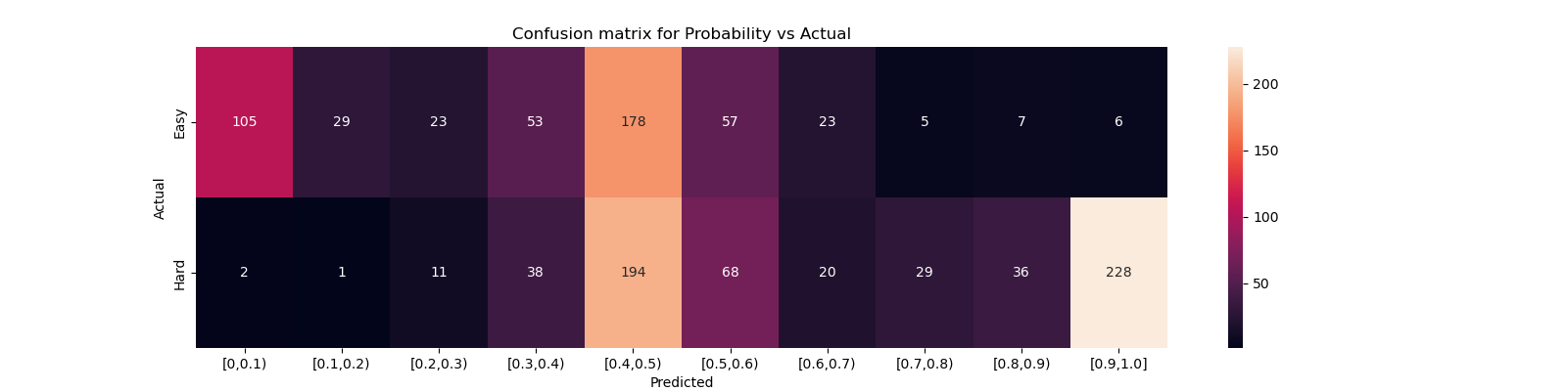
CNN + LSTM Difficulty: [Easy, Hard]

Slide 15
CNN + LSTM Difficulty: [Easy, Hard]
Feature importances.

Slide 16
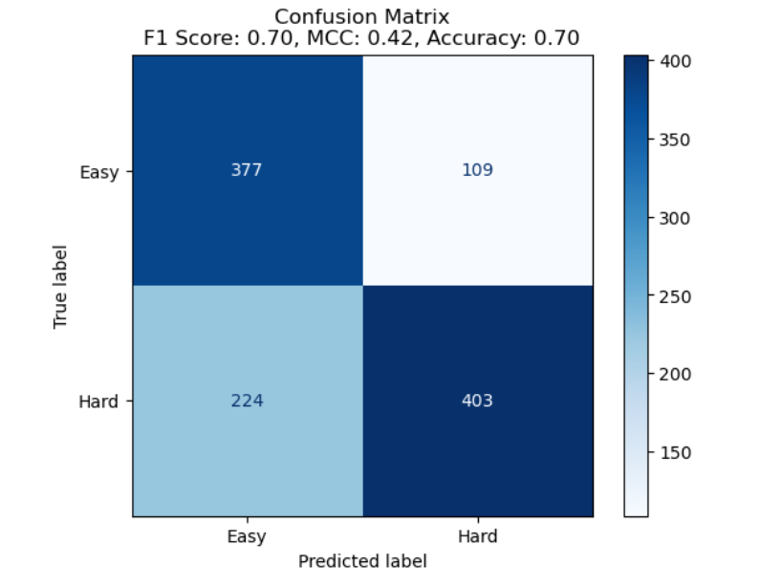
Transformer: Difficulty: [Easy, Hard]

Slide 17
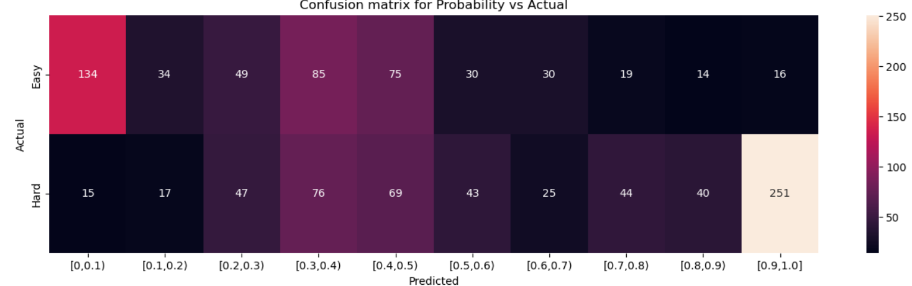
Transformer: Difficulty: [Easy, Hard]

Slide 18
Accuracy

Slide 19
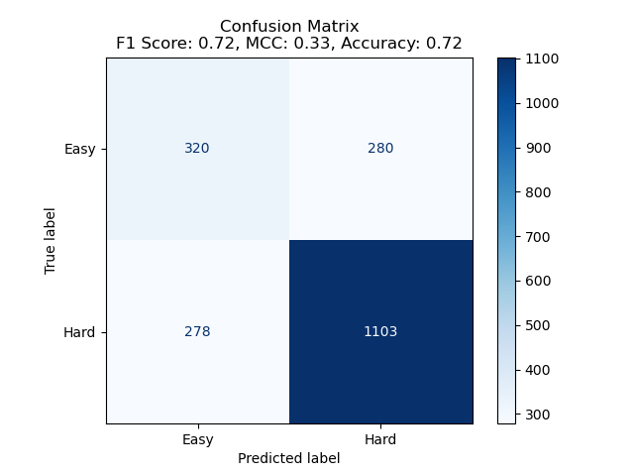
CNN + LSTM Accuracy:[Enumeration, WM]

Slide 20
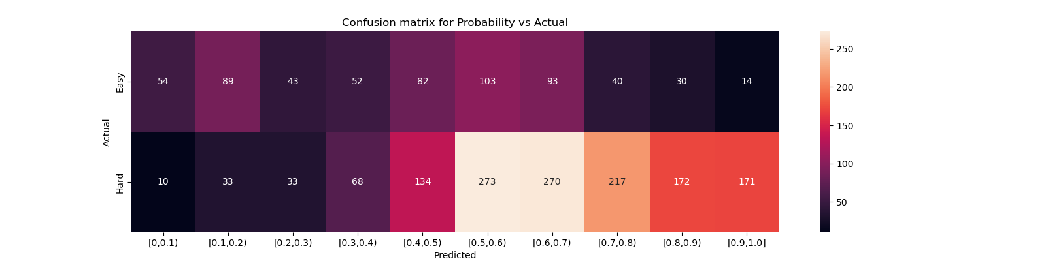
CNN + LSTM Accuracy:[Enumeration, WM]

Slide 21

Transformer: EYE Accuracy:[Enumeration, WM]

Slide 22
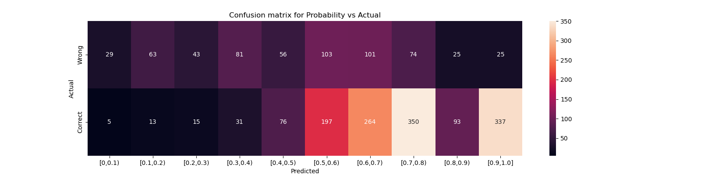
Transformer: EYE Accuracy:[Enumeration, WM]

Slide 23
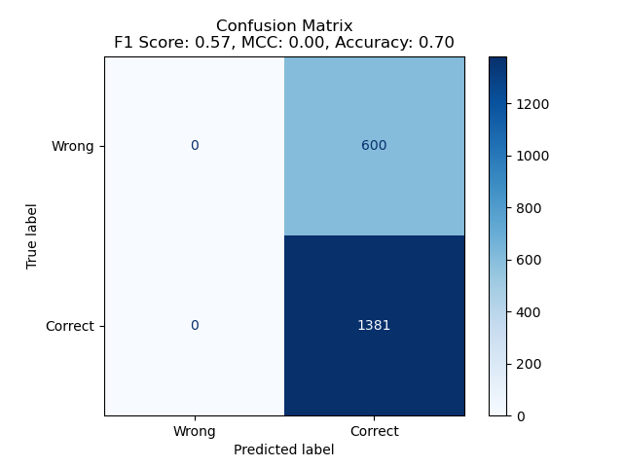
Transformer: ECG Accuracy:[Enumeration, WM]

Slide 24
Transformer: EYE Rebalancing Accuracy:[Enumeration, WM]
Using SMOTE:
Increase number of Wrong Sample == Correct Sample

Slide 25
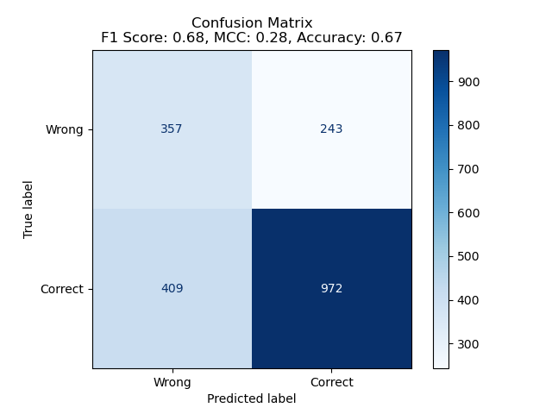
Transformer: EYE Rebalancing Accuracy:[Enumeration, WM]

Slide 26
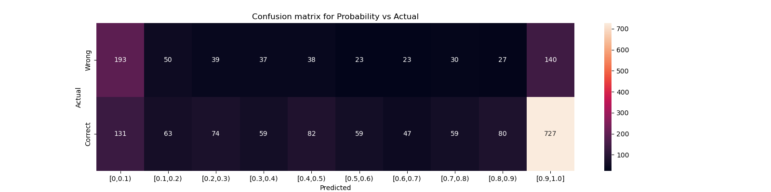
Transformer: EYE Rebalancing Accuracy:[Enumeration, WM]

