Slide 1
Dissertation Preparation

Slide 2
Overview
Previous work
Background
Thesis
Topic

Slide 3
Previous work
3 projects:
Cognitive event detection. Writing a paper.
Neurometrix study. Highlight the connection between body and mind
Respiration prediction using ECG.
NLP. Math classification. ?

Slide 4
Background

Slide 5
Thesis
We want to use machine learning to reverse engineers to understand human cognition.
Specific aims:
Using machine learning to understand human physiology respond to stress/workload

Slide 6
Cognitive Battery
Proficiencies/
Skill
Increase
Performance
(Accuracy)
Decrease
Focus/Concentrate
Decrease
Decrease
Increase
Workload
External Load /
Cognitive events
Increase

Slide 7
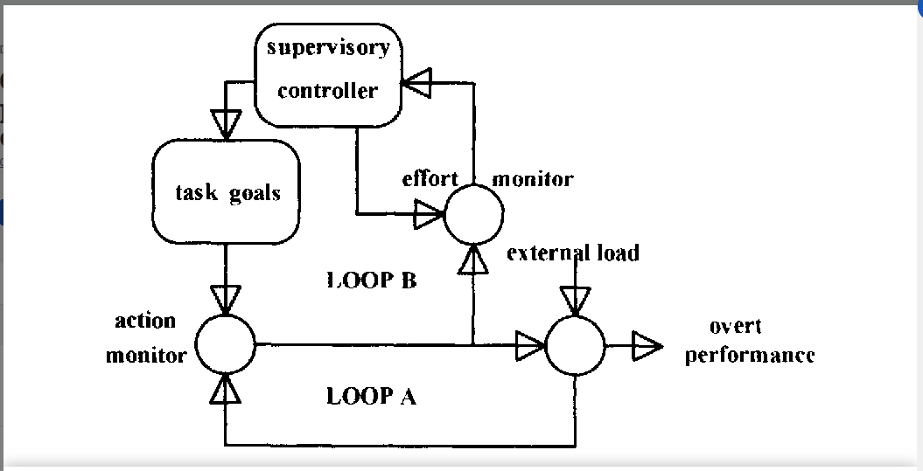
Hockey’s Compensatory control model
Loop A: routine activity (without effort)
Loop B: effort control. High workload
People is on high workload will switch to loop B.
Deep breath will reduce stress. It will keep people on loop A longer.

Slide 8
For cognitive battery
Cognitive events
Workload
Accuracy

Slide 9
Cognitive Battery
Proficiencies/
Skill
Increase
Performance
(Accuracy)
Decrease
Focus/Concentrate
Decrease
Decrease
Inverted
Relation
Increase
Workload
External Load /
Cognitive events
Increase

Slide 10
Proficiencies/
Skill
Increase
Performance
(Accuracy)
Decrease
Focus/Concentrate
Decrease
Decrease
Inverted
Relation
Increase
Workload
External Load /
Cognitive events
Increase
Purple: Target measure
Orange: Dynamics, Cannot control
Black: Unique to Individual
Green: Can control

Slide 11
Proficiencies/
Skill
Increase
Performance
(Accuracy)
Decrease
Focus/Concentrate
Decrease
Decrease
Inverted
Relation
Increase
Parasympathetic System
Workload
External Load /
Cognitive events
Decrease
Increase
Increase
Breath training
3 Scenarios:
Reducing workload
Increasing Accuracy
Some combination of both.

Slide 12
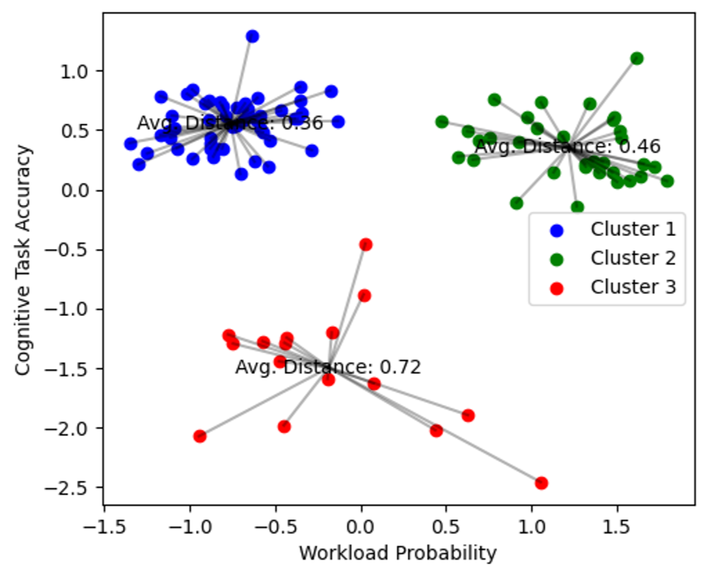
Murat’s Clustering

Slide 13
Murat’s Clustering
Accuracy
workload

Slide 14
Aim 1: Predicting workload
Step 1: build ML model can predict workload.
Input: Physio data
Output: Workload

Slide 15
Aim 2: Predicting Accuracy
Build ML model can predict accuracy.
Input: Physio data
Output: probability of success/fail

Slide 16
ML model
Demographic:
Age, sex, occupation,…
REST data:
5 mins baseline
Physio Data while doing task:
1 second - 30 seconds
3 input data:
Demographic: individual unchanged.
Rest data: unique per day per individual
Physio data: the key to predict output. Most dynamic.
ML model
Output:
Workload for aim 1
Probability of success for aim 2
Any interesting measurement.

Slide 17
Aim 3: Stimulating data to quantity the dynamical change in Physiology data
General Idea:
Stimulate physiology feature from existing data. Analysis how the change in this physiology can affect the workload and performance.
Example:
Collect a physio data for a subject:
Breath rate: 18 breath/mins -> predict their accuracy: 50%
If they can reduce breath rate to 10 breath/min -> predict their accuracy increase to 60%-70%

Slide 18
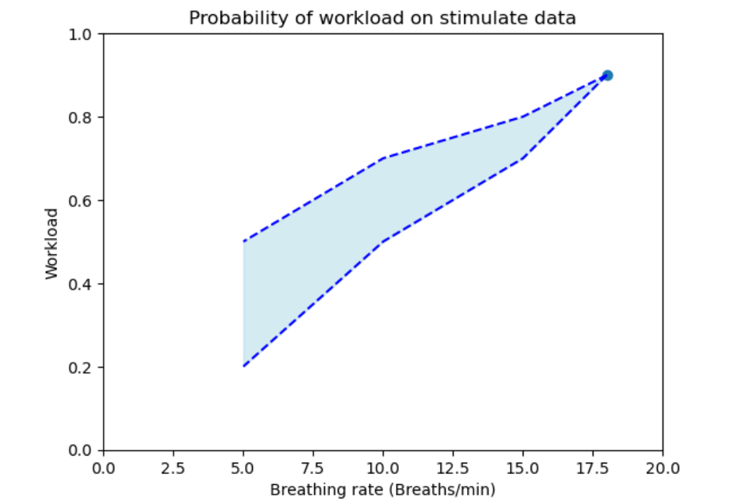
Stimulate data to predict workload (aim 1)

Slide 19
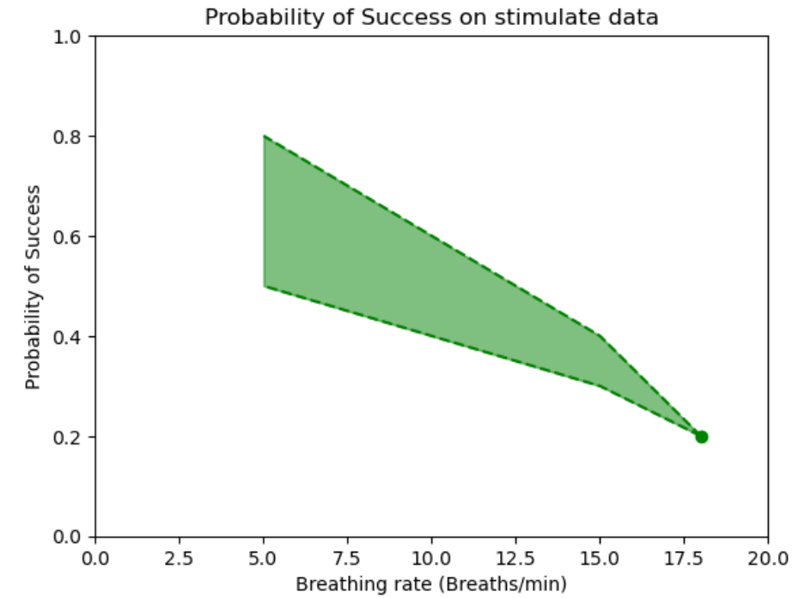
Stimulate data to predict success (aim 2)

Slide 20
Propose Project
Physio data will collect:
Pupil
Gaze position
ECG
Respiration
Audio for Respiration (?)
Audio communication (?)

Slide 21
Propose Project
Collect REST_1 data:
Watch 5 mins resting
collect PHASE1 data:
Participant will do some validation tasks.
(cognitive battery)
Phase 1
Collect PHASE2 data:
Participant will do breathe training.
The task will be different from phase1 and phase 3
Phase 2
Collect REST_3 data:
Watch 5 mins resting
Collect PHASE3 data:
Participant will do the same task as phase 1.
(cognitive battery)
Phase 3
NOTE:
Phase 2 and 3 can be on the same days.
Phase 2 can be multiple days
We might have resting data for phase 2.

