Slide 1
Missing data in shooting game

Slide 2
Saving Data progress
Kafka is a streaming platform
Shooting game -> Kafka -> Database (postgresSQL)
Problem:
If we send data to Kafka more than it can handle. When the pipeline is full, Kafka will drop oncoming data.

Slide 3
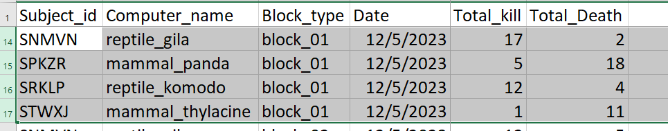

Before April (Dec 5, Game 1)

Slide 4
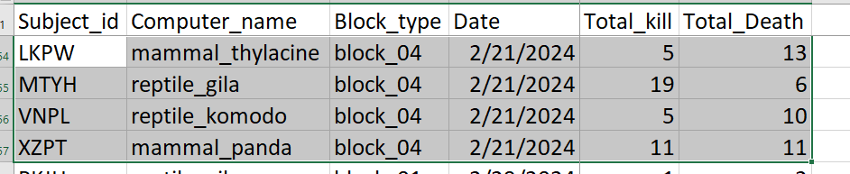
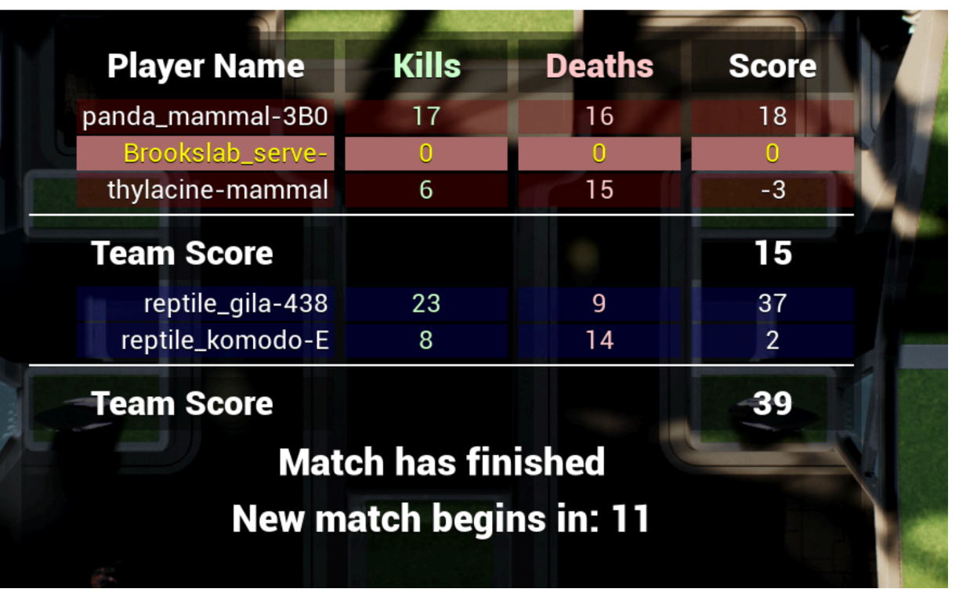
Before April (Feb 21, Game 4)

Slide 5
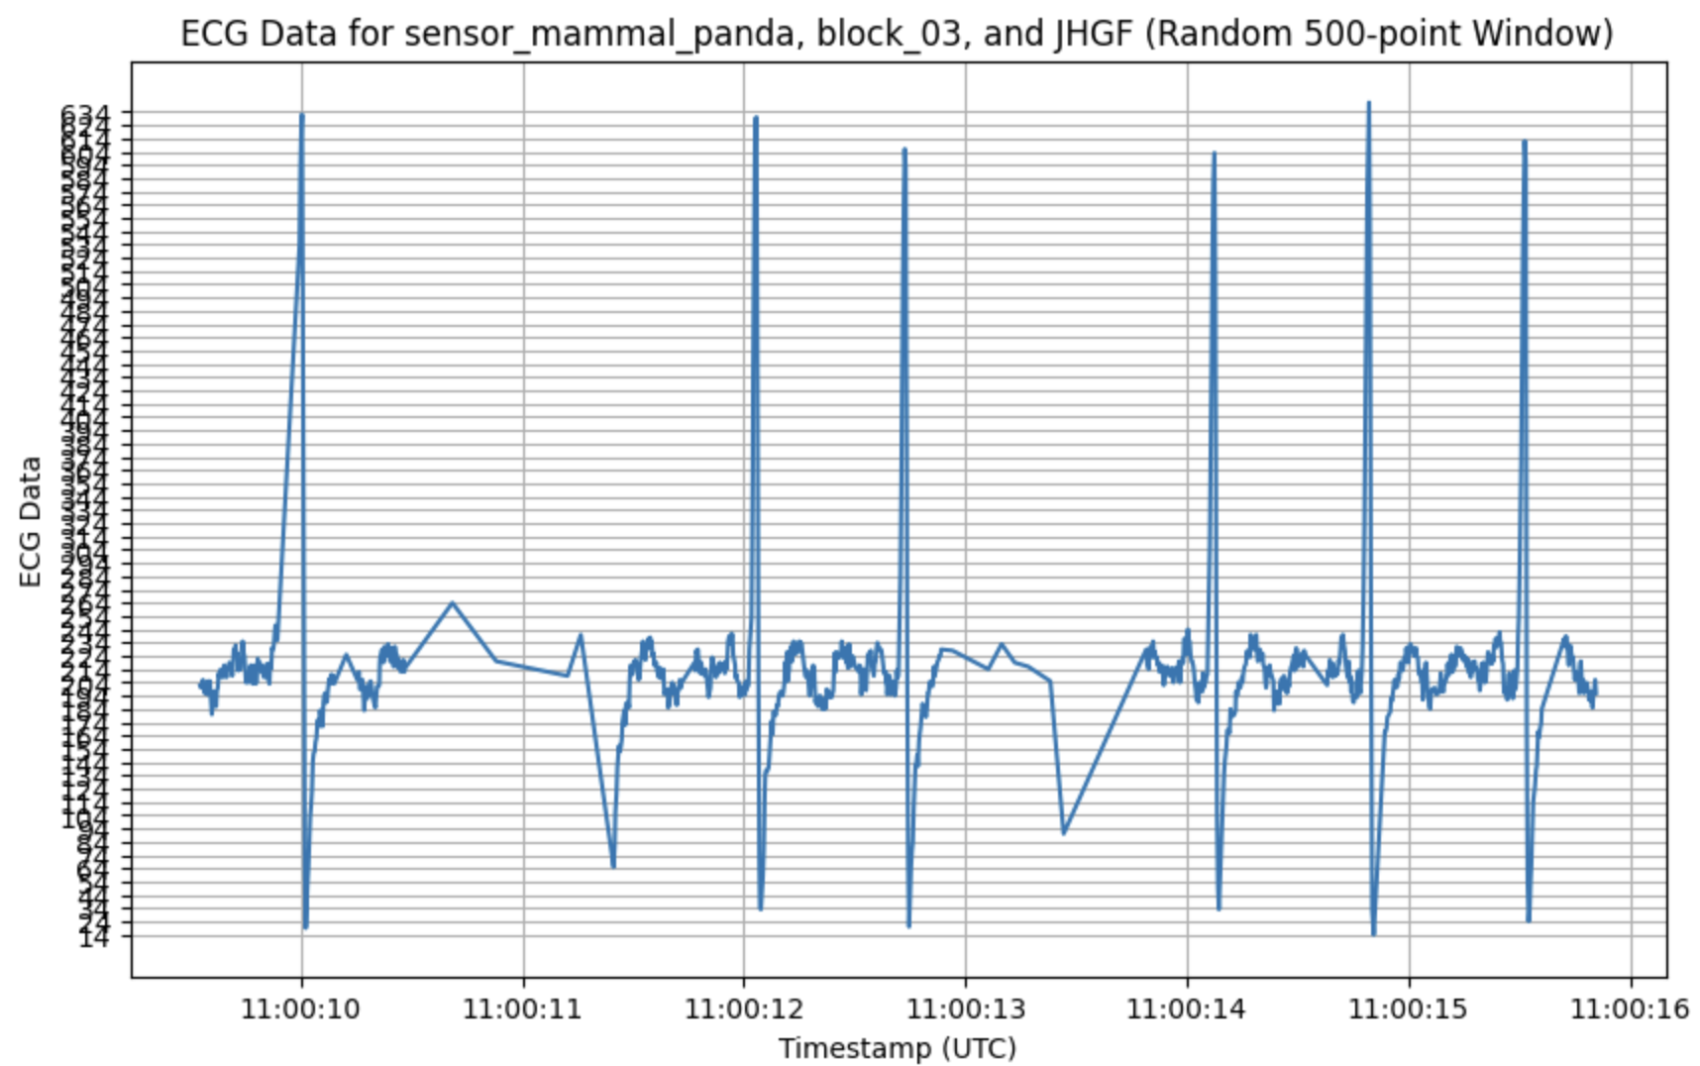
April

Slide 6
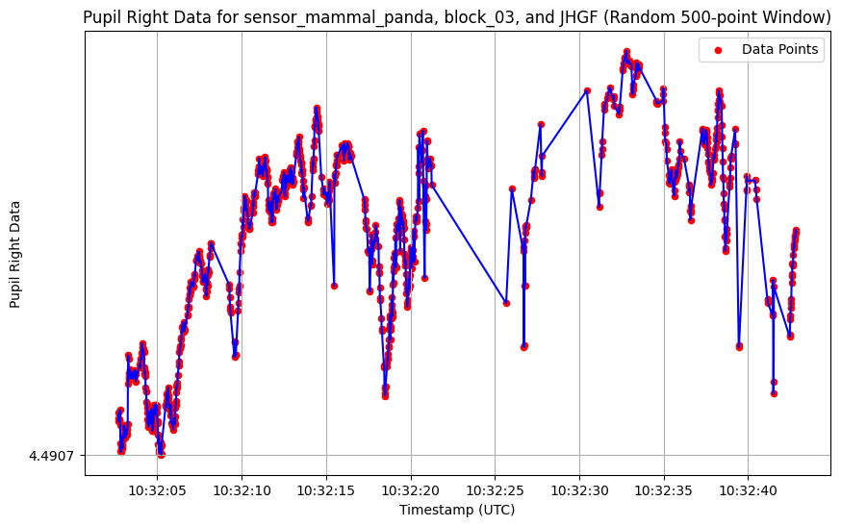
April

Slide 7
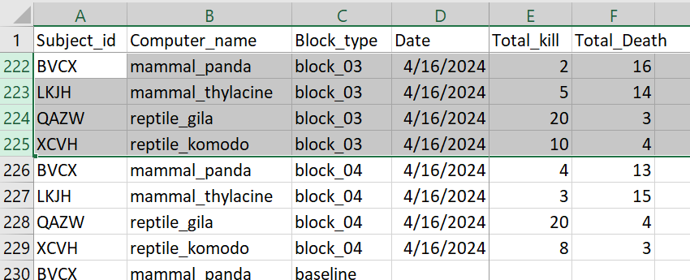
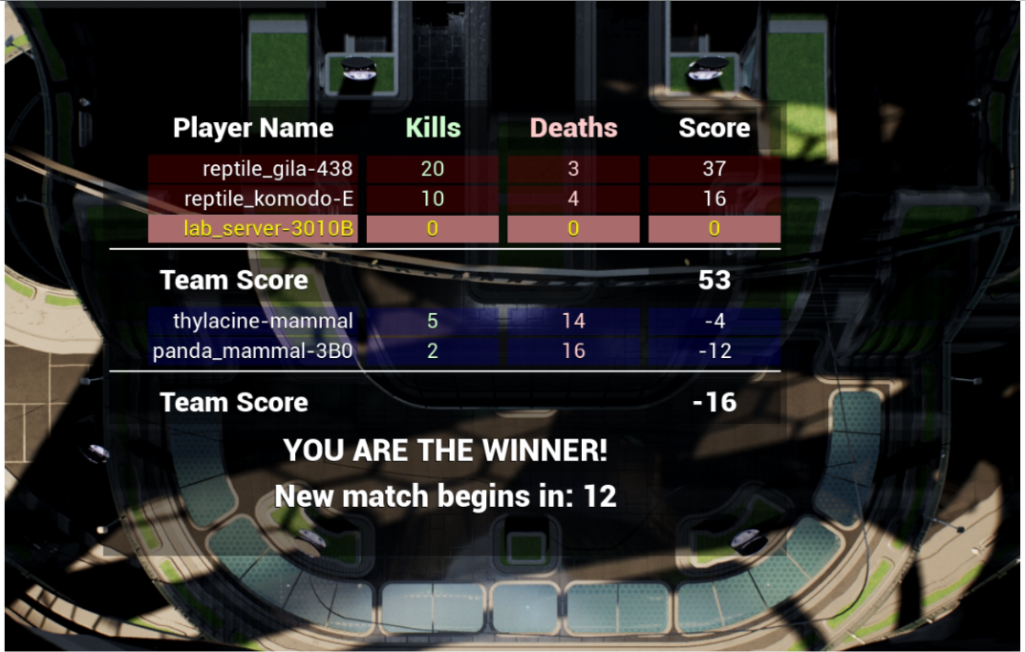
After April (April 16, Game 3) All 4 games look correct

Slide 8
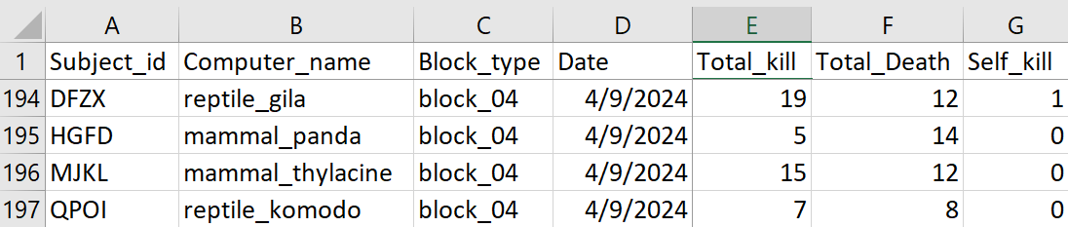
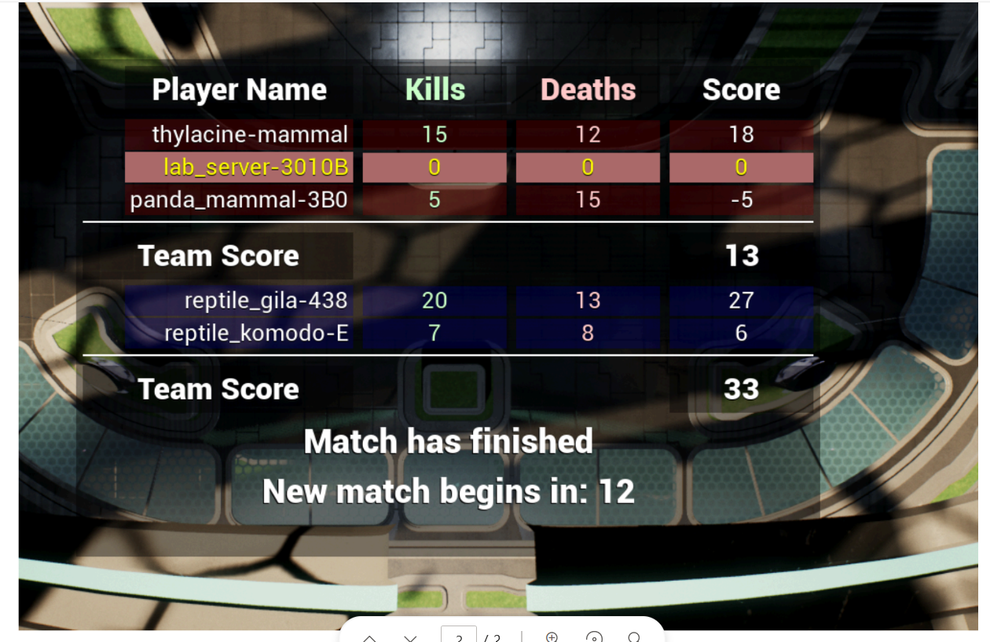
After April (April 9, Game 4) 2 games

Slide 9
Heart Rate Variability

