Slide 1
Descartes Overview

Slide 2
Descartes Overview
Descartes
Cognitive battery: 3 cognitive tasks
Enumeration
Task-switching
Working memory
Shooting game: FPS games, 2 vs 2

Slide 3
Cognitive battery
Cognitive battery: 3 cognitive tasks
Enumeration
Task-switching
Working memory
Each tasks have 3 blocks (easy, medium, hard). Order is randomized
9 blocks in total
Planning move from Web app to Desktop app.
Link: https://cognitive-battery.netlify.app/

Slide 4
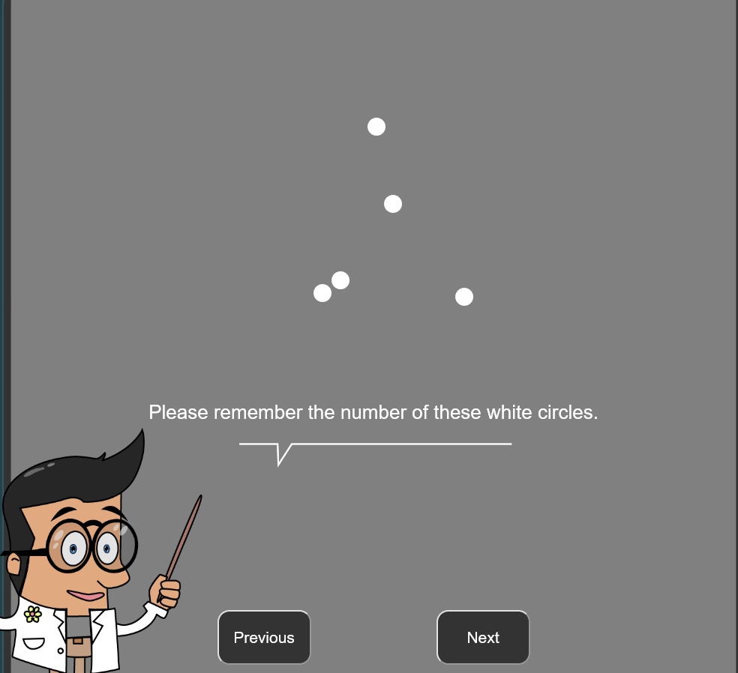
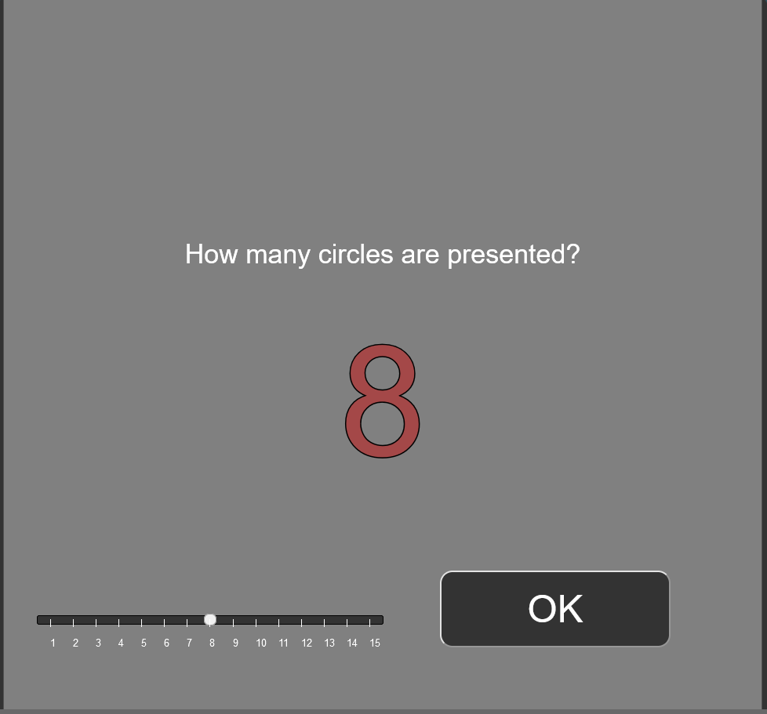
Enumeration

Slide 5
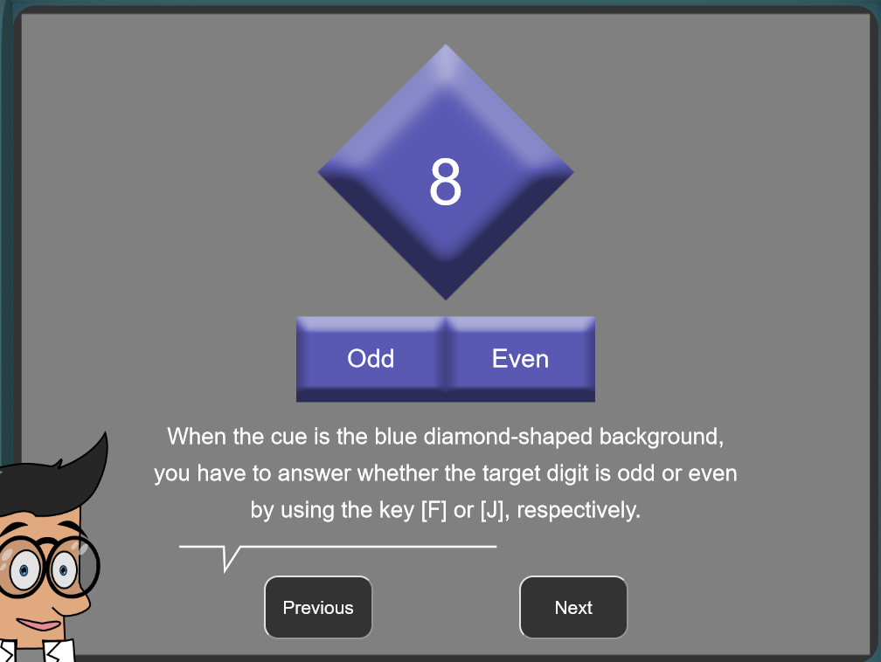
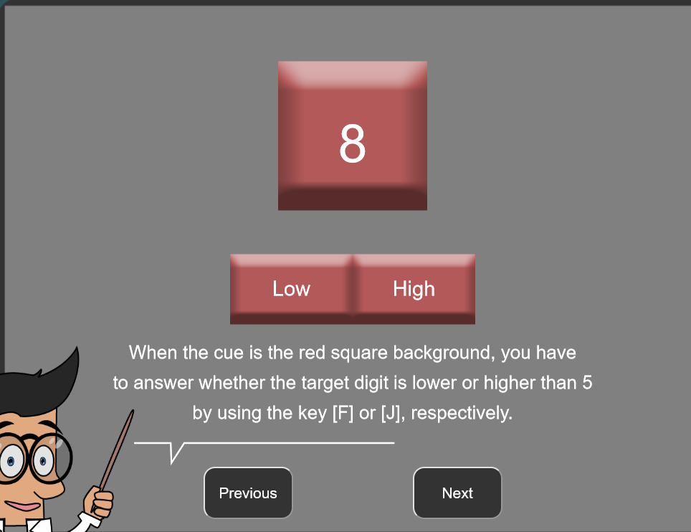
Task-switching. Number: 1-4, 6-9 skip 5

Slide 6
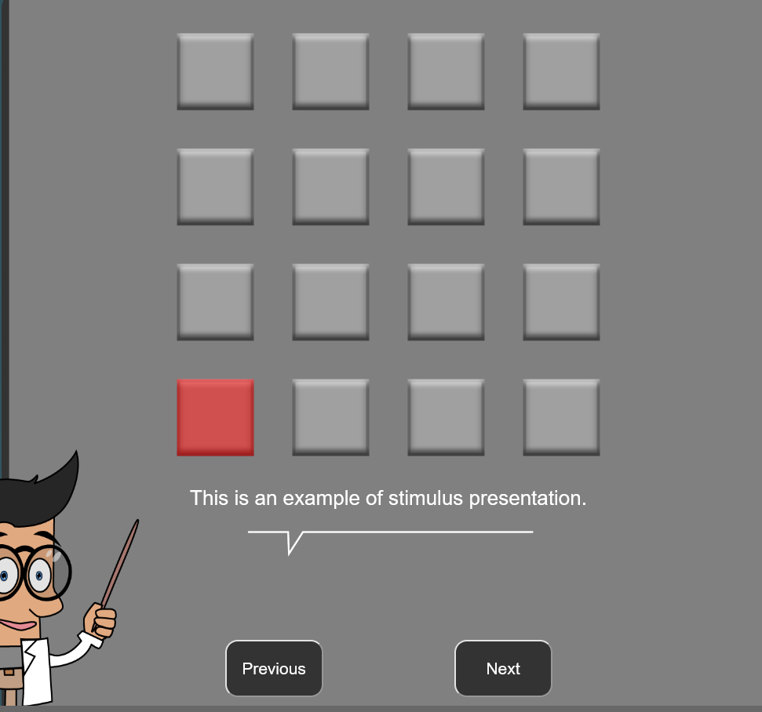
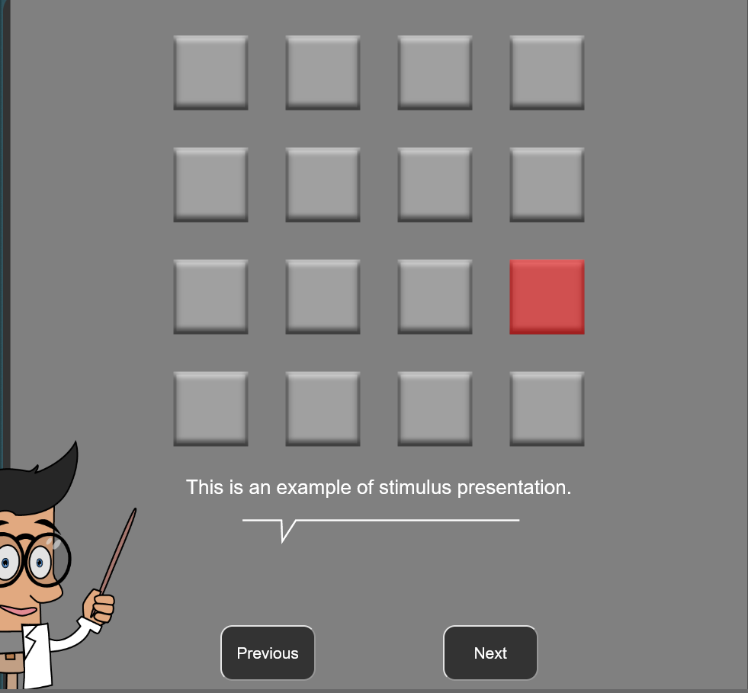
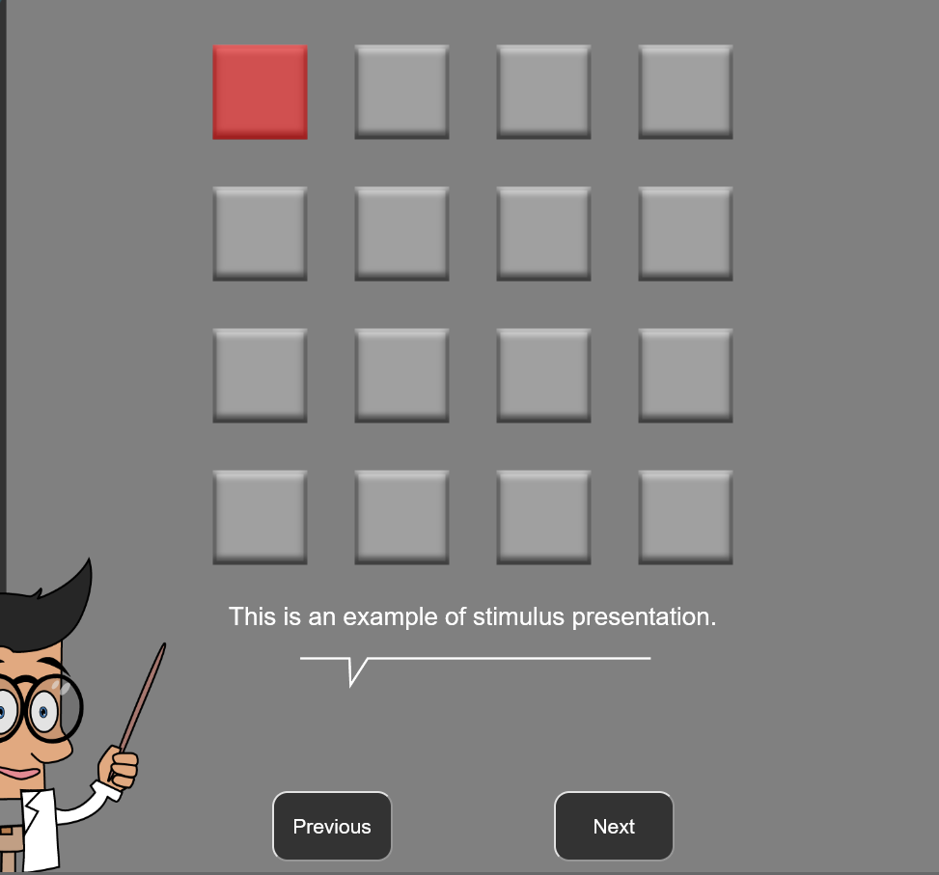
Working memory

Slide 7
Shooting game
FPS game. Developed by Army Research Lab
2 vs 2
Play 4 games.
Each game 10 minutes

Slide 8
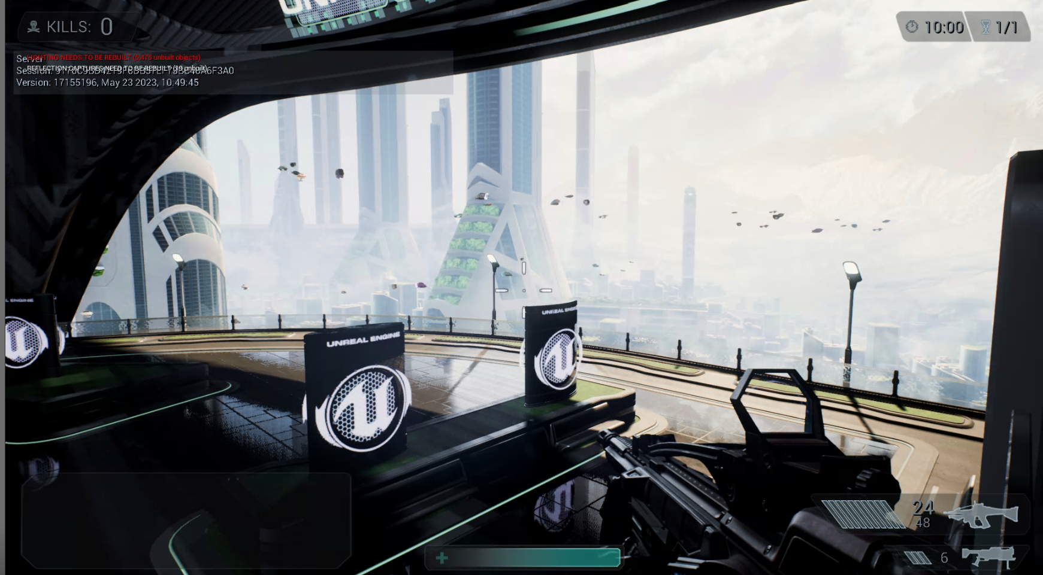
Shooting game

Slide 9
Participants side

Slide 10
Participants
2 days study
Day 1: cognitive battery
Day 2: shooting game
$25 for each day.
Thinking cut to 1 day
Not collect their name.
Assign 4 letters unique ID. Ex: GQME, GNIW

Slide 11
Day 1: cognitive battery
Pre-Survey: 4 surveys (15 mins)
Baseline: 5 minutes watch relax video (lava lamp)
Do 3 cognitive tasks (randomized). Each task has 3 blocks (randomized).
Do survey after each block.
9 blocks in total -> 9 surveys
Payment ($25)

Slide 12
Day 2: shooting games
Schedule 4 participants finished Day 1. (refer stranger)
Pre-Survey: 1 survey (1 min)
Baseline: 5 minutes watch relax video (lava lamp)
Play 4 games. (each games 10 mins)
Do survey after each game.
4 blocks in total -> 4 surveys

Slide 13
Data

Slide 14
Data
Collect 2 physiology data:
Eye:
Pupil left and right
Gaze X and Gaze Z
ECG

Slide 15
Dataset
Dataset:
Cognitive battery Eye data
Cognitive battery ECG data
Cognitive battery Game data (Enumeration)
Cognitive battery Game data (Task-switching)
Cognitive battery Game data (Working memory)
Shooting game Eye data
Shooting game ECG data
Shooting game (game data)

Slide 16
5 computers
Server computer (where to store data)
Local computer:
Mammal panda
Mammal thylacine
Reptile Komodo
Reptile Gila

Slide 17
Save data
Stored everything in Server computer. (planning to move to aws/cloud)
Database: PostgreSQL
A copy of data in local computer.
Normal dataset:
Save everything in .csv files in local computer. After participant leave, push to Postgres in server computer.

Slide 18
Shooting game (game data)
Has little control over this.
Game(local computer) -> Kafka (server computer) -> Postgres (server computer)

Slide 19
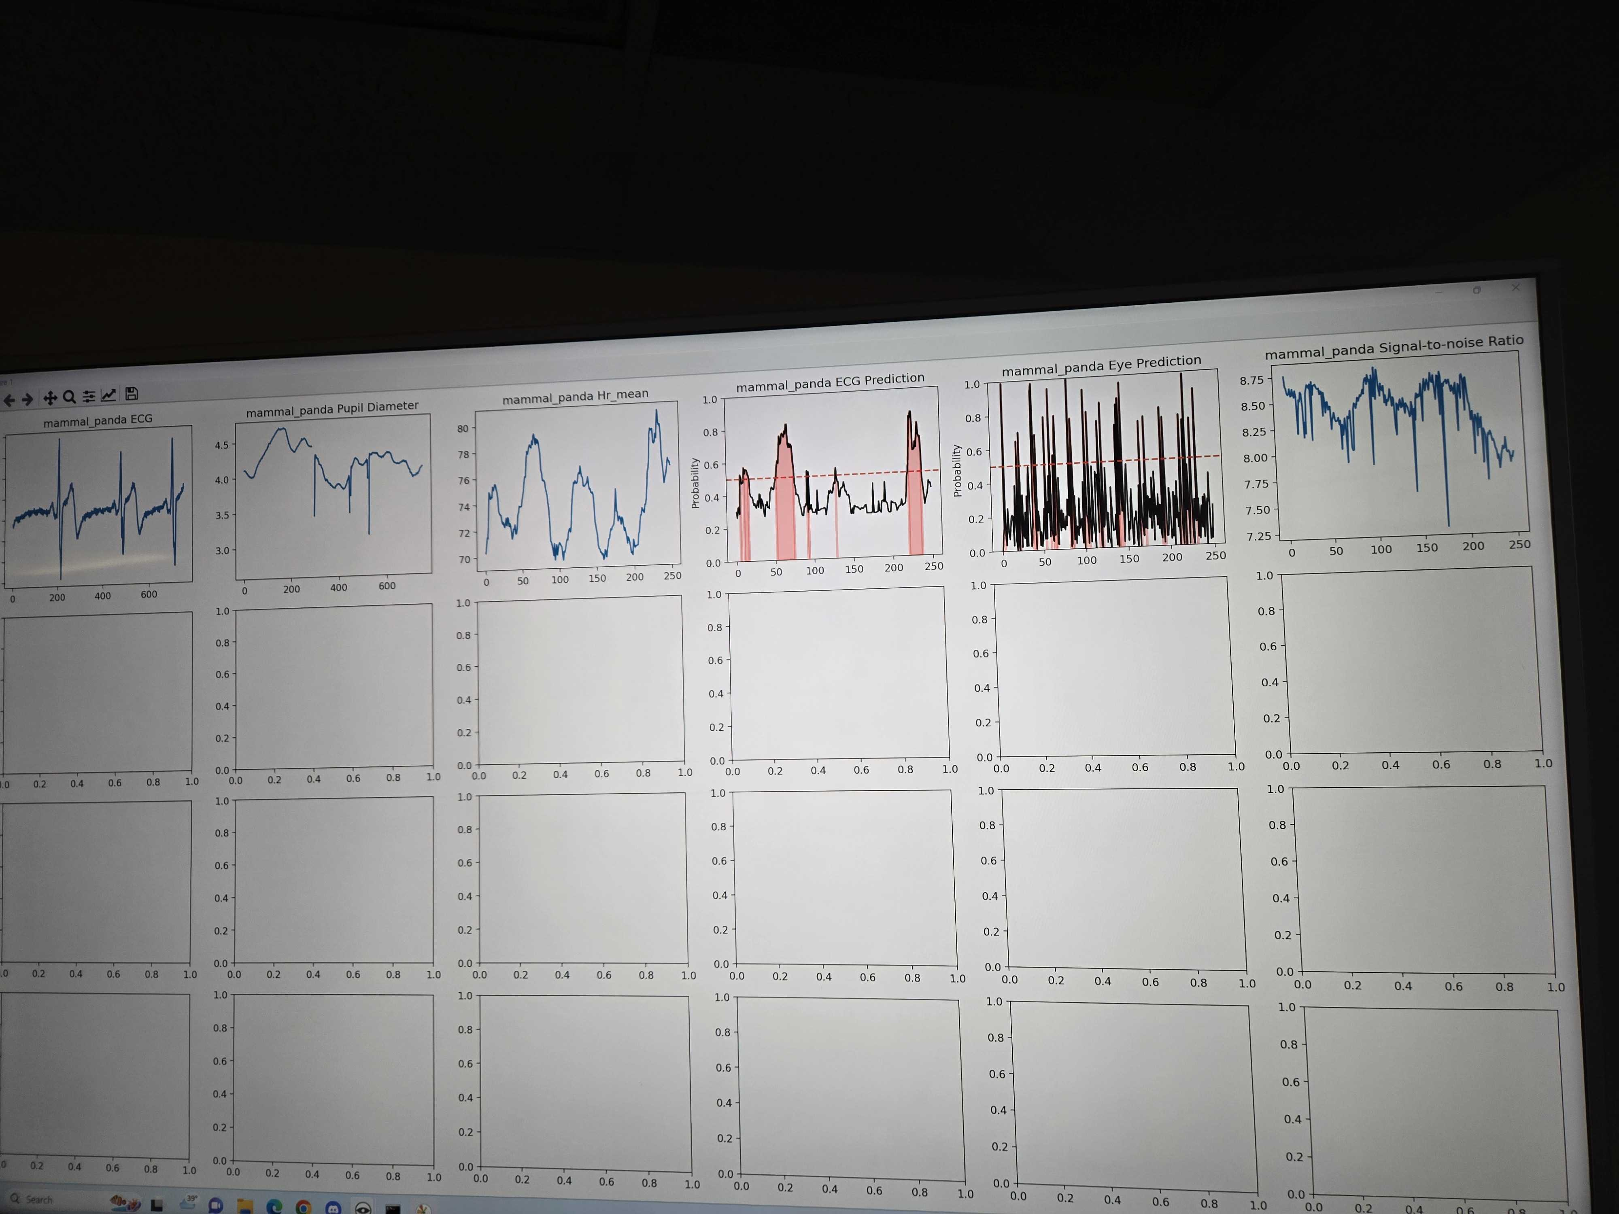
Visualization.

Slide 20
Other

Slide 21
Other
Purpose of project
Analysis
Build ML model

