Slide 1
Dissertation Preparation

Slide 2
Thesis
We want to use machine learning to reverse engineers to understand human cognition.
Specific aims:
Using machine learning to understand human physiology respond to stress/workload

Slide 3
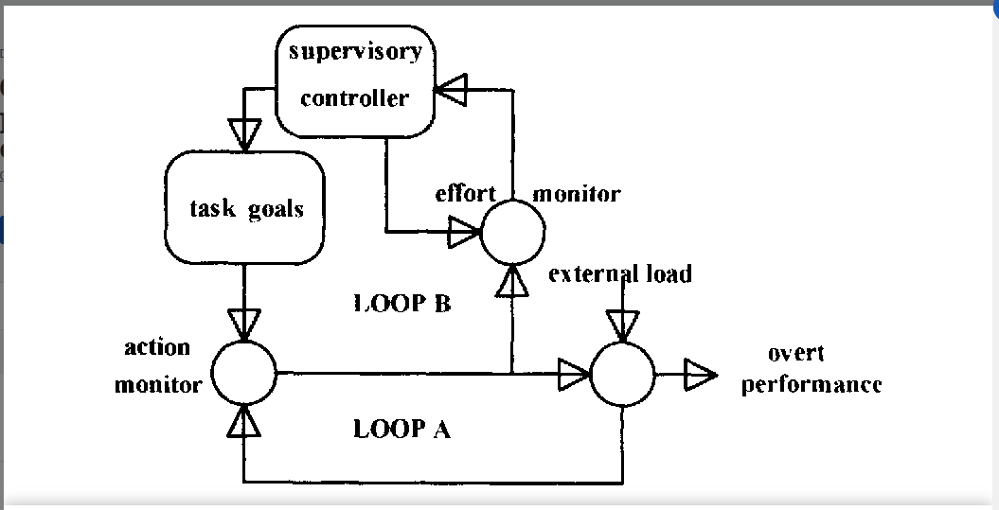
Background
Hockey’s Compensatory control model:
Loop A: routine activity (without effort)
Loop B: effort control. High workload
People is on high workload will switch to loop B.
Deep breath will reduce stress. It will keep people on loop A longer.

Slide 4
For cognitive battery
Cognitive events
Workload
Accuracy

Slide 5
Breath training
Reduce
Reduce
Stress
Sympathetic System

Slide 6
External Load /
Cognitive events
Breath training
Reduce
Reduce
Increase
Reduce
Stress
Sympathetic System
Reduce
Workload
Increase
Performance
(Accuracy)
Reduce
Increase
Proficiencies/
Skill

Slide 7
External Load /
Cognitive events
Breath training
Reduce
Reduce
Increase
Reduce
Stress
Sympathetic System
Reduce
Workload
Increase
Performance
(Accuracy)
Reduce
Increase
Proficiencies/
Skill
Black: Unique to Individual and Fixed
Green: Can control
Purple: Can measure
Blue: Cannot measure
Red: non-linear, Not independence, unique to individual

Slide 8
External Load /
Cognitive events
Breath training
Reduce
Reduce
Increase
Reduce
Stress
Sympathetic System
Reduce
Workload
Increase
Performance
(Accuracy)
Reduce
Increase
Proficiencies/
Skill
The effect of breath training:
Reduce Workload
Increase Performance
Some combination of both.

Slide 9
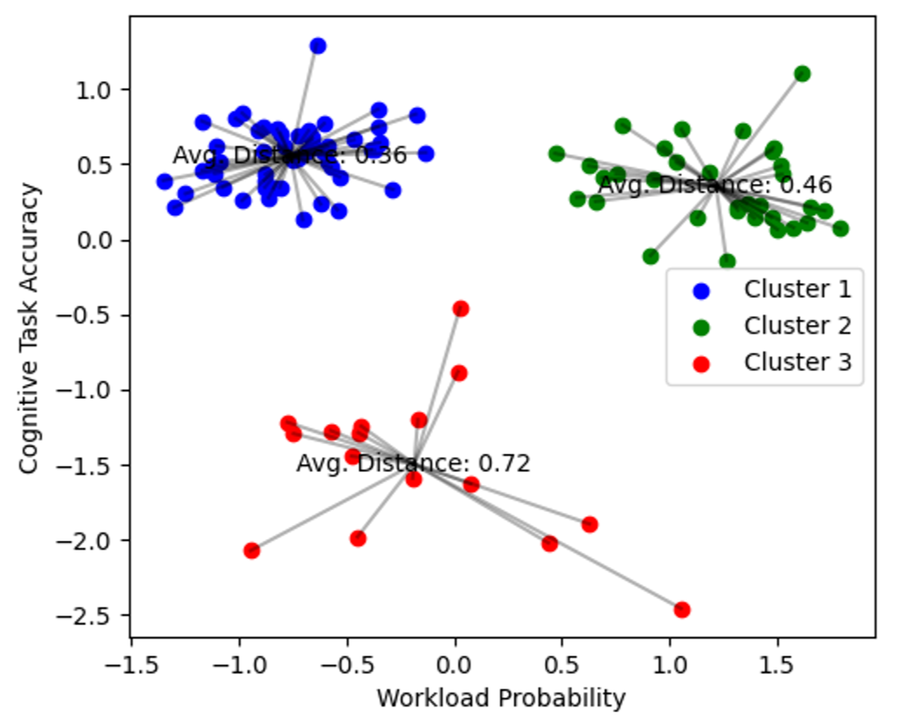
Murat’s Clustering

Slide 10
Aim 1: How physiology data can affect workload.
General Idea:
If a physio metric changed, how it affect the workload.
Examples: if HRV is double, how much workload will increase?
Step 1: build ML model can predict workload.
Input: Physio data
Output: Workload
Step 2: Isolate 1 physio metric( or 1 groups) and modified it to see the effect on workload.

Slide 11
Aim 2: How physiology data can affect probability of success on single trial.
General Idea:
If a physio metric changed, how it affect on the performance.
Examples: if HRV is double, how much probability of success will increase?
Step 1: build ML model can predict probability of success on single trial.
Input: Physio data
Output: probability of success.
Step 2: Isolate 1 physio metric( or 1 groups) and modified it to see the effect on workload.

Slide 12
Murat’s Clustering
Aim 1
Aim 2

Slide 13
Propose Project
Physio data will collect:
Pupil
Gaze position
ECG
Respiration
Audio for Respiration (?)

Slide 14
Propose Project
Collect REST_1 data:
Watch 5 mins resting
collect PHASE1 data:
Participant will do some validation tasks.
(cognitive battery)
Phase 1
Collect PHASE2 data:
Participant will do breathe training.
The task will be different from phase1 and phase 3
Phase 2
Collect REST_3 data:
Watch 5 mins resting
Collect PHASE3 data:
Participant will do the same task as phase 1.
(cognitive battery)
Phase 3
NOTE:
Phase 2 and 3 can be on the same days.
Phase 2 can be multiple days
We might have resting data for phase 2.

Slide 15
ML model
Demographic:
Age, sex, occupation,…
REST data:
5 mins baseline
Physio Data while doing task:
1 second - 30 seconds
3 input data:
Demographic: individual unchanged.
Rest data: unique per day per individual
Physio data: the key to predict output. Most dynamic.
ML model
Output:
Workload for aim 1
Probability of success for aim 2
Any interesting measurement.

Slide 16
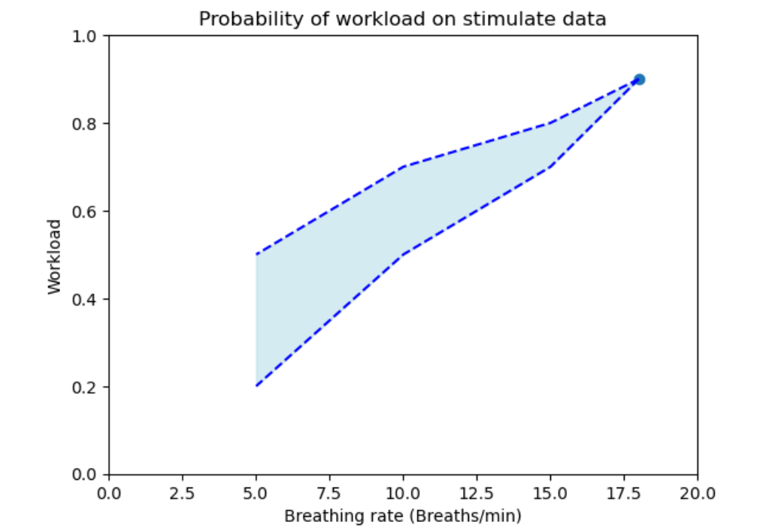
Stimulate data to predict workload (aim 1)

Slide 17
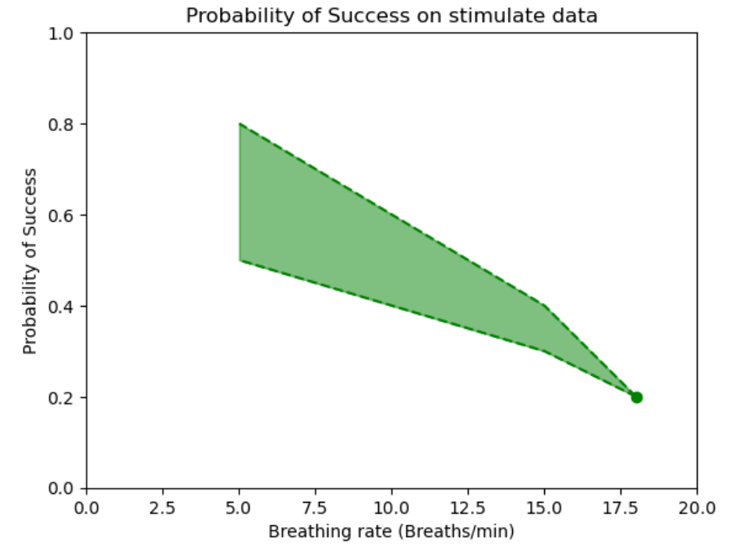
Stimulate data to predict success (aim 2)

Slide 18
Application for Aim 1 and 2
Collect a physio data for a subject:
Breath rate: 18 breath/mins -> predict their accuracy: 50%
If they can reduce breath rate to 10 breath/min -> predict their accuracy increase to 60%-70%

Slide 19
Aim 3: Identify which factor have more potential for improvement.
General Idea:
We want to measure a participant physiology data. Just from their physiology data, we want to able to tell that how much they can improve if they do the breath training.

