Slide 1






2,973,371 Tweets
2,848 Handles
Internet Research Agency
St Petersburg, Russia
Darren Linvill
Patrick Warren
FiveThirtyEight releases tweet data on July 31, 2018
Twitter deletes tweets and accounts of some known trolls
Linvill & Waren harvest, recreate, and categorize

Slide 2

Linvill & Warren Troll Categories
Left Trolls (230)
@4mysquad And so #BLM is called a "hate group" while cops sworn to serve and protect commit murder, torture, aggravated assault and theft.'
Another example of how all liberals are hateful, corrupt, lying, evil, deceitful, hypocritical, despicable pieces of s***
Right Trolls (617)
Nativist, right-leaning populist messages
Uniformly support Donald Trump
Denigrate the Democratic party
Employ “Make America Great Again” terminology
Derisive of mainstream and moderate republicans
Often with profile pictures of attractive young women
Socially liberal messages
Focused on racial identity
Often mimicked the Black Lives Matter movement
Attacked mainstream democratic politicians, particularly Hillary Clinton
Supportive of Bernie Sanders
RT mb141bar: Dear Lord, protect, guide, bless our President Trump. Please save us from those attempting to harm him
Good Night Warriors! Remember White Supremacy Must be Destroyed Globally in order for True Peace & Real Justice to Reign.

Slide 3
Building off Linvill and Warren’s categorization, what can we learn about :
The topics, sentiment, and emotional appeal used by Left and Right trolls in peak periods
Differences in topics, sentiment, and emotional appeal by time of day

Slide 4
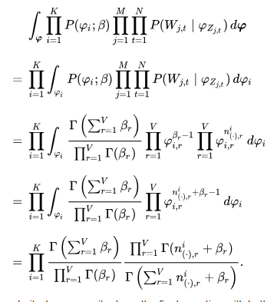
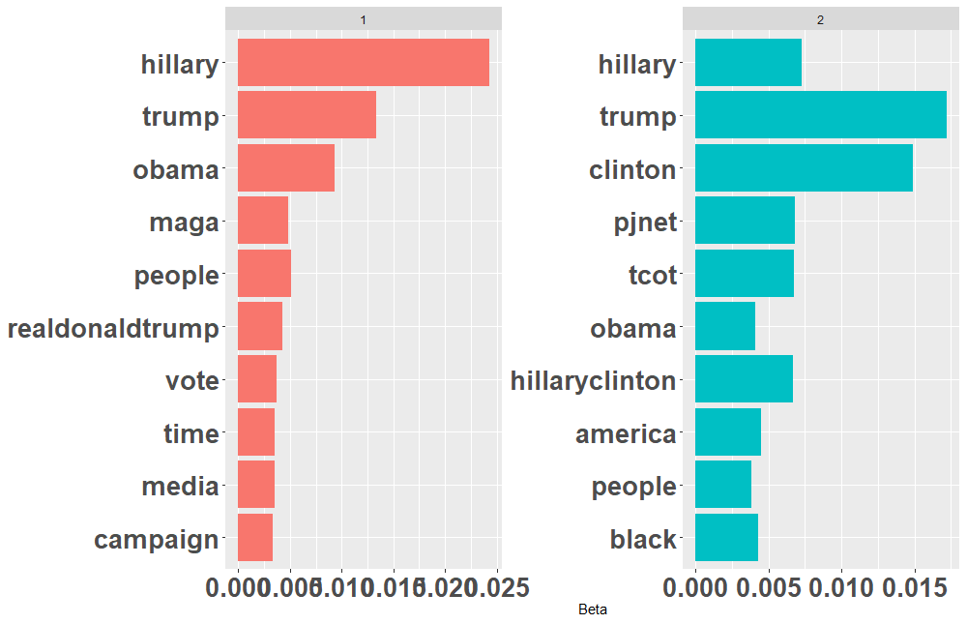

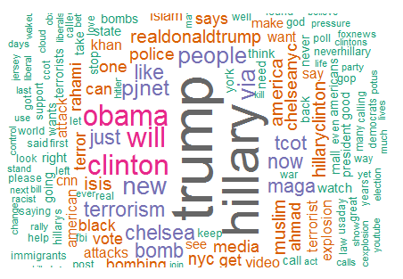
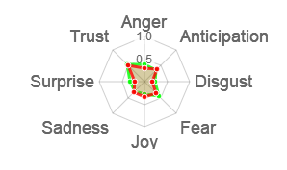
Techniques Used
Emotion
Sentiment
Right Troll
 | anger | antici-pation | disgust | fear | joy | sadness | surprise | trust |  | negative | positive
RT mb141bar: Dear Lord, protect, guide, bless our President Trump.Please save us from those attempting to harm him https://t.co/mu8fHj1V50 | 0 | 1 | 1 | 1 | 2 | 0 | 1 | 5 |  | 2 | 7
Another example of how all liberals are hateful, corrupt, lying, evil, deceitful, hypocritical, despicable pieces of s*** like @HussamA https://t.co/6E0oT6pDPp | 5 | 0 | 7 | 2 | 0 | 3 | 0 | 0 |  | 8 | 0
Sentiment
and
Emotion
(R syuzhet)
Unsupervised
Latent Dirichlet
Allocation (LDA)
Topic 1
Topic 2
(R topicmodels)
Word Cloud
Radar Chart
(R wordcloud)
(R radarchart)
Notes:
- Sentiment and emotion analysis go through a dictionary of words and values associated with the emotion and sentiment for each of those words, see examples for these (extreme) Right Troll tweets
Unsupervised Latent Dirichlet (deer-ih-clay) Allocation looks for connections between words using mathematical algorithms
Word Clouds show most commonly used words
Radar Charts show continuous values across multiple dimensions
Takes about 6 hours to run all analysis against 2M English language tweets

Slide 5
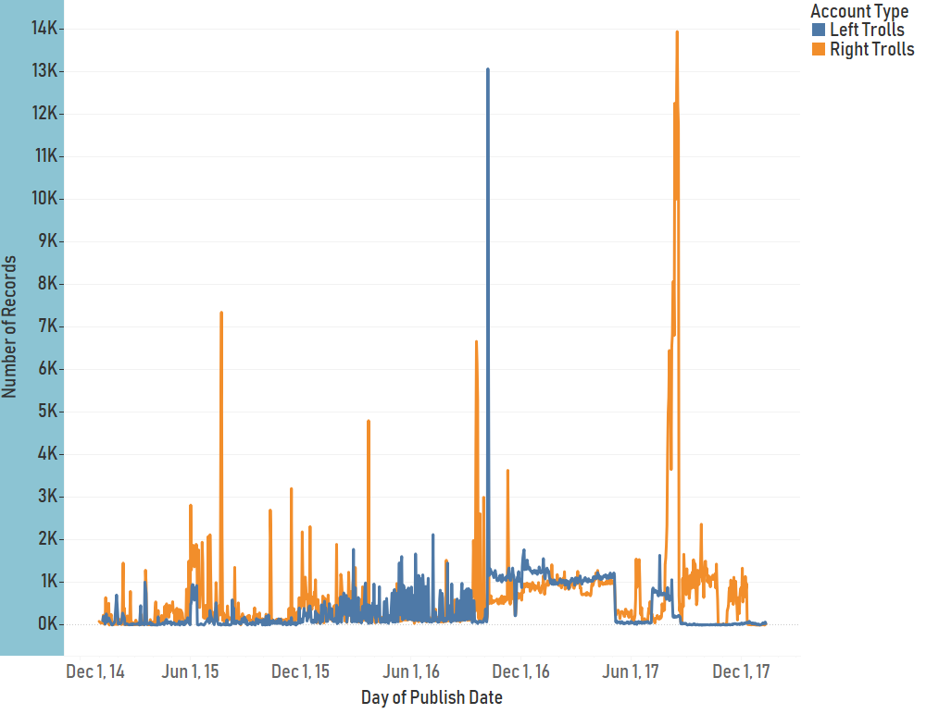
IRA Troll Tweets Dec 2014 – Dec 2018
Oct 5-8, 2016
Jul 28 –
Aug 26,
2017
July 20-24, 2015
Sep 11-30, 2016
Mar 21-23, 2016

Slide 6
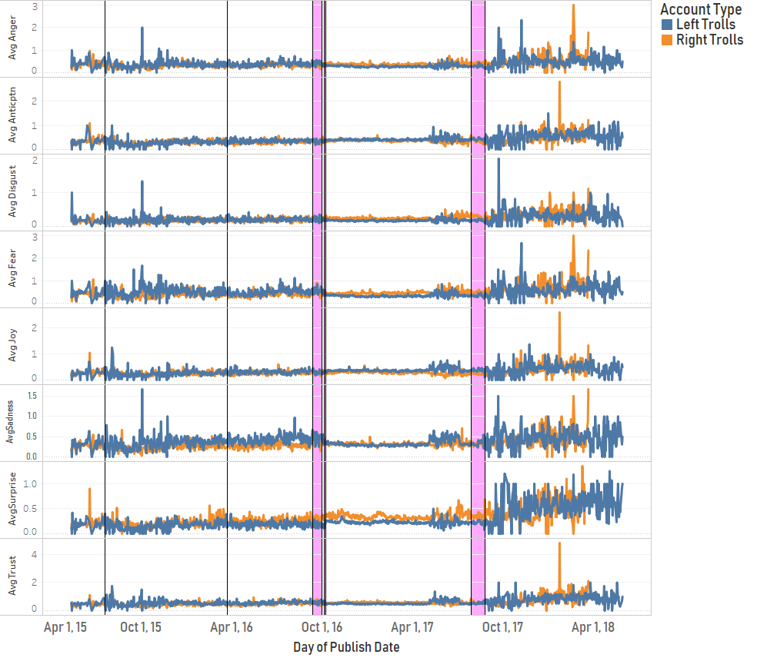
Emotion Analysis During Peak Tweet Periods
July 20-24, 2015
Mar 21-23, 2016
Sep 11-30, 2016
Oct 5-8, 2016
Jul 28 – Aug 26, 2017
Avg Anger
Avg Anticipation
Avg Disgust
Avg Fear
Avg Joy
Avg Sadness
Avg Surprise
Avg Trust
Notes:
Looking to see if emotion varied during peak periods by Troll type
While there were differences in emotion by troll type, they didn’t necessarily change during peak periods

Slide 7
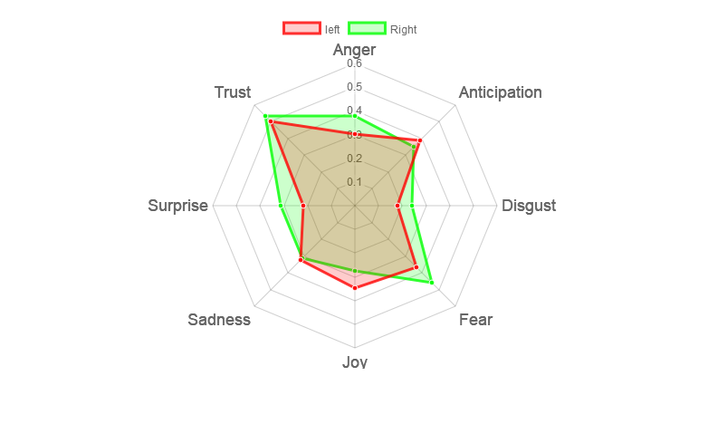
Emotion by Troll Type 2015-2017
Notes:
Right trolls use Fear, Anger, and Surprise to greater degree than left trolls

Slide 8
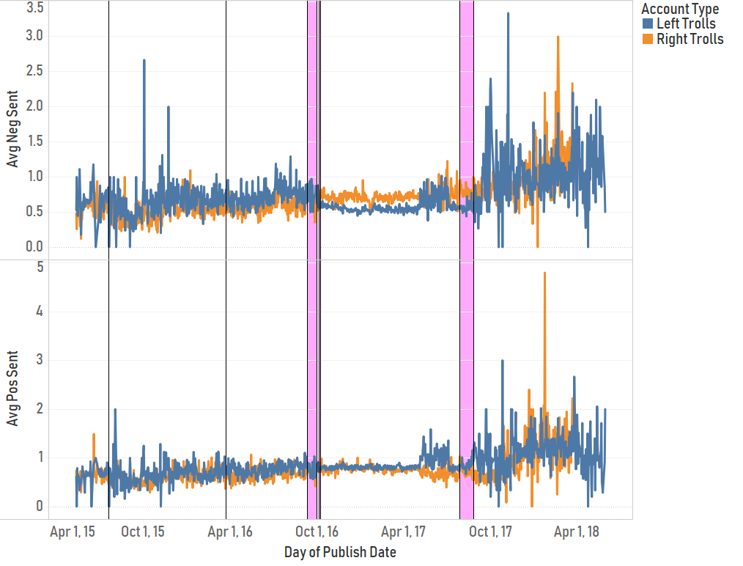
Sentiment Analysis During Peak Tweet Periods
July 20-24, 2015
Mar 21-23, 2016
Sep 11-30, 2016
Oct 5-8, 2016
Jul 28 – Aug 26, 2017
Avg Negative Sentiment
Avg Positive Sentiment
Notes:
-Like emotion, sentiment differed by Troll type but wasn’t specifically impacted by peak period tweets

Slide 9
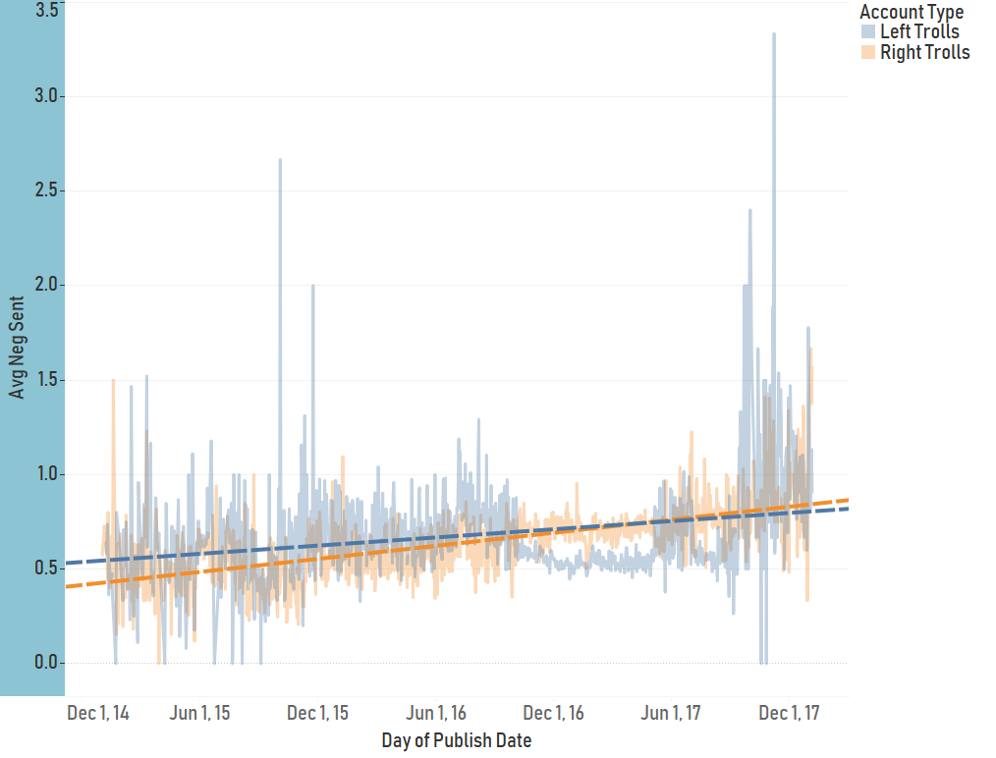
Negative Sentiment Trend 2015-2017
Notes:
-Negative sentiment increased by both Troll types with the rate of increase faster for Right trolls

Slide 10
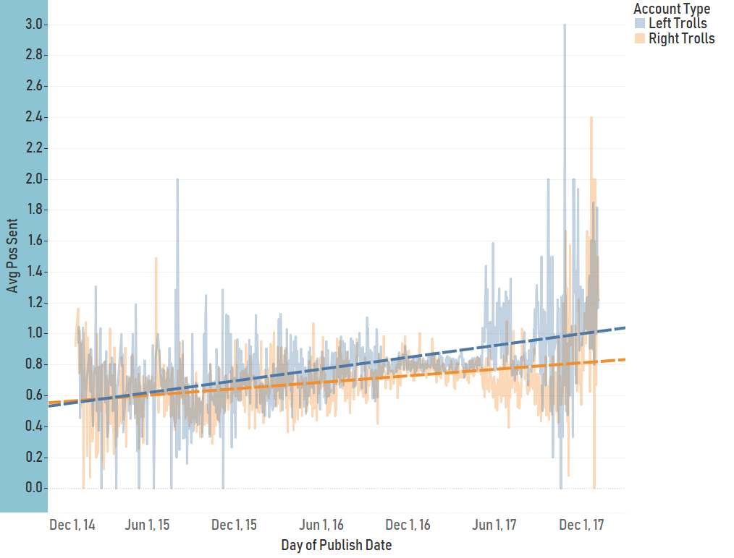
Positive Sentiment Trend 2015-2017
Notes:
- Positive sentiment also increased by both troll types with left trolls increasing faster than right

Slide 11
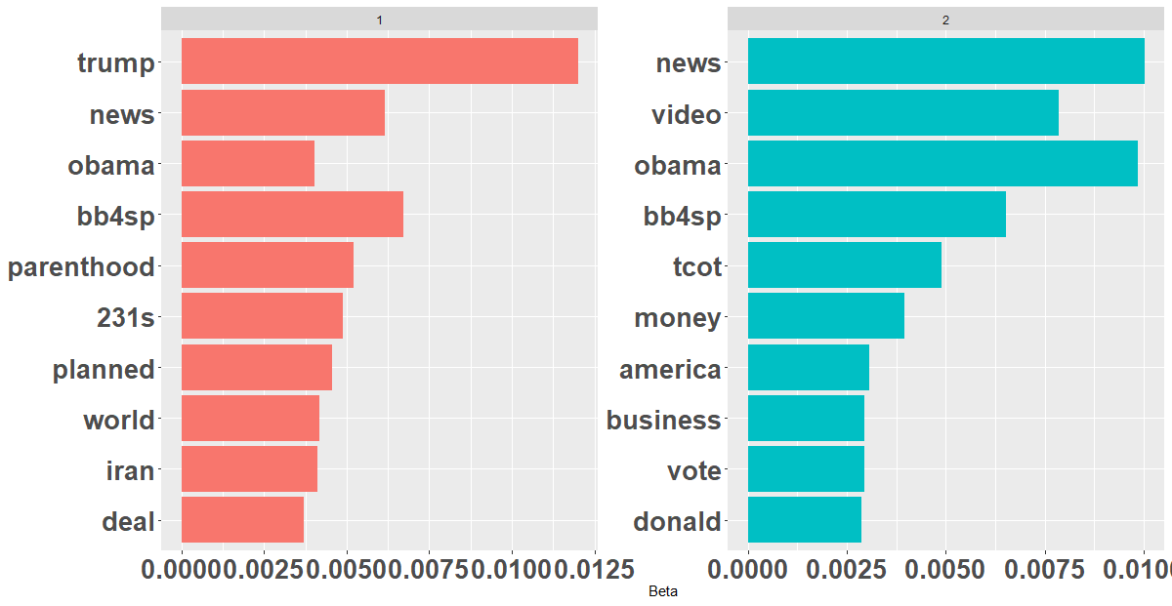
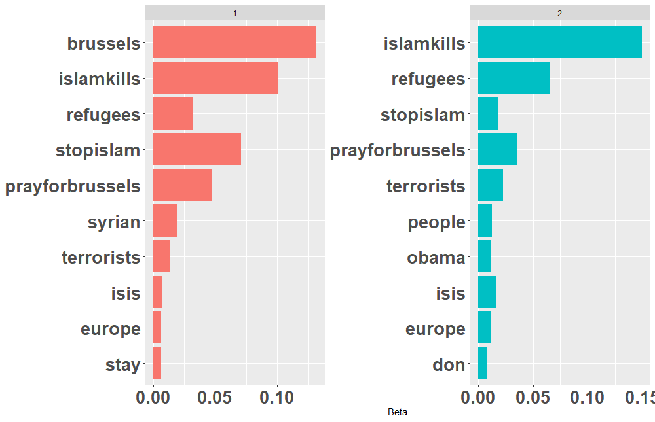
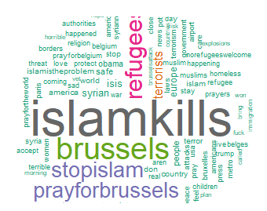
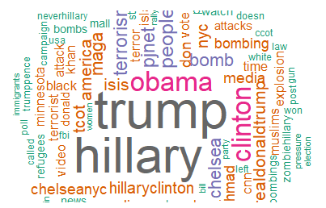
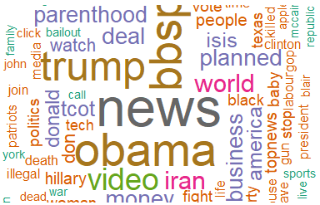
Peak Troll Tweet LDA Topic Values (Unsupervised)
July 20-24, 2015 (Right Trolls)
Mar 21-23, 2016 (Right Trolls)
Sep 11-30, 2016 (Right Trolls)
Sep 18-23, 2016 only
Notes:
Topic analysis and word use show a mix of useful information. Tweets during Mar 21-23, 2016 were heavily focused towards anti-Islamic sentiment
As the 2016 election neared, topics turned towards more predicatble topics indicative of troll types

Slide 12
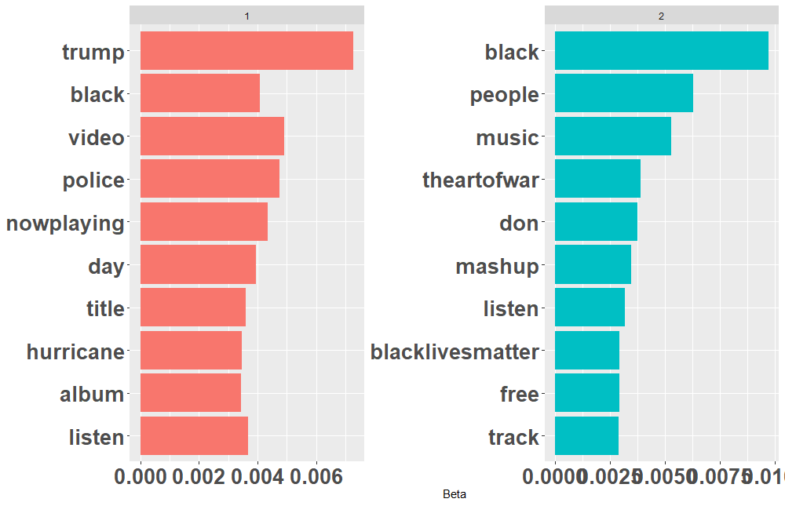
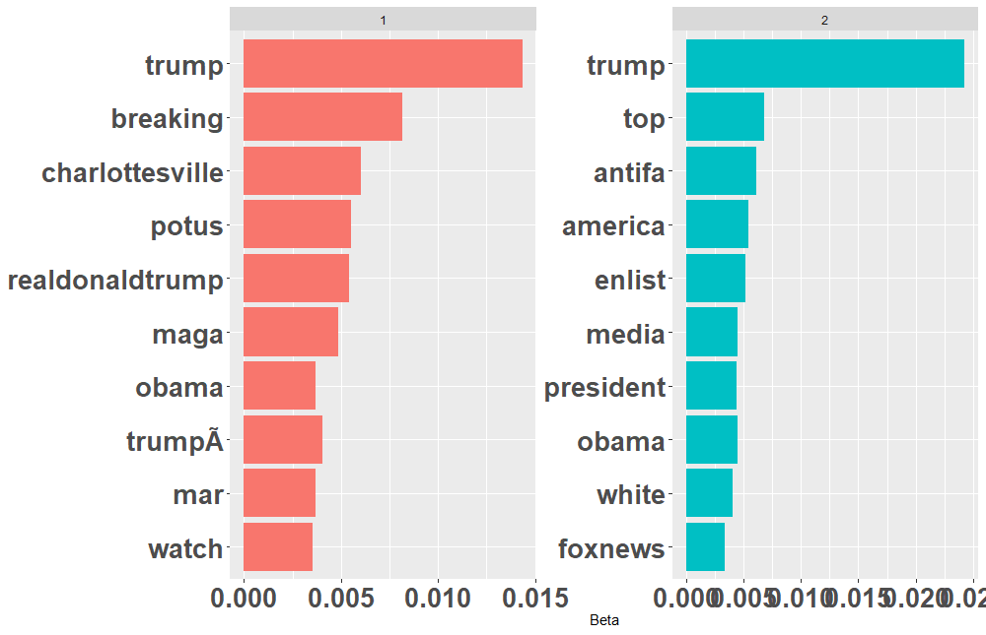
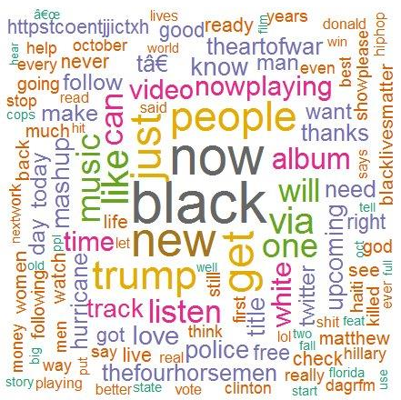
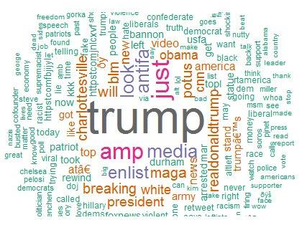
Peak Troll Tweet LDA Topic Values (Unsupervised)
Oct 5-8, 2016 (Left Trolls)
July 28 – Aug 26, 2017 (Right Trolls)
Aug, 15-16, 2017 only
Notes:
One of the peak tweet periods centered around the Aug 11-12 Unite the Right Rally in Charlottesville, VA
The high amount of traffic leading up to the Rally makes one consider if the Trolls were using it as a rallying point before, during, and after the “rally”

Slide 13
Peak Period Troll Summary
Differences in emotion and sentiment during peak periods were similar to trends before and after
Fear and Surprise emotions trended slightly higher for Right trolls while Joy trended slightly higher for Left trolls
Negative and Positive sentiment both trended up over the period, possibly indicating more extreme positions of Trolls
Positive sentiment increased at twice the rate for Left Trolls than for Right Trolls
Left Trolls started with a higher degree of negative sentiment but were overtaken by Right Trolls shortly after the Nov 2016 election
Tweets in Mar 22, 2016 around the time of terror attacks in Brussels showed strong anti-Islamic bias
Tweet topics around the Aug 11-12 Charlottesville, VA Unite the Right rally and subsequent riots were reflective of the events of that period…however there is a period of tweet volume by Right Trolls leading up to the rally date that looks suspicious and needs further investigation

Slide 14
Right Troll LDA Topic Words
2 hrs before work | morning work | lunch | afternoon work | 2 hrs after work | evening leisure | sleep
obama | obama | obama | obama | obama | obama | obama
people | people | people | people | people | people | people
pjnet | pjnet | pjnet | pjnet | pjnet | pjnet | pjnet
trump | trump | trump | trump | trump | trump | trump
hillary | hillary | hillary | hillary | hillary | hillary
america | america | america |  | america | america
don | don | don | don | don
 | realdonaldtrump | realdonaldtrump |  | realdonaldtrump | realdonaldtrump | realdonaldtrump
tcot | tcot | tcot |  | tcot |  | tcot
 | abi | abi | abi |  | abi
 | abiss | abiss | abiss |  | abiss
clinton | clinton |  |  | clinton | clinton
isis | isis |  | isis |  |  | isis
 |  |  | news | news | news | news
breaking |  |  |  | breaking | breaking
ccot |  | ccot |  |  |  | ccot
life |  | life | life
 |  |  | maga | maga |  | maga
 |  | president | president | president
time | time |  | time
accounts |  |  |  |  |  | accounts
american |  |  |  | american
 |  | day |  |  | days
 |  | enlist |  |  |  | enlist
god |  |  |  |  |  | god
 |  | gun |  |  |  | guntrust
 |  |  |  |  | iceisis | iceisis
 | love | love
 |  |  |  | remember | remember
 |  |  | rrzgbccxbo |  |  | rrzgbccxbo
 | usfa |  | usfa
 | world |  |  | world
For LDA topics found in more than one time category
Time category analysis restricted to tweets with one or more topic words in a given time category
Notes:
Let’s take a look at differences in topics, sentiment, and emotional appeal by time of day
We broke the hours of the day into logical categories
You see similar types of topics over the course of the day
Some of these words we were previously unfamiliar with such as “pjnet”, a reference to the Patriot Journalist Network, a right-wing twitter bot shut down by twitter in late 2017. It appears the trolls were leveraging the same user base

Slide 15
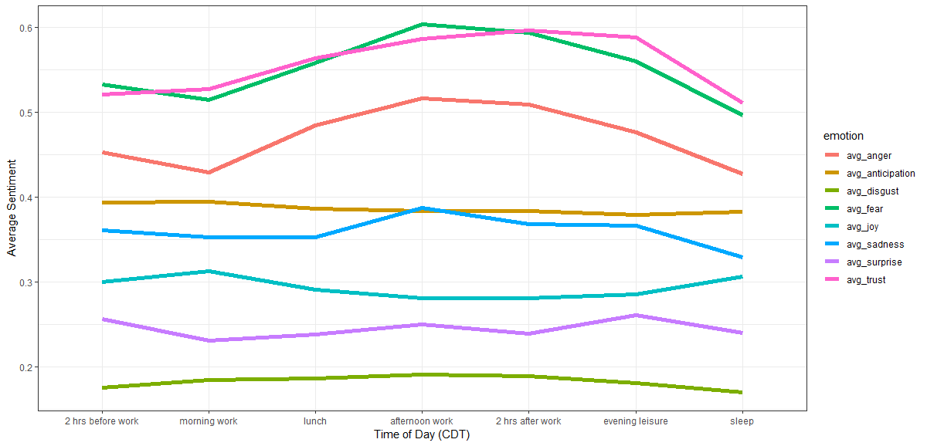
Emotional Appeal by Time of Day
Fear
Trust
Anger
Anticipation
Sadness
Joy
Surprise
Disgust
Notes:
- Looking at average emotion by time of day, we see that fear, trust, and anger appear somewhat higher in afternoon and evening hours

Slide 16
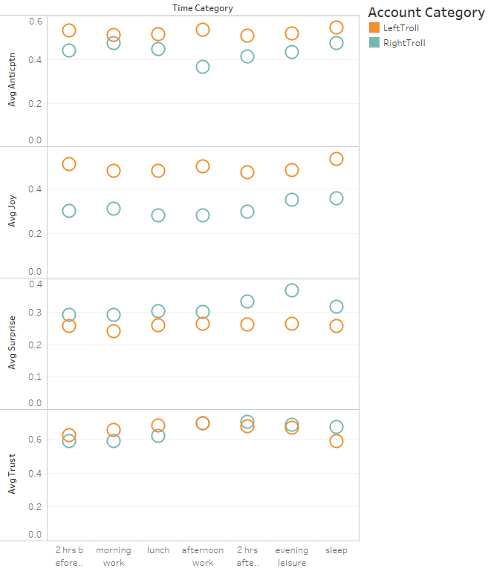
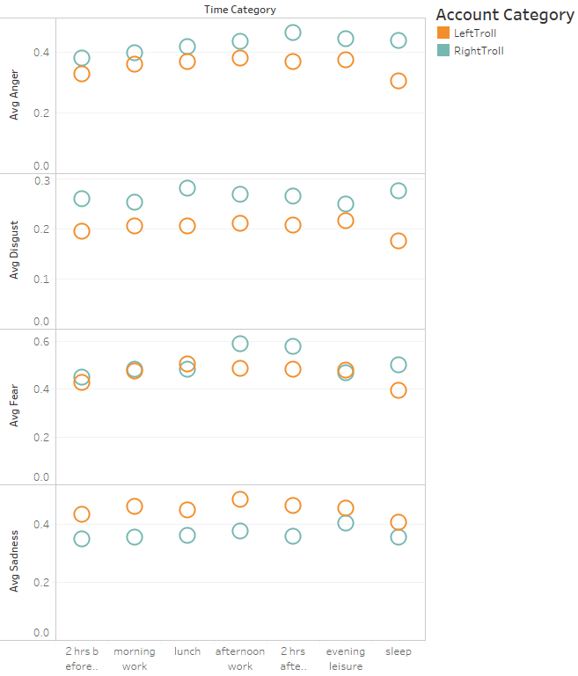
Emotional Appeal by Time of Day
Avg Anger
Avg Anticipation
Avg Disgust
Avg Joy
Avg Surprise
Avg Fear
Avg Trust
Avg Sadness
Notes:
If we look at it further by troll type we continue to see a somewhat predictable patter with a couple of anomalies:
Disgust and Anger go up for Right Trolls and down for Left Trolls and bedtime

Slide 17
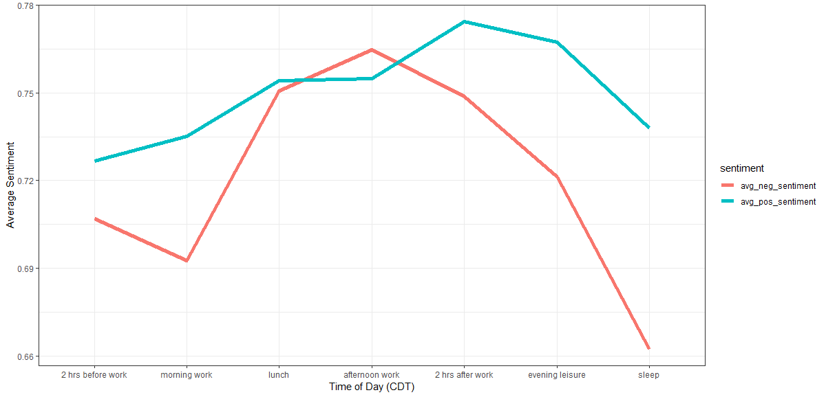
Sentiment by Time of Day
Positive
Negative
Notes:
Sentiment by time of day is also similar with a slight drop-off as the night goes on

Slide 18
Time of Day Tweet Analysis Findings
Tweets exhibit greater degrees of fear, anger, and trust than other emotions
Tweets exhibit greater degrees of fear, anger, and trust in the afternoon and evening
It’s not obvious from our analysis that tweet composition/topic/tone was intentionally changed by time of day

Slide 19
Top Things to Take Away
The US electorate is being manipulated through social media by foreign powers
The manipulation was not just related to the 2016 election but is ongoing
The techniques being used are sophisticated enough that it is not obvious how to reverse-engineer the attack strategy
Think twice before re-tweeting messages of unknown origin

Slide 20
Backup

Slide 21
Sentiment & Emotion Analysis
R Syuzhet Package- implements Saif Mohammad’s NRC emotion lexicon
Emotion
Sentiment
 | anger | antici-pation | disgust | fear | joy | sadness | surprise | trust |  | negative | positive
RT mb141bar: Dear Lord, protect, guide, bless our President Trump.Please save us from those attempting to harm him https://t.co/mu8fHj1V50 | 0 | 1 | 1 | 1 | 2 | 0 | 1 | 5 |  | 2 | 7
Another example of how all liberals are hateful, corrupt, lying, evil, deceitful, hypocritical, despicable pieces of s*** like @HussamA https://t.co/6E0oT6pDPp | 5 | 0 | 7 | 2 | 0 | 3 | 0 | 0 |  | 8 | 0
Good Night Warriors! Remember White Supremacy Must be Destroyed Globally in order for True Peace & Real Justice to Reign. https://t.co/eLiMbwhD5L | 2 | 4 | 0 | 2 | 4 | 1 | 2 | 6 |  | 2 | 6
@4mysquad And so #BLM is called a "hate group" while cops sworn to serve and protect commit murder, torture, aggravated assault and theft.' | 6 | 1 | 4 | 5 | 0 | 4 | 1 | 1 |  | 7 | 1
Right
Left

Slide 22
Right Troll LDA Topic Words
2 hrs before work | morning work | lunch | afternoon work | 2 hrs after work | evening leisure | sleep
 |  |  |  |  | abcgopdebate
 |  |  |  |  | abcnews
 |  |  |  |  | antifa
 |  |  |  |  | article
 | breitbartnews
 |  |  | brussels
 |  | country
 |  |  |  | cuba
 |  |  |  |  | demdebate
 |  |  |  |  | demndebate
 |  |  |  |  | diversity
 |  |  |  | fail
 |  |  |  | fraud
florida
 | girl
gop
 |  |  |  |  | gopdebate
 |  | guns4ny
 |  |  | illegal
 |  |  |  | iran
 |  |  | islamkills
 |  |  | james
 |  |  |  |  | kill
live
 |  |  |  |  |  | opiceisis
 | permit
 | picture
 |  | prayers4california
 |  |  | refugees
rubio
 | salary
 |  |  | stand
 |  |  | stop
 |  |  | stopislam
 |  |  |  | students
 |  |  |  |  |  | targeted
 |  |  |  |  |  | targets
 |  |  |  |  | time
 |  | trumpbecause
 |  |  |  | trumpforpresident
 |  |  |  |  | vegasgopdebate
 |  |  |  | vote
 |  |  |  |  |  | wikileaks
 |  |  |  | woman
For LDA topics found in only one time category

