Slide 1
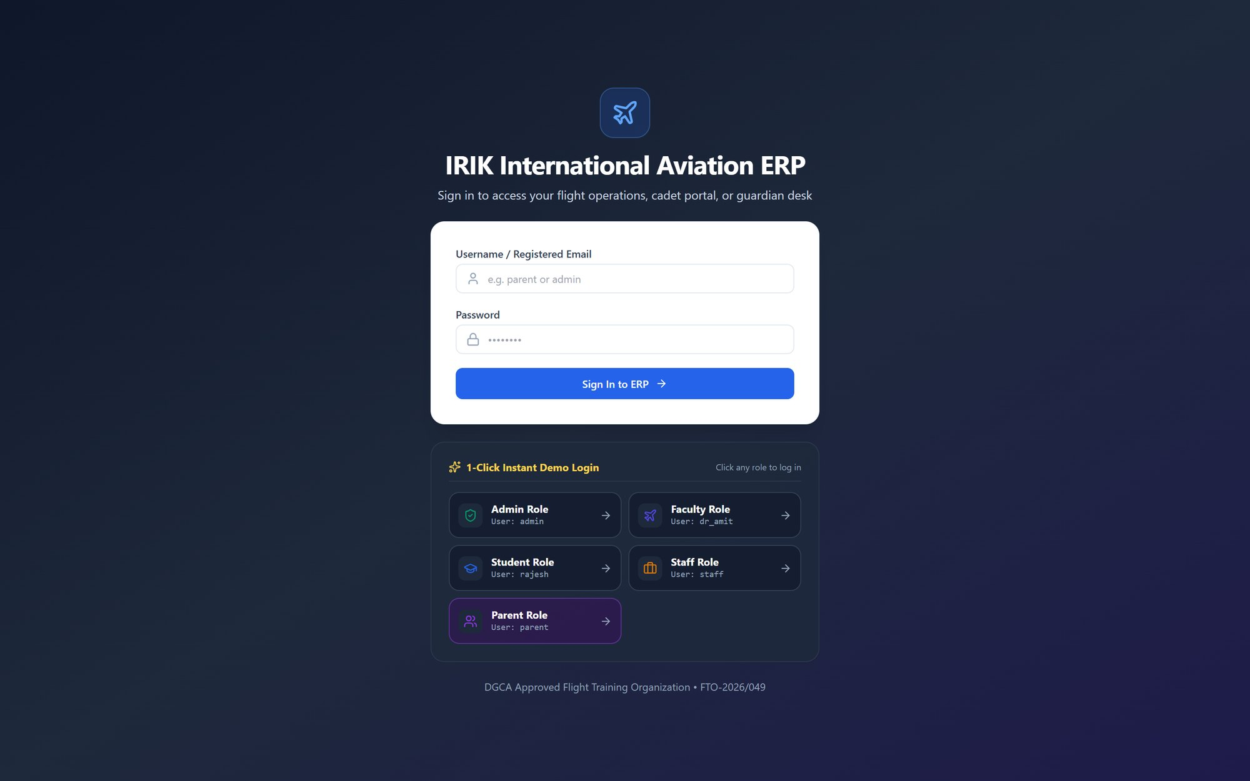
IRIK Aviation ERP
PRODUCT SHOWCASE · FOR MANAGEMENT & STAFF
One platform to run admissions, flight training, fees, staff and compliance — for every person on campus
Notes:
Welcome. Today we'll walk through the IRIK Aviation ERP — a single web application that replaces registers, spreadsheets and scattered WhatsApp updates. Everything you'll see is a live screenshot of the working system.

Slide 2






From scattered registers to one live system
TYPICAL TODAY
WITH IRIK ERP
Attendance on paper registers
Digital roll call that flags anyone below the 75% DGCA threshold
Fee dues tracked in spreadsheets
Live fee ledger with online payment and instant receipts
Schedule changes sent over WhatsApp
One timetable with simulator allocation and clash detection
Parents calling the office for updates
Parent portal showing dues, attendance and progress
Compliance papers in physical files
Signed-document vault and airworthiness tracking with audit trail
Notes:
These are the everyday pain points most institutes have. On the right is what each one becomes in the ERP. We'll see each of these screens in a moment.

Slide 3
The whole institute in one application
23
5
1
0
modules
role portals
login per person
installs needed
Admissions to payroll, fleet to alumni
Management, staff, instructor, student, parent
Each role sees only what it needs
Runs in any browser, phone or PC
Academics & Flight Ops
Finance & People
Admissions CRM · Students · Timetable & Flights · Attendance · Courses · Enrollments
Fee Management · Finance & Ledger · HR & Payroll · Faculty Directory
Operations & Compliance
Learning & Services
Fleet & Compliance · Visitor & Gate Pass · Hostel · Roles & Permissions
E-Learning / LMS · Instructor Ratings · ID Cards · Feedback · E-Sign · Library · Alumni
Notes:
At a glance: 23 modules and 5 portals in one system. Nothing to install — staff use a browser, students and parents can use their phones.

Slide 4
For the owner & management
01
Live dashboard · Finance & ledger · Fees · HR & payroll · Roles & permissions
Notes:
First, what the owner and management team see.

Slide 5
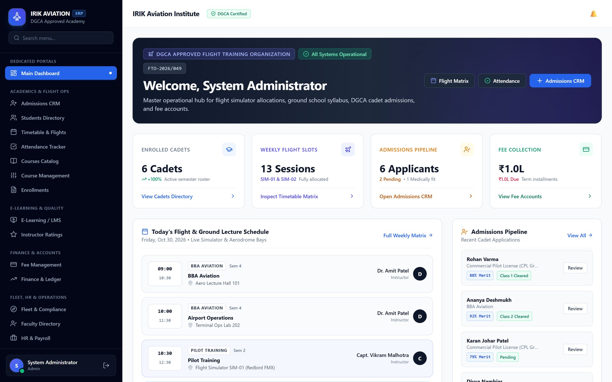



Main dashboard: the institute on one screen
Four live KPIs
Enrolled cadets, weekly flight slots, admissions pipeline and fee collection
Today's schedule
Every ground lecture and simulator session with its instructor
Admissions at a glance
Recent applicants with merit score and medical status
Notes:
This is the first screen the owner sees after login. Four numbers tell you the health of the institute; below is today's flying and lecture schedule and the latest applications waiting for review.

Slide 6
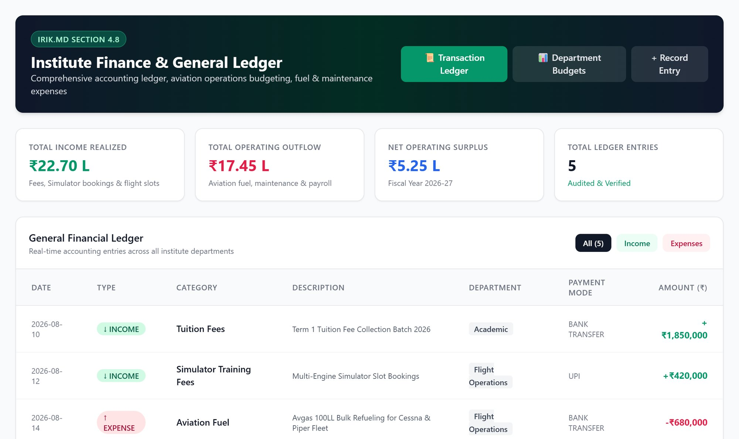



Finance & ledger: income, expenses and surplus
Income vs outflow
Realised income, operating spend and net surplus for the year
General ledger
Every entry tagged by category, department and payment mode
Department budgets
See where fuel, maintenance and payroll money goes
Notes:
Finance and ledger: tuition and simulator income on one side, fuel, aircraft maintenance and payroll on the other. Every rupee has a category and department.

Slide 7
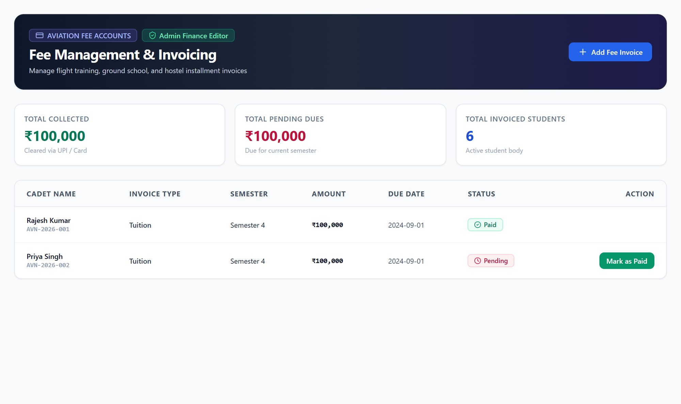



Fee management with online payment
Invoices per cadet
Tuition, hostel, lab and transport fees with due dates
Pay online
Razorpay and UPI QR checkout; status updates to Paid automatically
Automatic reminders
Students and parents are notified about dues and receipts
Notes:
Fee management. Each cadet's invoices, what is collected and what is pending. Online payment through Razorpay and UPI is built in — it activates once the institute's Razorpay merchant account is connected.

Slide 8
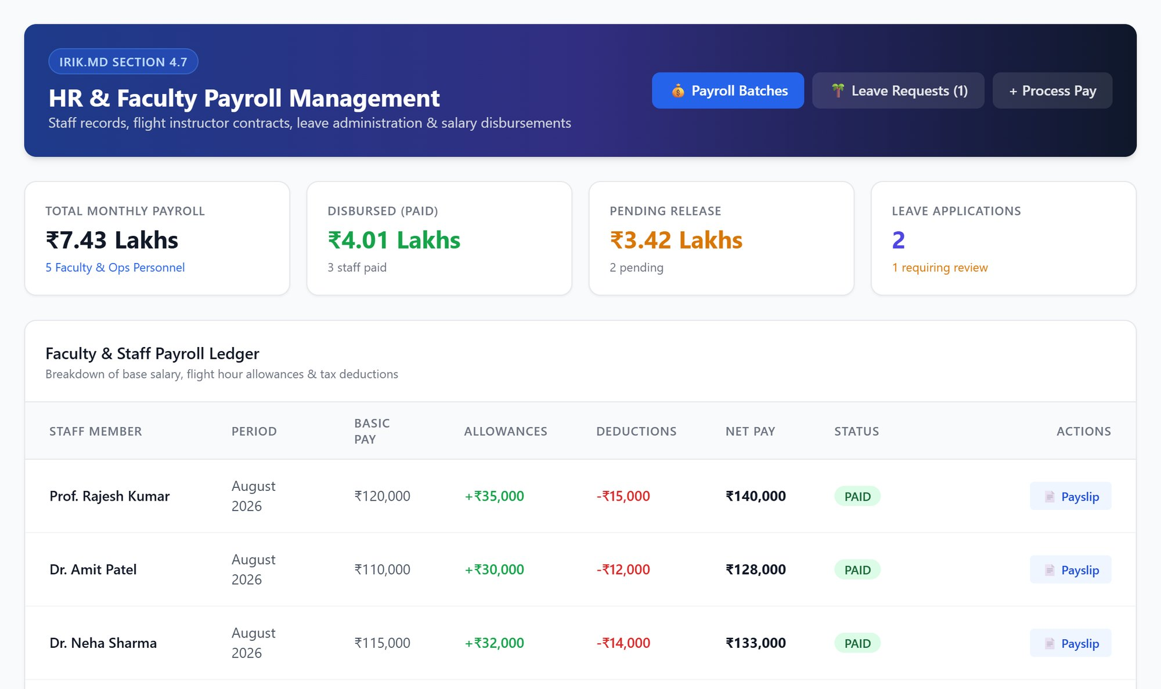



HR & payroll for faculty and staff
Monthly payroll
Basic pay, allowances and deductions calculated per person
Payslips & release
Track paid and pending salaries; issue payslips in one click
Leave requests
Approve or reject leave applications from the same screen
Notes:
HR and payroll: the monthly salary run for instructors and staff, what has been released and what is pending, plus leave approvals.

Slide 9
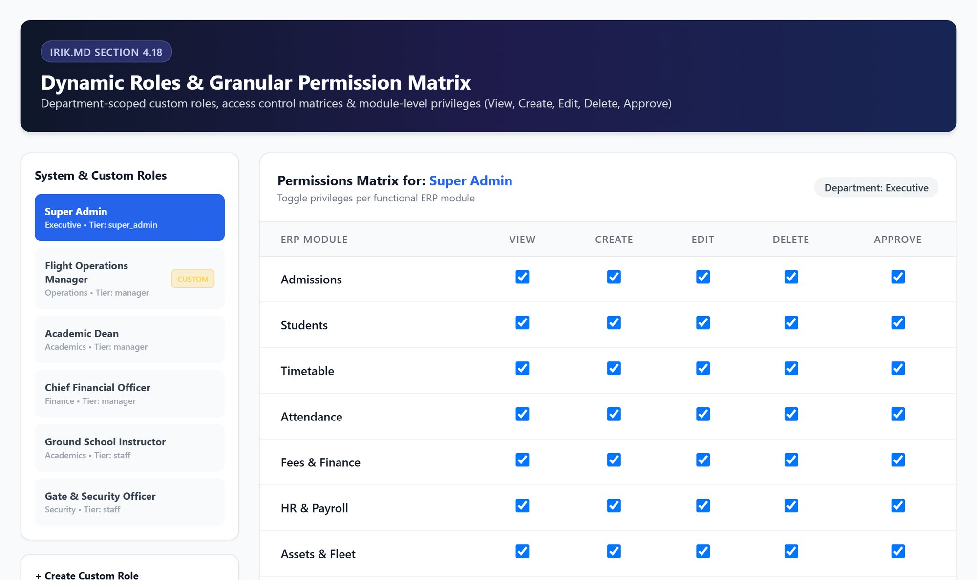



Roles & permissions: control who sees what
Ready-made roles
Super Admin, Academic Dean, CFO, Ground Instructor, Gate Officer and more
Granular matrix
View, create, edit, delete and approve rights for every module
Custom roles
Create a new role for any department in seconds
Notes:
Security. Management decides exactly what each role can do — for example the gate officer only sees visitor management, the accountant only finance.

Slide 10
Academics & flight operations
02
Admissions CRM · Timetable & simulators · Attendance · Fleet compliance · E-learning
Notes:
Next, the academic and flight-operations side used every day by the dean, instructors and office staff.

Slide 11
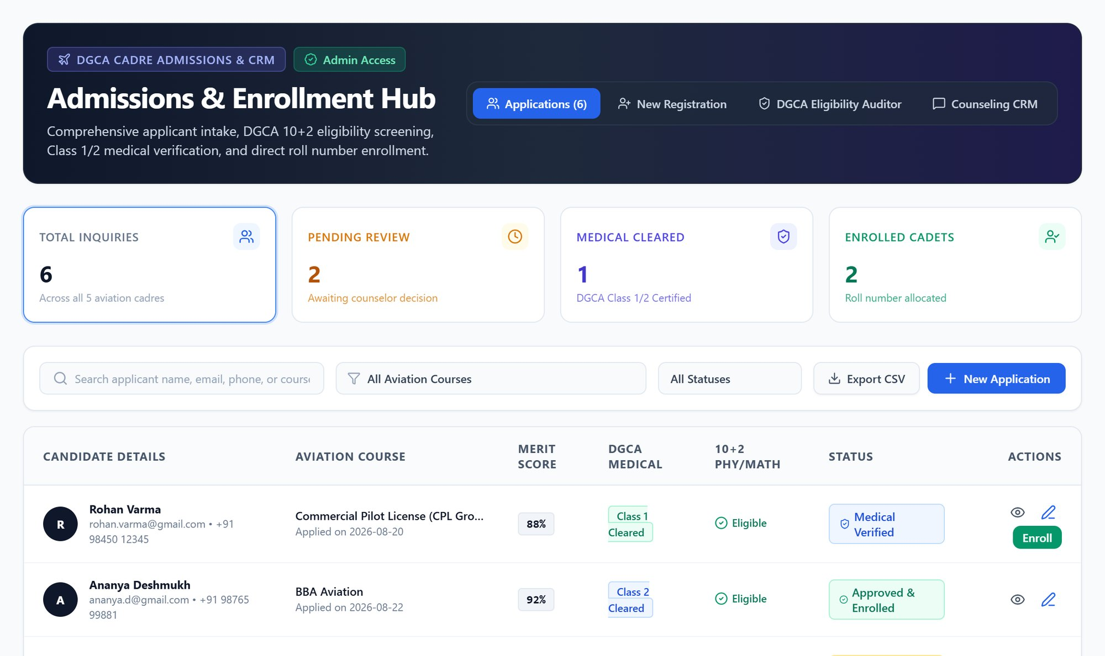



Admissions CRM: from enquiry to enrolled cadet
Full pipeline
Enquiries, pending review, medically cleared and enrolled
DGCA eligibility check
10+2 Physics/Maths, merit score and Class 1/2 medical
Counselling CRM
Follow-ups and status for every applicant
Notes:
Admissions: every enquiry is tracked until enrolment. The system checks DGCA eligibility — Physics and Maths in 10+2 and the medical class — so counsellors don't miss anything.

Slide 12
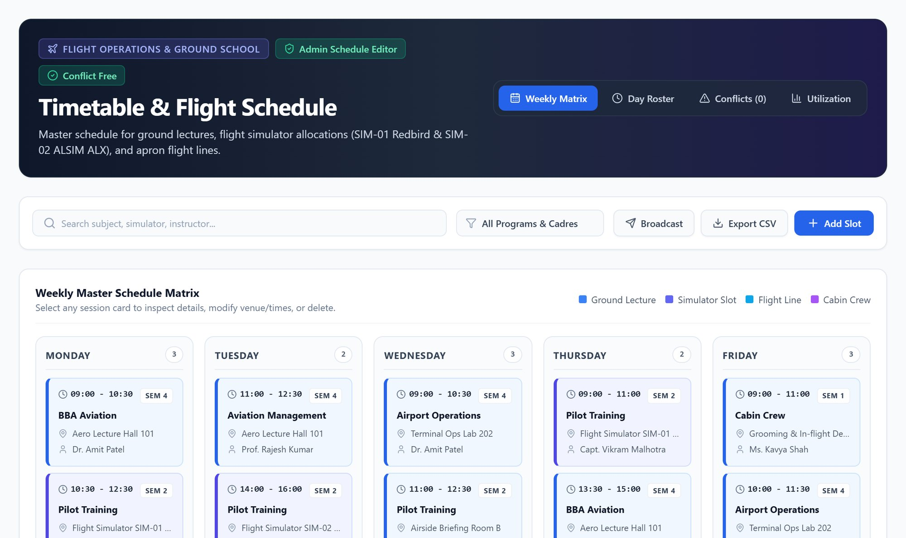
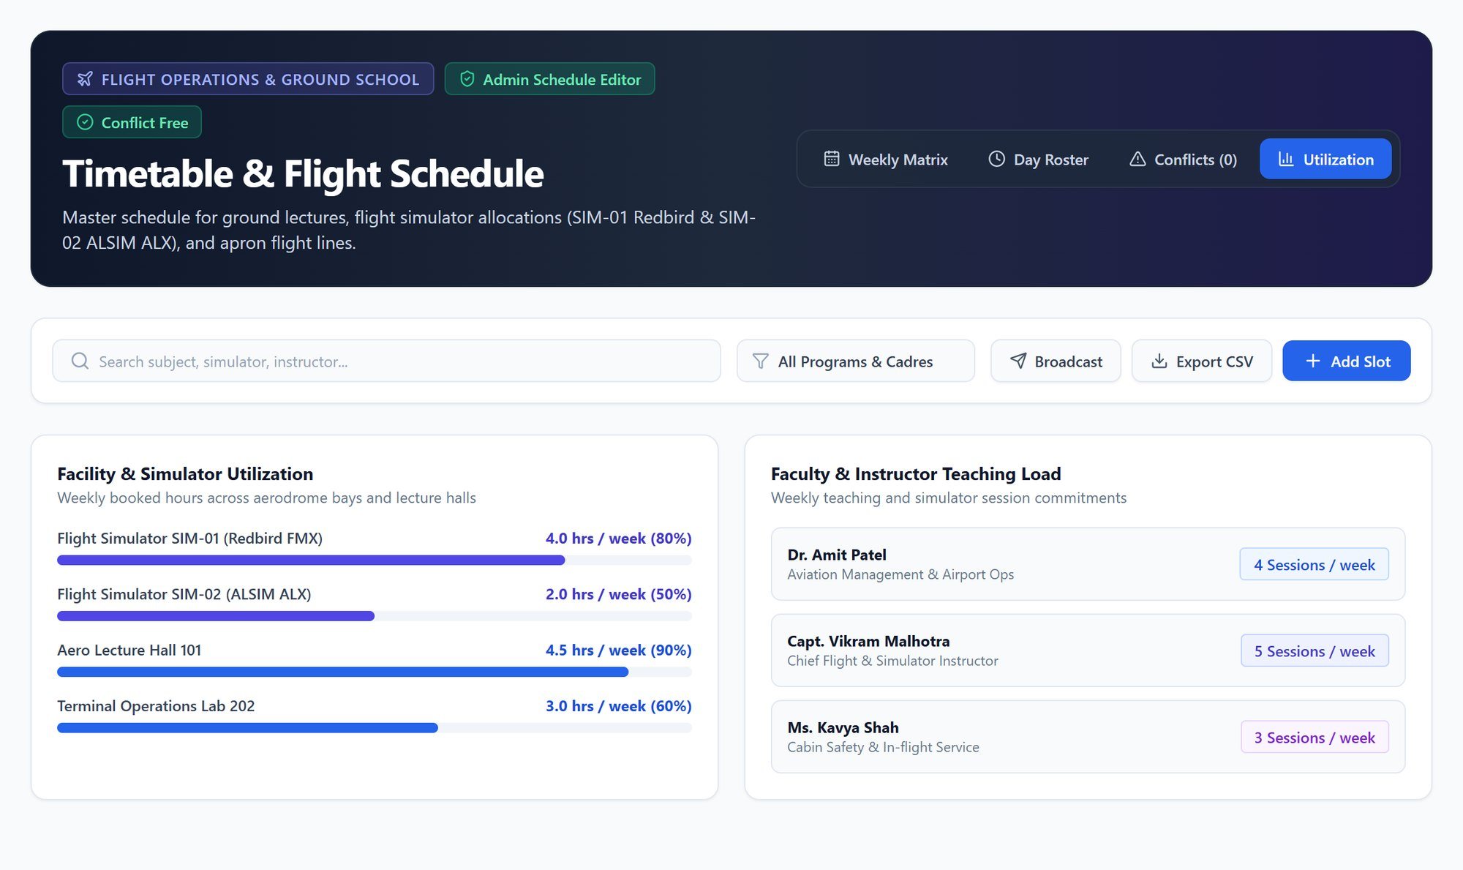
Timetable & flight schedule without clashes
Weekly matrix
Simulator & instructor utilisation
Ground lectures, SIM-01/SIM-02 slots, flight lines and cabin-crew classes in one colour-coded view, with automatic conflict detection
Hours used per simulator and lecture hall, and weekly teaching load per instructor — so expensive assets are never idle
Notes:
The timetable is the heart of flight operations. Left: the weekly matrix — the system warns if a simulator, room or instructor is double-booked. Right: utilisation, showing how many hours each simulator and instructor is actually used. Schedules can be exported or broadcast to students.

Slide 13
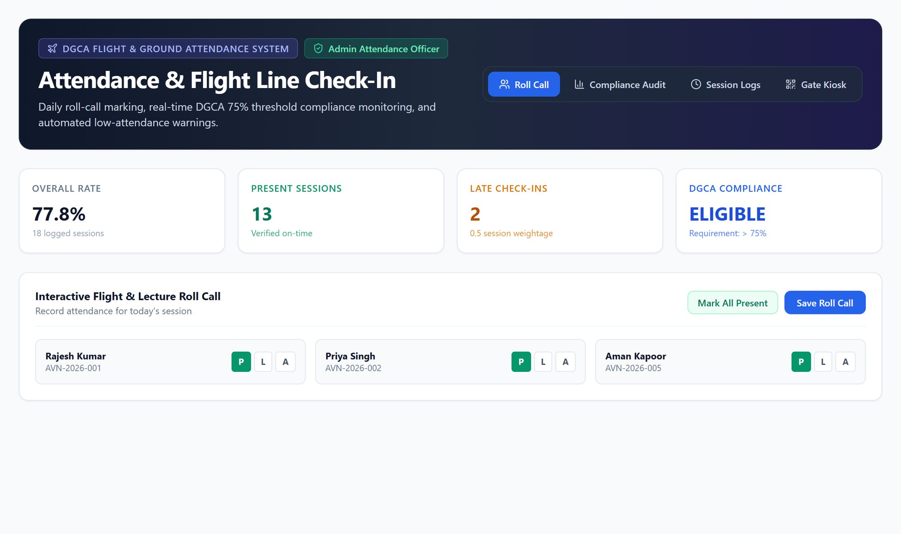



Attendance & DGCA compliance
One-tap roll call
Mark present, absent or late for the whole batch
75% threshold alerts
Cadets at risk of DGCA ineligibility are flagged early
Session logs & gate kiosk
Audit-ready records of every class and check-in
Notes:
Attendance. Instructors mark roll call in seconds. The system tracks the DGCA 75% requirement and flags cadets who are slipping, long before exams.

Slide 14
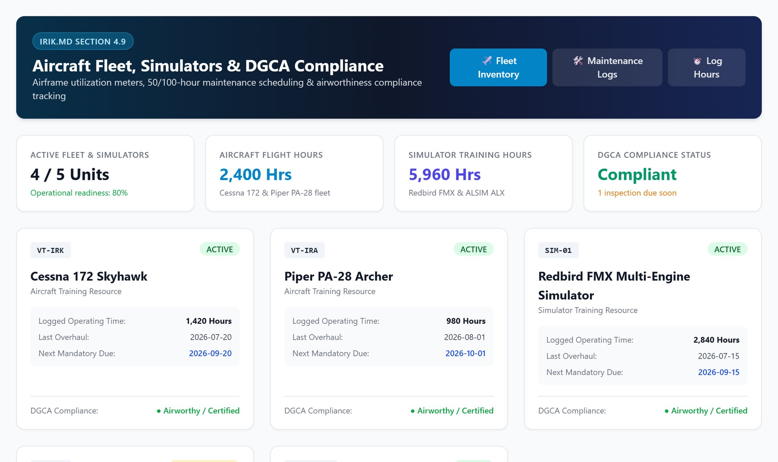


Fleet, simulators & airworthiness
Aircraft & simulators
Cessna 172, Piper PA-28, Redbird FMX, ALSIM ALX in one register
Hours & maintenance
Logged operating time and next mandatory maintenance due
Compliance status
Airworthiness certificates tracked for DGCA inspection
Notes:
Fleet and compliance. Every aircraft and simulator, its flying hours, when maintenance is next due and its airworthiness status — ready for a DGCA audit.

Slide 15
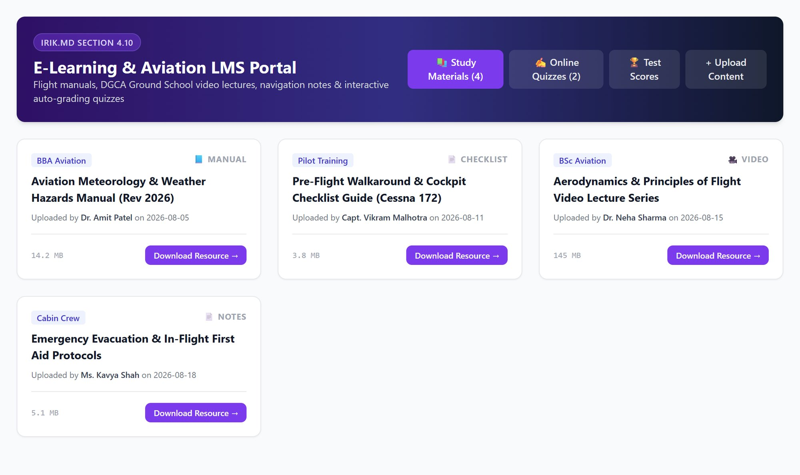
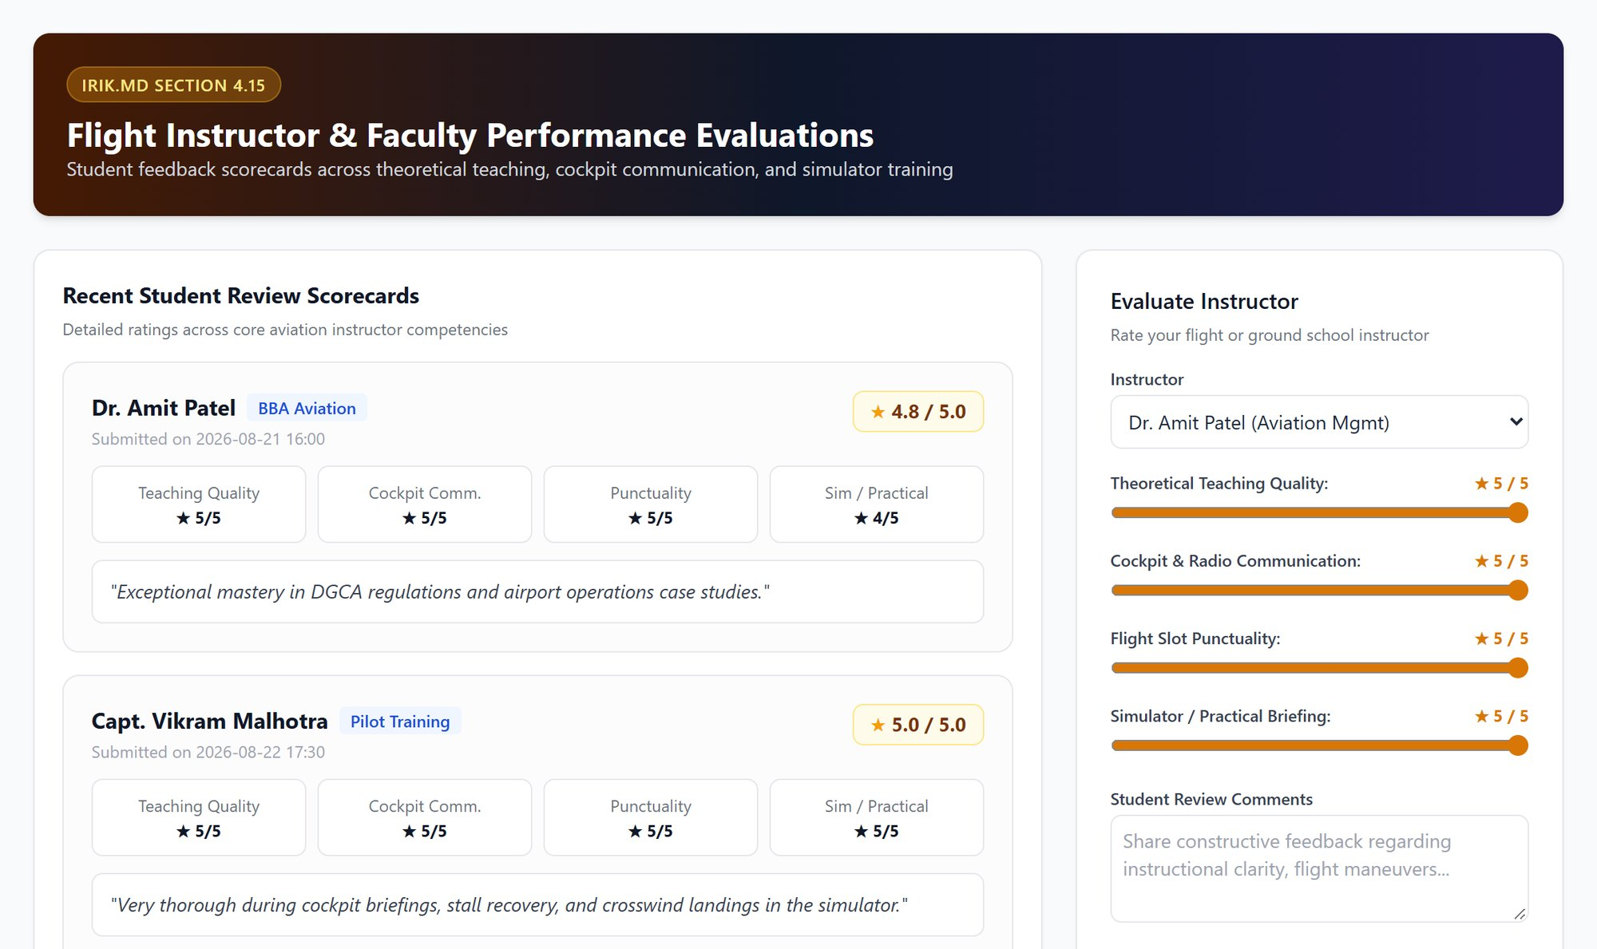
E-learning and instructor quality
E-Learning / LMS
Instructor ratings
Study manuals, checklists, video lectures and online quizzes uploaded by instructors and downloaded by cadets
Students score teaching, cockpit communication and punctuality — management sees a scorecard for every instructor
Notes:
Learning content lives in the LMS, and students rate their instructors — giving management objective data on teaching quality.

Slide 16
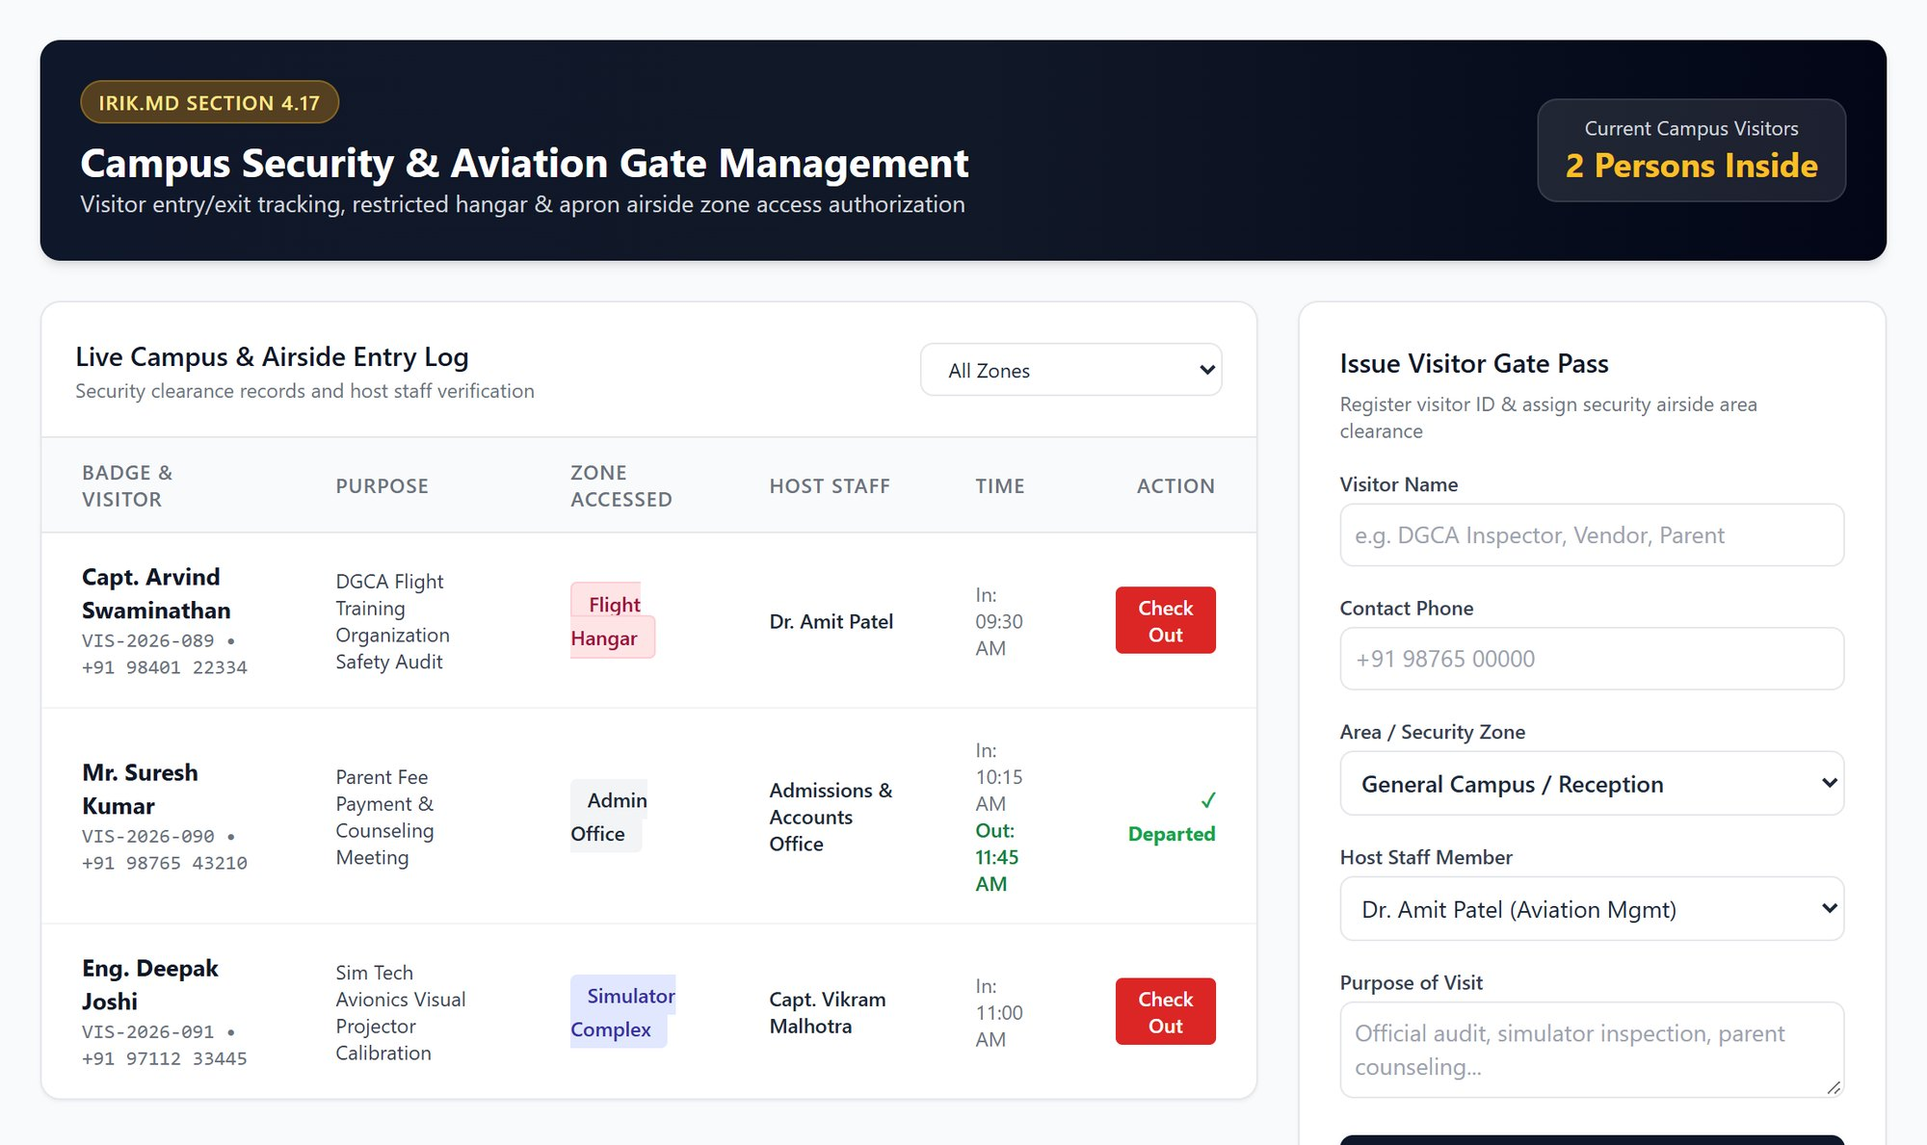
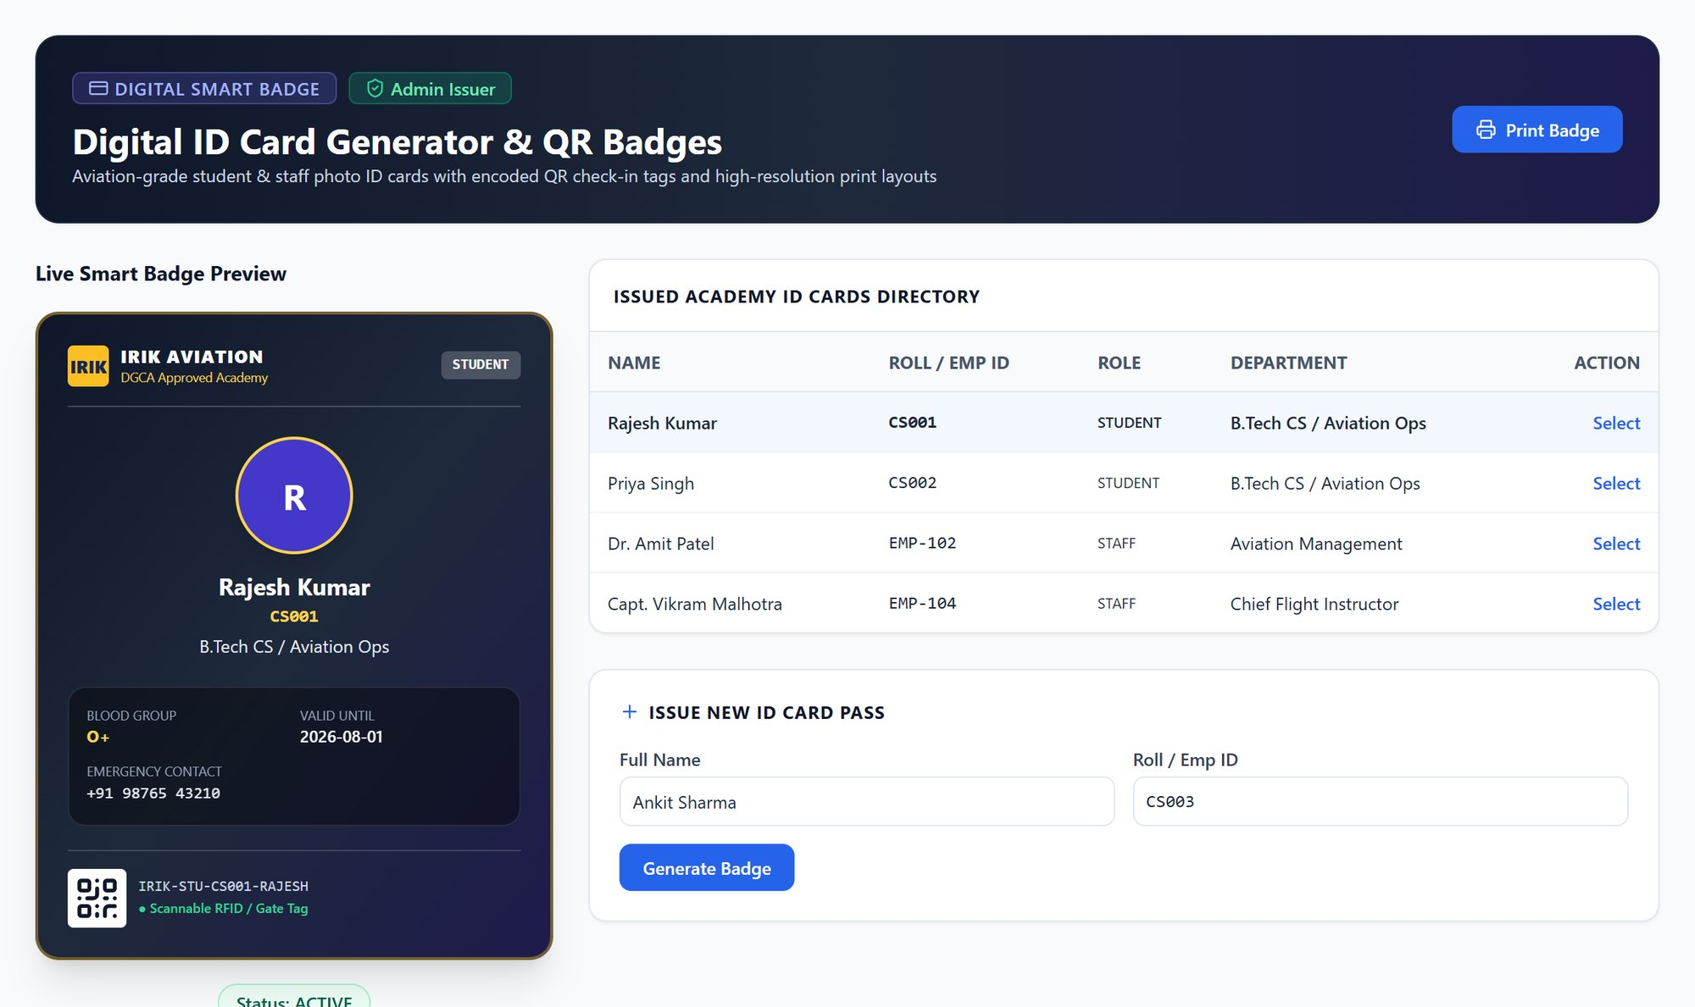
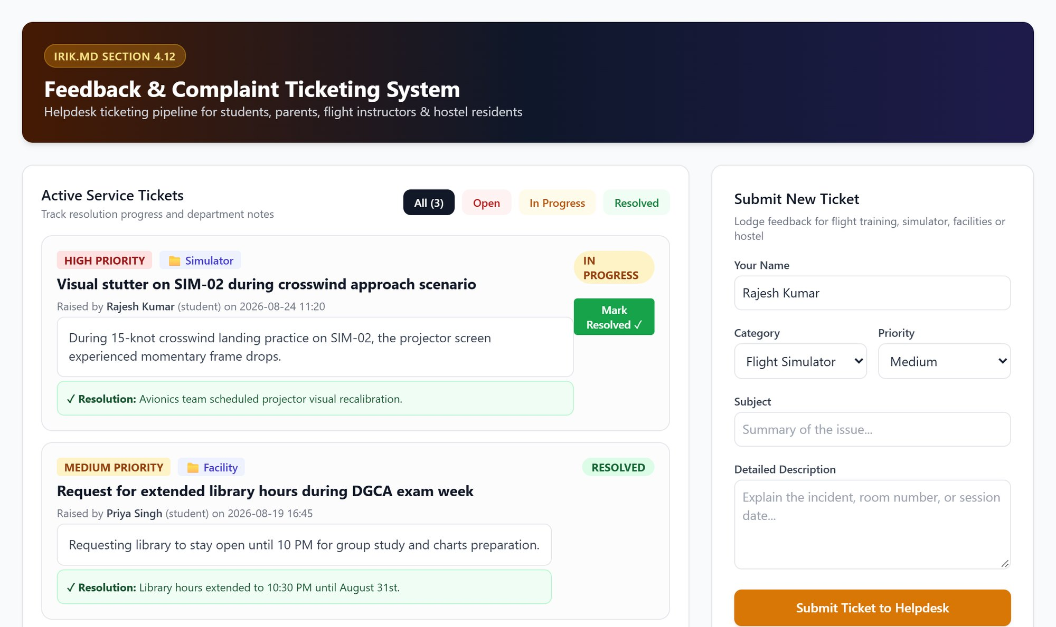
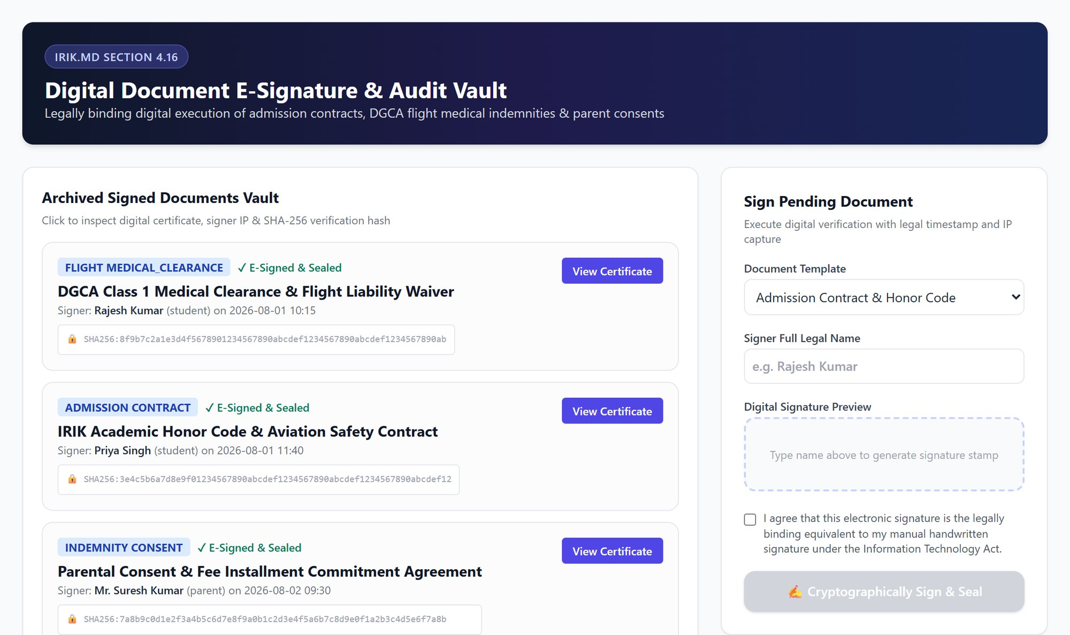
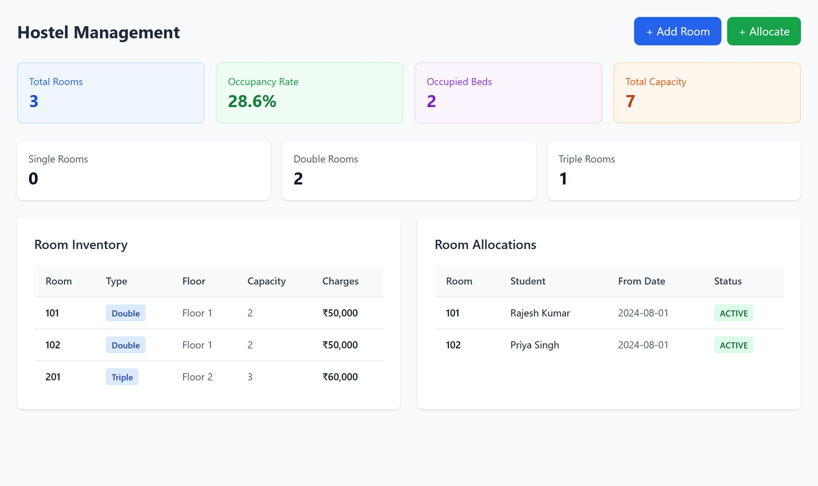
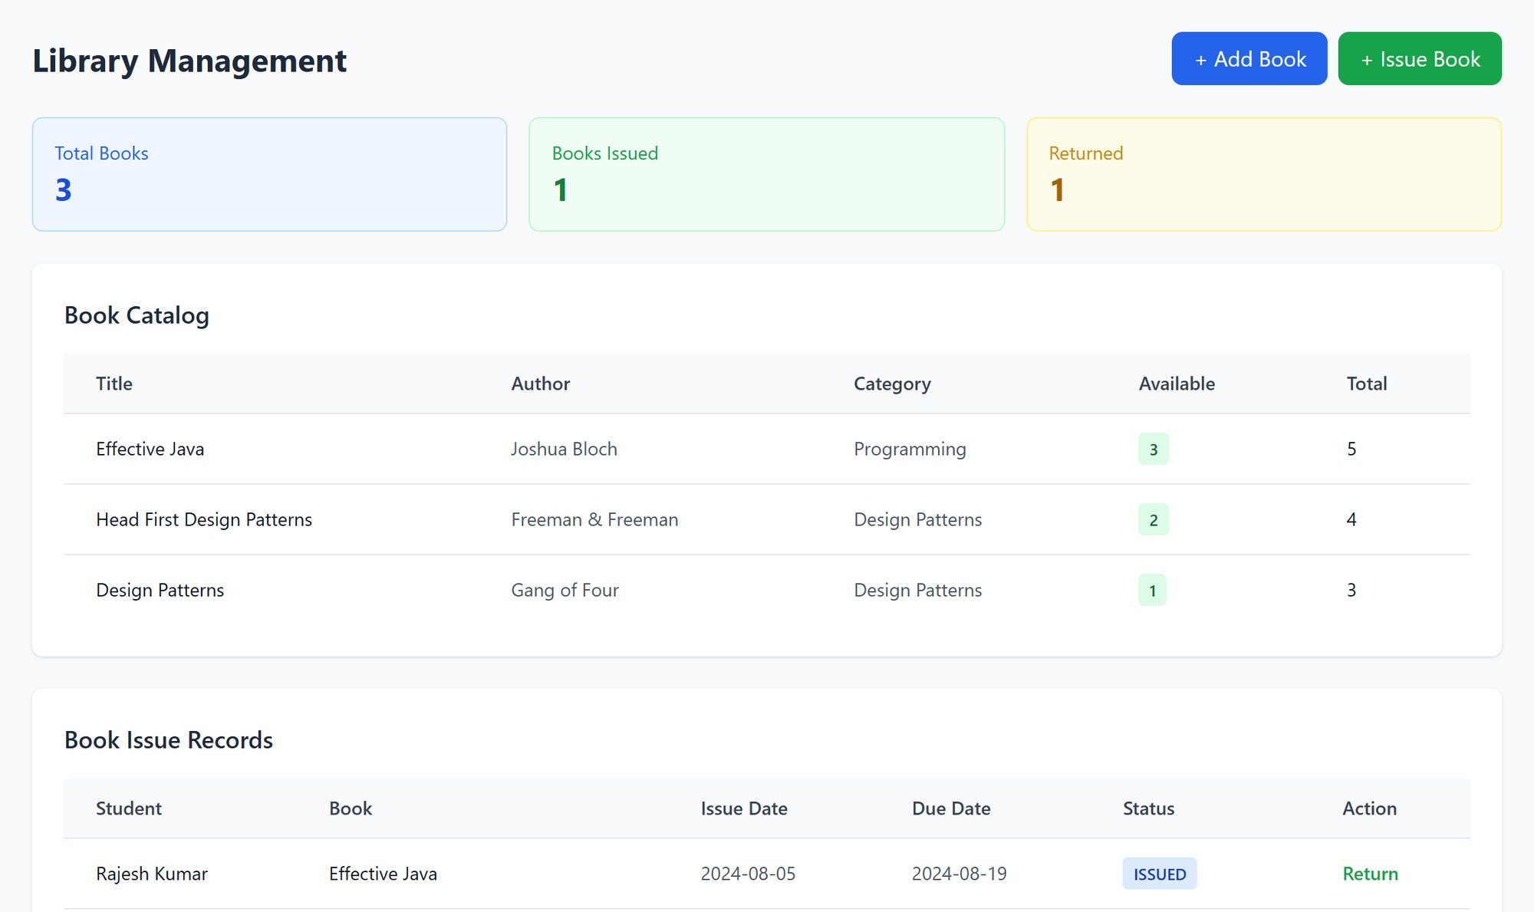
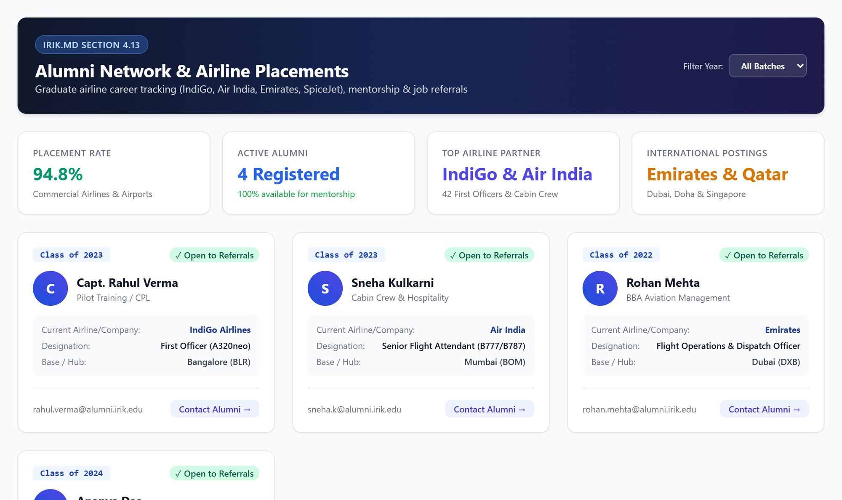
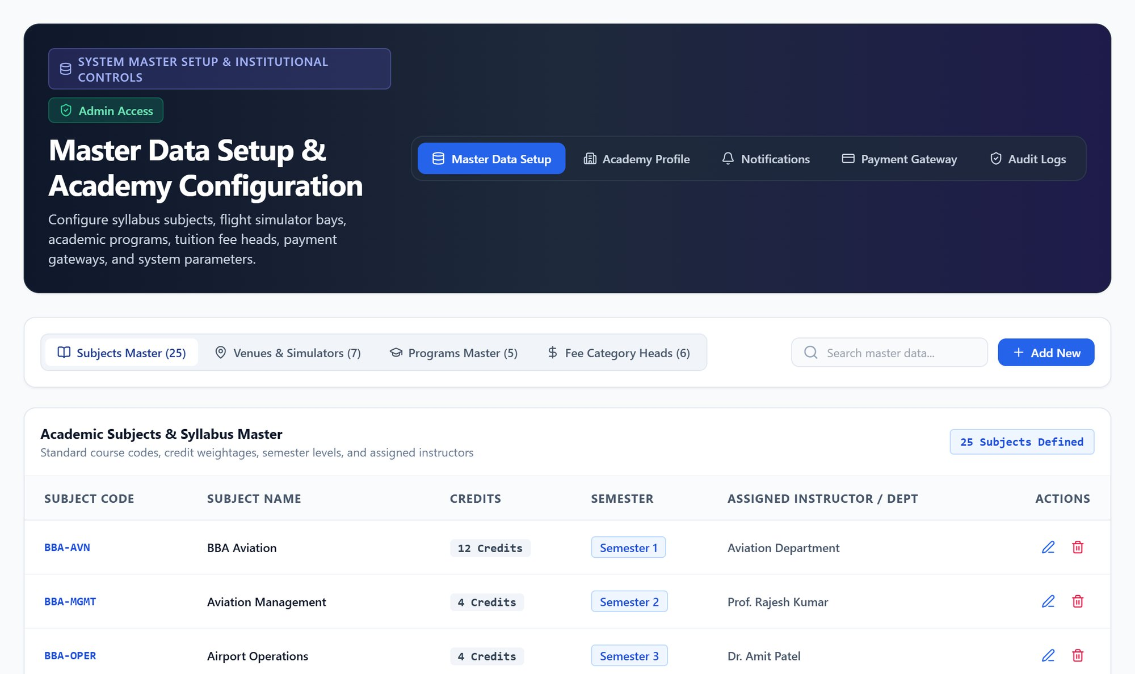
Campus services, all built in
Visitor & gate pass
ID card generator
Feedback & tickets
Document e-sign
Digital passes and live entry log
Smart ID badges with QR code
Helpdesk with priority and status
Signed consents with audit trail
Hostel
Aviation library
Alumni & placement
Institute settings
Rooms, occupancy and allocation
Book catalogue, issues and returns
Airline placements and referrals
Subjects, venues, fee heads
Notes:
Beyond academics, the everyday campus services are included: security gate, ID cards, a complaint helpdesk, digital signatures for consent forms, hostel, library and alumni placements.

Slide 17
A portal for every person
03
Staff · Instructors · Students · Parents — each sees only their own work
Notes:
Every person logs in to their own portal. Let's look at each one.

Slide 18
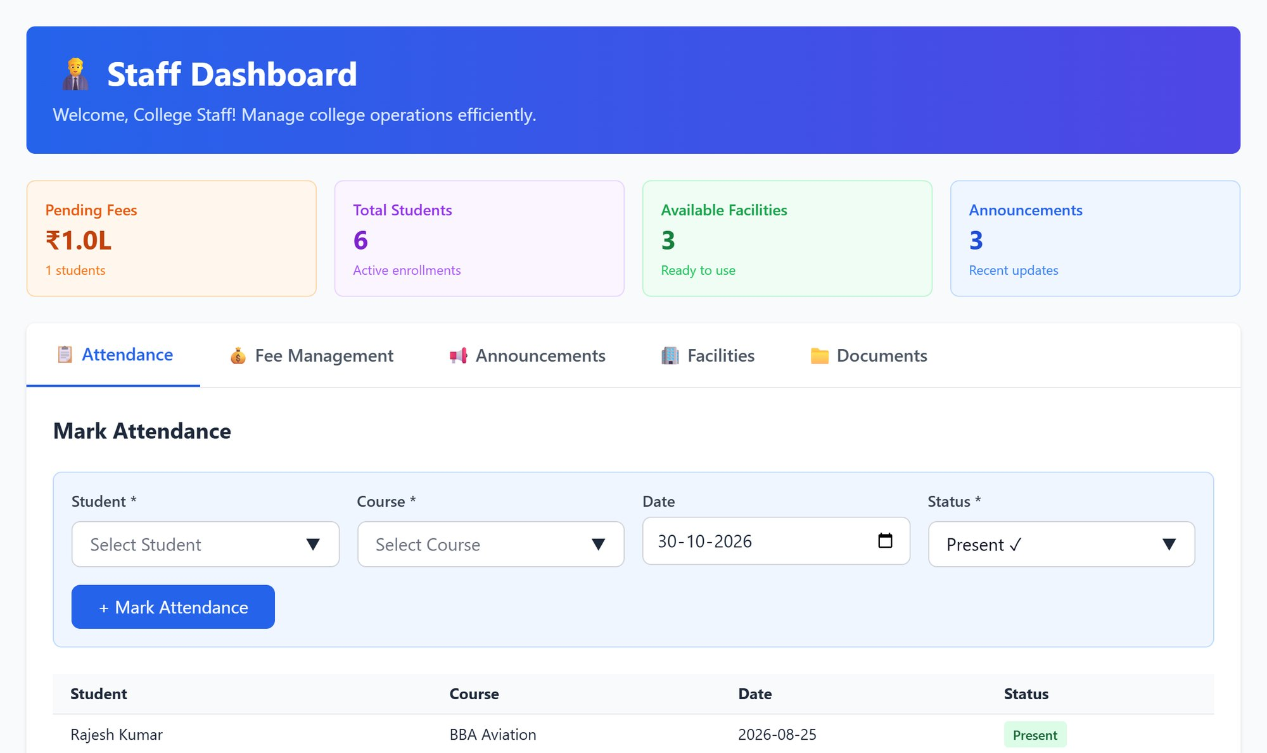
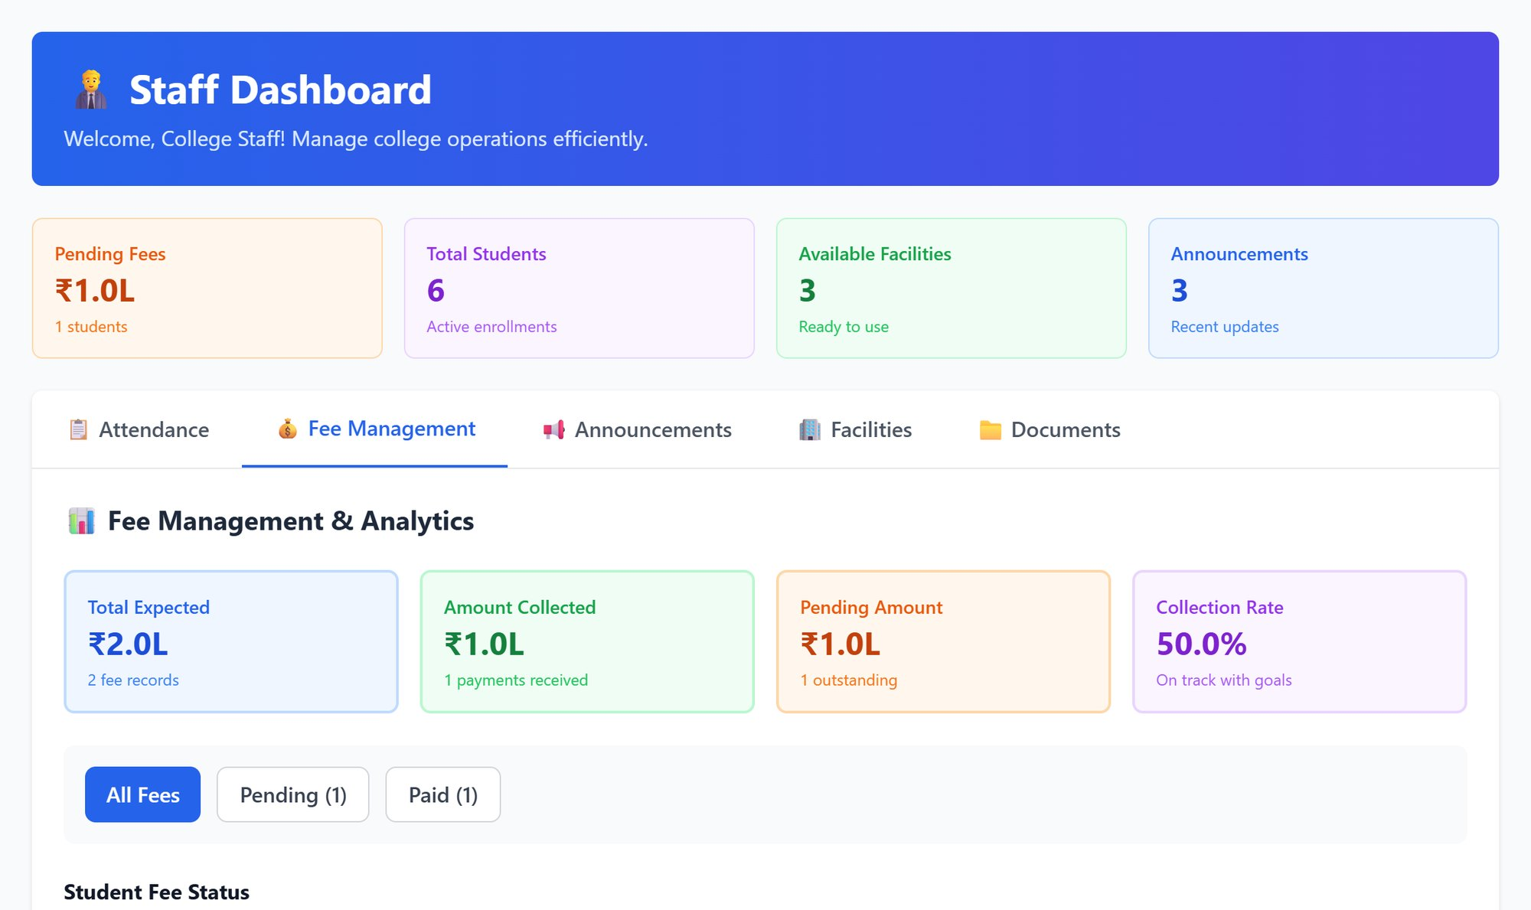
Staff portal: daily office work in one place
Front-office tasks
Fee collection view
Mark attendance, post announcements, check facility availability and download forms
Expected vs collected, collection rate and each student's progress bar — no spreadsheet needed
Notes:
Office staff get a focused portal: attendance, announcements, facilities and documents, and a fee-collection view that shows who has paid and who hasn't. They don't see payroll or settings.

Slide 19
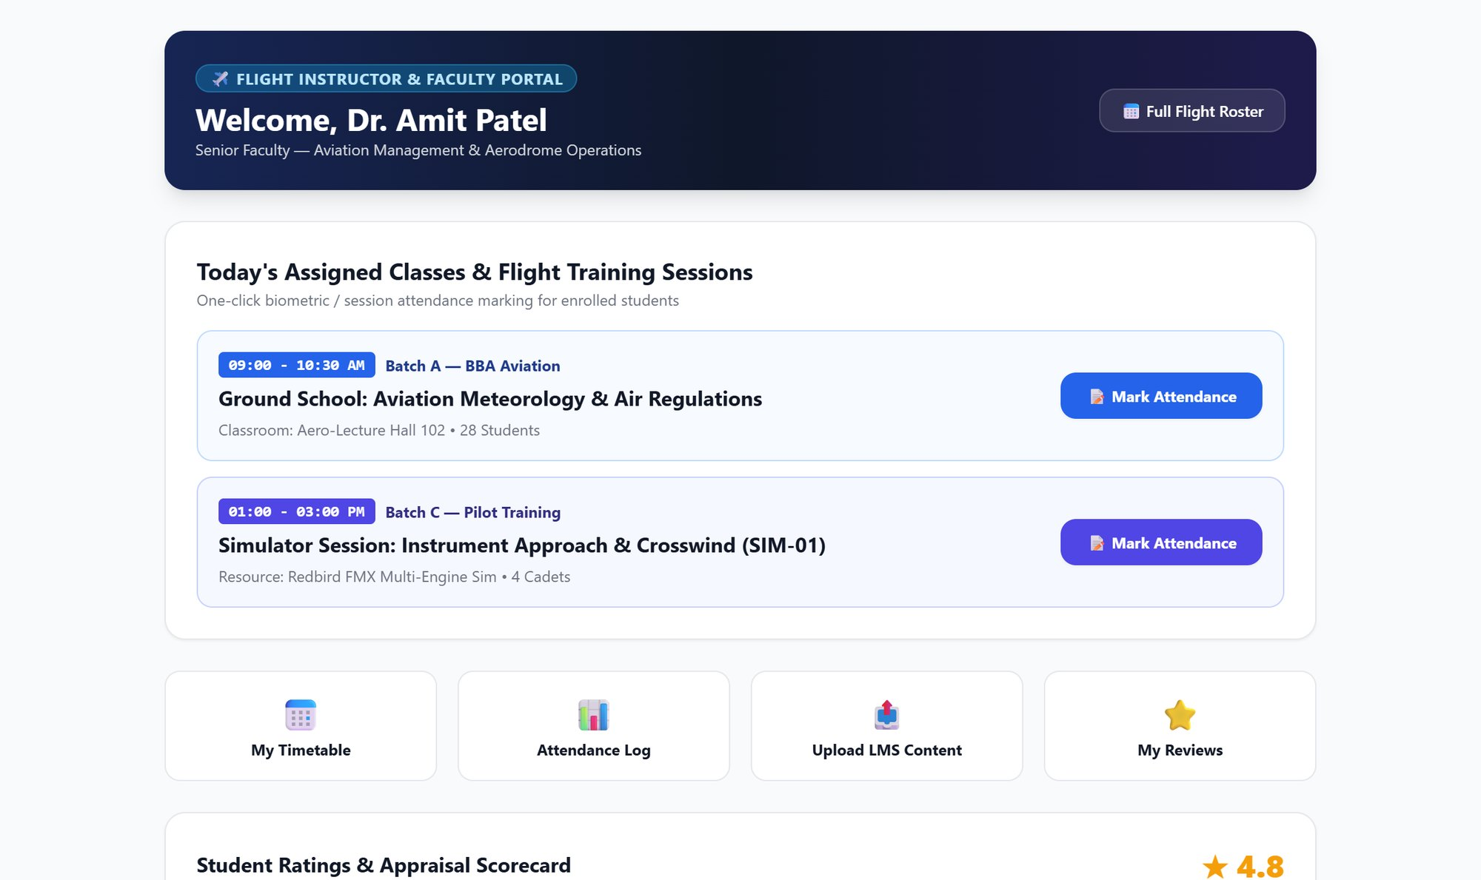

Instructor portal: classes, roll call and reviews
Today's sessions
Assigned ground classes and simulator slots with batch details
Mark attendance
One click from each session card
My ratings
Personal scorecard from student feedback
Notes:
Instructors see only their own day: which batch, which simulator, and a button to mark attendance. They also see their own student ratings.

Slide 20
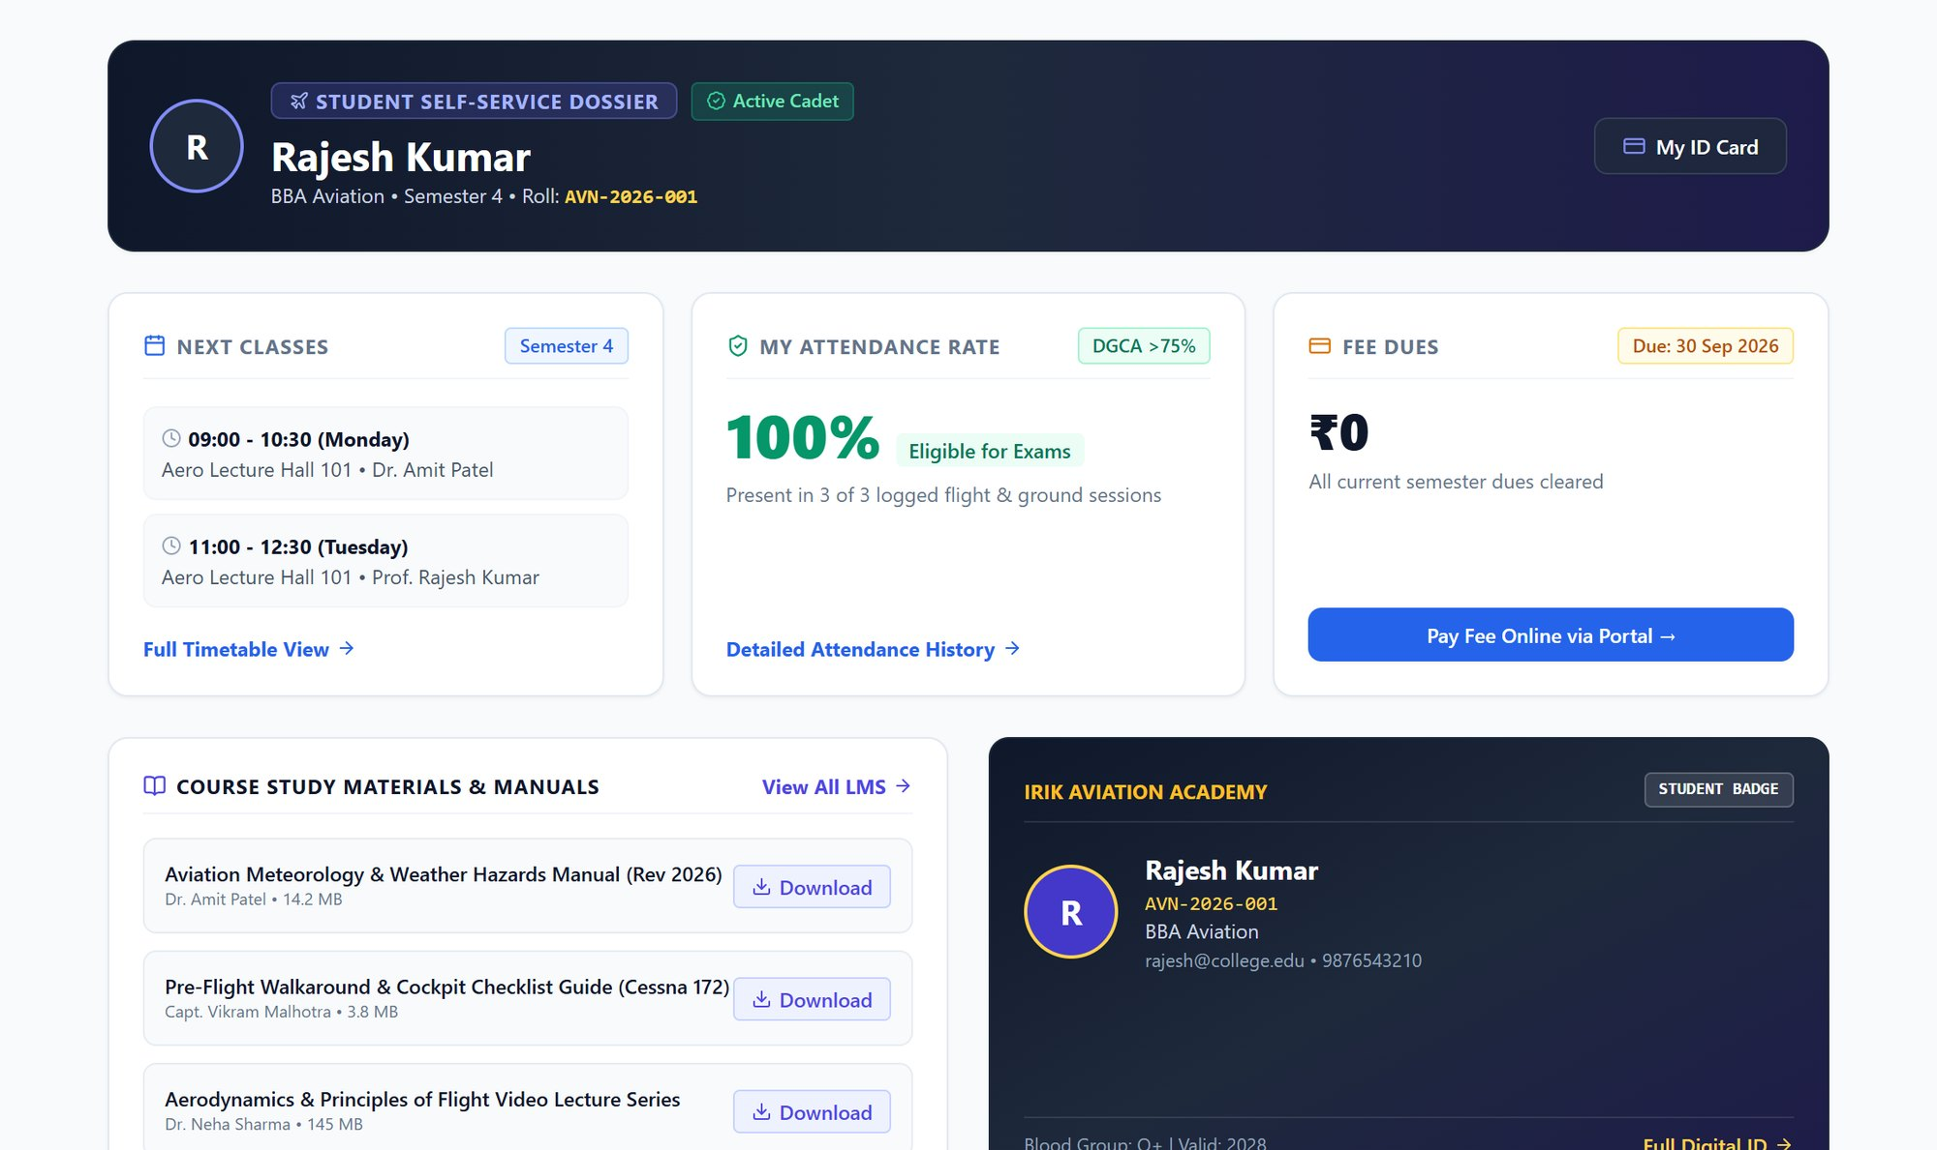


Student portal: everything a cadet needs
Classes & attendance
Next classes and live attendance % against the DGCA 75% rule
Fees & study material
Pay dues online and download manuals and checklists
Digital ID card
Smart student badge with QR, always on the phone
Notes:
Students see their classes, attendance percentage against the DGCA rule, fee dues with online payment, study material, and a digital ID card.

Slide 21
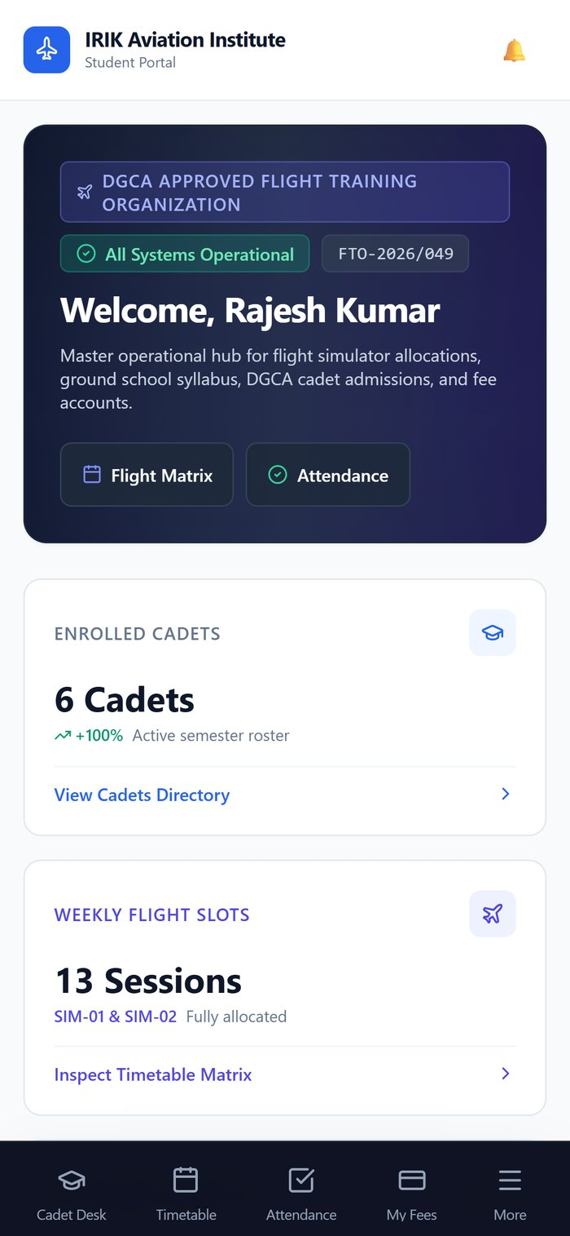
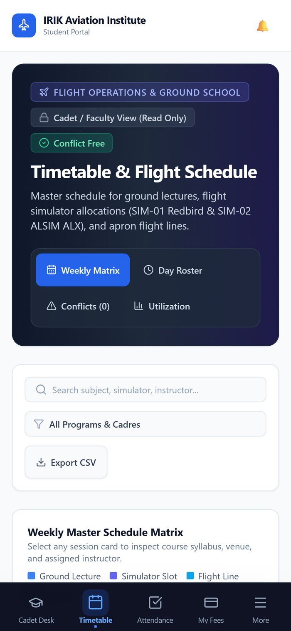


Works on every phone, like an app
Install to home screen
Students, parents and instructors open it like any other app — no app-store download
Opens without internet
Recently viewed timetable and pages stay available offline
Built for touch
Bottom navigation, large tap targets and swipe between days
Notes:
The same system adapts to the phone. It can be installed to the home screen, keeps working when the network drops, and is designed for touch — so cadets and parents don't need a separate app.

Slide 22
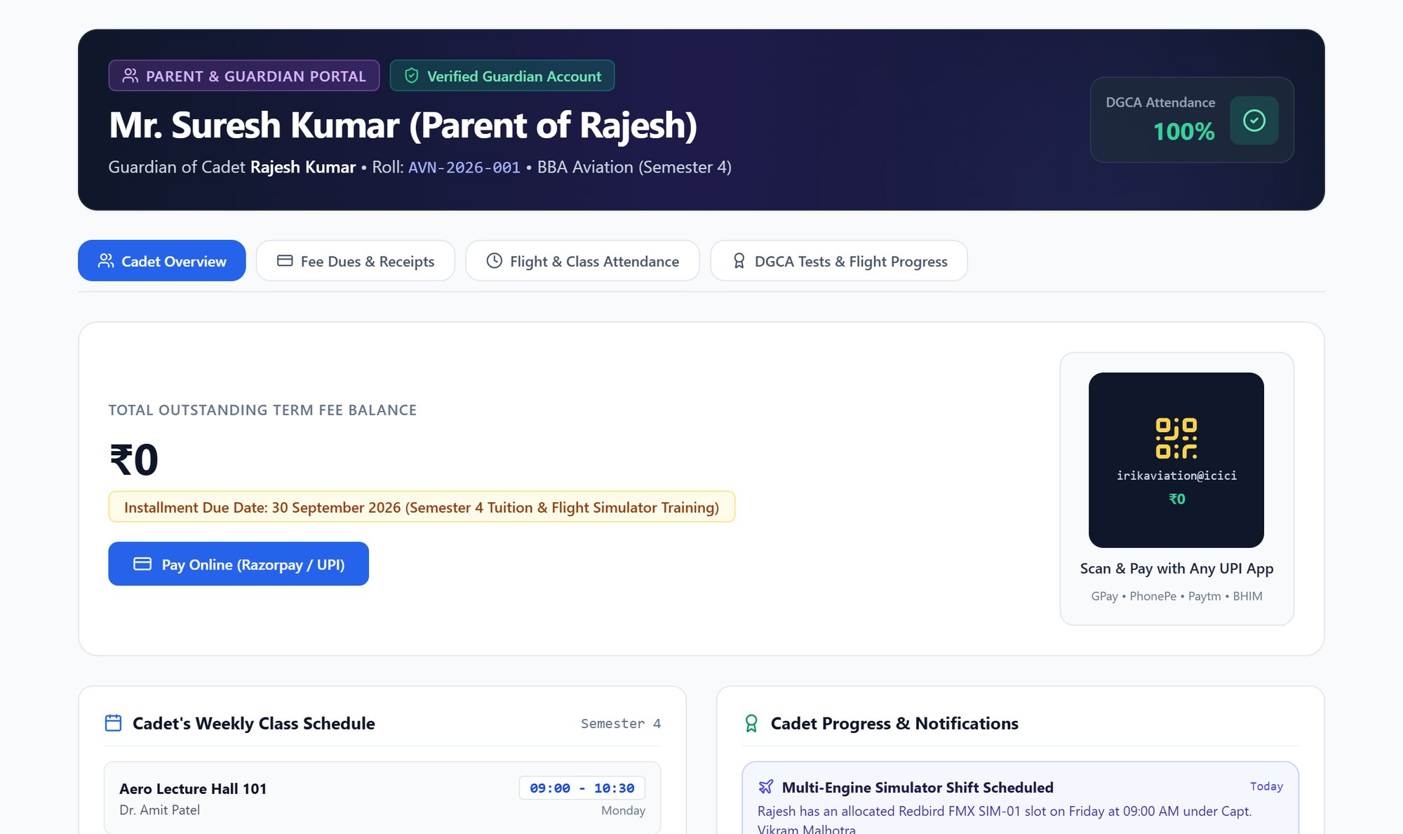

Parent portal: peace of mind for families
Fee balance & receipts
Outstanding dues with Razorpay or UPI QR payment
Attendance & schedule
Daily attendance and the weekly class plan
Progress updates
Ground exam scores and simulator milestones
Notes:
Parents log in to see exactly what the office would tell them on the phone: dues and receipts, attendance and their child's progress. This alone saves the office many calls every week.

Slide 23



Proposed rollout
1
Core office
2
Academics
3
Operations
Admissions, students, fees and attendance; staff portal live
Timetable, instructor, student and parent portals; LMS
Finance, HR & payroll, fleet compliance, gate and campus services
What we need from the institute to go live
Cloud hosting & database
Razorpay merchant account
SMS / email provider
Existing student & fee data
Role-wise staff training
Notes:
We suggest going live in three phases so staff adopt it gradually — the office modules first, then academics and portals, then finance and operations. To go live we need hosting, the Razorpay account for online fees, an SMS/email provider for alerts, the existing data to import, and a short training for each role.

Slide 24
Thank you
Questions, and a live demo of any module you'd like to see
Notes:
Thank you. Happy to take questions or open any module live.

