Slide 1
Revision
Long Tan Le
HCMC University of Technology
tanlong.ce@gmail.com

Slide 2
Outline
Arithmetic Circuits
Binary {Addition, Subtraction, Multiplication, Division}
Number Representation
Adders, Subtractors, BCD Adder, Carry Look-Ahead Adder
Counters & Registers
Shift Register, Integrated-Circuit Registers
Asynchronous Counter, Synchronous Counter
Ring Counter, Johnson Counter
ICs for Counters
MSI Logic Circuits
Multiplexer , Demultiplexer
Decoder, Encoder
Comparator
Logic Implementation using MSI circuits
ICs for MSI Circuits
Chapter 1,2,3,4
Self-revision!

Slide 3
Arithmetic Circuits
Topic 1

Slide 4
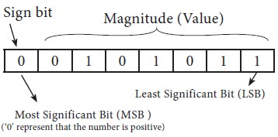
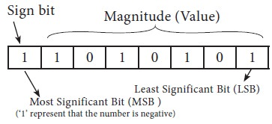
Representation for Binary Number
Signed Magnitude
Only (n-1) bit used for storing value
the left most bit is considered as SIGN BIT
0 – Positive
1 – Negative

Slide 5
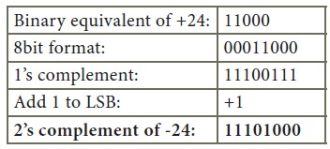
Representation for Binary Number
1’s Complement
Invert all bits (i.e. Change 1 as 0 and 0 as 1)
2’s Complement
Invert all bits (i.e. Change 1 as 0 and 0 as 1)
Add 1 to the result to the Least Significant Bit (LSB)

Slide 6
Representation for Binary Number
1’s complement
Simple implementation which uses only NOT gates for each input bit.
Can be used for signed binary number representation but not suitable as ambiguous representation for number 0.
0 has two different representation one is -0 (e.g., 1 1111 in five bit register) and second is +0 (e.g., 0 0000 in five bit register).
For k bits register, positive largest number that can be stored is (2^{(k-1)}-1) and negative lowest number that can be stored is -(2^{(k-1)}-1).
end-around-carry-bit addition occurs in 1’s complement arithmetic operations. It added to the LSB of result.
1’s complement arithmetic operations are not easier than 2’s complement because of addition of end-around-carry-bit.
Sign extension is used for converting a signed integer from one size to another.
2’s complement
Uses NOT gate along with full adder for each input bit.
Can be used for signed binary number representation and most suitable as unambiguous representation for all numbers.
0 has only one representation for -0 and +0 (e.g., 0 0000 in five bit register). Zero (0) is considered as always positive (sign bit is 0)
For k bits register, positive largest number that can be stored is (2^{(k-1)}-1) and negative lowest number that can be stored is -(2^{(k-1)}).
end-around-carry-bit addition does not occur in 2’s complement arithmetic operations. It is ignored.
2’s complement arithmetic operations are much easier than 1’s complement because of there is no addition of end-around-carry-bit.
Sign extension is used for converting a signed integer from one size to another.

Slide 7
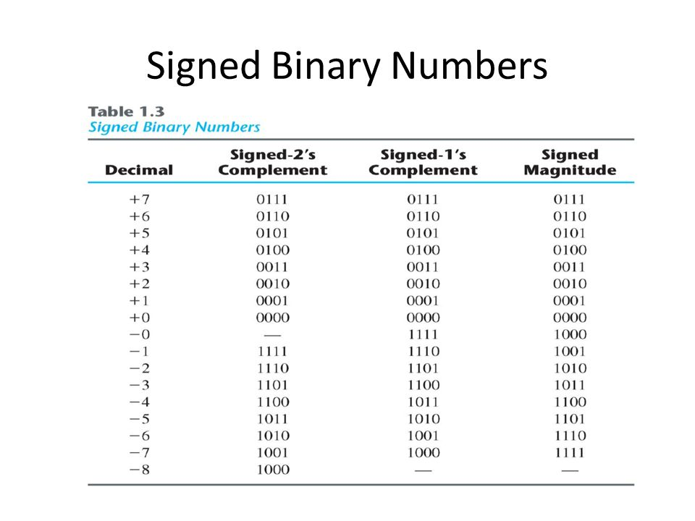

Slide 8
Representation for Binary Number
1-1. The 1’s complement form of the number 01001100₂?
A. 10110100 | C. 10110011
B. 00110010 | D. None of above
1-2. Using 5 bits to represent each number, the representations of 13 and -13 in signed 2's complement integers:
A. 01101 & 11101 | C. 01101 & 10011
B. 01101 & 10010 | D. None of above
1-3. Sign extension from 5 bits to 8 bits represent -13 in signed 2's complement integers of the above question:
A. 00011101 | C. 00010011
B. 11110010 | D. None of above
Notes:
1-1. C
1-2. C
1-3. D - Sign Extension: The operation of increasing the number of bits of a binary number while preserving the number's sign (positive (0)/negative (1)) and value.

Slide 9
Adding Two 1-bit Numbers
Performs the addition of two binary bits.
Four possible operations:
0+0=0
0+1=1
1+0=1
1+1=10
Circuit implementation requires 2 outputs; one to indicate the sum and another to indicate the carry.

Slide 10
Addition of Two n-bit numbers
1
1
1
1
1 0 1 1
0 1 0 1
1 0 0 0 0
We start from the lsb
Add the corresponding pair of bits and the carry in
Produce a sum bit and a carry out

Slide 11
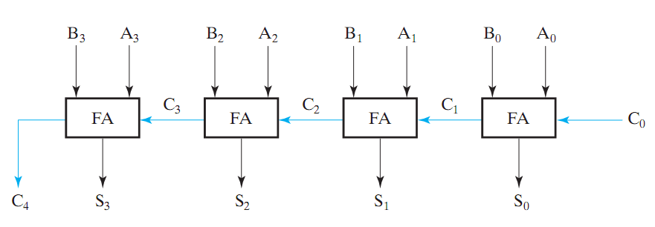

Subtraction (2’s Complement)
$$S = A + ( −B)$$
If we represent signed numbers in 2’s complement form, subtraction is the same as addition to negative (2’s complemented) number.

Slide 12
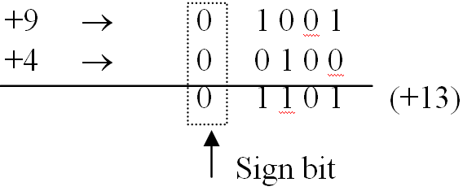
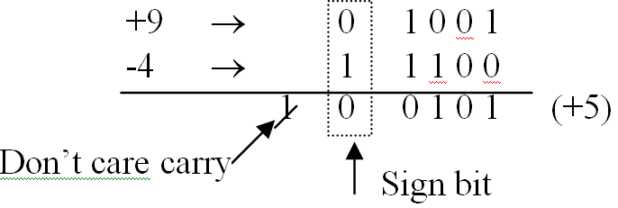
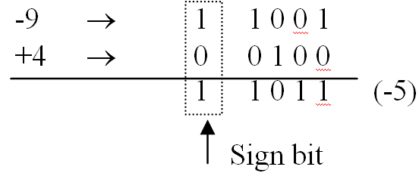
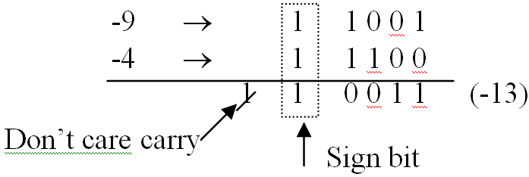
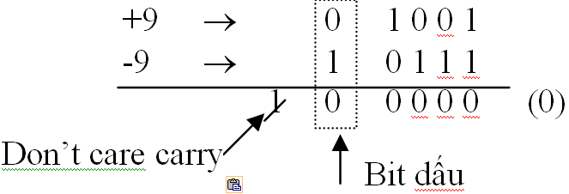

Addition in the 2’s Complement System
Perform normal binary addition of magnitudes.
Notes:
2 positives
positive and negative under
positive and negative numbers greater than
2 negatives
Equal

Slide 13
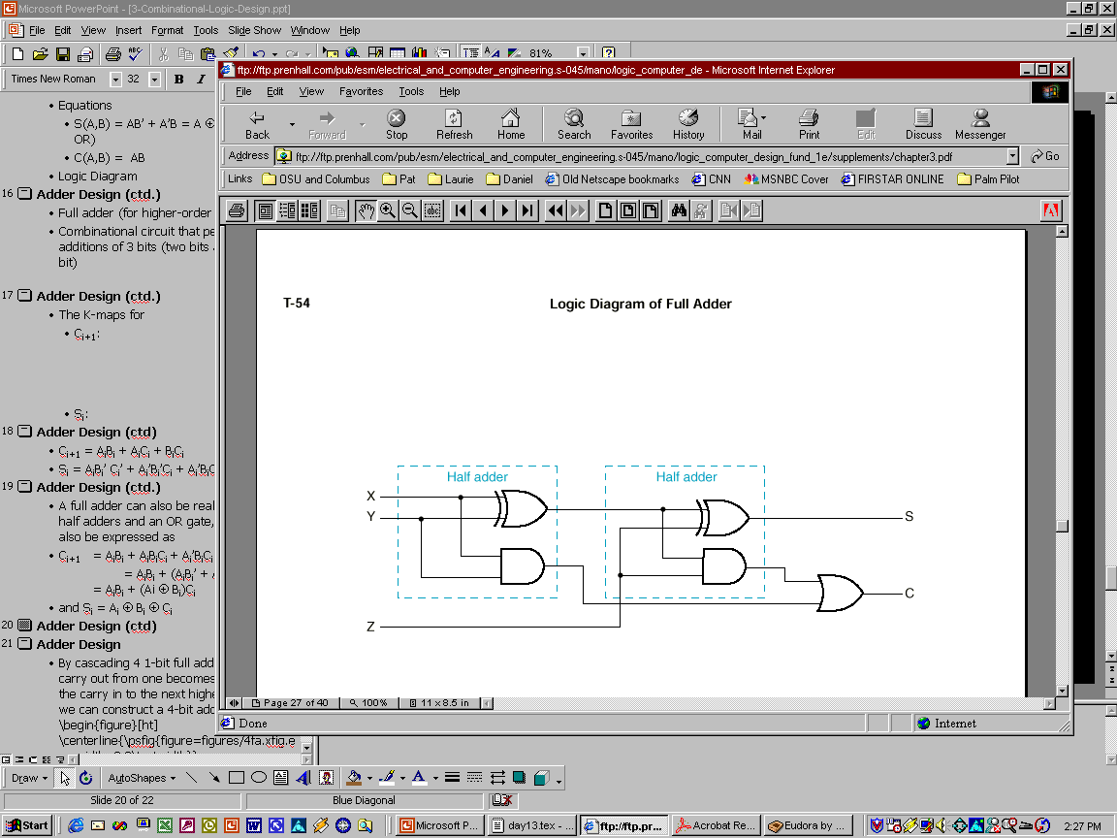
Full Adder from Half Adders
1-4. How many AND, OR and EX-OR gates are requires for the configuration of full adder?
A. 1, 2, 2 | B. 2, 1, 2 | C. 3, 1, 2 | D. 4, 0 ,1
Notes:
1-4. B

Slide 14
Adders & Subtractors
1-5. Half-adders have a major limitation in that they cannot:
A. Accept a carry from a present stage
B. Accept a carry bit from a next stage
C. Accept a carry bit from a previous stage
D. Accept a carry bit from the following stages
1-6. Full subtractor is used to perform subtraction of?
A. 2 bits | B. 3 bits | C. 4 bits | D. 8 bits
1-7. The output of a full subtractor is same as:
A. Half Adder | B. Full Adder | C. Half Subtractor
Notes:
1-5. C
1-6. B
1-7. B

Slide 15
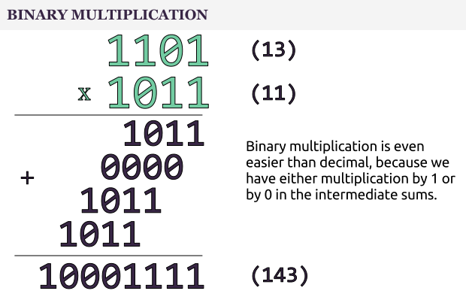
Multiplication & Division

Slide 16
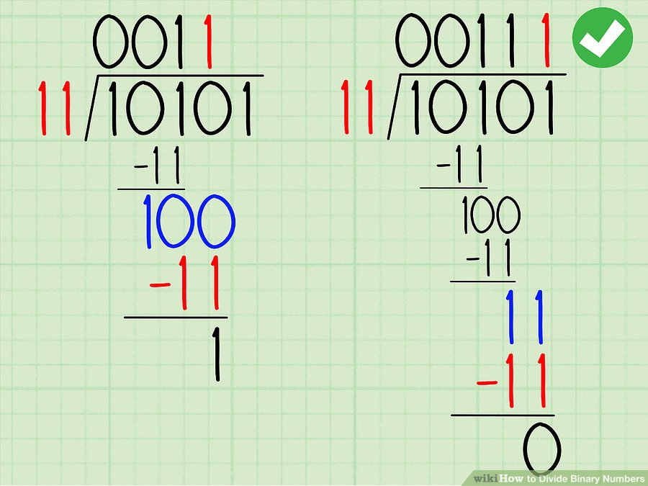
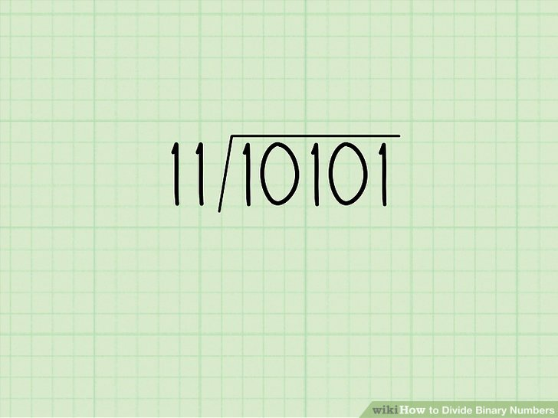
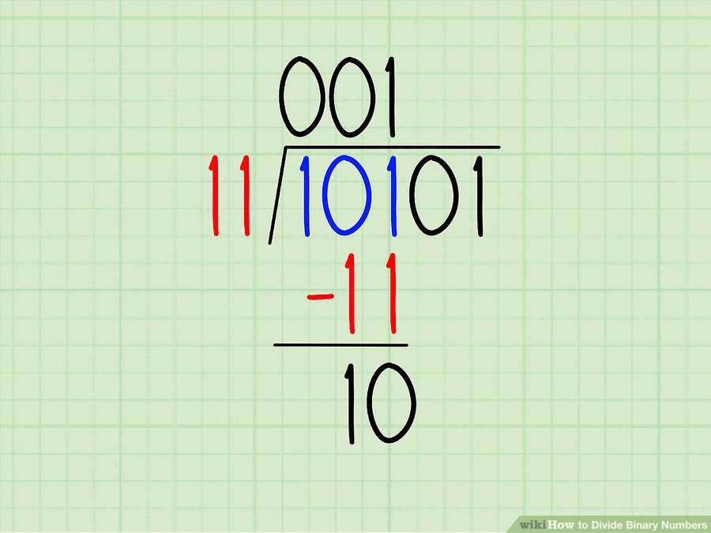
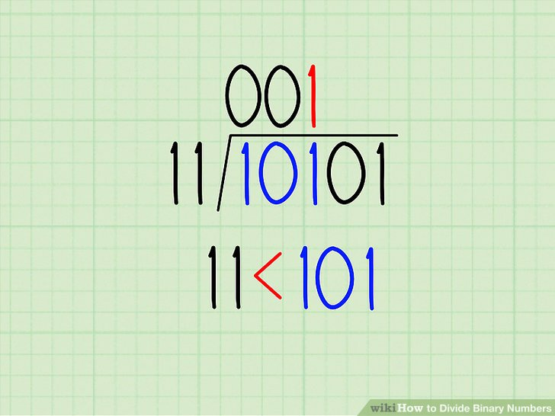
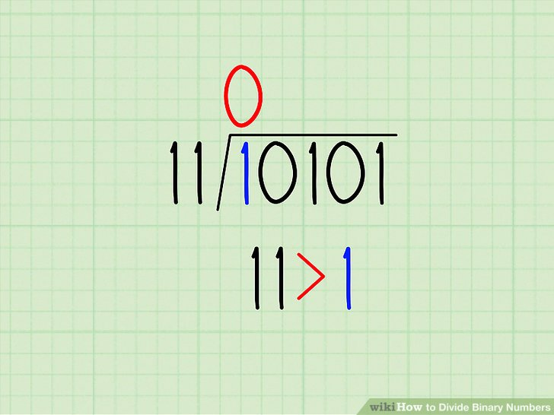
Multiplication & Division

Slide 17
Multiplication & Division
1-8. Perform multiplication of the binary number: 01001 x 01011
A. 001100011 | C. 010100110
B. 110011100 | D. 101010111
1-9. The quotient of 111101 ÷ 1001 is
A. 0010 | C. 1100
B. 1010 | D. 0011
1-10. In binary division process, a series of performed operations is said to be of
A. Additions | C. Multiplications
B. Subtractions | D. Complement
Notes:
A
D
B

Slide 18
BCD Adder
BCD Adder
When the sum of two digits is less than or equal to 9 then the ordinary 4-bit adder can be used
But if the sum of two digits is greater than 9 then a correction must be added “i.e. adding 0110”
We need to design a circuit that is capable of doing the correct addition

Slide 19
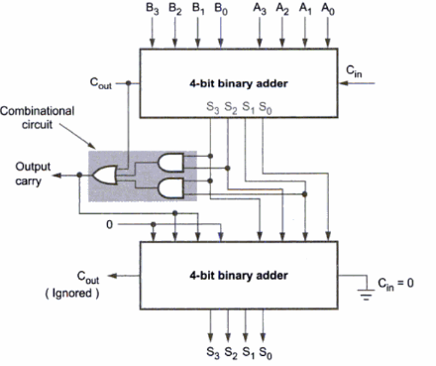
BCD Adder

Slide 20
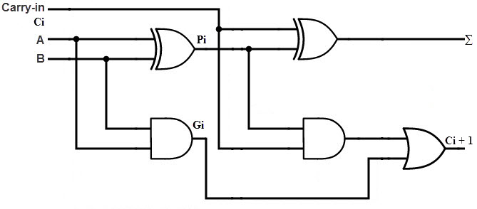
Carry Look Ahead (CLA) Adder
Used in most ALU designs
Faster than ripple carry logic adders or full adders
Especially when adding a large number of bits.
Be able to generate carries before the sum
Using the Carry Propagation (Pi) and Carry Generation (Gi) logic to make addition much faster.
Notes:
Carry Generation occurs when both inputs are 1
Carry Propagation occurs when input is rippled to the output carry
Where Gi is a carry generate which produces the carry when both Ai, Bi are one regardless of the input carry. Pi is a carry propagate and it is associate with the propagation of carry from Ci to Ci +1.

Slide 21
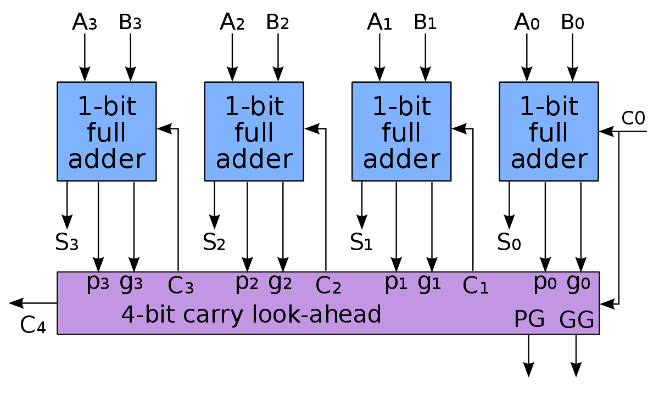
Carry Look Ahead (CLA) Adder
Notes:
Carry Generation occurs when both inputs are 1
Carry Propagation occurs when input is rippled to the output carry

Slide 22
Other Adders
1-11. One of the advantages of the fast carry or look-ahead carry circuits found in most 4-bit parallel-adder circuits
A. Add a 1 to complemented inputs
B. Increase ripple delay
C. Determine sign and magnitude
D. Reduce propagation delay
1-12. The carry generate (CG) and carry propagate (CP) function of the Carry Look-Ahead adder is
A. CG = A or B, CP = A xor B
B. CG = A xor B, CP = A or B
C. CG = A and B, CP = A xor B
D. CG = A and B, CP = A or B
Notes:
D
C

Slide 23
Counters and Registers
Topic 2

Slide 24
Registers
2-1. A register is defined as
A. The group of latches for storing one bit of information
B. The group of latches for storing n-bit of information
C. The group of flip-flops suitable for storing one bit of information
D. The group of flip-flops suitable for storing binary information
2-2. A shift register is defined as
A. The register capable of shifting information to another register
B. The register capable of shifting information either to the right or to the left
C. The register capable of shifting information to the right only
D. The register capable of shifting information to the left only
Notes:
D: Each flip-flop is a binary cell capable of storing one bit of information
B: A register in which data can be shifted only in one direction is called unidirectional shift register, while if data can shifted in both directions, it is known as a bidirectional shift register.

Slide 25
Registers
2-3. The full form of SIPO is
A. Serial-in Parallel-out | C. Serial-in Serial-out
B. Parallel-in Serial-out | D. Serial-in Peripheral-out
2-4. The group of bits 11001 is serially shifted (right-most bit first) into a 5-bit parallel output shift register with an initial state 01110. After three clock pulses, the register contains?
A. 01110 | C. 00101
B. 00001 | D. 00110
2-5. With a 200 KHz clock frequency, eight bits can be serially entered into a shift register in ?
A. 4 μs | C. 400 μs
B. 40 μs | D. 40 ms
Notes:
A: There are 4 types of shift registers, viz., Serial-In/Serial-Out, Serial-In/Parallel-Out, Parallel-In/Serial-Out and Parallel-In/Parallel-Out.
C: 01110 -> 10111 -> 01011 -> 00101
B: Explanation: f = 200 KHZ; T = (1/200) m sec = (1/0.2) micro-sec = 5 micro-sec; In serial transmission, data enters one bit at a time. After 8 clock cycles only 8 bit will be loaded = 8 * 5 = 40 micro-sec.

Slide 26
Asynchronous (Ripple) Counter
This type of counter is easiest to design, and requires the least amount of hardware
Called Asynchronous
Called Ripple
The flip-flops are not driven by the same clock signal
Propagation Delay causes Ripple Effect
Can lead to unwanted transitions
Glitches are possible

Slide 27
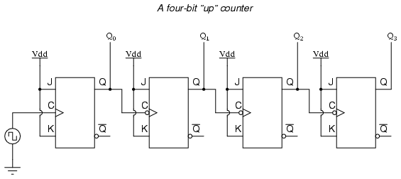
Design a Ripple Counter
Up Counter
using
JK FF
J & K at HIGH level
Use negative edge triggered (NGT) FFs:
Connect Q output of the previous to CLK input of the next
Use positive edge triggered (PGT) FFs:
Connect Q’ output of the previous to CLK input of the next

Slide 28
Design a Ripple Counter
Suppose we want to design a module-M counter
Counter will count up from 0 to M-1, and then back 0
Basic idea:
We first design a full-modulus ripple counter with $\left\lceil \log_{2}{M}\right\rceil$ (ceiling) flip-flops (e.g.: 4 FF -> MOD-16)
We first design a full-modulus ripple counter with ⌈log_2⁡𝑀 ⌉ (ceiling) flip-flops (e.g.: 4 FF -> MOD-16)
Then we design a gating circuit, which takes inputs from the counter outputs, and generate a 0 whenever the count value reaches M
Connect the output of the gating circuit to the CLR’ inputs of the flip-flops

Slide 29
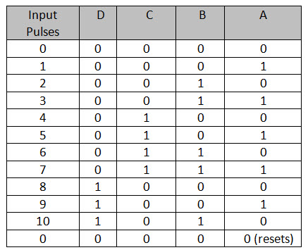
Design a Ripple Counter
Example: Design a MOD – 10 (Decade) Up Ripple Counter using JK Flip-Flop
Reset state

Slide 30
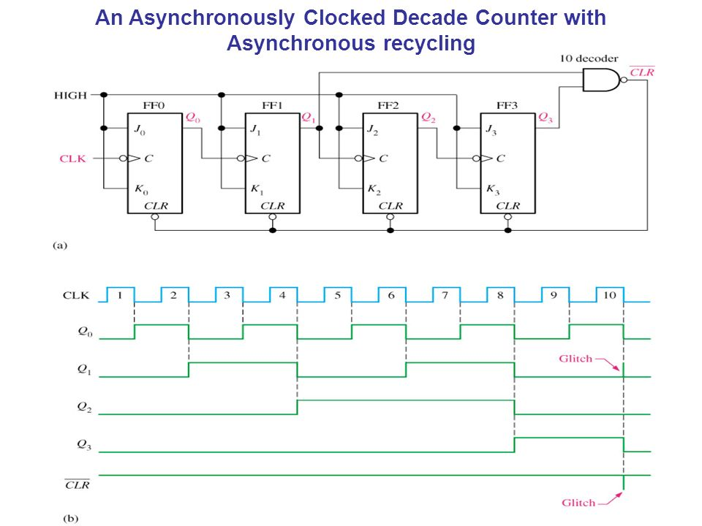
Design a Ripple Counter
Glitches: Temporary False / Unwanted outputs

Slide 31
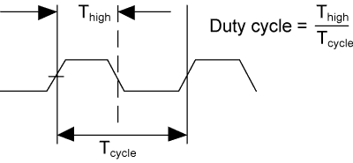
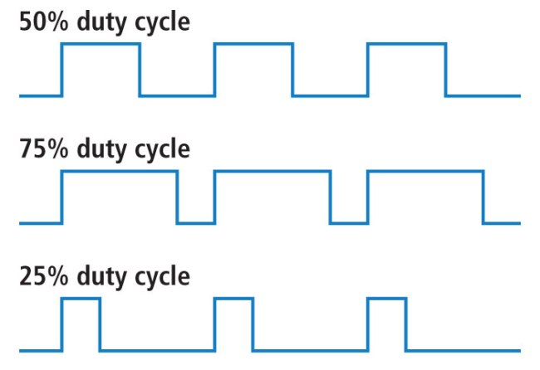
Duty Cycle
The percentage of time a digital signal is ON over an interval or period of time

Slide 32
Ripple Counters
2-6. Ripple counter’s speed is limited by the propagation delay of
A. Each flip-flop | C. The flip-flops only with gates
B. All flip-flops and gates | D. Only circuit gates
2-7. The duty cycle of the most significant bit from a 4-bit (0–9) BCD counter is
A. 20% | B. 50% | C. 10% | D. 50%
2-8. A 5-bit asynchronous binary counter is made up of five flip-flops, each with a 12 ns propagation delay
A. 12 ms | C. 48 ns
B. 24 ns | D. 60 ns
Notes:
A - A ripple counter is something that is derived by other flip-flops. It’s like a series of Flip Flops. The output of one FF becomes the input of the next. Because ripple counter is composed of FF only and no gates are there other than FF, so only propagation delay of FF will be taken into account. Propagation delay refers to the amount of time taken in producing an output when the input is altered
A- There are 10 states, out of which MSB is high only for (1000, 1001) 2 times. Hence duty cycle is 2/10*100 = 20%. Since the duty cycle is the ratio of on-time to the total time.
D- Since a counter is constructed using flip-flops, therefore, the propagation delay in the counter occurs only due to the flip-flops. Each bit has propagation delay = 12ns. So, 5 bits = 12ns * 5 = 60ns.

Slide 33
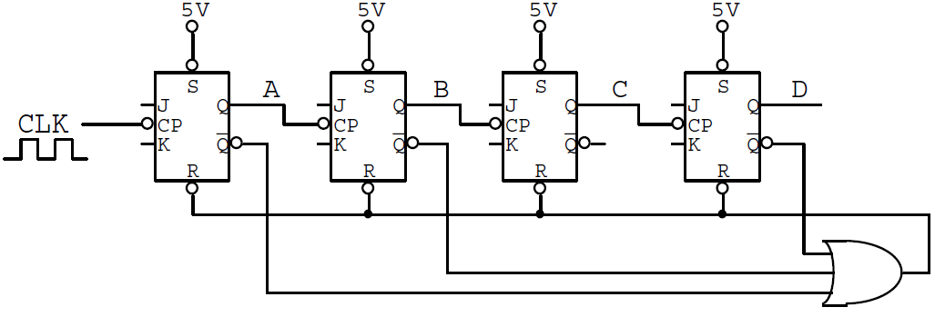
Ripple Counter
2-9. Chose a TRUE statement
The up counter with MOD-12
The down counter with MOD-9
The down counter with MOD-13
The up counter with MOD-11
Notes:
D - Reset state: DCBA = 1011 (11)

Slide 34
Ripple Counter
2-10. Determine the frequency of output C
CLK/8 C. CLK/12
CLK/11 D. CLK/13
2-11. Determine Duty Cycle (HIGH) of output C.
A. 50% C. 36.36%
B. 33.33% D. 18.18%
Notes:
B: 1111000000
C: 4(1)/11

Slide 35
Ripple Counter
2-12. Determine the output that has glitches.
Output A
Output B
Output C
Output D
Notes:
A: DCBA (1001 -> 1010 -> (1011) 0000

Slide 36
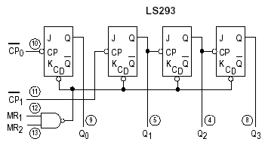
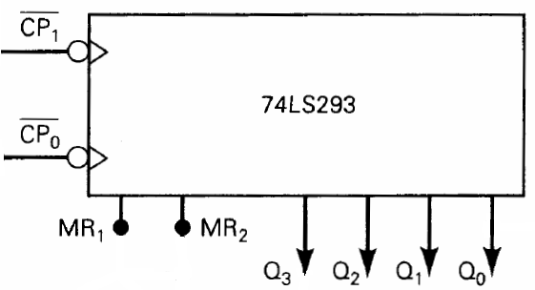
Cascading Ripple Counter
2-13. List which pins need to be connected together on two 74293 to make a MOD-60 counter
Notes:
IC 74293: MOD 2 x MOD 8 (MOD-16) Ripple Counter

Slide 37
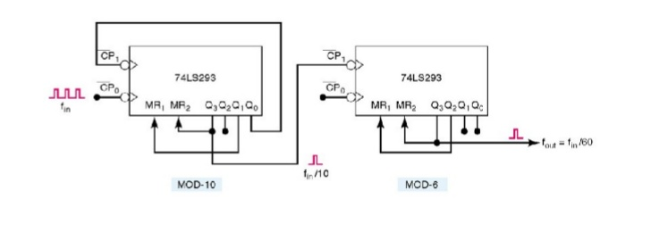
Cascading Ripple Counter
2-13. List which pins need to be connected together on two 74293 to make a MOD-60 counter

Slide 38
Cascading Ripple Counter
2-14. Design an asynchronous counter MOD-40 (4x10) using only 74LS293 ICs. (Do it yourself!)

Slide 39
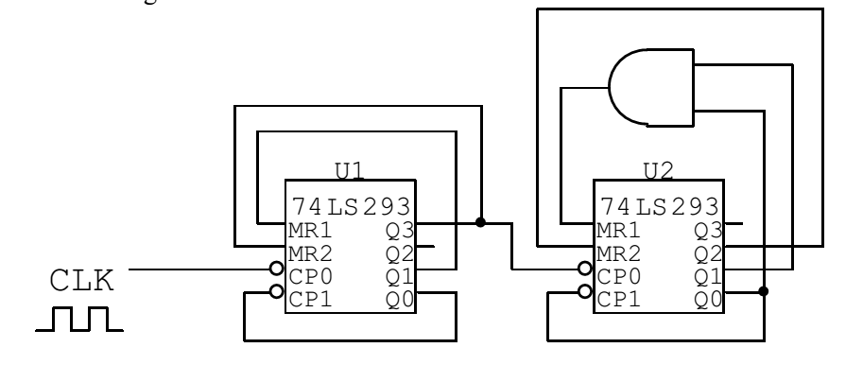
Cascading Ripple Counter
2-15. Given the following counter circuit
(Do it yourself!)
With the frequency of the clock signal f_{CLK} = 35 KHz
(a) What is the MOD of the counter ?
(b) Determine the frequency of Q3 of U1?
(c) Determine the frequency of Q2 of U2?
(d) In the Q3, Q2, Q1, Q0 signals of U1 and U2, which signals are glitches?
(e) Determine duty cycle of Q2 of U2?

Slide 40
Synchronous Counter
All flip-flops are simultaneously clocked by an external clock.
Synchronous counters are faster than asynchronous counters because of the simultaneous clocking.
Synchronous counters are an example of a state machines design.

Slide 41
Design a Synchronous Counter
1. Determine the # of FFs needed to support the counting sequence’s highest #.
2. Build a State Transition Diagram. Be sure to include all states.
3. Build a State/Excitation Truth Table.
4. Simplify expressions for J and K inputs for each F/F on K-Maps.
5. Implement the Synchronous Counter/State Machine Circuit. .

Slide 42
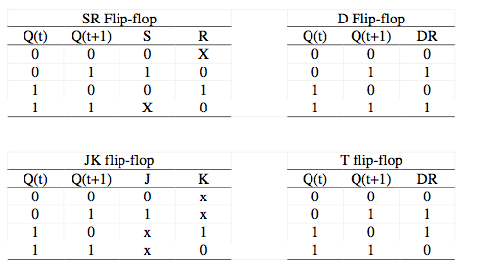
Design a Synchronous Counter
Flip-Flop Transition Tables

Slide 43
Design a Synchronous Counter
For the following stage diagram, design a synchronous counter using D Flip-Flops
(A: LSB, D: MSB)
Other states
0000
1111
0001
1110
0110
1001
0111
1000
Notes:
B
D

Slide 44
Design a Synchronous Counter
For the following stage diagram, design a synchronous counter using D Flip-Flops (A: LSB, D: MSB)
State table
Present State |  |  |  | Next State |  |  |  | Output
D | C | B | A | D | C | B | A | D_{D} | D_{C} | D_{B} | D_{A}

Slide 45
Present State |  |  |  | Next State |  |  |  | Control Signal
D | C | B | A | D | C | B | A | D_{D} | D_{C} | D_{B} | D_{A}
0 | 0 | 0 | 0 | 0 | 0 | 0 | 1 | 0 | 0 | 0 | 1
0 | 0 | 0 | 1 | 0 | 1 | 1 | 0 | 0 | 1 | 1 | 0
0 | 0 | 1 | 0 | 0 | 0 | 0 | 0 | 0 | 0 | 0 | 0
0 | 0 | 1 | 1 | 0 | 0 | 0 | 0 | 0 | 0 | 0 | 0
0 | 1 | 0 | 0 | 0 | 0 | 0 | 0 | 0 | 0 | 0 | 0
0 | 1 | 0 | 1 | 0 | 0 | 0 | 0 | 0 | 0 | 0 | 0
0 | 1 | 1 | 0 | 0 | 1 | 1 | 1 | 0 | 1 | 1 | 1
0 | 1 | 1 | 1 | 1 | 0 | 0 | 0 | 1 | 0 | 0 | 0
1 | 0 | 0 | 0 | 1 | 0 | 0 | 1 | 1 | 0 | 0 | 1
1 | 0 | 0 | 1 | 1 | 1 | 1 | 0 | 1 | 1 | 1 | 0
1 | 0 | 1 | 0 | 0 | 0 | 0 | 0 | 0 | 0 | 0 | 0
1 | 0 | 1 | 1 | 0 | 0 | 0 | 0 | 0 | 0 | 0 | 0
1 | 1 | 0 | 0 | 0 | 0 | 0 | 0 | 0 | 0 | 0 | 0
1 | 1 | 0 | 1 | 0 | 0 | 0 | 0 | 0 | 0 | 0 | 0
1 | 1 | 1 | 0 | 1 | 1 | 1 | 1 | 1 | 1 | 1 | 1
1 | 1 | 1 | 1 | 0 | 0 | 0 | 0 | 0 | 0 | 0 | 0
Notes:
B
D

Slide 46

Design a Synchronous Counter
For the following stage diagram, design a synchronous counter using D Flip-Flops (A: LSB, D: MSB)
K-maps
D_{D}=
D_{c}=
D_{B}=
D_{A}=

Slide 47
Design a Synchronous Counter
For the following stage diagram, design a synchronous counter using D Flip-Flops (A: LSB, D: MSB)
Implement the logic circuit using D Flip-Flops

Slide 48
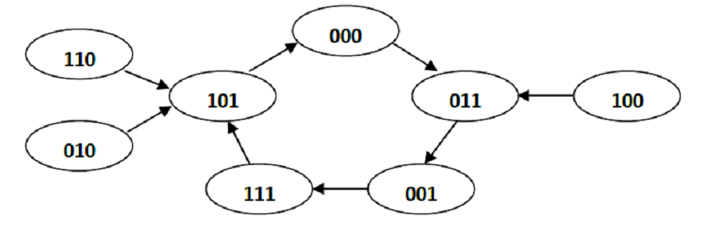
Design a Synchronous Counter
2-16. Design a ripple counter, MOD-12, up counter, using J-K Flip-Flop and D Flip-Flop
2-17. Use J-K Flip-Flop and D Flip-Flop to design an asynchronous down counter as follows
6 → 5 → 4 → 3 → 2 → 1 → 6 → ...
2-18. Use J-K Flip-Flop to design a synchronous counter circuits according to the following transition diagram

Slide 49
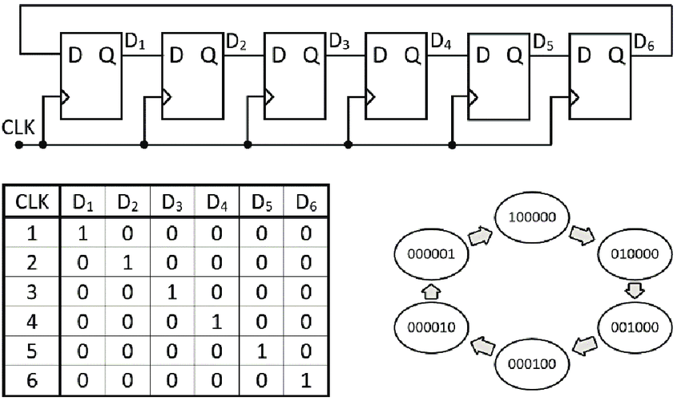
Ring & Johnson Counter
Ring Counter

Slide 50
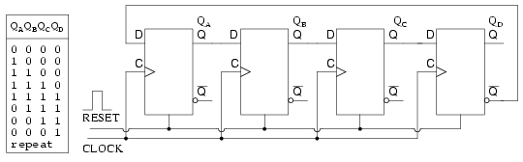
Ring & Johnson Counter
Johnson Counter

Slide 51
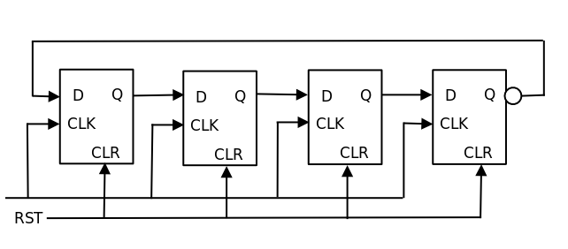
Ring & Johnson Counter
2-19. On the fifth clock pulse, a 4-bit Johnson sequence is Q₀ = 0, Q₁ = 1, Q₂ = 1, and Q₃ = 1. On the sixth clock pulse, the sequence is….
Q₀ = 1, Q₁ = 0, Q₂ = 0, and Q₃ = 0
Q₀ = 1, Q₁ = 1, Q₂ = 1, and Q₃ = 0
Q₀ = 0, Q₁ = 0, Q₂ = 1, and Q₃ = 1
Q₀ = 0, Q₁ = 0, Q₂ = 0, and Q₃ = 1
Notes:
C

Slide 52
Ring & Johnson Counter
2-20. What is the difference between a ring shift counter and a Johnson shift counter?
A. There is no difference | C. The feedback is reversed
B. A ring is faster | D. The Johnson is faster
2-21. In a 6-bit Johnson counter sequence there are a total of how many states, or bit patterns ?
A. 2 | C. 12
B. 6 | D. 24
2-22. A modulus – 12 ring counter requires a minimum of
A. 10 Flip-flops | C. 6 Flip-flops
B. 12 Flip-flops | D. 2 Flip-flops
Notes:
C
C
B

Slide 53
Others
2-23. A MOD-16 ripple counter is holding the count 1001₂. What will the count be after 31 clock pulses?
A. 1000₂ | C. 1011₂
B. 1010₂ | D. 1101₂
2-24. A MOD-12 and a MOD-10 counter are cascaded. Determine the output frequency if the input clock frequency is 60 MHz
A. 500 kHz | C. 6 MHz
B. 1500 kHz | D. 5 MHz
2-25. A BCD counter is a
A. Binary Counter | C. Decade Counter
B. Full-modulus Counter | D. Divide-by-10 Counter
Notes:
A
A
C

Slide 54
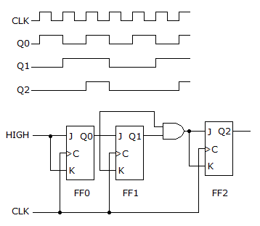
Others
2-26. Give the circuit and waveform respectively. Is the waveform Correct or Not Correct? Explain why?
Notes:
C

Slide 55
MSI Logic circuits
Topic 3

Slide 56
MSI Devices
Medium Scale Integration (MSI)
Using a few tens to hundreds of logic gates.
Used as discrete devices packed in a single Integrated Circuit (IC),
Building blocks for more complex devices such as memory devices or microprocessors.
Some typical MSI devices are the following:
Encoders and Decoders
Multiplexers and Demultiplexers
Comparator
Notes:
- Adders, Registers, Counters are also types of MSI

Slide 57
Examples of MSI Devices
Decimal to BCD Encoder
4-to-1 Multiplexer
BCD to Decimal Decoder

Slide 58
Multiplexer (MUX)
A MUX has a
2^{N} data inputs,
N control inputs
One output
The select lines determine which input is connected to the output.
MUX Types
→ 2-to-1 (1 select line)
→ 4-to-1 (2 select lines)
→ 8-to-1 (3 select lines)
→ 16-to-1 (4 select lines)
Multiplexer
Block Diagram
2^{N}
1
Inputs
(sources)
MUX
Output
(destination)
N
Select
Lines

Slide 59

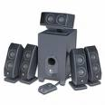
Typical Application of a MUX
Multiple Sources
Selector
Single Destination
MP3 Player
Docking Station
D0
D1
D2
D3
Laptop
Sound Card
MUX
Y
Surround Sound System
Digital
Satellite
B | A | Selected Source
0 | 0 | MP3
0 | 1 | Laptop
1 | 0 | Satellite
1 | 1 | Cable TV
Digital
Cable TV

Slide 60
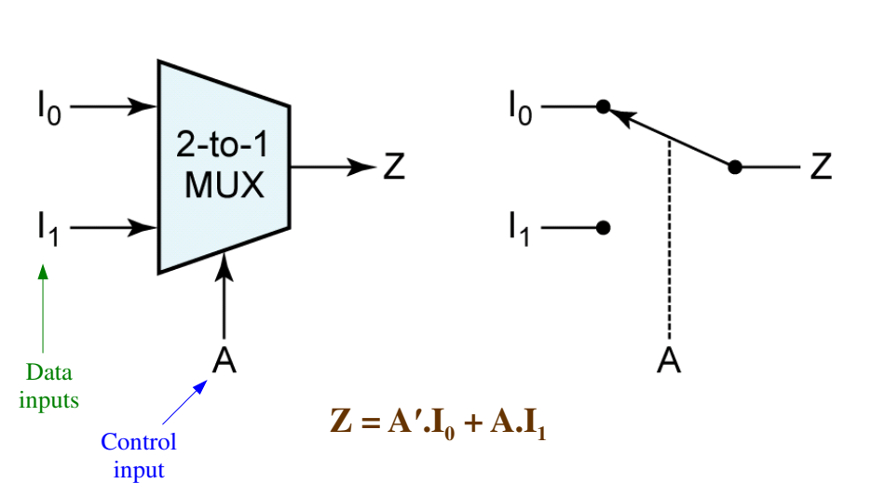
Multiplexer

Slide 61
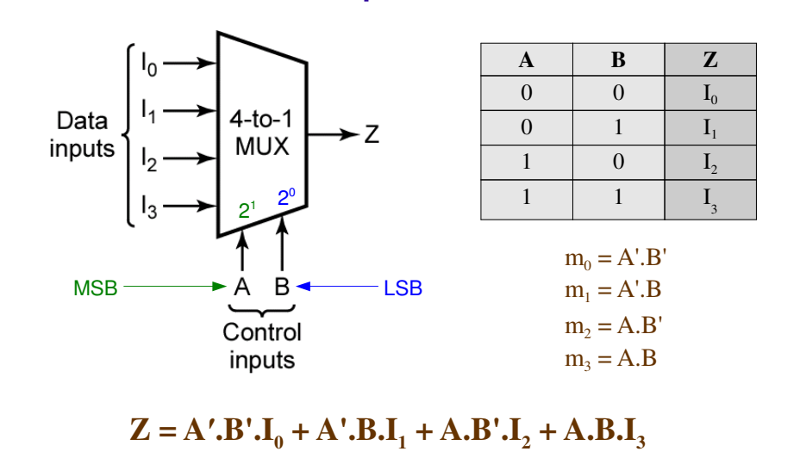
Multiplexer

Slide 62
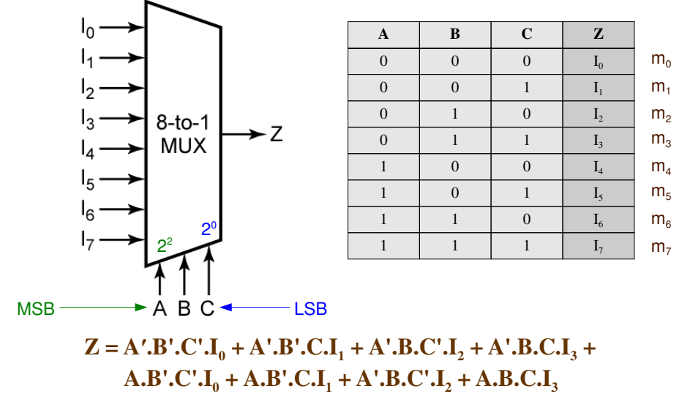
Multiplexer

Slide 63
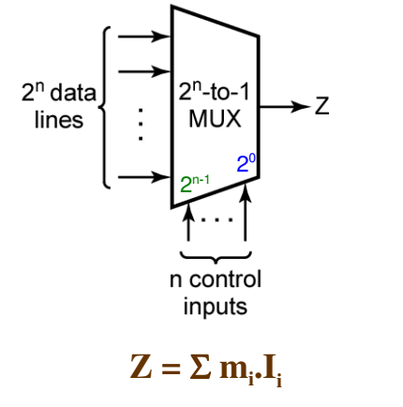
Logic Implementation using MUX
A 2^{n}-to-1 MUX
Can be used to implement ANY function of n variables
Can be used to implement SOME functions of (n + 1) variables

Slide 64
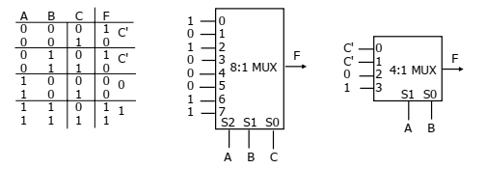

Logic Implementation using MUX
Example:
$$F\left(A,B,C\right)=∑m\left(0, 2, 6, 7\right)$$
$=m0+m2+m6+m7$
= A’B’C’ + A’B’C + ABC’ + ABC
= A’B’(C’) + A’B’(C) + AB(0) + AB(1)

Slide 65
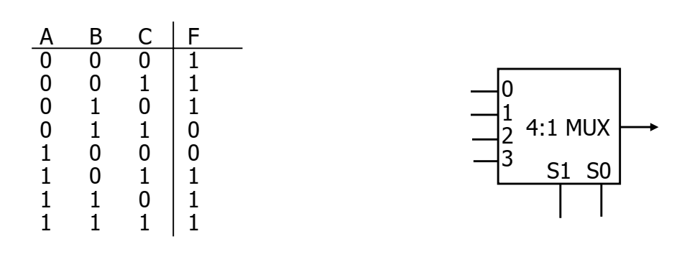
Logic Implementation using MUX
3-1. Implementing the following function as a 4-to-1 MUX
Notes:
- S1(B), S0(C),

Slide 66
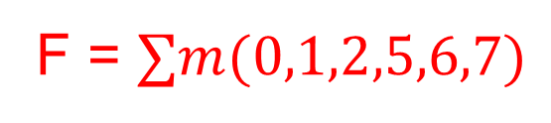
Logic Implementation using MUX
3-1. Implementing the following function as a 4-to-1 MUX
A’
1
F
1
A
B
C
 | I0(B’C’) | I1(B’C) | I2(BC’) | I3(BC)
A’ | 1 | 1 | 1 | 0
A | 0 | 1 | 1 | 1
 | A’ | 1 | 1 | A
F = $∑m(0,1,2,5,6,7)$

Slide 67

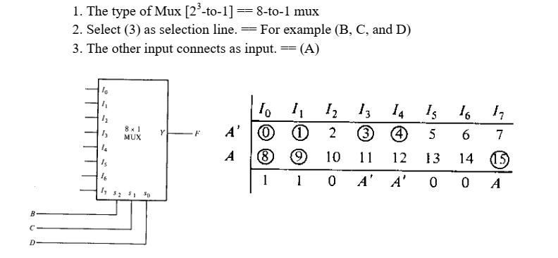
MSI
3-2. Implement following function using MUX:

Slide 68
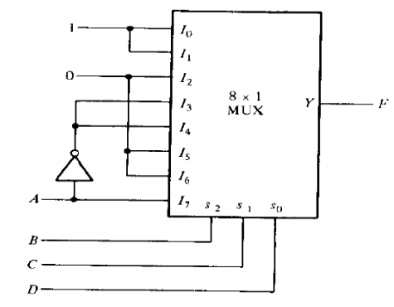
MSI
3-2. Implement following function using MUX:

Slide 69
Demultiplexer (DEMUX)
A digital switch with
One input (source)
N control inputs
2^{N} outputs (destinations).
The select lines determine which output the input is connected to.
DEMUX Types
→ 1-to-2 (1 select line)
→ 1-to-4 (2 select lines)
→ 1-to-8 (3 select lines)
→ 1-to-16 (4 select lines)
Demultiplexer
Block Diagram
1
2^{N}
Input
(source)
DEMUX
Outputs
(destinations)
N
Select
Lines
Notes:
This slide explains the function of a demultiplexer.

Slide 70
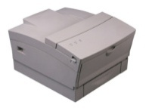
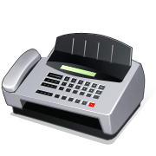
Typical Application of a DEMUX
Single Source
Selector
Multiple Destinations
B/W Laser
Printer
Fax
Machine
D0
D1
D2
D3
X
DEMUX
Color Inkjet
Printer
B | A | Selected Destination
0 | 0 | B/W Laser Printer
0 | 1 | Fax Machine
1 | 0 | Color Inkjet Printer
1 | 1 | Pen Plotter
Pen
Plotter
Notes:
This slide shows a typical application of a demultiplexer (in this case a 1-to-4 DEMUX). Ask students to share other common applications of DEMUXs.

Slide 71
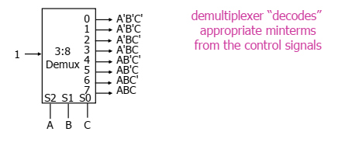

Logic Implementation using Demux

Slide 72
Decoders
A decoder has
N inputs
2^{N} outputs
Only one of the outputs is enabled at a time.
The output enabled is the one specified by the binary number formed at the inputs of the decoder.
Notes:
On the circuit below, the inputs of the decoder are connected on three switches, forming the number 5 [(101)₂], thus only the lamp #5 will be ON

Slide 73

2 to 4 Line Decoder

Slide 74

3 to 8 Line Decoder

Slide 75
Decoders
3-3. Which statement below best describes the function of a decoder?
A decoder will convert a decimal number into the proper binary equivalent.
A decoder will convert a binary number into a specific output representing a particular character or digit.
Decoders are used to prevent improper operation of digital systems.
Decoders are special ICs that are used to make it possible for one brand of computer to talk to another.
Notes:
B

Slide 76

Decoders
3-4. Output 5 of a 74138 octal decoder is selected when it is enabled by a data input of:
A0 = 1, A1 = 1, A2 = 0
A0 = 1, A1 = 0, A2 = 1
A0 = 0, A1 = 1, A2 = 0
A0 = 1, A1 = 0, A2 = 0
Notes:
B

Slide 77


Logic Implementation using Decoder
3-5. Implement following function with decoder:
$$f\left(a,b,c\right)=∑m(0,3,4,6,7)$$

Slide 78


Logic Implementation using Decoder
3-6. Using a 2-to-4 line decoder, design a logic circuit to realize the following Boolean function
$$F\left(A,B,C\right)=∑m\left(0, 1, 4, 6, 7\right)$$
3-7. Using a 3-to-8 line decoder, design a logic circuit to realize the following Boolean function
$$F\left(A,B,C\right)=∑m\left(2, 3, 5, 6, 7\right)$$

Slide 79

Encoders
An encoder has
2^{N} inputs
N outputs
Performs the inverse operation of a decoder

Slide 80


Magnitude Comparator
Compares two input binary quantities and generates outputs to indicate which one has the greater magnitude

Slide 81
Magnitude Comparator
3-8. What are the outputs of a 7485 four-bit magnitude comparator when the inputs are A = 1001 and B = 1010?
A < B is 1; A = B is 0; A > B is 1
A < B is 0; A = B is 1; A > B is 0
A < B is 0; A = B is 0; A > B is 1
A < B is 1; A = B is 0; A > B is 0
3-9. Which is the decimal number for the BCD number, 10110110 ?
182
36
116
10110110 is not a valid BCD number
Notes:
D
D

Slide 82

Others
3-10. Determine the correct output for the multiplexer and its associated timing diagram given below.
Ya
Yb
Yc
Yd
Notes:
D

