Slide 1
Homomorphic encryption: Cryptography for Cloud computing
Student: Q.D. MCGAW
Supervisors: Dr. Wei Dai and Dr. Cong Ling
Second marker: Professor Athanassios Manikas
20 June 2016

Slide 2

1. Objectives of the project
Provide a general purpose C++ API for homomorphic encryption and cloud computing
This is regularly asked by the cryptographic community
Push current available technologies to their limits
Implement a simple but useful data analysis operation: the average
Prove homomorphic encryption can be used for some computing operations today.

Slide 3
2. Cloud computing today
Plaintext
Ciphertext
Unsecured communication medium
Client side
Cloud storage
My sensitive data
Encryption
l#sd9?/$%fg(45}[
l#sd9?/$%fg(45}[
My sensitive data
Decryption
l#sd9?/$%fg(45}[
Client side
Cloud computing
My sensitive data
Encryption
l#sd9?/$%fg(45}[
l#sd9?/$%fg(45}[
Decryption
My sensitive data
Normal Processing
My sensitive result
Decryption
^dfsd&12@ff90~
My sensitive result
Encryption
^dfsd&12@ff90~
Notes:
Cloud storage can contain only encrypted data and should not be the main issue here. The main problem is for cloud computing such as amazon elastics cloud computing.
Privacy issues for data on cloud computers. Security issue if cloud computers (priority target for hackers) gets corrupted.

Slide 4


Plaintext
Ciphertext
Unsecured communication medium
Client side
Cloud computing
Homomorphic Encryption
l#sd9?/$%fg(45}[
Decryption
My sensitive data
Encryption
l#sd9?/$%fg(45}[
My sensitive data
Normal Processing
Homomorphic Processing
Homomorphic Decryption
My sensitive result
Encryption
My sensitive result
Decryption
^dfsd&12@ff90~
3. Homomorphic encryption for cloud computing
^dfsd&12@ff90~
Homomorphic operations
Homomorphic Encryption
17
Xp4#hs11df~9tq?
Xp4#hs11df~9tq?
$$+3$$
Homomorphic Decryption
$$×5$$
100
^dfsd&12@ff90~
^dfsd&12@ff90~
Notes:
Cloud storage can contain only encrypted data and should not be the main issue here. The main problem is for cloud computing such as amazon elastics cloud computing.
Privacy issues for data on cloud computers. Security issue if cloud computers (priority target for hackers) gets corrupted.

Slide 5
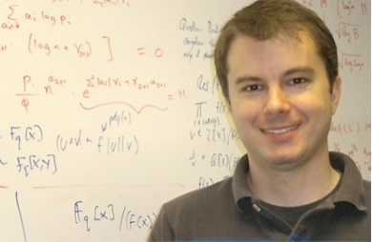

History
Homomorphic encryption has been there for many years, i.e. in the RSA scheme.
Fully homomorphic encryption (FHE) allows arbitrary numbers of additions and multiplications to be processed on ciphertexts in the plaintext space.
It was theoretically proved possible in 2009 by Craig Gentry
This was made practically possible in 2011 by Craig Gentry and Shai Halevi.
Since then many FHE schemes were designed.
There are today several software libraries implementing FHE schemes, such as HElib which is maintained by Shai Halevi (IBM).
4. The technology today
BGV scheme
Fan and Vercauteren scheme
DGHV scheme
GSW scheme
NTRU scheme
LTV scheme
DHS sceme

Slide 6
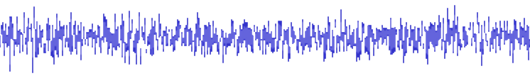
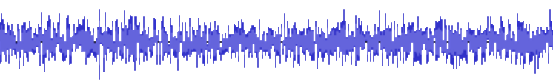
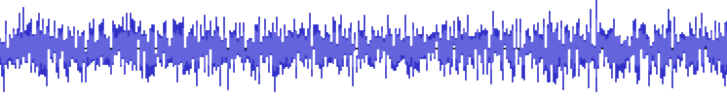
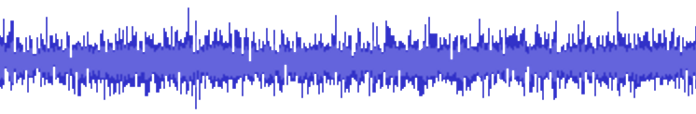



4. The technology today
Ciphertext noise
The ciphertext can’t be decrypted anymore once the noise grows above a certain threshold.
Homomorphic ciphertext A
$$×$$
Homomorphic ciphertext B
Homomorphic ciphertext A
$$+$$
Homomorphic ciphertext B
Homomorphic ciphertext A
$$×$$
Homomorphic ciphertext B
Homomorphic multiplications add more noise to the ciphertext than the homomorphic additions.
Homomorphic ciphertext A
From now, the number of homomorphic multiplications required is called the complexity
Notes:
Noise is due to randomness added for security purposes

Slide 7
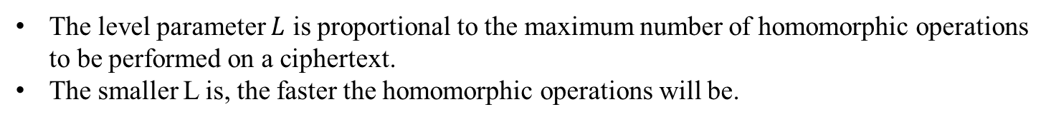
4. The technology today
Bootstrapping and BGV scheme
To counter the growing ciphertext noise, there are two main techniques as listed in the columns of the table below.
Bootstrapping | Levelled homomorphic encryption
Used by Craig Gentry’s first construction (2009) | Used by the BGV scheme (2011)
Homomorphic operations are not bounded. | Homomorphic operations are bounded according to the level parameter L.
Very slow and expensive | More performant, for low values of L.
The level parameter $L$ is proportional to the maximum number of homomorphic operations to be performed on a ciphertext.
The smaller L is, the faster the homomorphic operations will be.

Slide 8
4. The technology today
The library used: HElib
The library HElib is
The second most performant homomorphic encryption library
Portable
Flexible and tweakable
Well documented and maintained
It supports
Bootstrapping, for a fully homomorphic encryption (Craig Gentry’s 2009 construction)
Modulus key switching, for a levelled homomorphic encryption (BGV scheme)
Homomorphic addition and multiplication operations in any field.
SIMD mode, for a higher maximum throughput.
Plaintext vector v1
4
17
19
2
Encryption
&f5£sc25@kg*
Single instruction
Multiple data
X
6
2
1
12
Encryption
G3)#fh[2j{\gz5
Plaintext vector v2
Resulting plaintext vector
24
34
19
24
Decryption
G>7£9sg2/ky0p

Slide 9
5. The missing part
There are many schemes and several homomorphic software libraries
There are a few already built applications
Remote end-to-end voting
Prince block cipher
Sorting algorithm
But no general purpose API for number operations such as comparison or division.

Slide 10
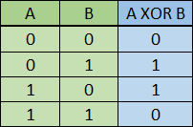
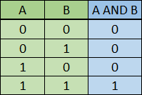

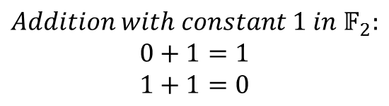
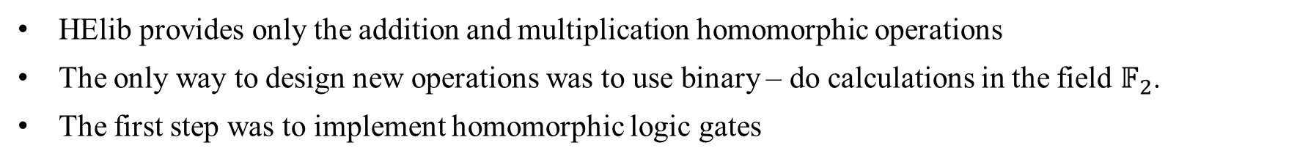

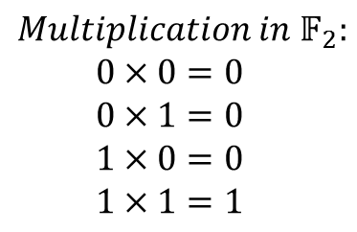
Starting point
HElib provides only the addition and multiplication homomorphic operations
The only way to design new operations was to use binary – do calculations in the field $𝔽_{2}$.
The first step was to implement homomorphic logic gates
$$Addition in 𝔽_{2}:$$
$$0+0=0$$
$$0+1=1$$
$$1+0=1$$
$$1+1=0$$
$$Multiplication in 𝔽_{2}:$$
$$0×0=0$$
$$0×1=0$$
$$1×0=0$$
$$1×1=1$$
6. Implementation
The last gate required to go forward was the NOT gate
$$Addition with constant 1 in 𝔽_{2}:$$
$$0+1=1$$
$$1+1=0$$
How does the cloud computer knows what is 1... Without knowing it?

Slide 11
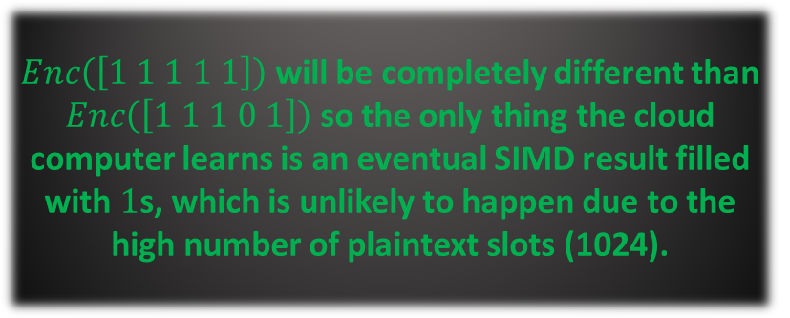


6. Implementation
The NOT gate
CLIENT
$Enc\left(\left[1 1 1 1 1\right]\right)$ will be completely different than $Enc\left(\left[1 1 1 0 1\right]\right)$ so the only thing the cloud computer learns is an eventual SIMD result filled with $1$s, which is unlikely to happen due to the high number of plaintext slots (1024).
Generation of key pair
Number of plaintext slots nslots
Creates a vector filled with nslots 1s
Encrypt vector and send SIMD ready ciphertext
CLOUD COMPUTER
Assigns the ciphertext to the “Ones” ciphertext
$$Ones=\left[1 1 …1\right]$$
Copies the “Ones” ciphertext into the “Zeroes” ciphertext
$$Zeroes=\left[1 1 …1\right]$$
Adds “Zeroes” to “Zeroes”
$$Zeroes=\left[1 1 …1\right]+\left[1 1 …1\right]=[0 0 …0]$$

Slide 12



6. Implementation
Representation of an n bit number
$n$ bits
0
0
0
One number
1
0
1
………
………
………
$$N numbers$$
0
1
1
$n$ ciphertexts

Slide 13



6. Implementation
Example: The homomorphic Euclidean division arithmetic circuit
$n$ bits
Homomorphic Euclidian division arithmetic circuit
$n$ bits
Binary number A
Quotient
$n$ bits
$n$ bits
Binary number B
Remainder

Slide 14


6. Implementation
The other gates and circuits implemented
XOR logic gate
Complexity 0
AND logic gate
Complexity 1
NOT logic gate
Complexity 0
XNOR logic gate
Complexity 0
Requires XOR, NOT
OR logic gate
Complexity 1
Requires AND, NOT
NOR logic gate
Complexity 1
Requires AND, NOT
NAND logic gate
Complexity 1
Requires AND, NOT
Half Adder
Complexity 1
Requires XOR, AND
Half Subtractor
Complexity 1
Requires XOR, NOT, AND
Half Equal
Complexity 0
Requires XNOR
Lower than comparator
Complexity 1
Requires NOT, AND
2:1 multiplexer
Complexity 3
Requires NAND, NOT
Full Adder
Complexity 3
Requires Half adder, OR
Full Subtractor
Complexity 3
Requires Half subtractor, OR
Full Equal
Complexity 1
Requires Half Equal, AND
Half comparator
Complexity 1
Requires Half Equal, Lower than comparator
N:1 multiplexer
Complexity 3n
Requires 2:1 multiplexer
Ripple carry adder
Complexity 3n+1
Requires Half and Full Adder
Ripple borrow subtractor
Complexity 3n+1
Requires Half and Full Subtractor
Ripple equality tester
Complexity n-1
Requires Half and Full Equality
Full comparator
Complexity 4
Requires Full Equal, Lower than comparator, AND, OR
Binary left & right shift
Complexity 0
Ripple comparator
Complexity 4(n-1)+1
Requires Half and Full Subtractor
Multiplication circuit
Complexity 4$n^{2}$-3.5n
Requires Ripple carry adder, left shift and AND
Euclidian division
Complexity $6n^{2}$+n
Requires Ripple borrow subtractor, shifts, NOT and N:1 multiplexer
Fast Average circuit
Very high complexity
Requires ripple carry adder and Euclidian division
Average circuit
Very high complexity
Requires ripple carry adder and Euclidian division

Slide 15
Logic gates
7. Results and evaluations
Homomorphic multiplications add between 12 and 34 times more noise than the homomorphic addition.
This is why it is called complexity here.

Slide 16
7. Results and evaluations
Combinational circuits, for 1024 SIMD plaintext slots
The complexity of a homomorphic circuit and its execution time are highly correlated

Slide 17
7. Results and evaluations
Sequential circuits, for 1024 SIMD plaintext slots
LINEAR
Increasing the number of SIMD data slots decreases the time per operation

Slide 18
7. Results and evaluations
Arithmetic circuits, for 1024 SIMD plaintext slots
This involves the following 5 circuits built on top of the sequential circuits:
Binary multiplication
Binary Euclidean division
Binary Average
Binary “Fast” Average which only calculates the quotient of a division
Exponential
Arithmetic circuits become quickly unusable as the number of bits n grows

Slide 19
7. Results and evaluations
Arithmetic circuits, for 1024 SIMD plaintext slots
Not timely useful anymore

Slide 20
8. Conclusion
10. Questions
11. Answers
9. Thank you
Some operations can be used now with the API developed and are not too expensive in terms of time.
Binary additions, subtractions, comparisons
Binary “Fast” averages (based on shifts)
Binary multiplications, for numbers up to 8 bits.
Multiplexers
Code is
Robust: 75% of the API code is covered by unit tests
Open source: http://qdm12.github.io/hbc/ and well documented
Easy to setup and use: A makefile was crafted for Windows and Linux to download, compile and install everything
Compatible: On all platforms, although some like OSX will have to install manually.
A lot of future work possible
Changing the sequential and arithmetic circuits algorithms
Adding more homomorphic circuits
Using bootstrapping for very complex circuits
Adding parallel circuits for an even bigger throughput
Using multiple cores of the CPU, or even GPU with the cuHE library
Already used by a Computer science Masters student in the University of Manitoba, Canada.

Slide 22
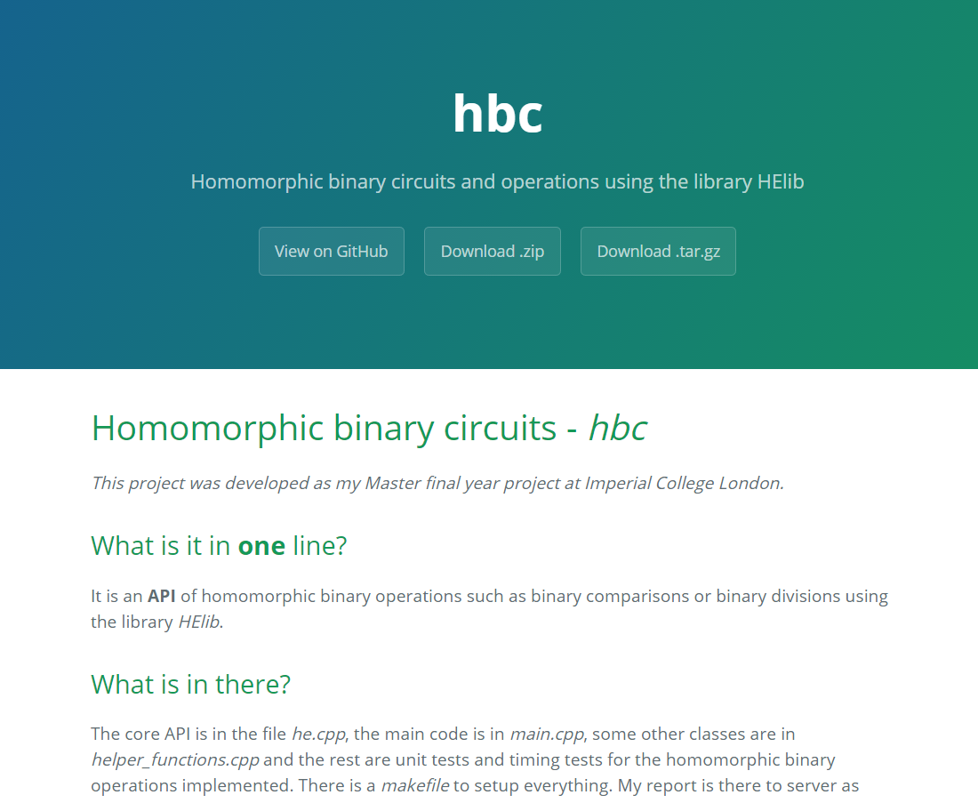
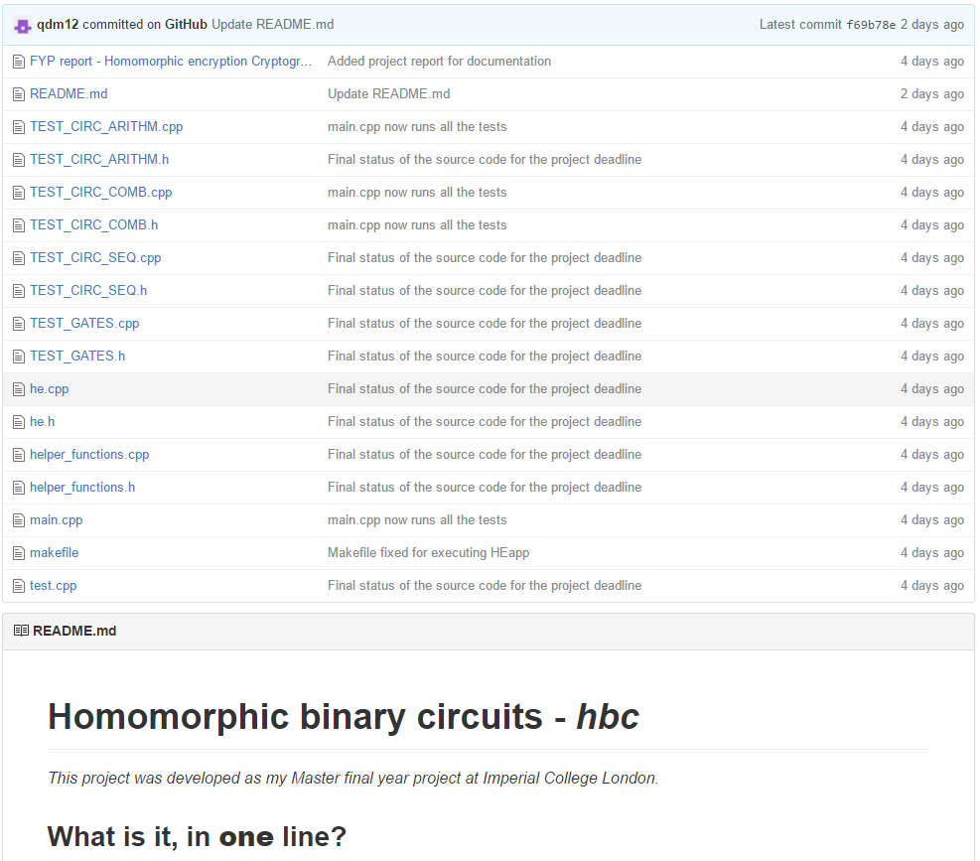

Slide 23
A: 101
B: 010
5 / 3 ?
X: 000 101
Blue arrows operations represent memory operations or shifts and have a zero homomorphic complexity
Left shift
X: 001 010
Iteration 1
R: 001 – 010 = 1111
Red and orange arrows have a high homomorphic complexity
X: 001 010
The green arrow is a NOT gate (zero complexity)
Left shift
X: 010 100
Iteration 2
R: 010 – 010 = 0000
LOOP
X: 000 100
Left shift
X: 001 001
Iteration 3
R: 001 – 010 = 1111
X: 001 001
Left shift
X: 010 010
R: 010
Q: 010
Right shift
R: 001
Q: 010
5 = 2 x 2 + 1

Slide 24
&f5£s@kg*
a39es$sfz
G6”15fl8h
OR
Encryption
Encryption
Decryption
0
0
0
1
0
1
………
………
………
0
1
1

