Slide 1

Hyperspectral microscopy
Under the supervision of: Mr. Pierre Weiss
With the help of: Ms. Corinne Barreau, Ms. Coralie Sengenes
Quentin Douzery
Alexia Ghozland
January, 21st 2022
Notes:
Alexia

Slide 2
Introduction
Wrinkles
Fibrosis emergence
Loss of
skeletal muscle mass
AGEING
Tissue composition
changes
Can we detect these ageing phenomenons?
Notes:
Alexia

Slide 3



Summary
Scientific context
Materials and methods
Results and discussion
Notes:
Alexia

Slide 4



Scientific context
What is spectroscopy
How does the light interact with the target?
Spectrum: how much light is emitted from the target?
Spectroscopy
Analysis
Detection
Spectral signature
Identification
Equivalent to a human fingerprint
Notes:
Alexia
Autofluorescence of biological tissues
Spectroscopy = technique for 3 steps

Slide 5
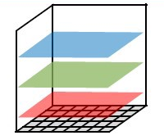
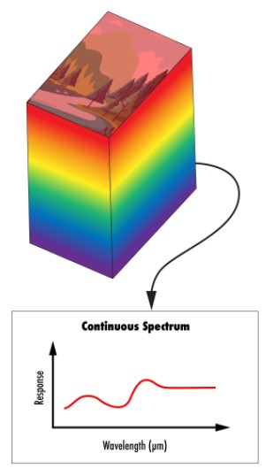
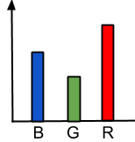
Scientific context
What is hyperspectral imaging (HSI)
RGB
HSI
Non contact
Non destructive
More informative
For each voxel
Voxel 3D ≡ Pixel 2D
Does the hyperspectral signature of a muscle of mouse indicate its ageing?
Notes:
Alexia
Record Spectrum regarding 3 wavelengths
HSI records Continuous narrow spectral bands
What (spectrum)? Where (voxel)?

Slide 6

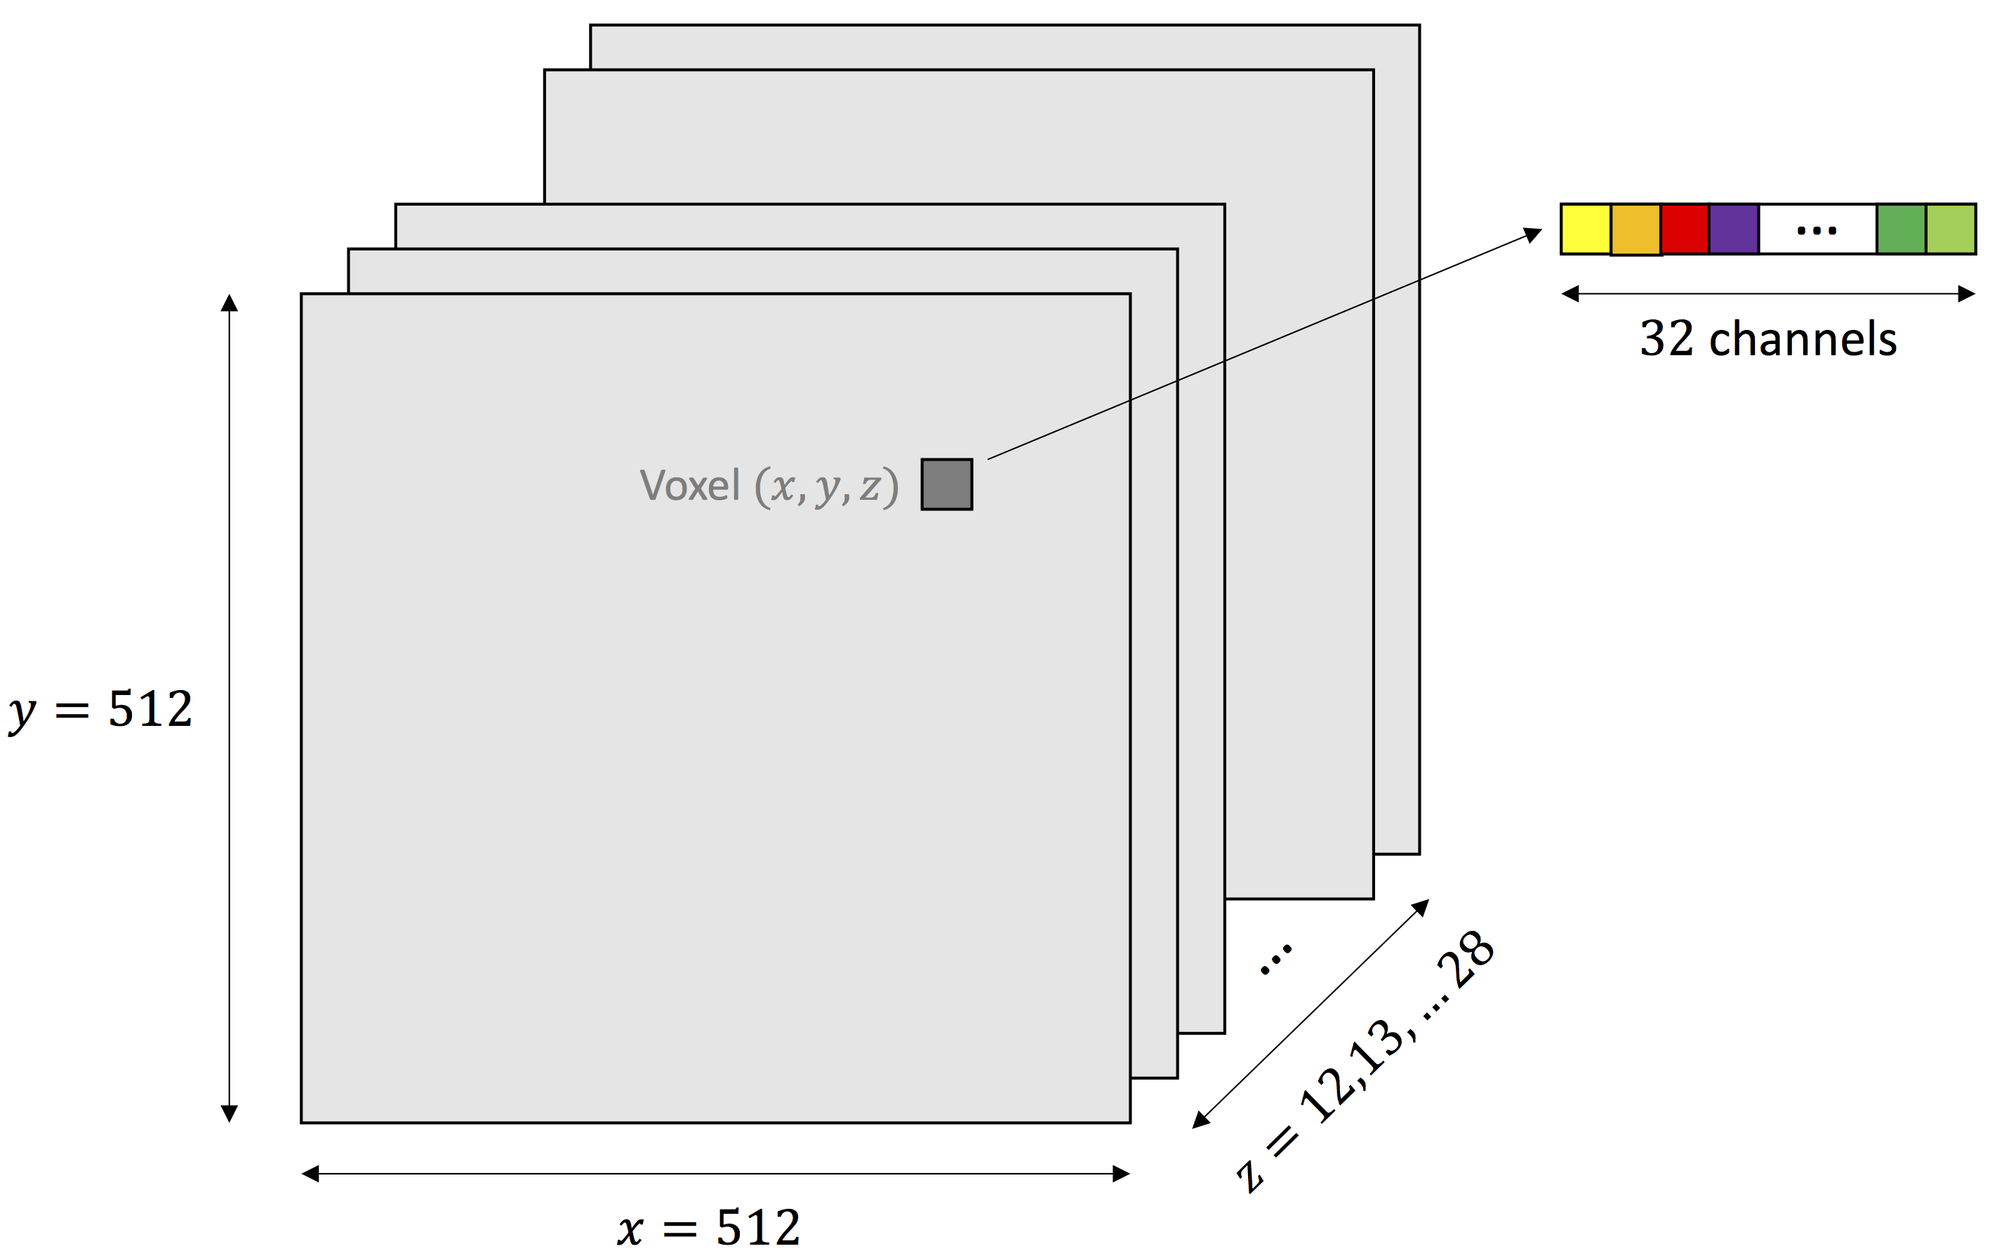



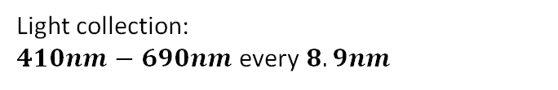

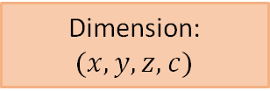
Scientific context
Hyperspectral microscopy in our case
6 mice:
3 young, 3 old
Excitation wavelengths: $740nm, 780nm,820nm$
Light emission:
fluorescent tissues
Light collection:
$410nm−690nm$every $8.9nm$
Dimension: $(x,y,z,c)$
32 channels
Voxel 3D ≡ Pixel 2D
Notes:
Alexia
Lasers illuminates target and hyperspectral camera collects emitted light
Recall : pixel 2D = voxel 3D

Slide 7
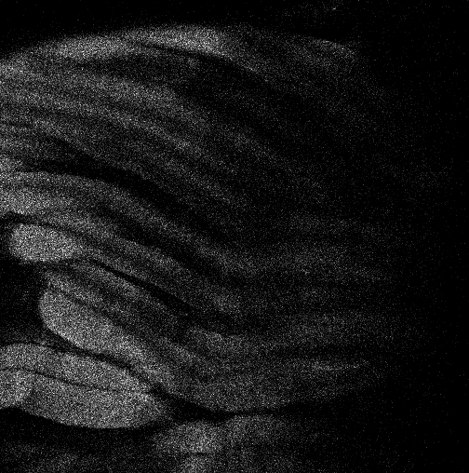
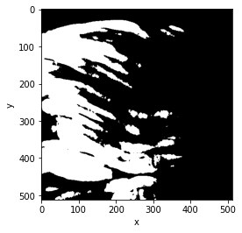


Materials and methods
Segmentation of the images
Raw image
Segmented image
Ilastik
Size: $(512, 512, 12, 32)$
Size: $(512, 512, 12)$
Muscle
Colour: white
Value: 1
Muscle
Non muscle
Colour: black
Value: 0
Non muscle
Notes:
Quentin

Slide 8
Materials and methods
Segmentation of the images
Choose features
Add labels
Ilastik
Train classifier
Predict voxels
Segment image
Notes:
Quentin

Slide 9
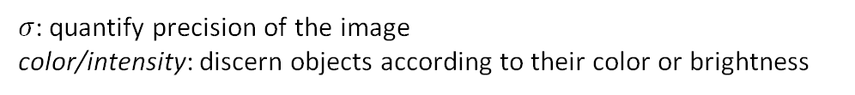
Materials and methods
Segmentation of the images
Choose features
$σ$: quantify precision of the image
color/intensity: discern objects according to their color or brightness
Add labels
Ilastik
Train classifier
Predict voxels
Segment image
Notes:
Quentin

Slide 10
Materials and methods
Segmentation of the images
Choose features
Add labels
Manually, just on the objects we are sure about
Ilastik
Train classifier
Predict voxels
Segment image
Notes:
Quentin

Slide 11
Materials and methods
Segmentation of the images
Random forest: aggregation of decision trees
Algorithm trained on each labelled voxel
Choose features
Add labels
Ilastik
Train classifier
Predict voxels
Segment image
Notes:
Quentin

Slide 12
Materials and methods
Segmentation of the images
Choose features
Add labels
Ilastik
Train classifier
Predict voxels
1 prediction for each voxel
Random forest predicts a probability to be a muscle voxel
Segment image
Notes:
Quentin

Slide 13
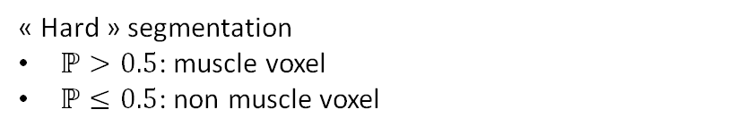
Materials and methods
Segmentation of the images
Choose features
Add labels
Ilastik
Train classifier
Predict voxels
Segment image
« Hard » segmentation
$ℙ>0.5$: muscle voxel
$ℙ≤0.5$: non muscle voxel
Notes:
Quentin

Slide 14
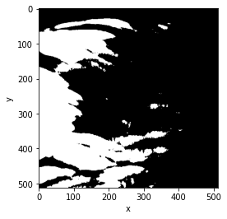
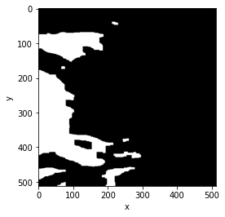
Materials and methods
Mathematical morphology
Erosion
Dilation
Kernel
Opening
Shape (circle, square, etc.)
Given size (e.g. 5x5 pixels)
Slides through image
Under the kernel:
If 1 pixel = 0
► all pixels set to 0
Under the kernel:
If 1 pixel = 1
► all pixels set to 1
Erosion + Dilation
Segmented image
Image after opening + erosion
Notes:
Quentin

Slide 15

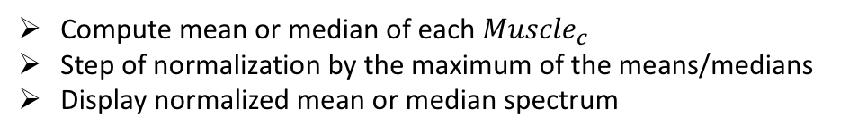

Materials and methods
Spectrum analysis
170
456
2349
…
0
0
1
…
2349
…
…
…
…
…
…
…
…
…
x
…
…
…
…
…
…
…
…
7246
…
7246
3208
741
…
1
1
0
3208
Raw image
Open segmented image
$${Muscle}_{c}$$
$${Muscle}_{c}$$
Array that contains the fluorescence value of all « muscle voxels » for a given channel $c$
Compute mean or median of each ${Muscle}_{c}$
Step of normalization by the maximum of the means/medians
Display normalized mean or median spectrum
Notes:
Quentin

Slide 16




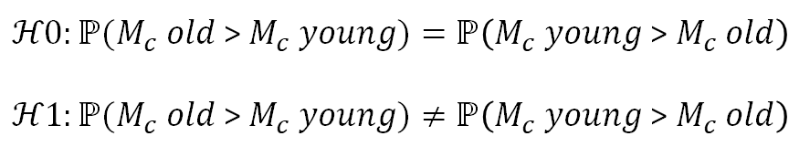



Materials and methods
Mann Whitney U test
Are the distributions of both samples same?
120
160
$ℋ0:ℙ(M_{c} old$ > $M_{c} young)=ℙ\left(M_{c} young \text{> }M_{c} old\right)$
$ℋ1:ℙ(M_{c} old$ > $M_{c} young)≠ℙ\left(M_{c} young \text{> }M_{c} old\right)$
…
…
5763
1003
6034
4902
$p$: probability to reject $ℋ0$ wrongly
$$p≤0.05$$
$ℋ0$ rejected
$$M_{c} old$$
$$M_{c} young$$
$$p>0.05$$
$ℋ0$ not rejected
Notes:
Alexia

Slide 17
Results and discussion
The samples
4 mice
2 young
2 old
2 viewpoints for each mouse
2 viewpoints for each mouse
Notes:
Alexia

Slide 18
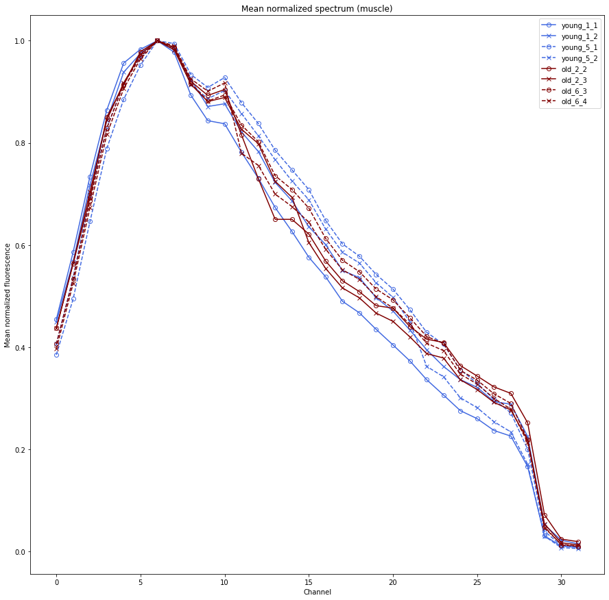
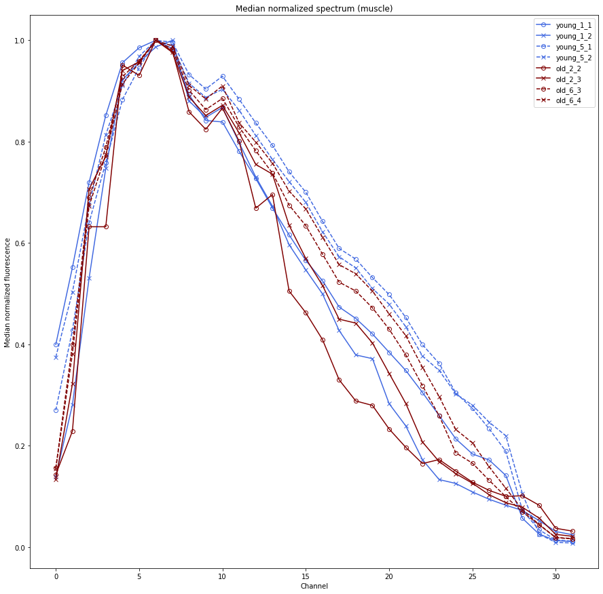
Results and discussion
Spectrum analysis
Some differences
BUT no tendency due to the age
Normalized mean spectrum
Normalized median spectrum
Notes:
Alexia

Slide 19
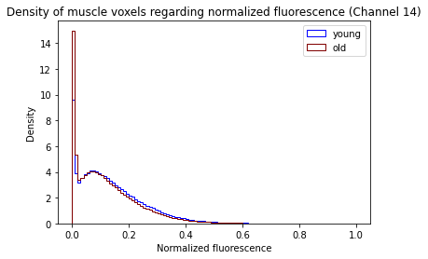

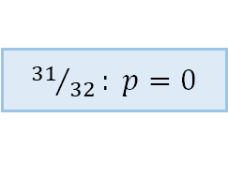
Results and discussion
Mann Whitney U test
Comparison young sample vs. old sample
32 p-values
$ℋ0$ rejected
${31}/{32}: p=0$
Different samples distribution according to Mann-Whitney U test
Notes:
Alexia

Slide 20
Results and discussion
Reservations about conditions of application of Mann Whitney U
1
Samples are very large
200 000 values for a given channel
Probability laws tabulated for small samples
2
Observations of each sample are not independent
Observations come from the same image = same individual
Some assumptions are not fullfilled
We cannot conclude from the results
Notes:
Quentin

Slide 21


Results and discussion
What next ?
Conclusion: we did not find out significant differences between young and old hyperspectral signatures
Mann Whitney test on normalized mean/median fluorescence for a given channel
Requires at least 4 old mice and 4 young mice
Bright points detection and analysis
Notes:
Quentin

Slide 22
References
Websites
https://www.ilastik.org/documentation/pixelclassification/pixelclassification
https://fr.wikipedia.org/wiki/Test_de_Wilcoxon-Mann-Whitney
https://www.specim.fi/hyperspectral-technology-vs-rgb/
https://docs.opencv.org/3.4/d9/d61/tutorial_py_morphological_ops.html
http://www.jybaudot.fr/Inferentielle/mannwhitney.htm
Images
https://towardsdatascience.com/what-are-hyper-spectral-images-a5de5d9fa91
https://www.edmundoptics.fr/knowledge-center/application-notes/imaging/hyperspectral-and-multispectral-imaging/
https://www.analyticsvidhya.com/blog/2020/05/decision-tree-vs-random-forest-algorithm/
https://thenounproject.com/

