Slide 1
接口测试

Slide 2
Agenda
什么是接口测试
Web 接口测试 – HTTP 协议说明
如何进行Web 接口测试
Web 接口测试工具
Web 接口压力测试

Slide 3
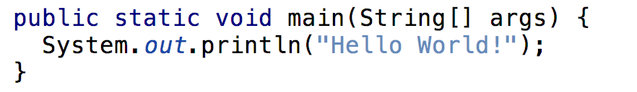
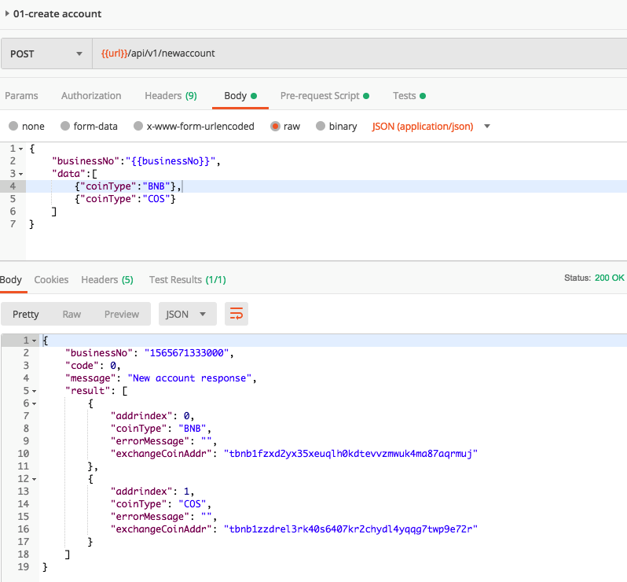
什么是接口测试
API(Application Programing Interface) 一个非常宽泛的定义，调用一个方法就是一个接口测试
Web Service :
一种通过HTTP 协议调用的API，
同时获取返回值
Notes:
Web Services are a subset of the generic term API(Application Programming Interface)
All Web Services are APIs but all APIs are not WebServices
A Web Service is simply an API wrapped in HTTP
APIs – Selenium, Rest Assured
Web Services – Google Maps REST API, GitHub REST API

Slide 4
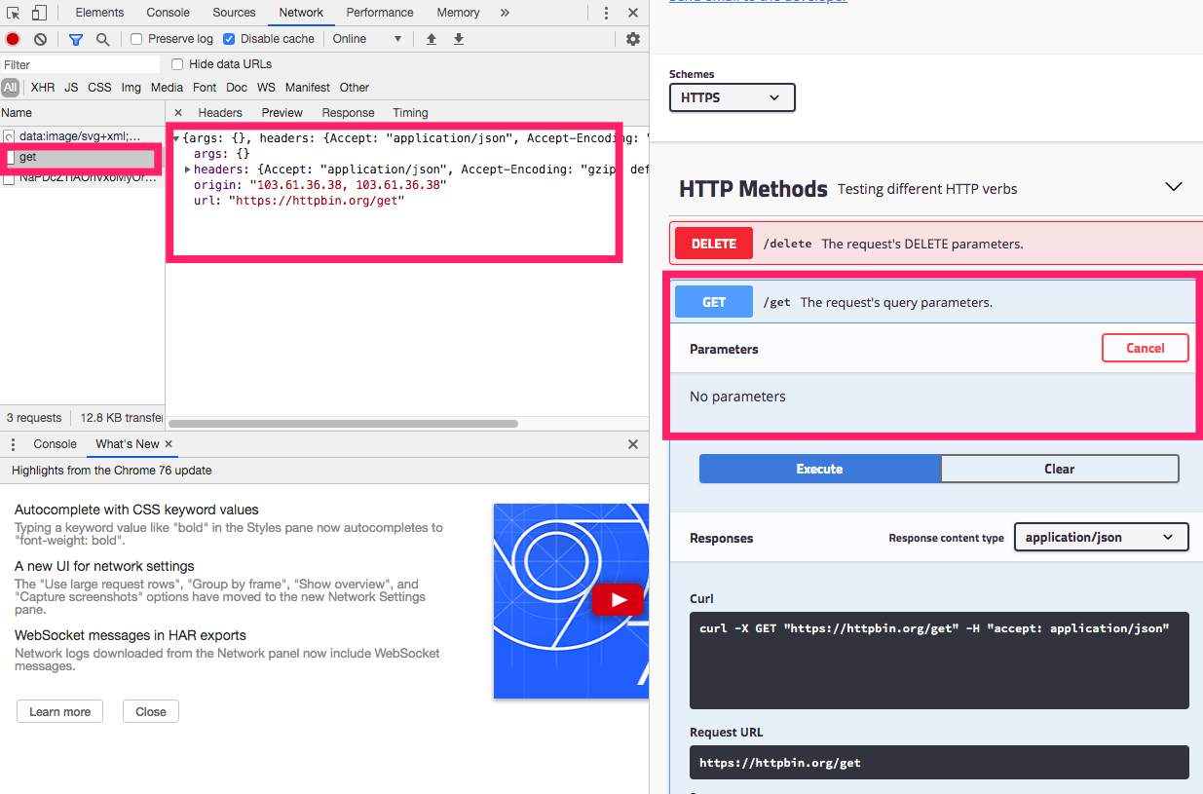
什么是接口测试
Notes:
Web Services are a subset of the generic term API(Application Programming Interface)
All Web Services are APIs but all APIs are not WebServices
A Web Service is simply an API wrapped in HTTP
APIs – Selenium, Rest Assured
Web Services – Google Maps REST API, GitHub REST API

Slide 5
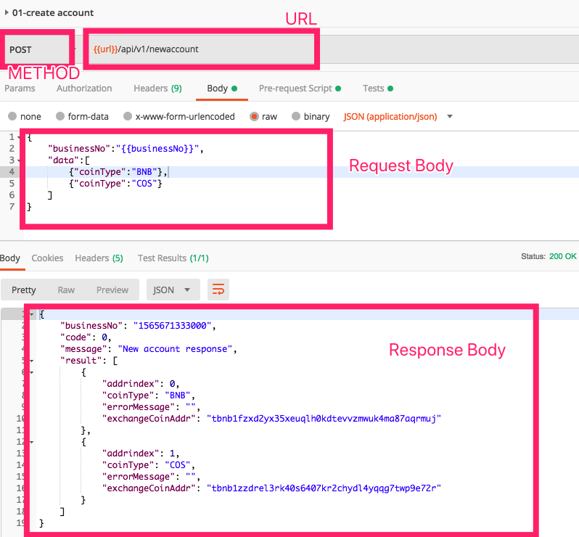
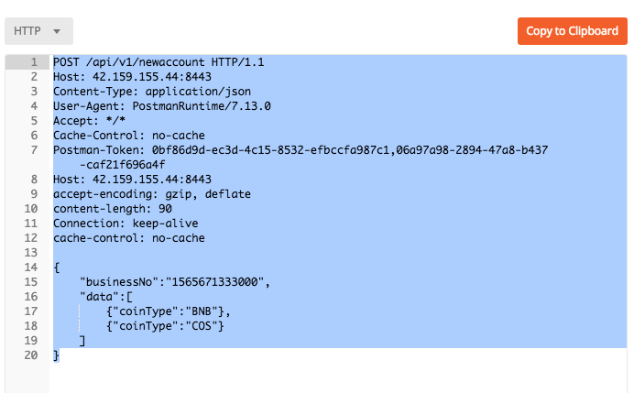
什么是接口测试 – HTTP 协议
URL | 访问位置
METHOD | GET/POST/DELETE/PUT/OPTION
HEADER | 可以用来放额外的信息入请求/返回格式/权限认证数据等
Request Body | 请求数据，一般用于PUT/POST 方法，请求其实不固定，比较常见的为JSON
Reponse Body | 返回的数据，返回格式其实不固定，比较常见的为JSON
HTTP 原始协议报文:
Notes:
Web Services are a subset of the generic term API(Application Programming Interface)
All Web Services are APIs but all APIs are not WebServices
A Web Service is simply an API wrapped in HTTP
APIs – Selenium, Rest Assured
Web Services – Google Maps REST API, GitHub REST API

Slide 6
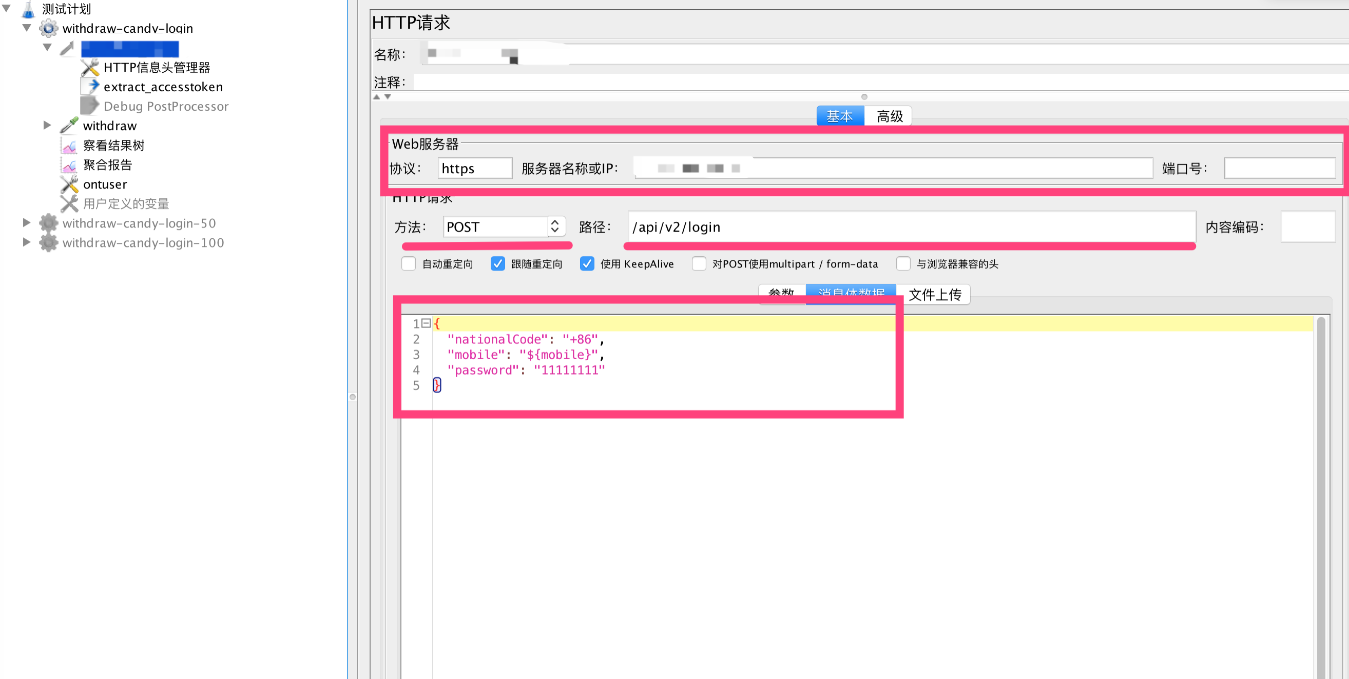
接口测试工具 – JMETER
安装JMETER
创建测试计划
创建线程组
创建请求
参数化
上下文数据抓取
运行测试用例
Notes:
Web Services are a subset of the generic term API(Application Programming Interface)
All Web Services are APIs but all APIs are not WebServices
A Web Service is simply an API wrapped in HTTP
APIs – Selenium, Rest Assured
Web Services – Google Maps REST API, GitHub REST API

Slide 7
什么是接口测试 – HTTP 接口调用例子
POSTMAN echo service
HTTPBIN samples
JMETER samples
Notes:
Web Services are a subset of the generic term API(Application Programming Interface)
All Web Services are APIs but all APIs are not WebServices
A Web Service is simply an API wrapped in HTTP
APIs – Selenium, Rest Assured
Web Services – Google Maps REST API, GitHub REST API

Slide 8
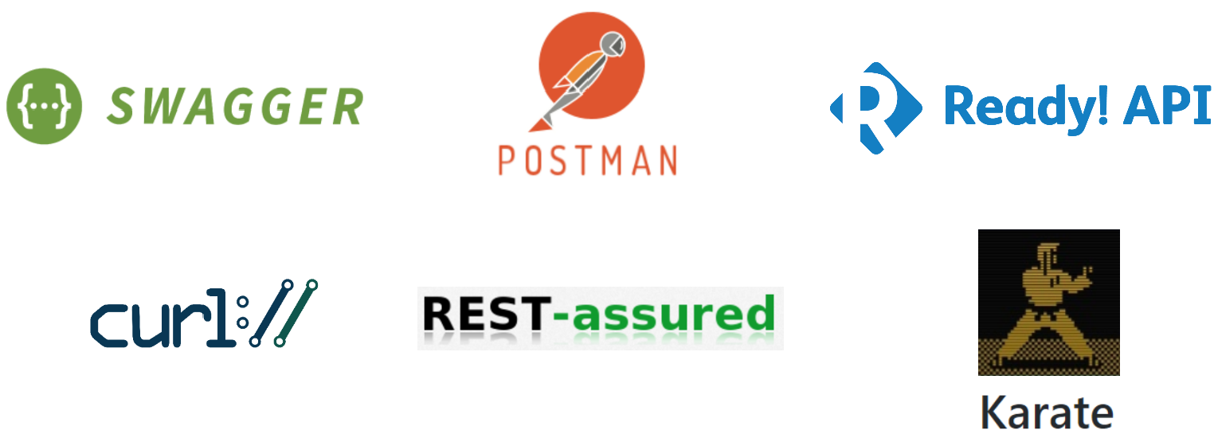
接口测试工具
JMETER
Notes:
Web Services are a subset of the generic term API(Application Programming Interface)
All Web Services are APIs but all APIs are not WebServices
A Web Service is simply an API wrapped in HTTP
APIs – Selenium, Rest Assured
Web Services – Google Maps REST API, GitHub REST API

Slide 9
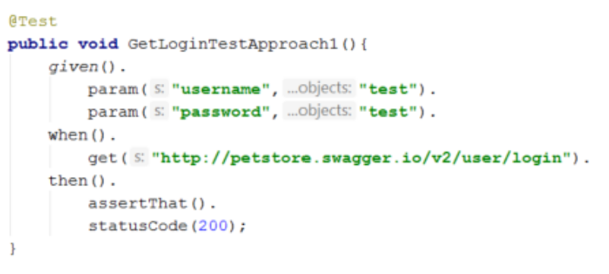
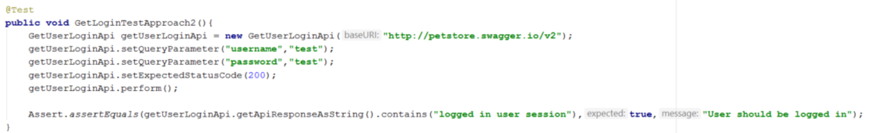
接口测试自动化
API Object Model
Notes:
Web Services are a subset of the generic term API(Application Programming Interface)
All Web Services are APIs but all APIs are not WebServices
A Web Service is simply an API wrapped in HTTP
APIs – Selenium, Rest Assured
Web Services – Google Maps REST API, GitHub REST API
https://github.com/kohli-harshit/automated-automation-demo/blob/master/src/test/java/TestPetStore.java

Slide 10
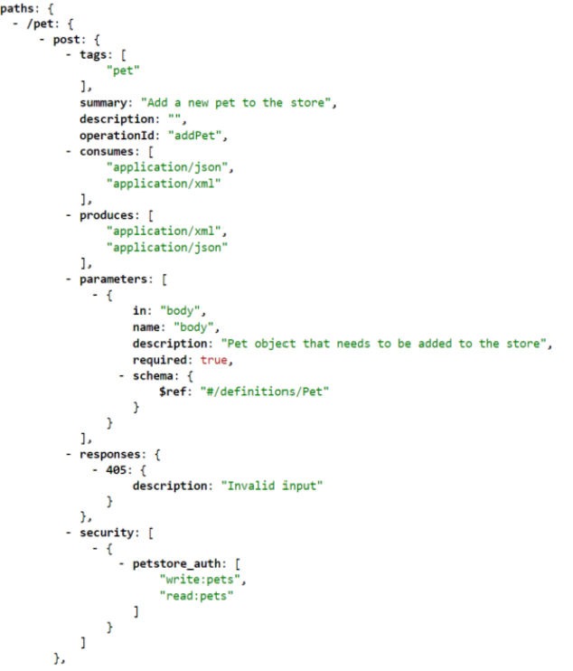
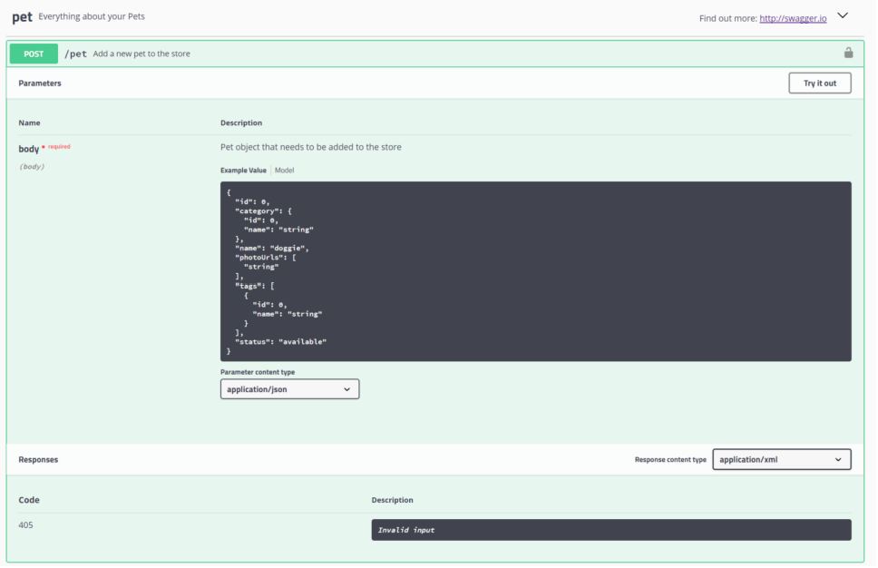
接口测试自动化 - SWAGGER
Notes:
Web Services are a subset of the generic term API(Application Programming Interface)
All Web Services are APIs but all APIs are not WebServices
A Web Service is simply an API wrapped in HTTP
APIs – Selenium, Rest Assured
Web Services – Google Maps REST API, GitHub REST API
https://github.com/kohli-harshit/automated-automation-demo/blob/master/src/test/java/TestPetStore.java

Slide 11
接口测试自动化 –JSON Tools
JsonPath (https://github.com/json-path/JsonPath)
JsonSimple (https://github.com/fangyidong/json-simple)
Jsonschema2pojo (http://www.jsonschema2pojo.org/)
http://gluonhq.com/products/scene-builder/
Notes:
Web Services are a subset of the generic term API(Application Programming Interface)
All Web Services are APIs but all APIs are not WebServices
A Web Service is simply an API wrapped in HTTP
APIs – Selenium, Rest Assured
Web Services – Google Maps REST API, GitHub REST API
https://github.com/kohli-harshit/automated-automation-demo/blob/master/src/test/java/TestPetStore.java

