Slide 1



NYC Car Crash and Injuries
Helen Jeon

Slide 2
Given characteristics of a crash, what is the probability that the crash results in an injury?

Slide 3
NYC Open Data: NYC Vehicle Collisions
Features:
Number of persons injured
Contributing Factors
Vehicle Code
Borough
Date & Time
Data

Slide 4
Risk is heavily concentrated during periods of high activity and geographic density.
Manhattan is the most hazardous borough
Risk peaks on Mondays and Tuesdays
Most dangerous at 11:00 AM and 11:00 PM
Findings

Slide 5
Data Exploration

Slide 6
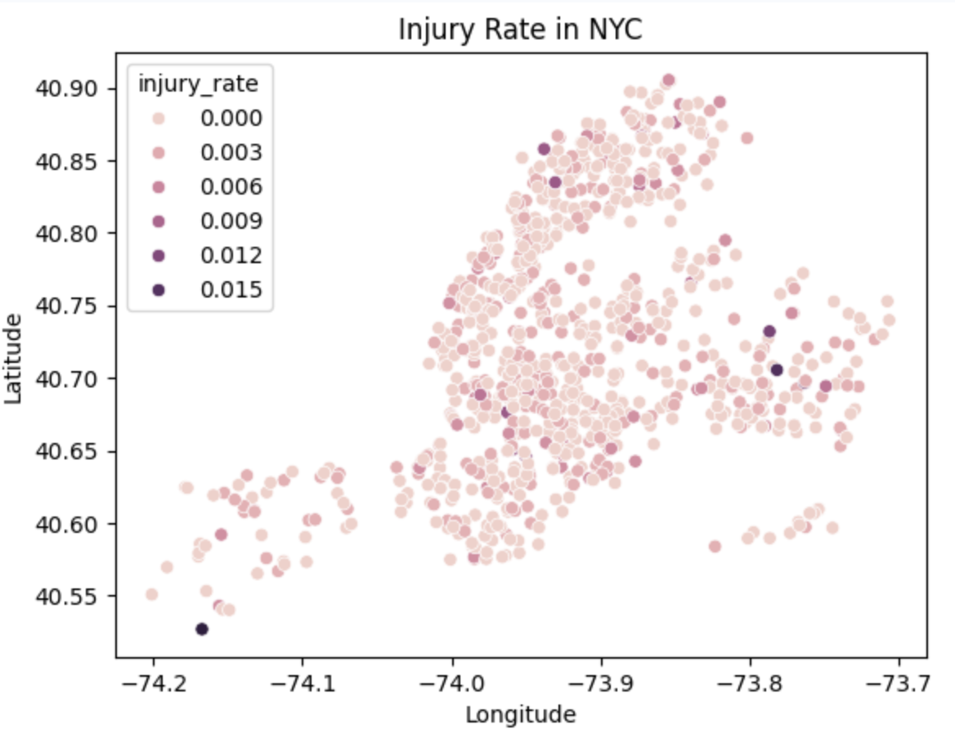

Slide 7
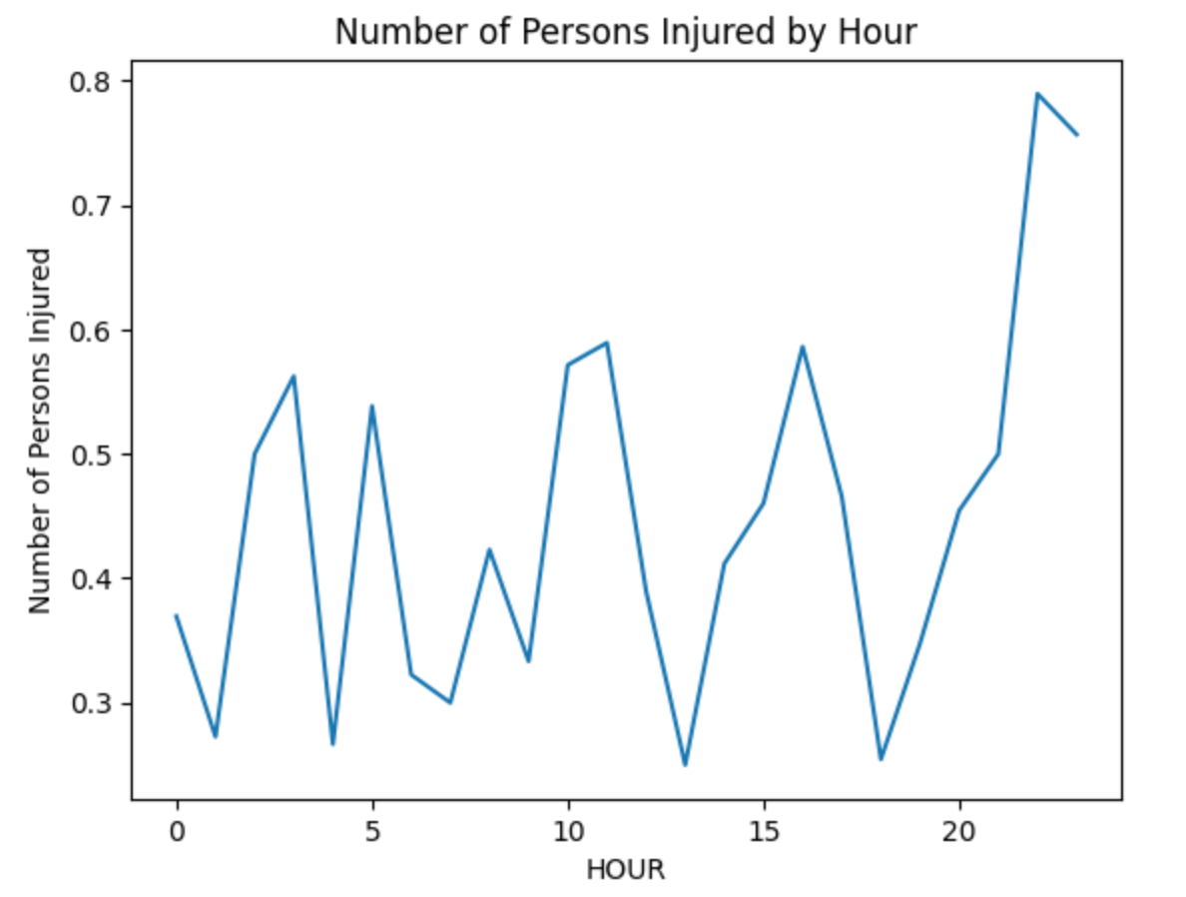

Slide 8
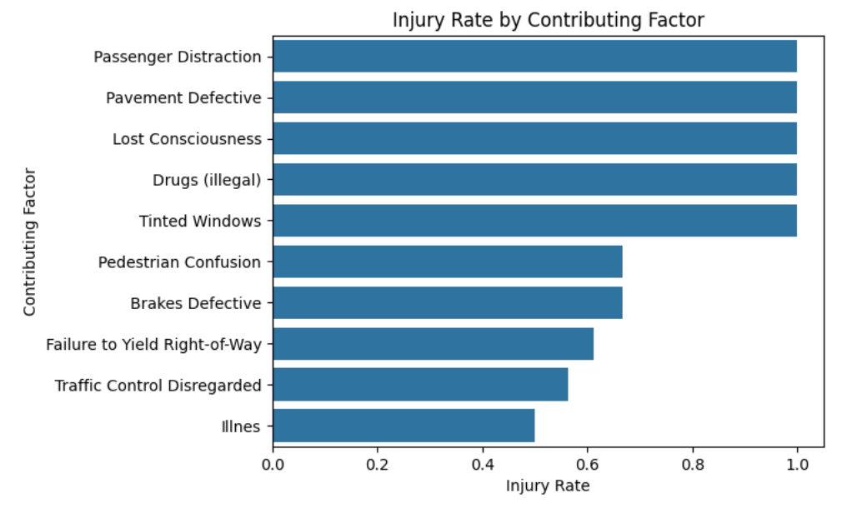

Slide 9
Injured = 1, Not injured = 0
Logistic Regression
Modeling

Slide 10
Accuracy of Model
 | Accuracy
Train | 0.729
Test | 0.676
Baseline Accuracy: 0.657

Slide 11
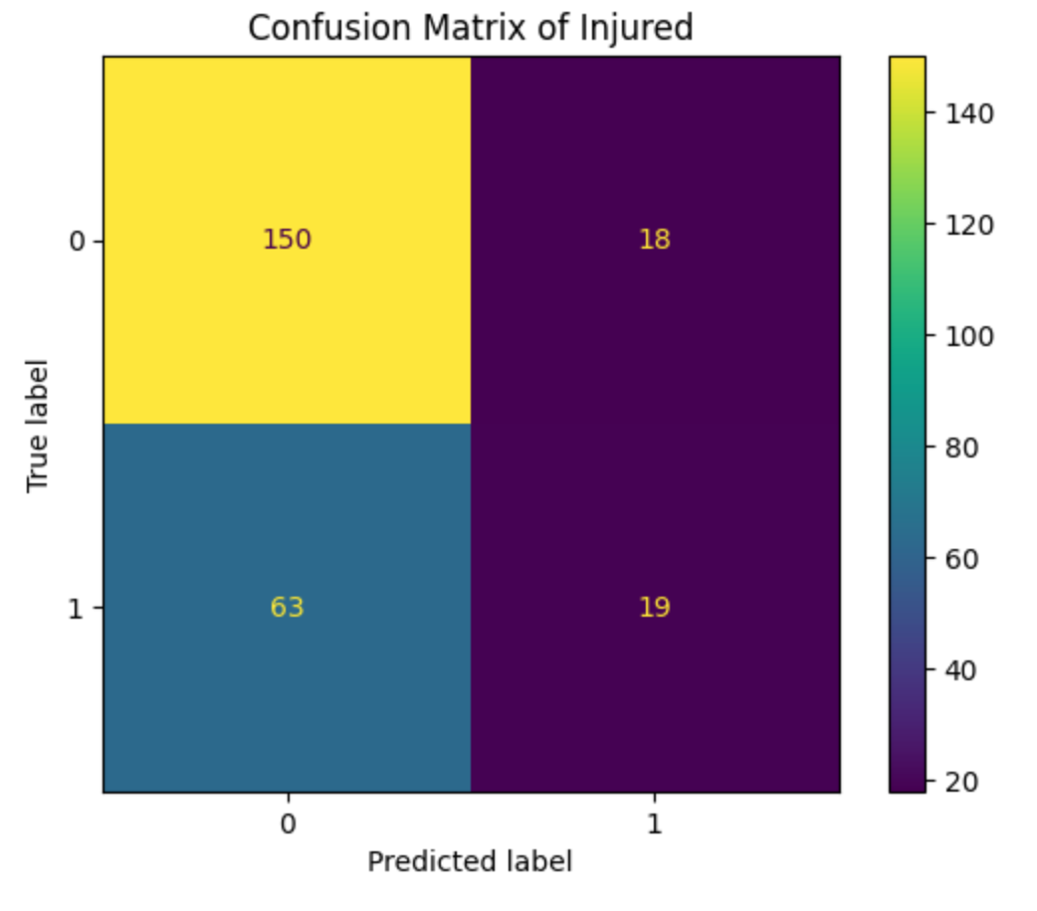
Recall = TP / (TP+FN)
= 19 / (19 + 63)
= 19 / 82
≈ 0.23

Slide 12
Coefficient of Top 10 Factors
VEHICLE_CODE_Motorcycle | 1.40
VEHICLE_CODE_Bike | 1.20
FACTORS_Failure to Yield Right-of-Way | 1.07
HOUR_11 | 0.92
FACTORS_Traffic Control Disregarded | 0.89
VEHICLE_CODE_E-Bike | 0.88
HOUR_23 | 0.84
FACTORS_Pedestrian/Bicyclist/Other Pedestrian Error/Confusion | 0.78
HOUR_2 | 0.61
FACTORS_Following Too Closely | 0.60

Slide 13
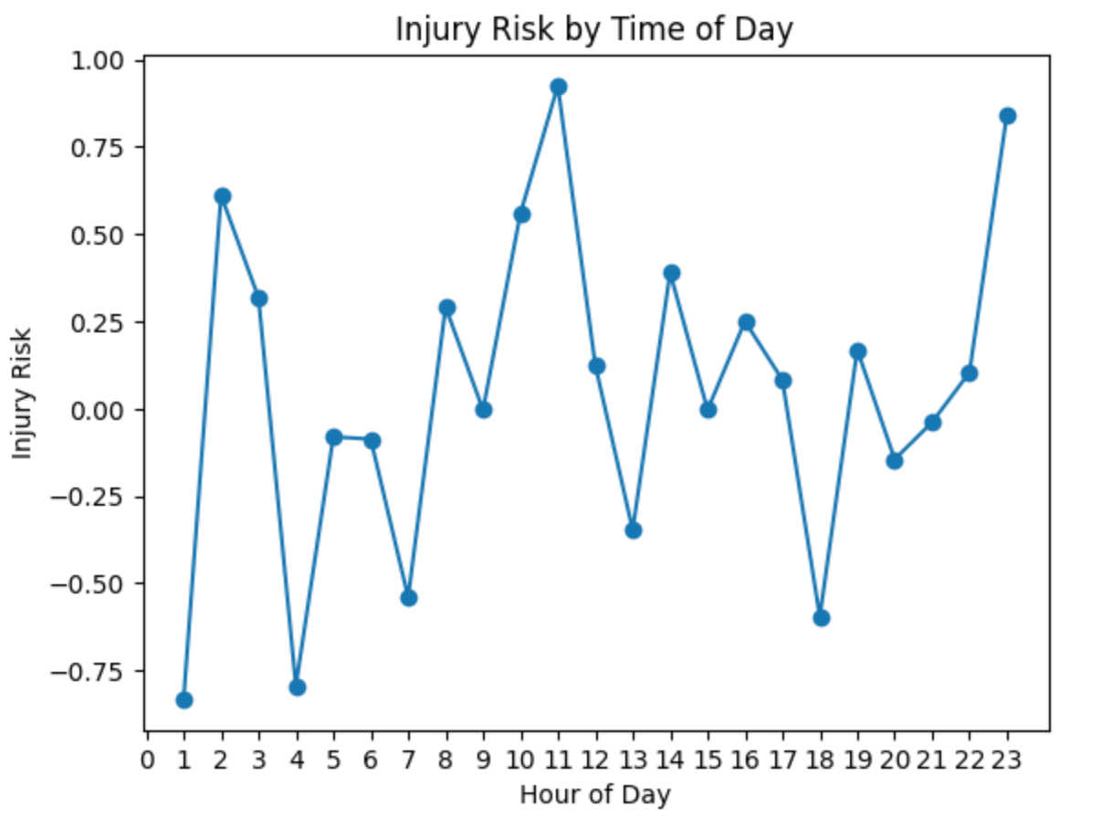

Slide 14
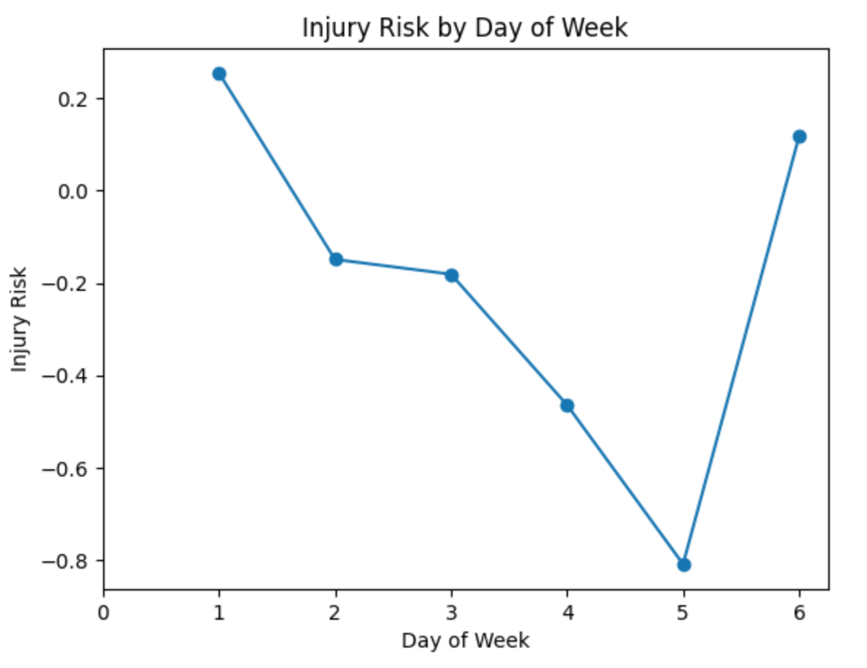

Slide 15
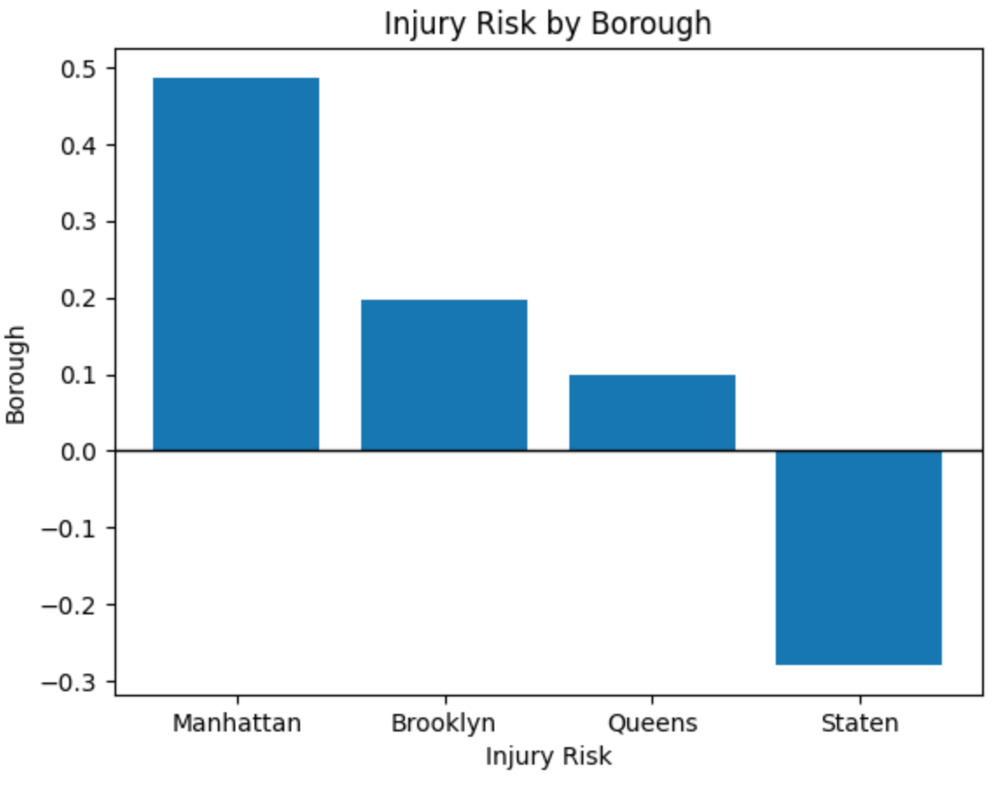

Slide 16
Class Weight: Balanced
Grid Searching

Slide 17
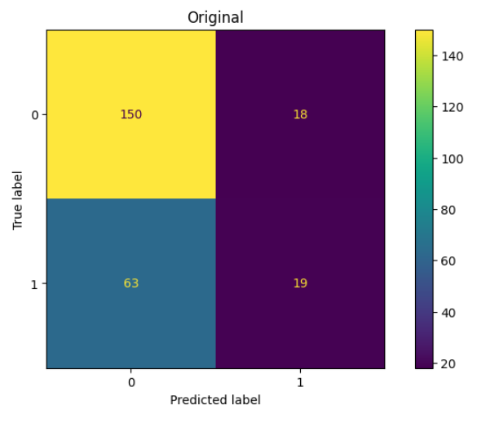
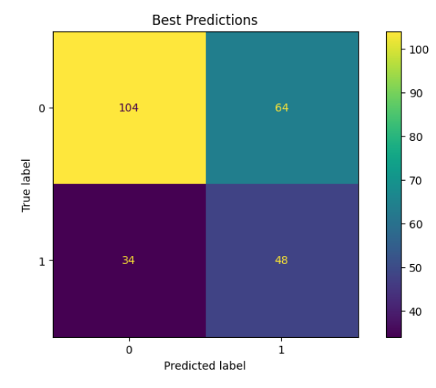
Recall Score: 0.23
Recall Score: 0.59

Slide 18
Lowering Probability Threshold

Slide 19
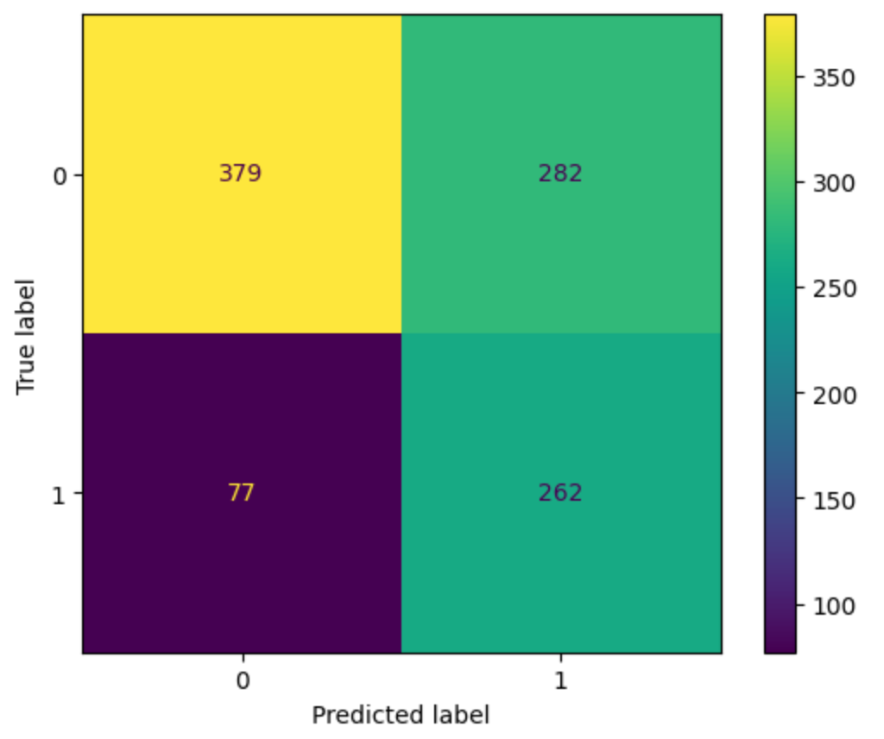
Recall Score: 0.77
0.3 Probability Threshold

Slide 20
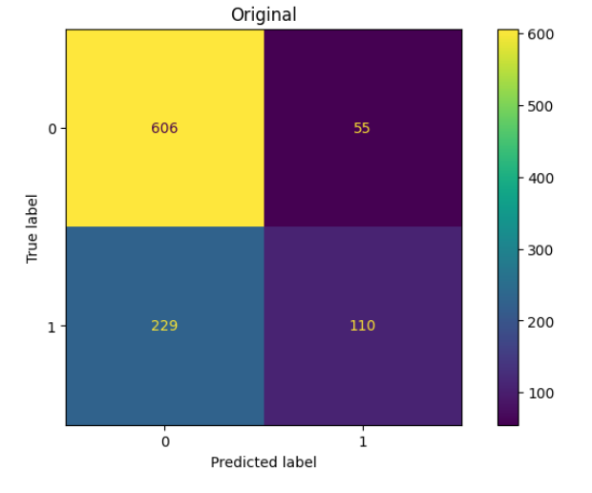
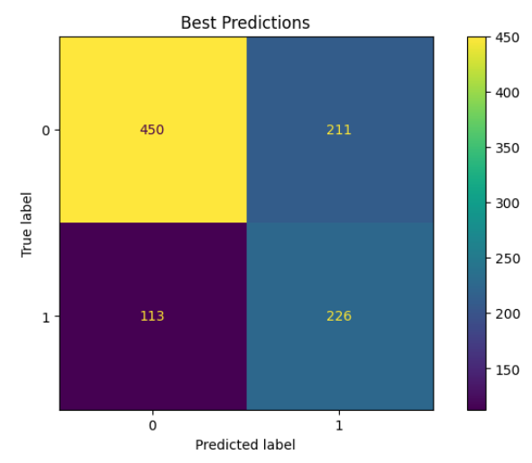
Recall Score: 0.32
Recall Score: 0.67

Slide 21
Based on Injury Risk Coefficients:
Manhattan identified as the most hazardous borough
Risk if highest late at night (10:00PM) and during the midday rush (11:00 AM)
Collisions involving motorcycles and bicycles are the strongest predictors of injury
Traffic violations are major risk indicators
Conclusion

Slide 22
Initial model struggled to identify actual injury cases, with recall score of 0.23
Optimizing for recall score with grid searching and lowering the probability threshold reduced the number of missed injuries.
Conclusion

Slide 23
Similar Modeling for Deaths
Random Forest Classifier Modeling
Add weather data
Interpret for areas with weak infrastructure
Next Steps

