Slide 1
Thermoelectric sulfides
Electronic screening and phonon research progress
SrCu2SnS4 / SrZrS3 / Rb2Cu2SnS4
Research update for Holger and Roy
Repository evidence reviewed 21 September 2026
Notes:
I have completed the three electronic first passes and tested the phonon workflow. The present milestone is a traceable research record and a focused plan for the remaining scientific questions. None of the three materials currently has an accepted lattice thermal conductivity under our current criteria. This update uses saved repository evidence, not a current cluster check.
Sources:
experiments/phonon_research_sandbox/CURRENT_STATE.md

Slide 2
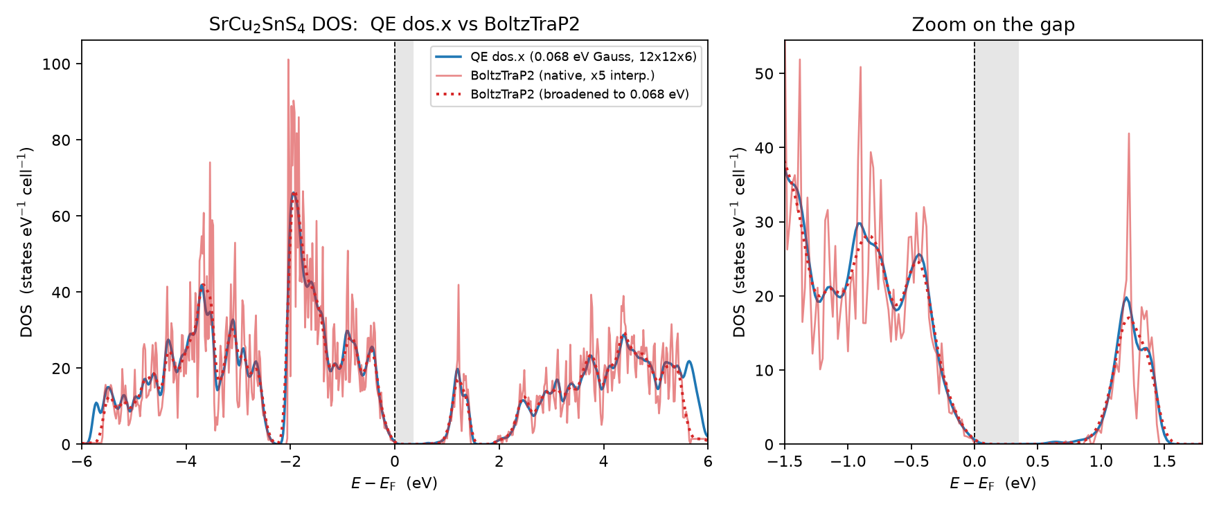
Electronic workflow completed
Material-specific convergence tests, relaxation, SCF/NSCF and BoltzTraP2
An existing validation example
SrCu2SnS4
QE and interpolated DOS
Transport-property convergence
on denser k meshes remains open.
02
Notes:
Each material used its own convergence workflow before the electronic transport first pass. This existing SrCu2SnS4 plot compares the Quantum ESPRESSO density of states with the BoltzTraP2 interpolation. It supports a workflow comparison but does not by itself establish convergence of every transport property. The calculations use PBE without explicit spin–orbit coupling.
Sources:
thermo_candidates/SrCu2SnS4/results/dos_qe_vs_boltztrap2.png
thermo_candidates/SrCu2SnS4/results/workflow_summary.md
thermo_candidates/SrZrS3/results/workflow_summary.md
thermo_candidates/Rb2Cu2SnS4/results/workflow_summary.md

Slide 3
Electronic screening at 300 K
Best PF/τ on the sampled carrier-density grid
Rb2Cu2SnS4
The p-type first pass is a useful
follow-up candidate.
PF/τ is not absolute PF.
Electronic-only zT is not full zT.
03
Notes:
The bars are the best power-factor-over-relaxation-time values selected independently for each carrier sign on the sampled 300 K grid. Rb2Cu2SnS4 has the largest p-type value among these first passes. This does not establish the best final thermoelectric material, because relaxation time and accepted lattice thermal conductivity remain missing. SrZrS3 carrier preference depends on the metric and temperature, so I do not assign one universal doping preference.
Sources:
thermo_candidates/SrCu2SnS4/results/transport_best_power_factor.csv
thermo_candidates/SrZrS3/results/transport_best_power_factor.csv
thermo_candidates/Rb2Cu2SnS4/results/transport_best_power_factor.csv

Slide 4
Phonon evidence and acceptance
Execution, file integrity and scientific convergence are separate checks
Material | Forces and FCs | Current limitation
SrCu2SnS4 | Historical dataset v2 preparation only | Units, mixed settings, terminal health and mesh
SrZrS3 | 788 force records FC2 / FC3 generated | Sampled imaginary modes κL rejected
Rb2Cu2SnS4 | Recovery recorded Limited FC audit passed | Every tested mesh step fails κL unaccepted
No accepted lattice thermal conductivity for any of the three materials
04
Notes:
The table separates artifact creation from scientific acceptance. SrCu2SnS4 preserves a historical campaign with known problems, while its corrected workflow remains preparation only. SrZrS3 produced force constants but failed a sampled-frequency gate. Rb2Cu2SnS4 has a saved artifact audit with limited integrity checks, but all tested mesh transitions fail the convergence rule. For the latter two, this update reads the saved audit records rather than revalidating the remote HDF5 files.
Sources:
thermo_candidates/SrZrS3/phono3py/evidence/first_pass_unconverged/force_audit_summary.json
thermo_candidates/Rb2Cu2SnS4/phono3py/evidence/firstpass_20260914/production/postprocess_22312417_hdf5_readonly_audit_20260920.json
thermo_candidates/SrCu2SnS4/phono3py_v2/campaign.json
fourth step result (phono3py lattice thermal conductivity)/README.md

Slide 5
SrCu2SnS4: a separate corrected campaign
Correct units and consistent inputs are necessary preparation
Historical cutoff
4 bohr = 2.1167 Å
Intended v2 cutoff
4 Å ≈ 7.5589 bohr
Historical forces mix settings and include unhealthy terminal outputs.
The corrected v2 workflow has not produced a new validated dataset.
05
Notes:
The historical Quantum ESPRESSO interface interpreted the pair cutoff in bohr. The value four therefore meant about 2.12 angstrom, and the included pair groups were onsite only. The new preparation explicitly converts four angstrom to about 7.5589 bohr and requests uniform force settings. These software corrections do not demonstrate a converged force dataset. The old raw outputs and sent attachments remain unchanged.
Sources:
thermo_candidates/SrCu2SnS4/phono3py_v2/campaign.json
thermo_candidates/SrCu2SnS4/phono3py/phono3py_disp.yaml
fourth step result (phono3py lattice thermal conductivity)/README.md

Slide 6
SrCu2SnS4 v2: minimal proposed pilot
Plan only. A corrected input contract still needs computational evidence.
01
Healthy pristine reference
Independent SCF, residual forces, exact input and pseudopotential binding
02
Small displaced-force controls
Repeated single and pair displacements, then amplitude and force-setting checks
03
Conditional expansion
Only after signal, health and mapping checks: cutoff, supercell and q-mesh studies
06
Notes:
I propose beginning with a healthy independent pristine calculation and a small set of repeated single and pair displacement controls. The detailed plan defines how to distinguish numerical noise from incremental force signal and when to stop. Amplitude and force-setting sensitivity should inform any larger production campaign. The exact displacement count and cost require real generation and measured timing. No new campaign has been submitted.
Sources:
thermo_candidates/SrCu2SnS4/phono3py_v2/campaign.json
experiments/phonon_research_sandbox/plans/

Slide 7
SrZrS3: imaginary-mode origin is unresolved
The finite diagnostic κL cannot be used for zT
−1.0716 THz
Small discriminating controls
Minimum sampled frequency
q = (0, 0.4, 0)
Residual forces and SCF sensitivity
Harmonic range and supercell size
Mode character and structural response
Pristine maximum force
9.342 × 10⁻⁵ Ry/bohr
Preferred gate: 5 × 10⁻⁵
No direct claim of real-material instability
07
Notes:
The saved first-pass audit reports a minimum frequency of minus 1.0716 terahertz at the stated q point. Twelve sampled modes are below minus 0.1 terahertz. The pristine residual force exceeded the preferred threshold, and a historical exception allowed a diagnostic continuation. Residual forces, force convergence and finite-range effects deserve targeted controls before a physical instability interpretation. Eigenvectors and structural response would help distinguish competing explanations. Simply removing imaginary modes would not validate thermal conductivity.
Sources:
thermo_candidates/SrZrS3/phono3py/evidence/first_pass_unconverged/force_audit_summary.json
experiments/phonon_research_sandbox/plans/

Slide 8
Rb2Cu2SnS4: direction-dependent mesh response
300 K, saved first-pass diagnostic tensors
zz changes most
A smoother average can
hide a poorly converged
direction.
No extrapolated value
08
Notes:
This figure replots the conventional Cartesian tensor components recorded in the September 20 audit. The horizontal axis is the phono3py q-mesh density length, not a real-space cutoff or a supercell size. The zz component changes substantially across the ladder, while yy is comparatively less sensitive. All values are rejected first-pass diagnostics. I have neither fitted an asymptote nor estimated a supposedly converged thermal conductivity.
Sources:
thermo_candidates/Rb2Cu2SnS4/phono3py/evidence/firstpass_20260914/production/postprocess_22312417_hdf5_readonly_audit_20260920.json

Slide 9
Rb2Cu2SnS4: the final step still fails
90 to 105 Å. Relative change uses the denser-mesh value as denominator.
Current acceptance rule
Average < 3%
Each diagonal < 5%
At every temperature
Two consecutive
passing transitions
09
Notes:
I recalculated these changes using the same denominator as the implemented gate: the denser mesh result. At 300 kelvin, the average changes by about 4.266 percent and the largest diagonal by about 10.192 percent. Both fail. The same conclusion holds at 600 and 900 kelvin, and no earlier transition passes. A denser mesh could reuse the force constants only for the same underlying force model with retained provenance. It would still not establish supercell, cutoff or amplitude convergence.
Sources:
thermo_candidates/Rb2Cu2SnS4/phono3py/evidence/firstpass_20260914/production/postprocess_22312417_hdf5_readonly_audit_20260920.json
thermo_candidates/Rb2Cu2SnS4/phono3py/run_postprocess_firstpass.py

Slide 10
Proposed next research choices
Each route starts with a bounded question and a stopping decision
Material | Smallest useful next question | Expansion depends on
SrCu2SnS4 | Can a clean v2 pilot resolve force signal consistently? | Healthy pristine, reproducible forces and uniform settings
SrZrS3 | Does the soft mode persist under numerical controls? | Mode diagnosis and independent harmonic evidence
Rb2Cu2SnS4 | Which force-model uncertainty should be checked first? | Reuse audit, focused sensitivity and measured mesh cost
Cost estimates need measured timings and generated displacement counts.
10
Notes:
These are alternatives for discussion, not a decision made on behalf of Roy. For SrCu2SnS4, the benefit is a clean corrected baseline. For SrZrS3, the key benefit is understanding a failure mechanism. For Rb2Cu2SnS4, existing force data may support a bounded convergence study, but provenance and force-model limitations must remain explicit. I will estimate resource use from actual task counts and measured timing before asking to expand any route.
Sources:
experiments/phonon_research_sandbox/plans/
experiments/phonon_research_sandbox/CURRENT_STATE.md

Slide 11
Discussion with Roy
I would appreciate guidance on the next scientific priority.
A corrected baseline
Prioritize a new SrCu2SnS4 v2 pilot
An instability diagnosis
Investigate SrZrS3 before further thermal transport
A convergence study
Continue Rb2Cu2SnS4 with a bounded, evidence-based scope
11
Notes:
I have sent the revised status update and am awaiting guidance on the next priority. I would appreciate guidance on whether to prioritize the corrected SrCu2SnS4 baseline, diagnose SrZrS3, or continue a bounded Rb2Cu2SnS4 convergence study. The accompanying plans and local evidence dashboard make these options reviewable. No new cluster calculation or email was initiated during this preparation round.
Sources:
experiments/phonon_research_sandbox/CURRENT_STATE.md

