Slide 1
2018 Group Long-Term Disability Experience Study – New Variables and Predictive Analytics Applications

Slide 2
1. Exeutive Summary
Consolidated Data Base (CDB) include all the 2016 Study variables in one database. The CDB was intended to allow companies to do their own analysis of the full complexities of the new data.
It would also facilitate companies’ use of Predictive Analytics (PA) techniques.

Slide 3
Exeutive Summary
The Work Group considered:
Experience for variables not included in the previously released pivot tables
Insights into potential drivers of termination experience trends observed in the 2016 Study
Demonstrating how the CDB could be utilized in Predictive Analysis applications

Slide 4
Content
Executive Summary
Description of the CDB ：The SOA created a CDB that contains all the data elements in the pivot tables, plus several new variables that were calculated from those.
Analysis of New Variables ：Contains four variables not included. Analysis of those shows some interesting results, summarized in section 3. In particular, COLA was noted to have a material impact on termination experience.

Slide 5
Content
4. Trend Analysis – Traditional Approach
Analyze trend using traditional regression analysis techniques
5. Predictive Analytics Methodology
Work Group was to apply PA techniques to the CDB. We felt a detailed description of the process our Work Group used would be valuable.
6. Predictive Analytics Trend Attribution Analysis
Significant improvement in recovery A/E trend was evident when using the 2008 Study as the expected.

Slide 6
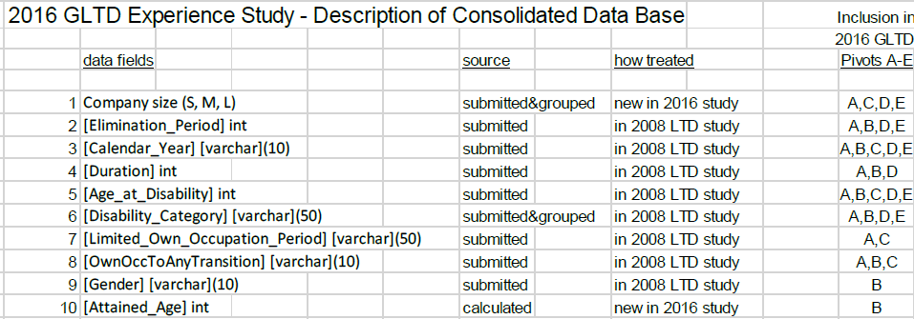
2. Description of the CDB

Slide 7
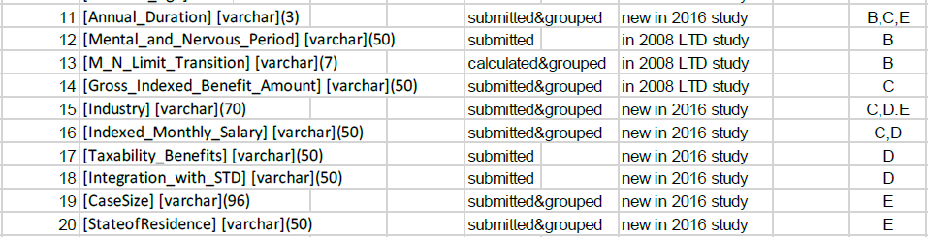
2. Description of the CDB

Slide 8
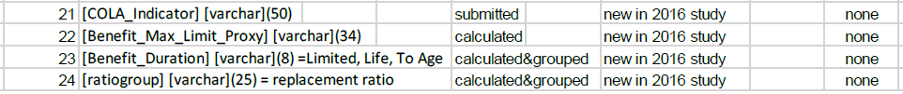
2. Description of the CDB
New Variables

Slide 9
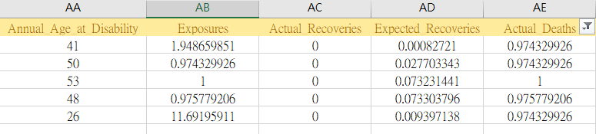
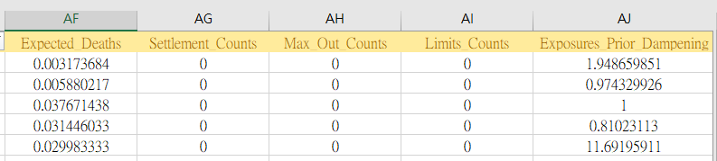
2. Description of the CDB
Response Variables

Slide 10
2.1 Description of New Variables
COLA Indicator： (Cost of Living Adjustment：Base on CPI)
COLA indicators were submitted by contributors in the GLTD study data request. They are included in the CDB.Valid fields include “Y,” “N” and “U” (unknown).

Slide 11
2.1 Description of New Variables
Benefit Max Limit Proxy
This indicator was defined and calculated as a proxy for identifying claims with benefit amounts that had been capped by plan maximums;
Valid fields are benefit amounts that end in “000,” benefit amounts that end in “00,” and “Not ending in 000 or 00.” The underlying assumption was that a benefit amount that was a % of salary would usually not end in “00” or “000” unless it had been capped.

Slide 12
2.1 Description of New Variables
Benefit Duration Proxy
This indicator was defined and calculated as a proxy for identifying each claim’s plan maximum benefit duration; (e.g., whether the plan was To Age (65) vs. short term vs. lifetime.)
To sort claims into the above three categories based on their Ages at Disability and their Benefit Maximum End Dates. “To Age” claims are intended to include to ages 60, 65, 70, 75 and Social Security Normal Retirement Age (SSNRA).

Slide 13
2.1 Description of New Variables
Replacement Ratio Proxy
This indicator was defined and calculated as a proxy for identifying each claim’s replacement ratio; i.e., the ratio of the claim gross benefit amount to the claimant’s salary.
To calculate the ratios and then sort the results into ranges that would provide the most useful basis for analysis. There are 11 valid ranges plus “NA,” as follows:

Slide 14
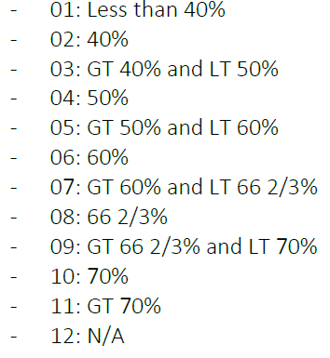
2.1 Description of New Variables

Slide 15
3. Analysis of New Variables
New variables discussed in Section 2. There are three graphs for each new variable:
• By observation year
• By disability category, and
• By duration

Slide 16
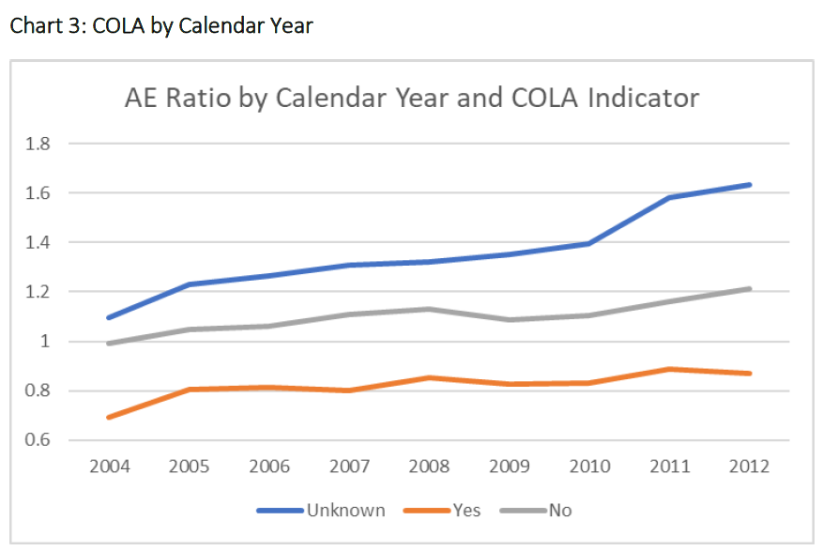
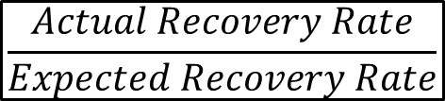
3. Analysis of New Variables
$$\frac{Actual Recovery Rate}{Expected Recovery Rate}$$

Slide 17
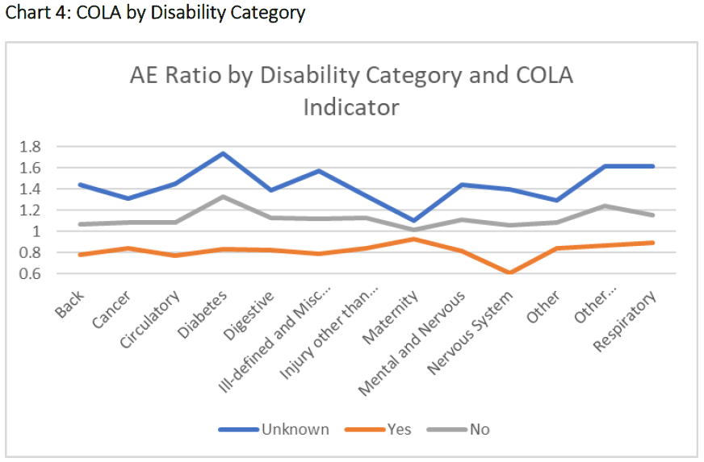
3. Analysis of New Variables

Slide 18
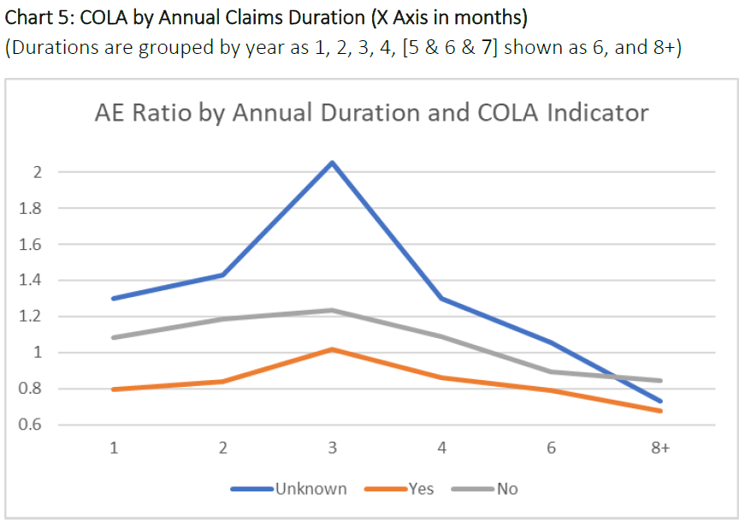
3. Analysis of New Variables

Slide 19
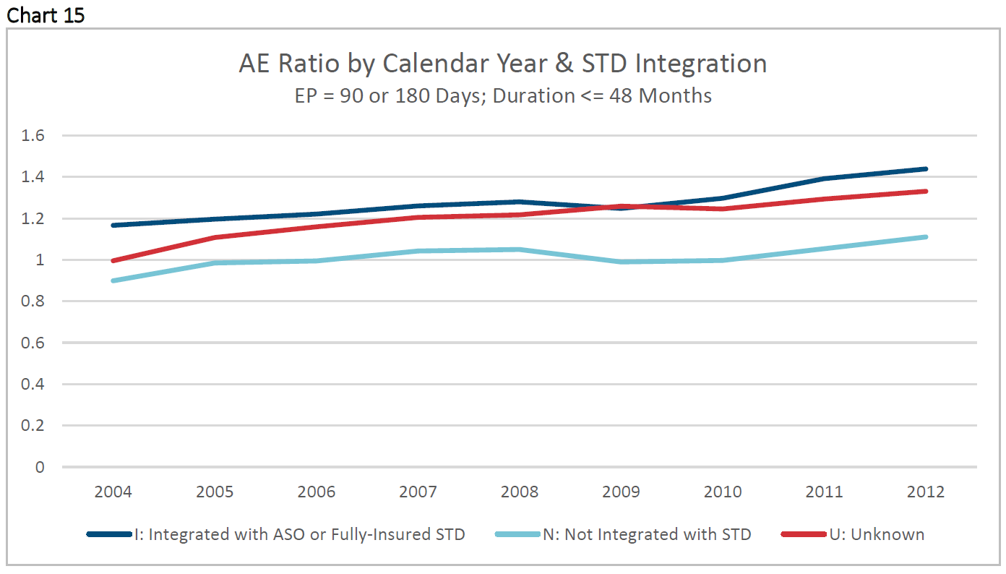
4. Trend Analysis – Traditional Approach

Slide 20
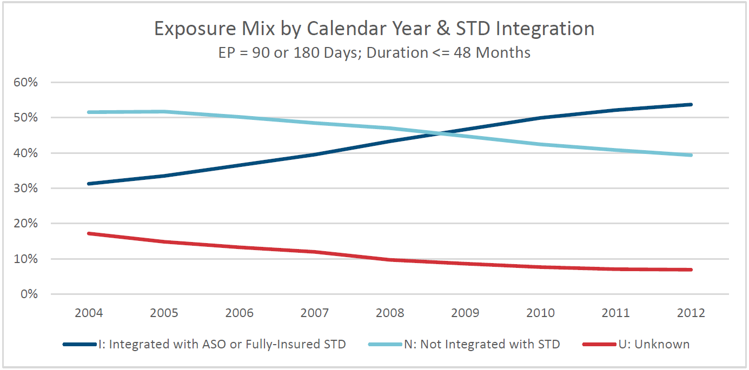
4. Trend Analysis – Traditional Approach

Slide 21
5. Predictive Analytics Methodology
GLMs are commonly used for many risks in the insurance industry, as they provide a framework that:
Is relatively easy to understand
Allows for a wide range of statistical diagnostics
Is extremely flexible, accommodating to a wide range of distributions, input variables and applications.

Slide 22

5. Predictive Analytics Methodology
Contains a Log link function and a Poisson error structure

Slide 23
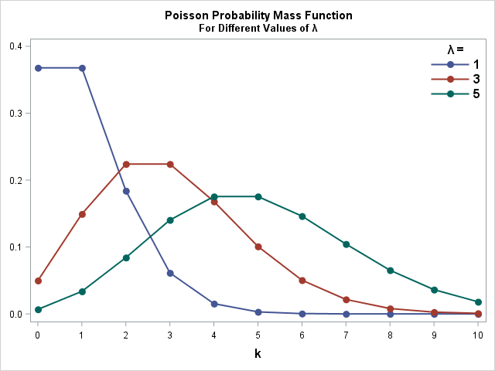
5. Predictive Analytics Methodology

Slide 24
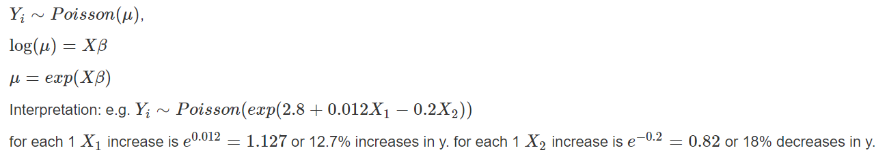
5. Predictive Analytics Methodology
Contains a Log link function and a Poisson error structure

Slide 25

5. Predictive Analytics Methodology
Logit link function
The result of the model will be the probability (between 0 and 1)
the logistic model are typically hard to visualize and interpret.

Slide 26
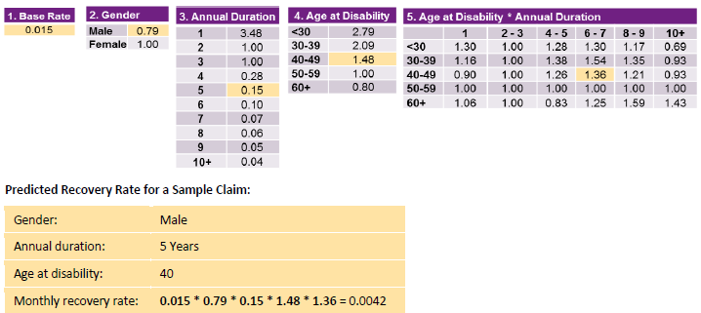
5. Predictive Analytics Methodology

Slide 27
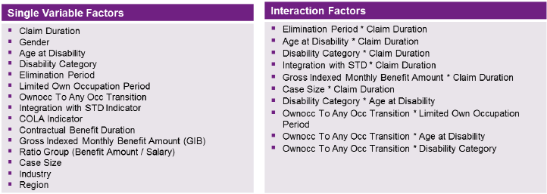
5. Predictive Analytics Methodology
Randomly selected three quarters of the experience study data to fit the model, with the remaining one quarter held back to validate the model

Slide 28
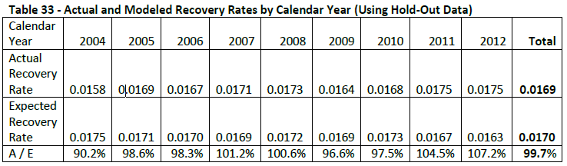
5. Predictive Analytics Methodology

Slide 29
5. Predictive Analytics Methodology

Slide 30
6. Predictive Analytics Methodology

Slide 32
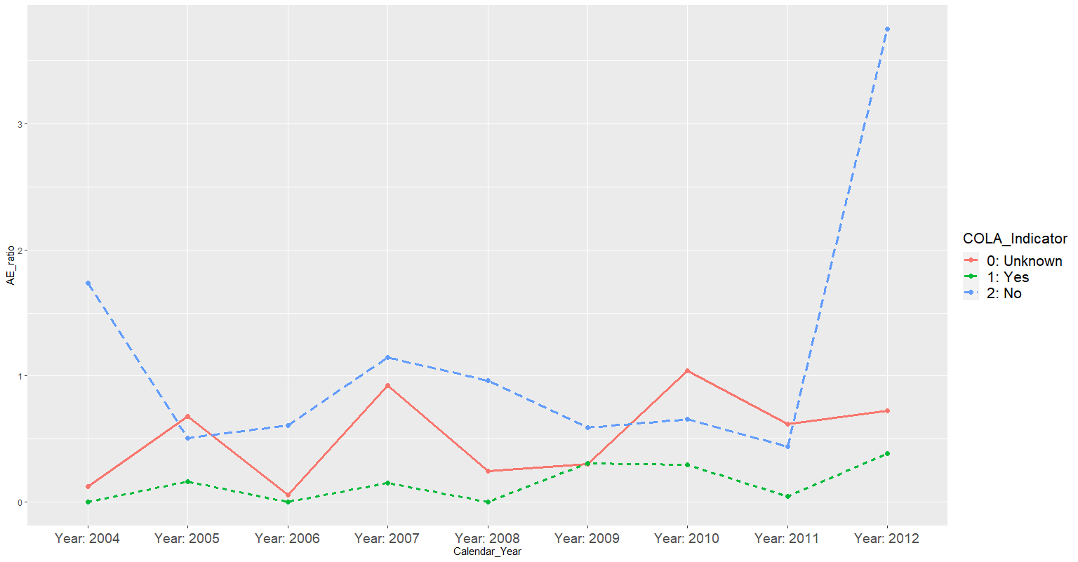
My Try

Slide 33
6. Predictive Analytics Methodology

Slide 34
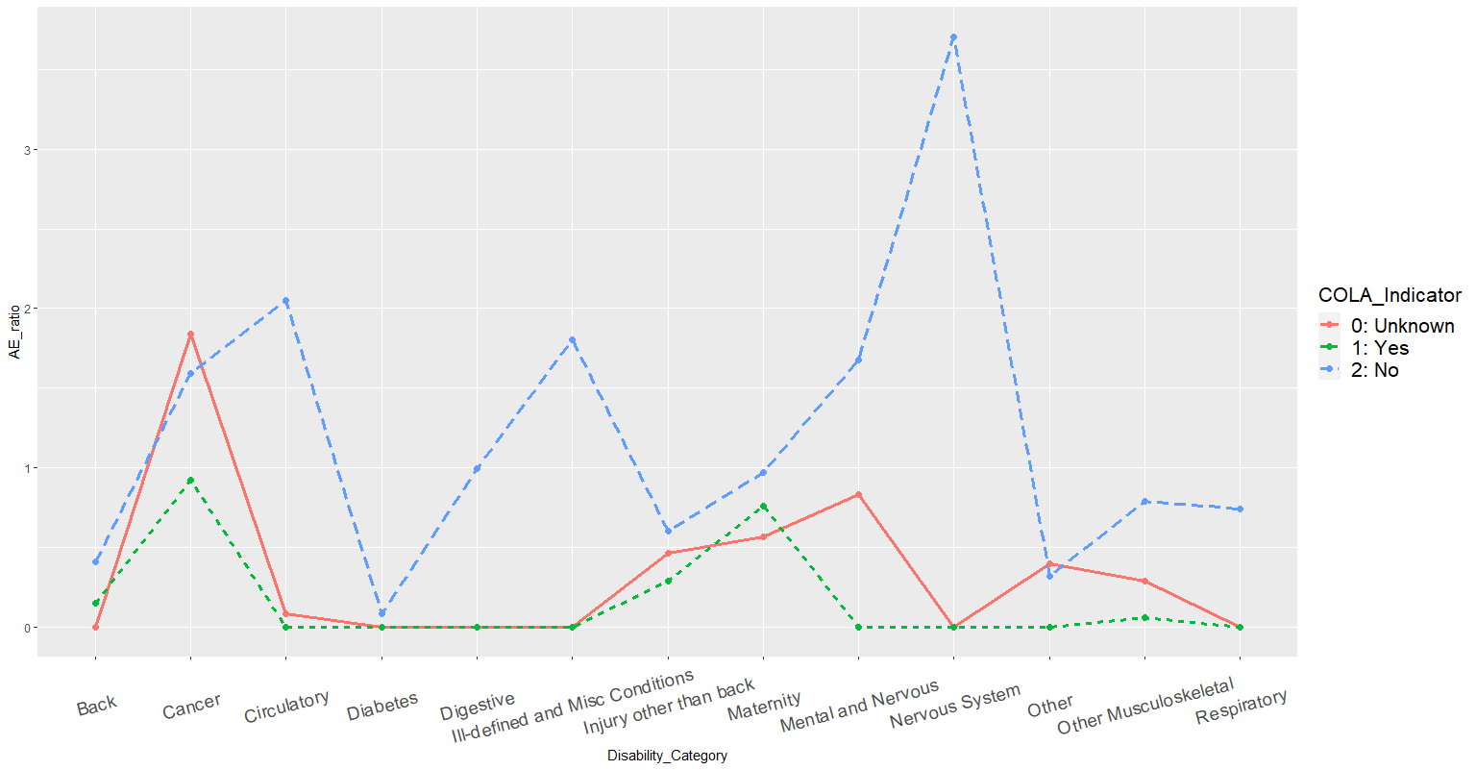
My Try

