Slide 1

Sales Prediction System: Machine Learning Approach with PySpark
Tran quang Phuoc – itdsiu20099

Slide 2
Context
1. Introduction
2. Dataset
3. Methodology
4. System Architecture
5. Demo

Slide 3
Introduction
Project Objectives
Build an intelligent sales prediction system
Integrate distributed computing with machine learning
Develop web interface for business users
Why PySpark?
Efficient big data processing
Built-in machine learning libraries
Distributed processing support
High compatibility with Python ecosystem

Slide 4
Dataset
Source: Sample Sales Data[Kaggle]
Size: 2823 records
Time period: 2003-2005
Key data fields:
+ QUANTITYORDERED: Order quantity
+ PRICEEACH: Price per unit
+ PRODUCTLINE: Product category
+ MSRP: Manufacturer's Suggested Retail Price
+ DEALSIZE: Order size category

Slide 5
Methodology
Initial Data Processing
Data loading and cleaning
Handle missing values
Remove duplicates
Schema validation

Slide 6
Methodology
Feature Engineering Pipeline
Time-Based Features
Yearly averages
Quarterly patterns
Monthly trends
Product-Based Features
Product line statistics
Sales patterns by category
Historical performance
Price Features
Price/MSRP ratio
Discount analysis
Price level categorization

Slide 7
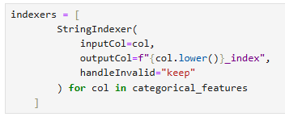
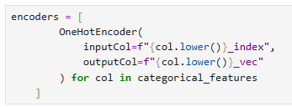
Methodology
Model Development
Data Split & Preparation
Train/Test split (80/20)
Feature scaling
Encoding categorical variables

Slide 8




Methodology
Model Pipeline Architecture
Model Training
Train 4 models:
Linear Regression
Random Forest
GBT
Decision Trees
Evaluation: Based on RMSE, which one is lower will be chosen ➔ Random forest.
Due to weak relationships between variables during preprocessing, R^2 point below 0.7

Slide 9
System Architecture
Frontend Layer
Flask
Bootstrap
Realtime validation
Application Layer
- PySpark processing
- Model serving
- API endpoint
Model Layer
- Random forest
- Feature pipeline
- Model management

Slide 10

Demo

