Slide 1
Visualization 1
120 years of Olympic Games

Slide 2
Critique

Slide 3
What

Slide 4
Background
Saúl Buentello a Web Developer, Data Enthusiast and a big fan of the Olympics came out with a project to demonstrate how anyone can benefit from the built system’s visual representations using the Olympics as a use case.
Dataset: Athlete events, Event regions (Kaggle)
Visualisation Tool: RStudio
Objective: How to analyze and visualize 120 years of Olympic Games with R

Slide 5
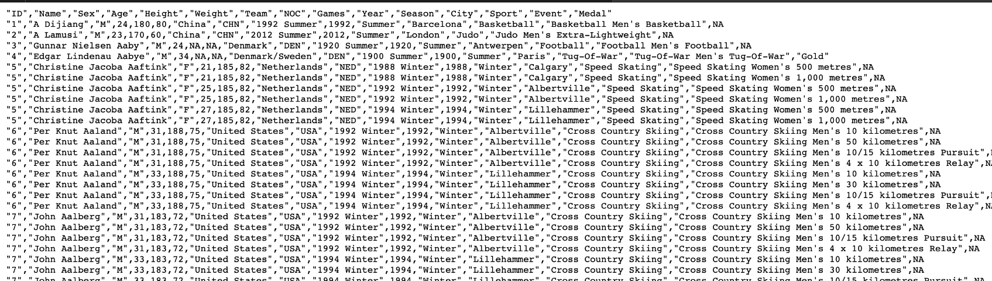

Slide 6
Characteristics of the Data
Occurrences (summer and winter)
Data at the sport level, Art competitions were not included in the athletes’ data (focused on athletics)
large-scale dataset (spans the years 1896 to 2016)

Slide 7
Why

Slide 8
Objectives
Author’s intentions for this visualisation is to answer the following questions:
Which countries are the most dominant?
How has involvement evolved?
Which countries have the most medals in various disciplines?
What is the ratio of female/male Olympic attendees?

Slide 9
How

Slide 10
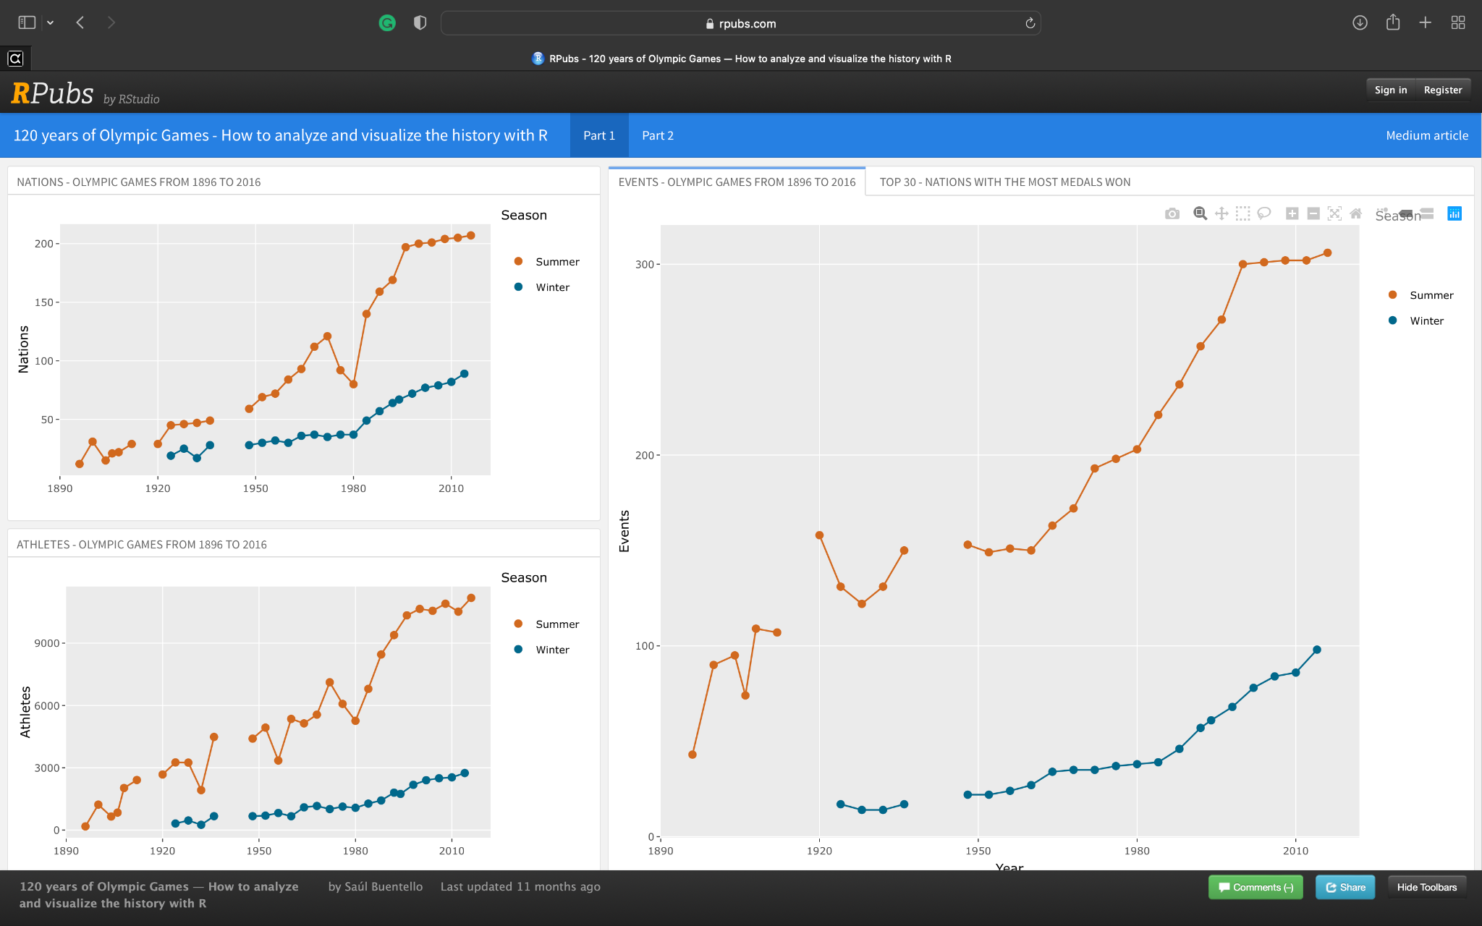
Notes:
Data is for everyone, but is useful to none
Main idea is to redo the visualisation for athletes

Slide 11
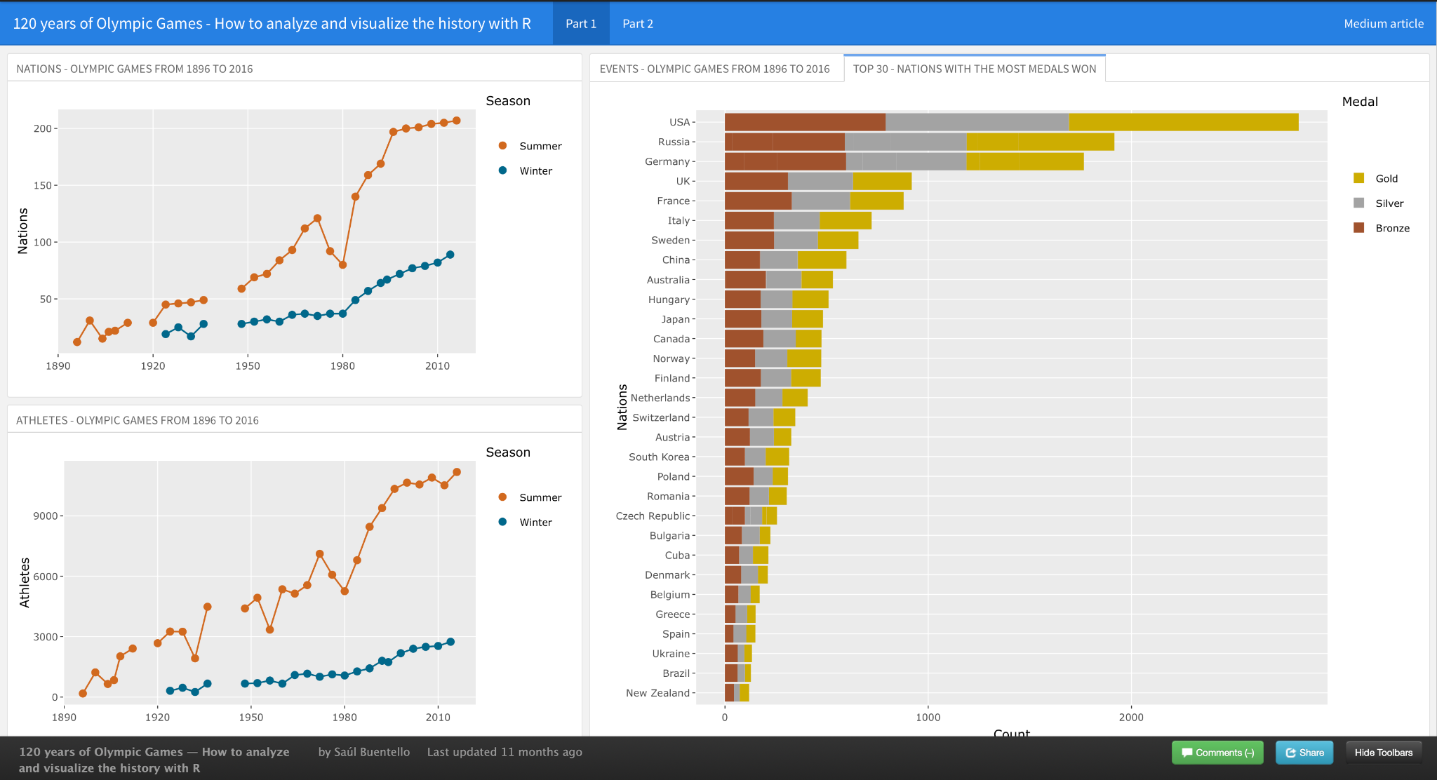

Slide 12
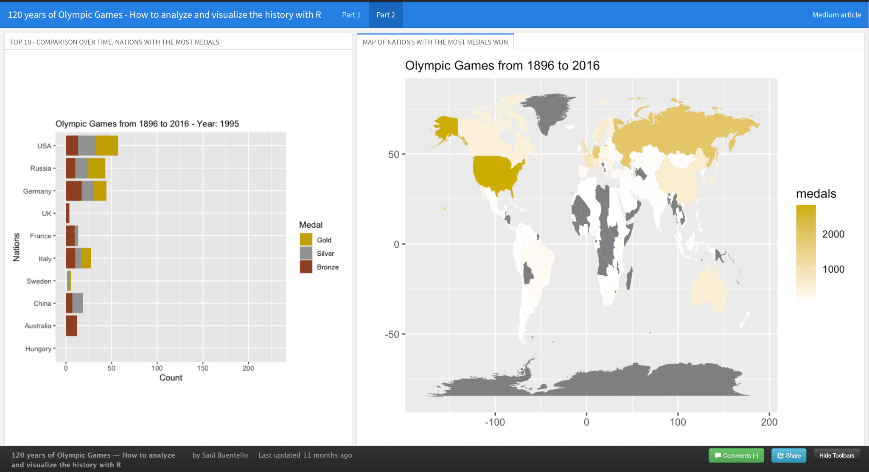
How is the data currently visualised

Slide 13
Did it achieve its intended task?
Which countries are the most dominant?
Yes
How has involvement evolved?
To a certain degree
Which countries have the most medals in various disciplines?
No
What is the ratio of female/male Olympic attendees?
No

Slide 14
Observations
Pros
Nodes in the line chart represent each year the Olympics takes place
Statistical overview of the data
Utilisation of different contrasting colours to show different type of data
Cons
Predominant usage of line charts
Lacks detailed information about the following:
Number of participating countries
Number of athletes
Number of events
Types of events
Total number of medals

Slide 15
Observations
Pros
Animated changes to the medal tally for each Olympic Game each year
Statistical overview of the data
Utilisation of a World Choropleth with a chromatic scale to show the number of medals won by each country
Cons
Hard to differentiate the difference with the current chromatic scale
Blends in with the background
The shades are nearly similar
Same colour used to represent the gold medal (Misleading)
Animation can seem confusing at times
User is not given enough time to process the data

Slide 16
Suggestions

Slide 17
What

Slide 18
We plan to use the same dataset

Slide 19
Why

Slide 20
Provide insight for aspiring Olympic athletes

Slide 21
How

Slide 22
Improvements
Certain visualisation can be combined into one visualisation
Would recommend more forms of interactivity to view more in-depth data
Use better colour scales to represent the data
Not to reuse the colors assigned to gold, silver & bronze to prevent any misconceptions
World Choropleth can be more interactive

Slide 23
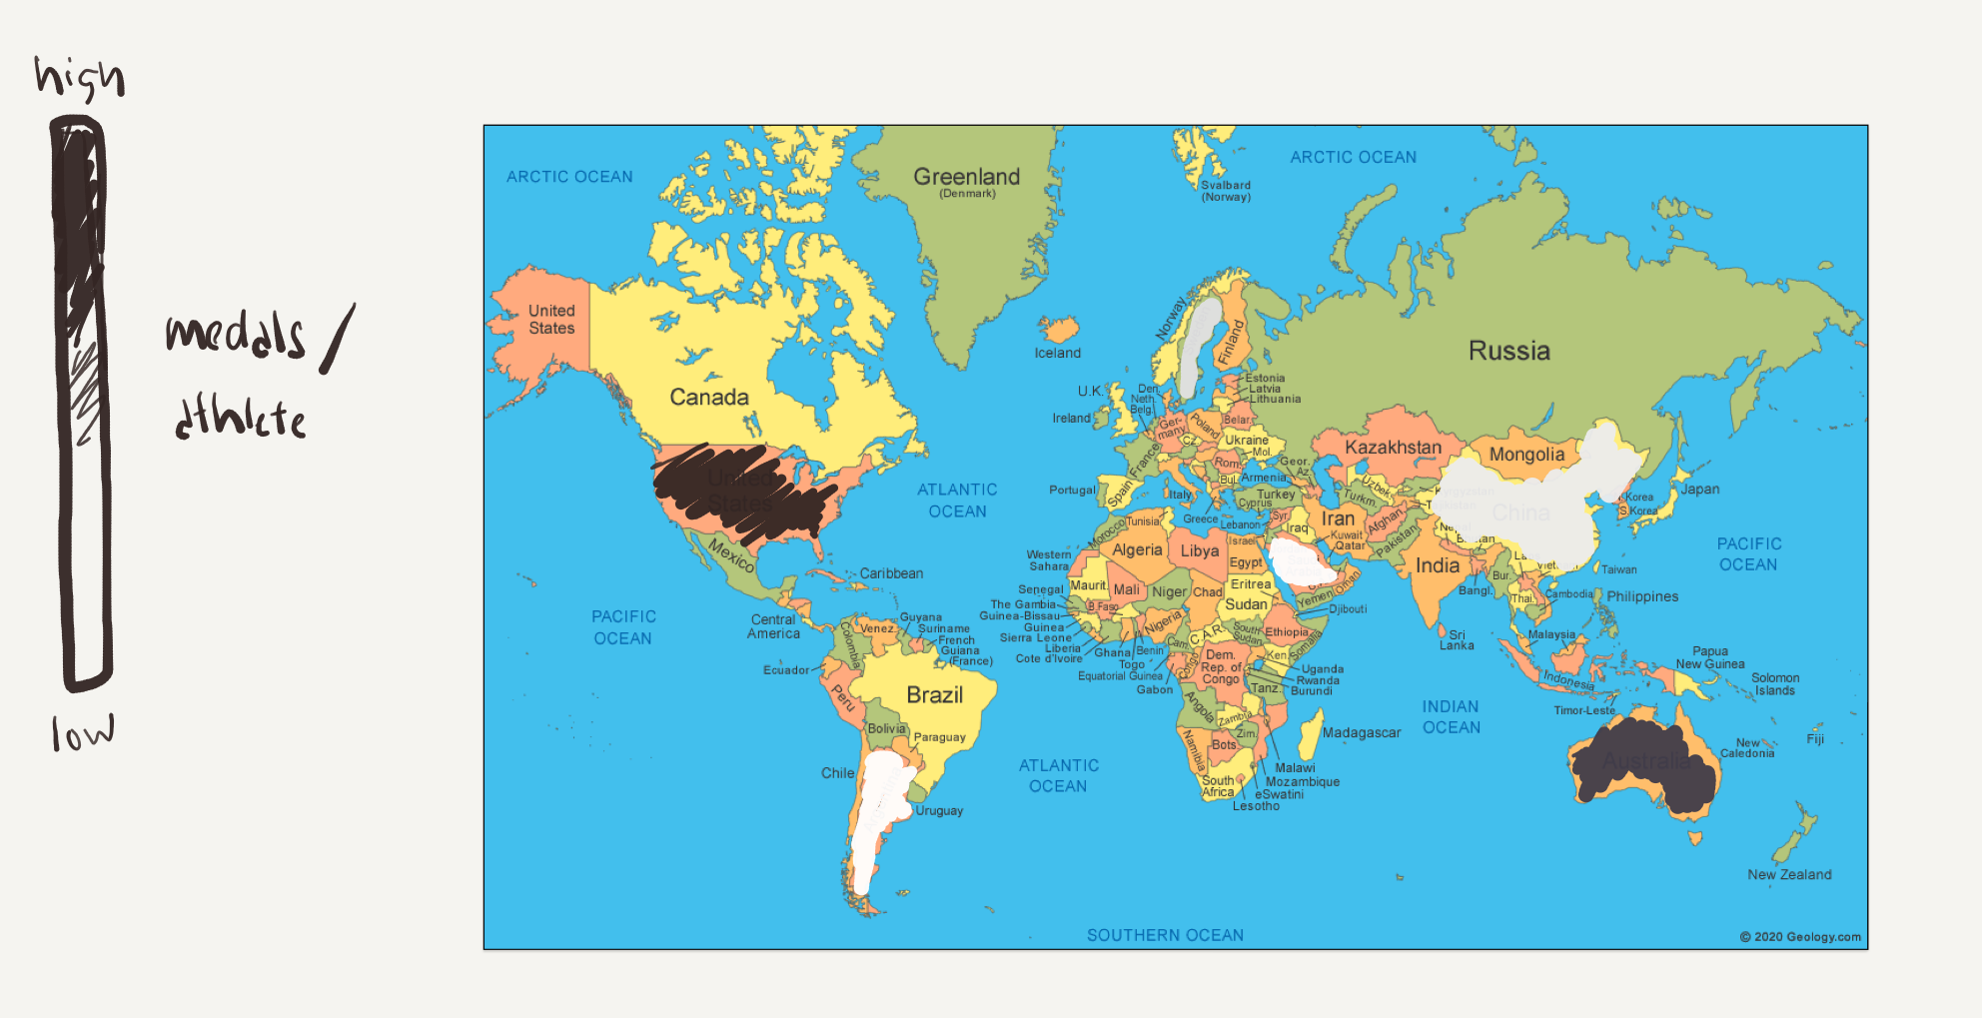
Improvements

Slide 24
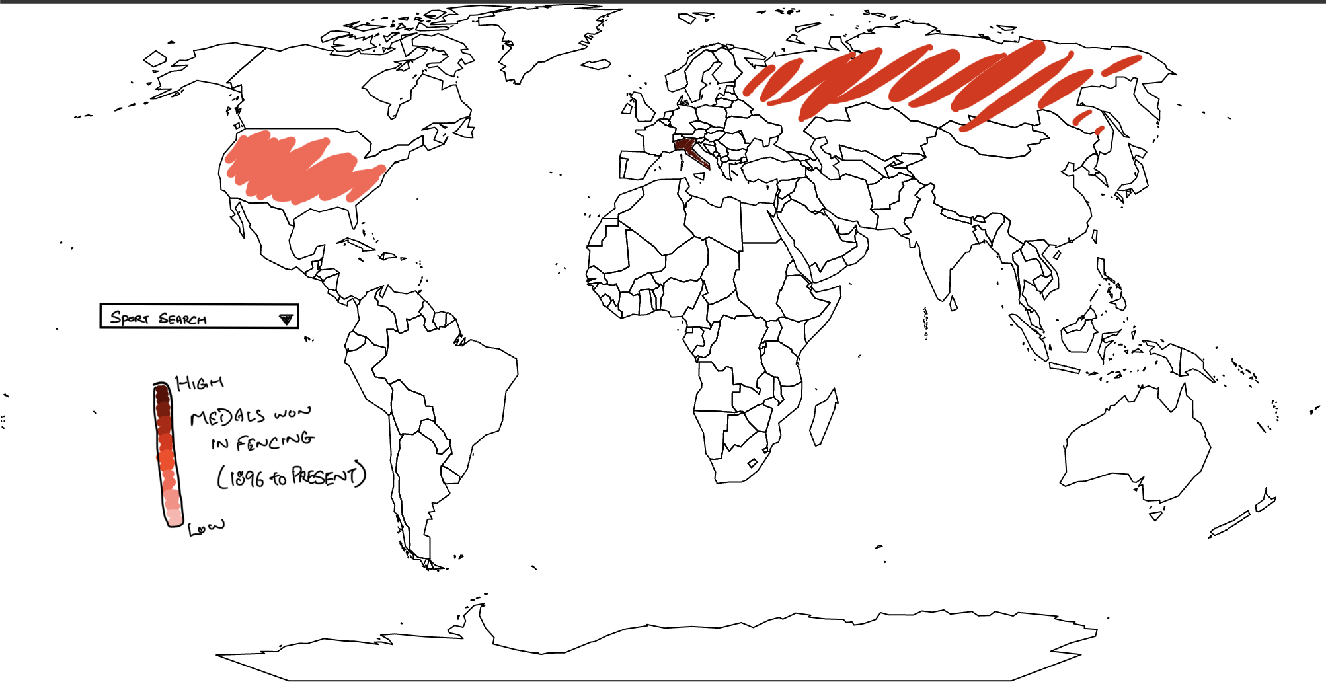
Improvements
Medals won in Fencing:
Gold: 44
Sliver: 43
Bronze: 36

Slide 25
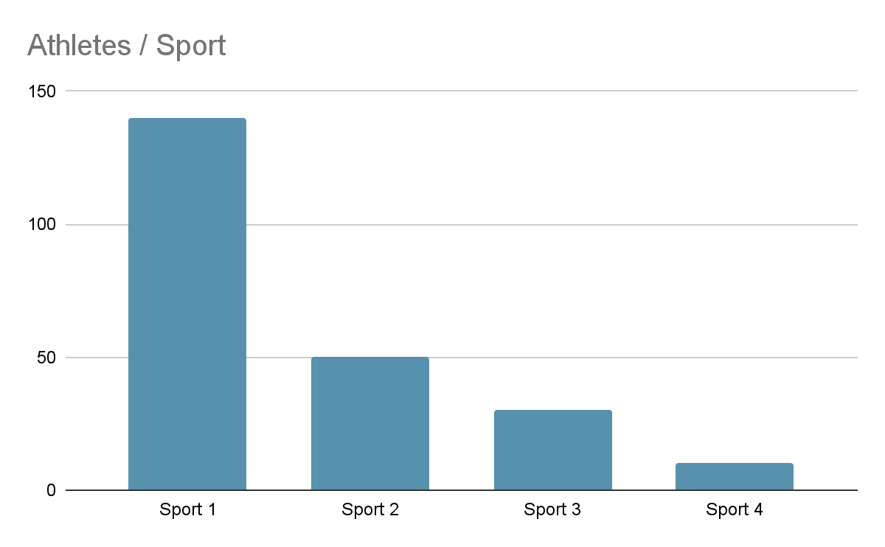
Improvements

Slide 26
Improvements
Country: America

Slide 27
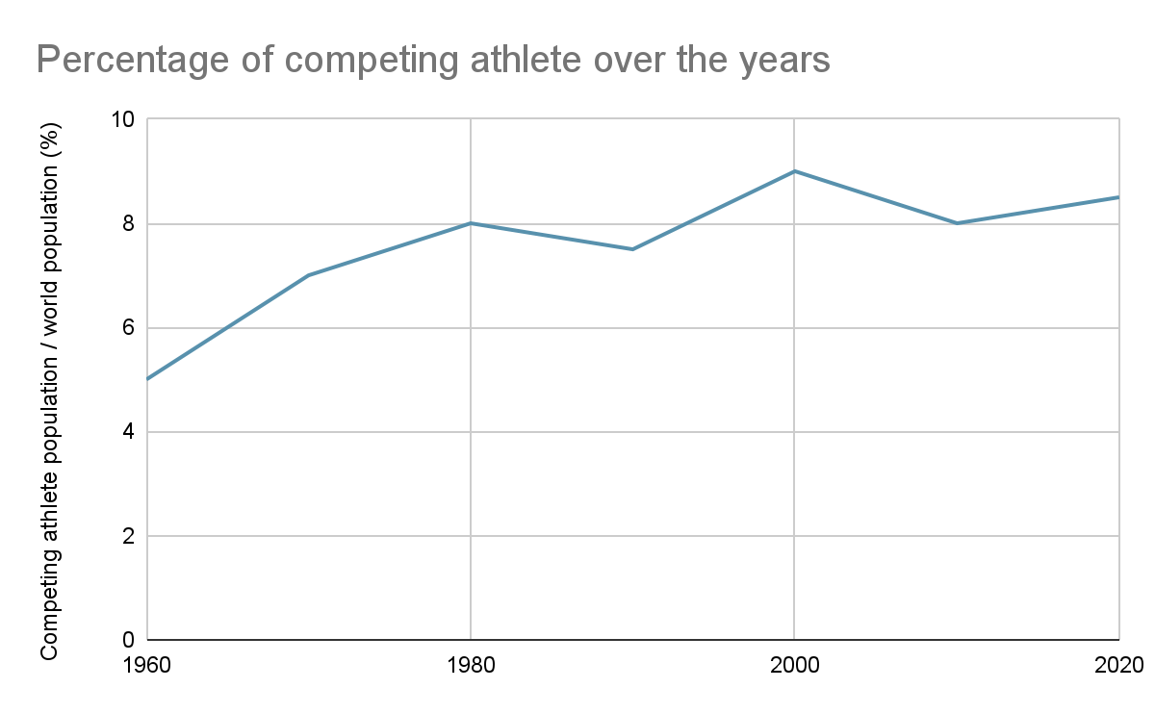
Improvements

Slide 28
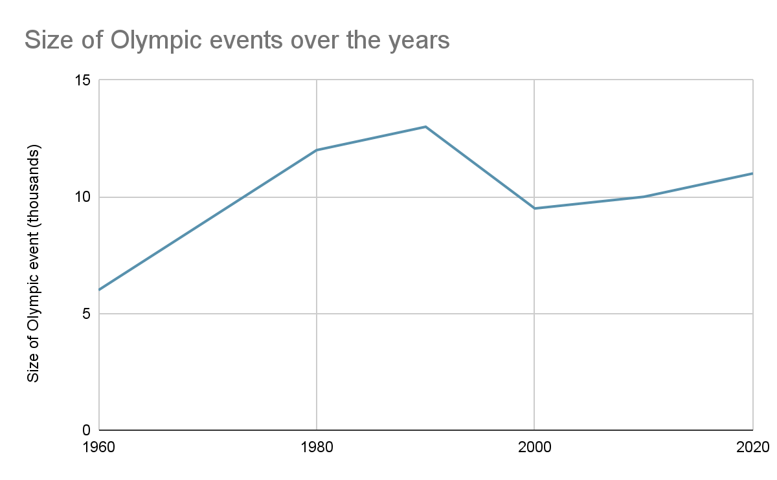
Improvements

Slide 29
Visualization 2
Singapore Automotive Sales Volume

Slide 30
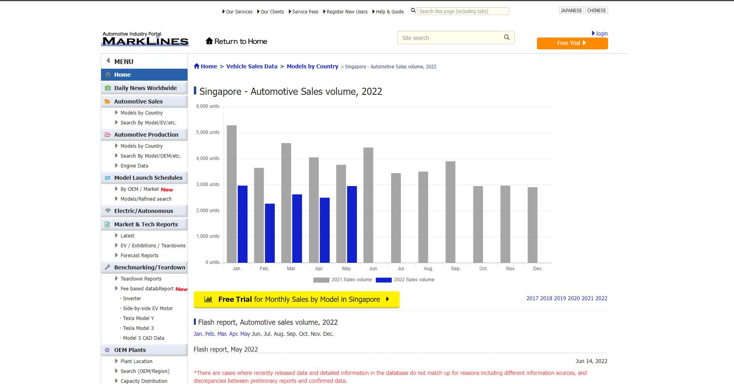

Slide 31
Critique

Slide 32
What

Slide 33
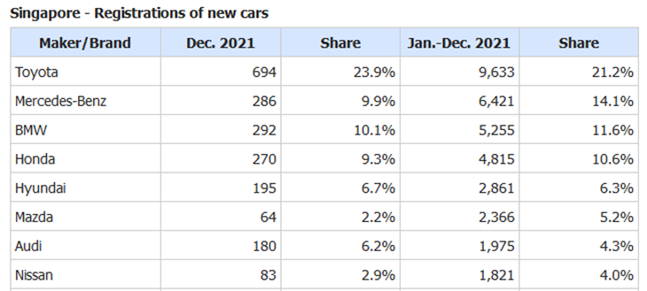
Notes:
New cars sold in Singapore based on the brand of the cars
The sales are broken down into a year-month basis
And shows the percentage sold of a particular brand compared to the total cars sold in the current month/year

Slide 34
Why

Slide 35
Provide accurate information for end-user
Notes:
Suppliers (Spare parts)
Government Sector such as LTA (COE quota)

Slide 36
How

Slide 37
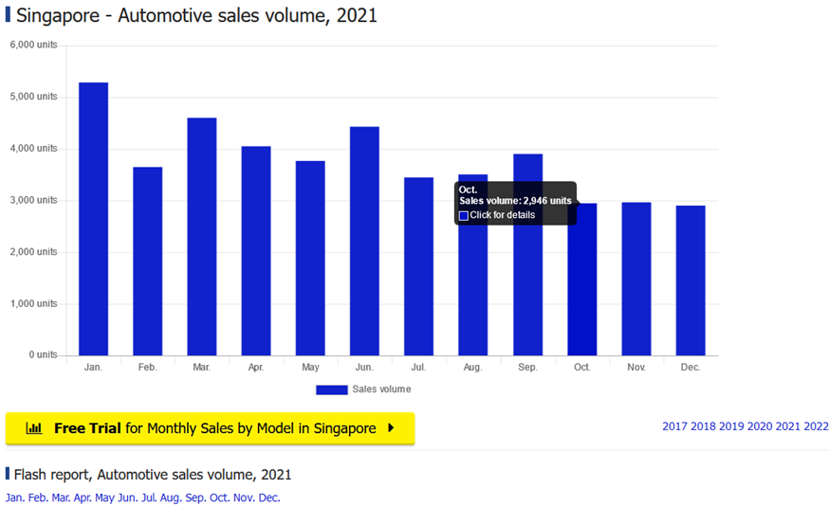
Notes:
This bar-chart shows the sales volume of year 2021

Slide 39
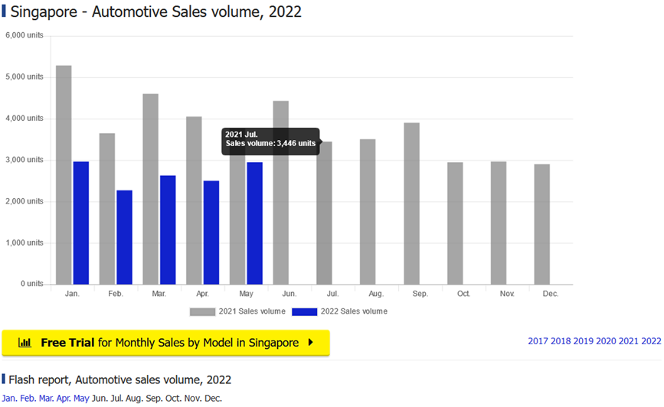

Slide 40
Did it achieve its intended task?
Does it show the consumer trend
Yes, total sales only
Which brands should the suppliers stock up for spare parts?
Hard to visualise from a table
Does it provide any insights of the consumer trend across the years?
Yes, in multiple tables and no visualisation

Slide 41
Suggestions

Slide 42
What

Slide 43
Why

Slide 44
How

Slide 45
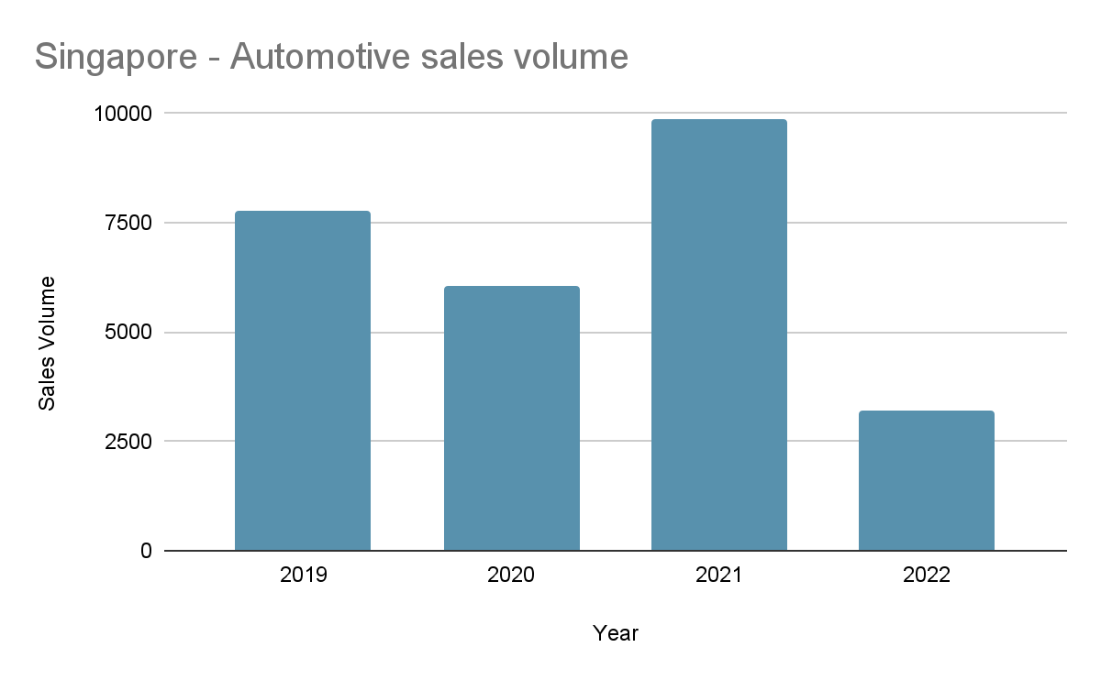
Sales volume by year
Notes:
For the users to better understand how the sales volumes will/ has affected their use case, a breakdown of the sales volume by the years will provide them a high level overview of the sales volume over the years. It also provides the user information on the number of new vehicles joining the read. If the user is interested to view more data with relation to a particular year, they can click on the year they would like to see to open another table to view the sales volume/ month for that year.
This graph is for the users to have a better understanding of how the sales volumes will or has affected their use case.
A breakdown of the sales volume by the years will provide them a high level overview of the sales volumes over the years.
It also provides the user, information on the number of new vehicles joining the read and if the user is interested to view more data with relation to a particular year, they can click on the year of interest which will
open another graph —> Shown here…

Slide 46
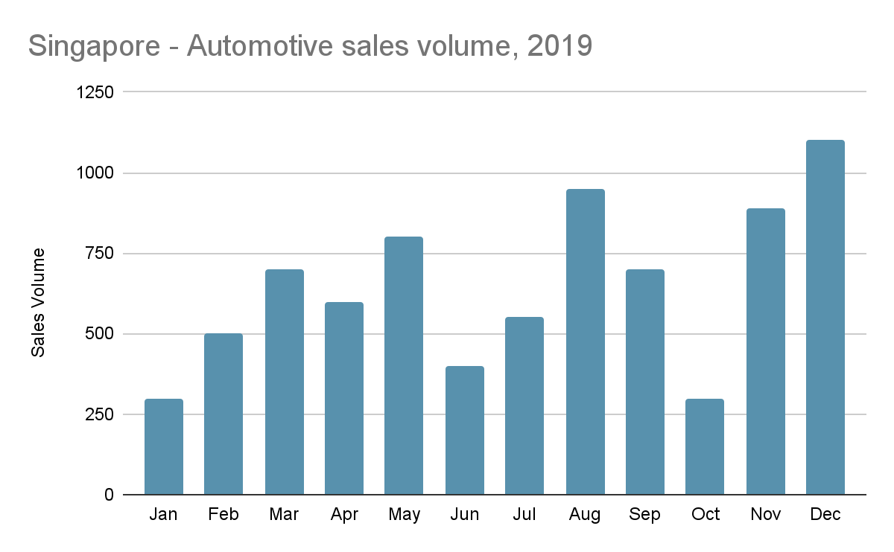
Sales volume by month
Notes:
If the user is interested to view more data with relation to a particular month, they can click on the month to see the breakdown of sales volume for that particular brand in the chosen month.
Shown here… This allows the user to view the sales volume per month for selected year. However, if the user is interested to explore further on the sales of the different car brands in relation to a particular month, they can click on the month of interest. Which will ->

Slide 47
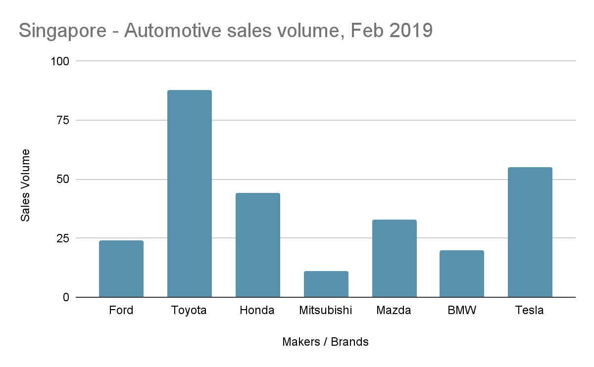
Sales volume by brands for particular month
Notes:
This would provide the users a high level overview of the sales volume of a brand for a chosen month.
Which will… provide the users with a high level overview of sales volume of a brand for a chosen month.

Slide 48
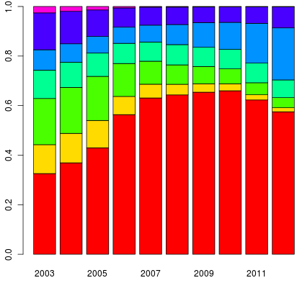
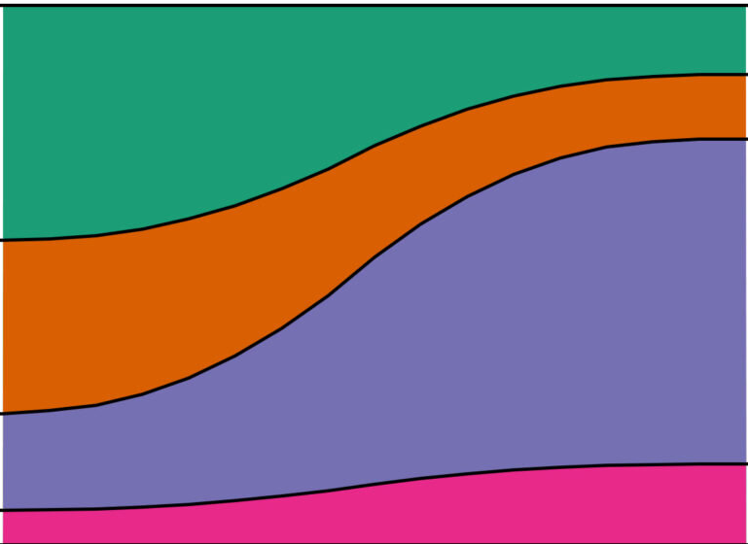
Show market share over years
Notes:
This chart displays the market share over years which was previously displayed as a tabular format mentioned by PK earlier on.
This allows the user to visualise which car brands has a higher percentage of sales volume over the years which can be serve as an indication of the user’s sales.
However, if the sales of a car brand in 2018 only covers 20% of the market share, it does not mean that the 10% market share of the same car brand in 2019 is lower in sales.

Slide 49
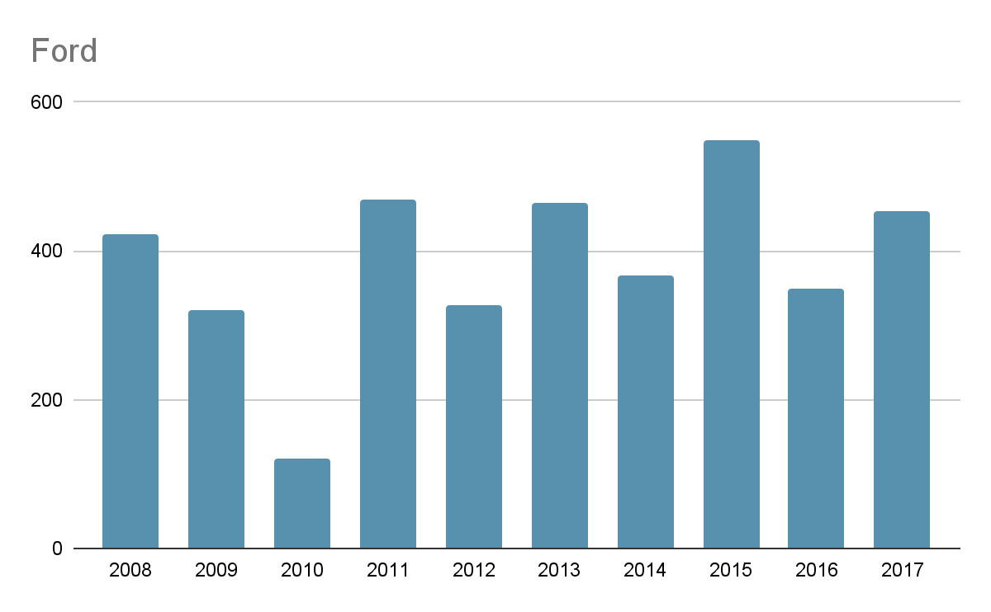
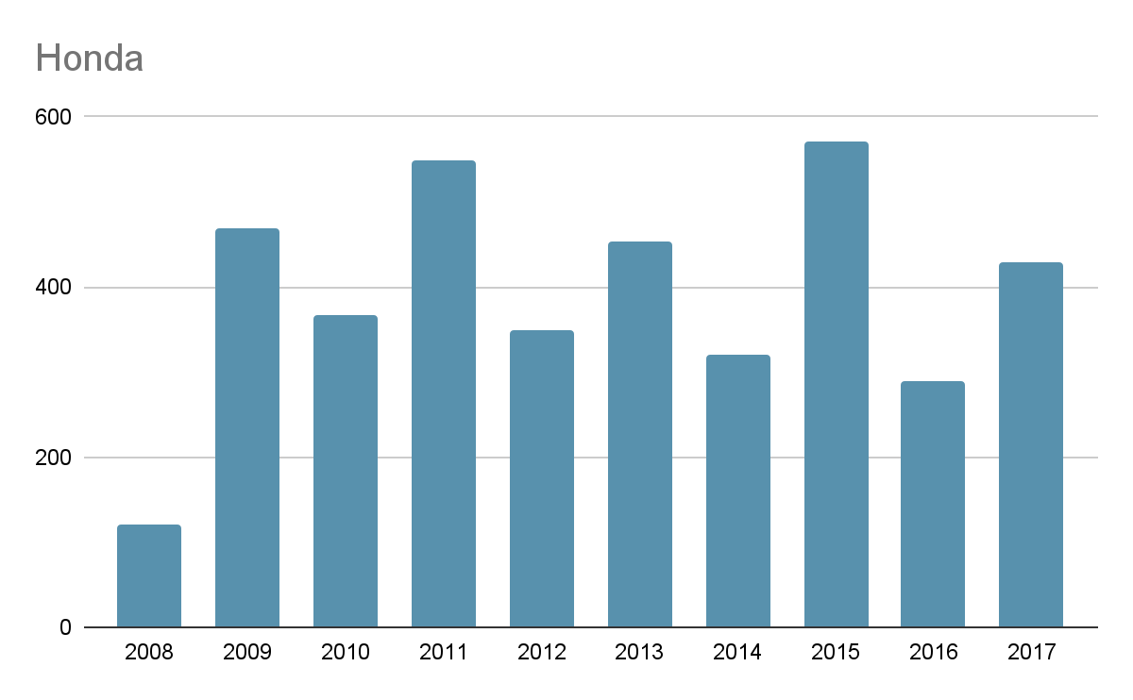
Sales volume by brand over the years
Notes:
In this chart, it shows the raw data of a particular car brand which can be paired with the previous chart to have a more precise numerical values of the market share which was shown in percentage.
This allows the user to make a comparison with their sales on whether the majority of the car owners are using the services provided by the user’s company.
For example, if the user has a sales of 100 deals for Honda cars in both 2008 & 2009, it shows that the sales covers the majority of the Honda owners in 2008. However, in 2009 it only covers the minority.
With this information, the user is able to determine on quality of service being poor and make amendments needed.

Slide 50
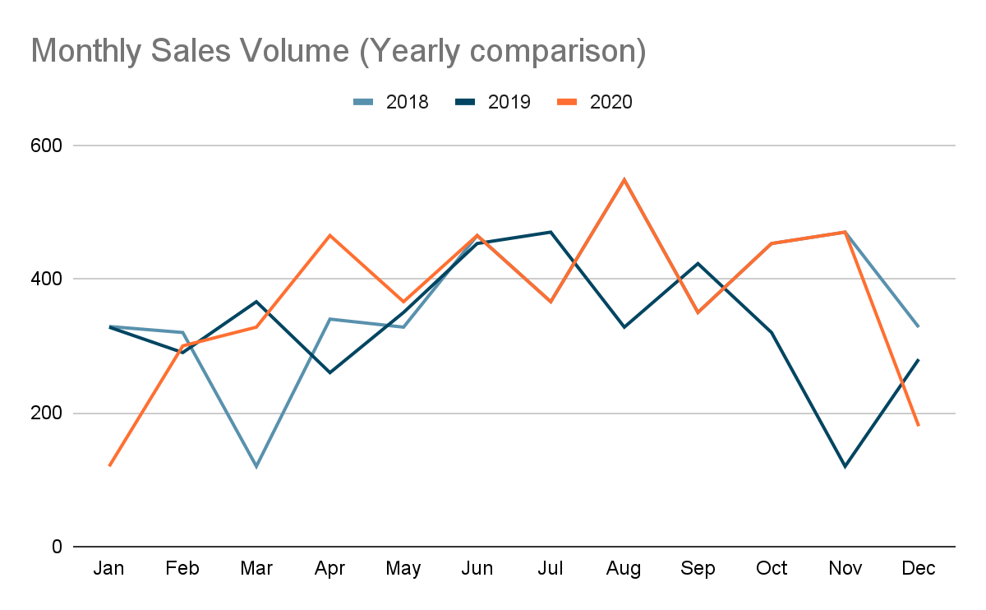
Total sales volume pattern
Notes:
In this chart, it gives an insight on the consumer buying patterns over the months in the different years.
The user can use this insight to predict future trends on the sales volume. E.g. keeping more stocks or bringing more car spare parts in the 3rd quarter of the year

Slide 51
Project Links
Visualisation 1
https://github.com/cosmoduende/r-olympic-games
https://rpubs.com/cosmoduende/olympic-games
Visualisation 2
https://www.marklines.com/en/statistics/flash_sales/automotive-sales-in-singapore-by-month

Slide 52
End

