Slide 1

Toy Horse Conjoint Analysis
Group 9: Anjali Shastri, Futao Xie, Guchuan Qiu, Huiwen Ge, Tianbi Guo

Slide 2
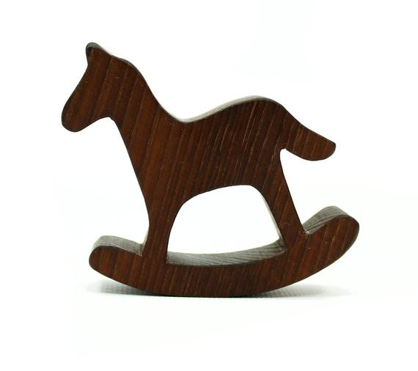
Executive Summary
Key Insights
Divided customer into 3 segments will be the best option.
(benefit segmentation)
Price is the main factor to affect customer’s rating.
(a priori segmentation)
Product 4(or 3), 12(or 11), 14(or 13), 16(or 15) are best possible options to target each segment.
Recommendations
Product 12 & Product 14
Notes:
Raspberry and Black Cherry are two of the most favorite flavors based on the survey data.
“High Protein” and “0% fat” have a high proportion in survey attributes, because we think customer would focus on their physical health.
Turf analysis的目标：compagin 我们希望爱买regular的人去买greek. 希望增加新的口味增加greek. 把goal 放在前面。

Slide 3

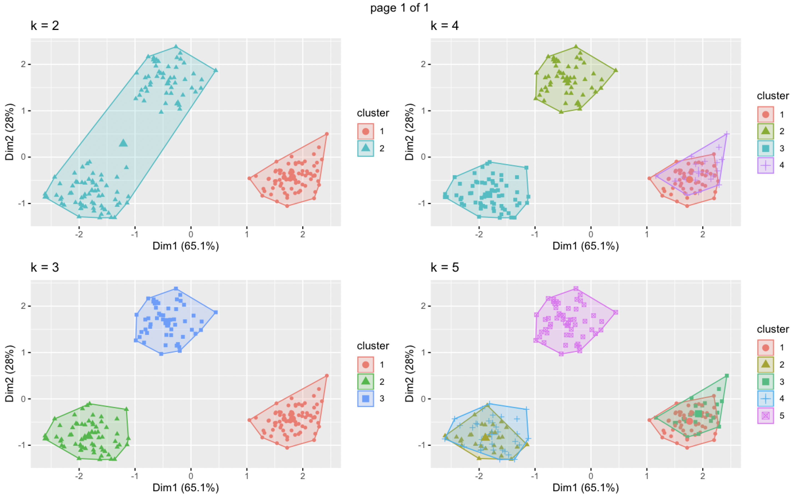
Benefit Segmentation
Best output is K = 3
Separate All customers into 3 segments.
No Overlap
Overlap when K over 3
Didn’t correctly Separate the segments when k = 2.

Slide 4
Benefit Segmentation
40% customers are more price sensitive than others.
34% customers preferred the 26 inches Model.
26% customers varied by both price and motion.

Slide 5
A Priori Segmentation (Gender & Age)
Segment Interactions
Ratings = β0+ β1*price+...+ β4*style+ β0s+ β1s*price*age……+ β4s*style*age + e
Ratings = β0+ β1*price+...+ β4*style+ β0s+ β1s*price*gender……+ β4s*style*gender + e
Price is the most important reason to impact customer’s rating
The difference of coefficients between whole population and priori segmentation is significant

Slide 6
Market Simulation—Overview
Assumptions:
Sufficient fund for covering the costs;
Duration for the product line is 5 years;
The competitor would decrease their price with a market share lower than 50% and would take fierce action with a market share lower than 30%.
Method | Segment | Ideal Product | Alternative Product
Post Hoc Segmentation | Size Sensitive | 16 | 15
 | Small Rocking Fan | 14 | 13
 | Price Sensitive | 4 | 3
A Priori Segmentation | 2-year-old | 16 | 15
 | 3/4-year-old | 12 | 11
 | female | 16 | 15
 | male | 4 | 3
Principles of Recommendations:
Using combinations of profile 4(or 3),12(or 11), 14 (or 13),16 (or 15)
Product line of 3 (or 2) products

Slide 7
Market Simulation—Scenarios with 3 products
Market Share
Scenario | Prod A |  | Prod B |  | Prod C
 | Product number | Profit | Product number | Profit | Product number | Profit | Design Cost | Other Fixed Cost | Firm Profit - 1st year | Firm Profit – 5 years
4 | 3 | 0 | 4 | 145,584 | 14 | 71,009 | 6,667 | 60,000 | 149,926 | 776,298
13 | 3 | 0 | 12 | 163,782 | 14 | 64310 | 13,333 | 60,000 | 154759 | 827,127
38 | 11 | 4,499 | 12 | 161,962 | 14 | 64,310 | 6,667 | 60,000 | 164,105 | 847,193

Slide 8
Market Simulation—Scenarios with 2 products
Scenario | Prod A |  | Prod B
 | Product number | Profit | Product number | Profit | Design Cost | Other Fixed Cost | Firm Profit - 1st year | Firm Profit - 5 years
21 | 4 | 119,984 | 14 | 96,449 | 6,667 | 40,000 | 169,767 | 875,503
39 | 12 | 134,982 | 14 | 87,350 | 6,667 | 40,000 | 175,666 | 904,998
53 | 14 | 68,991 | 16 | 132,845 | 6,667 | 40,000 | 155,170 | 802,518
Market Share
The highest profit generating scenario with 2 products of 12 and 14.

Slide 9
Thank you

Slide 10
Appendix

Slide 11
Appendix – All Scenarios for 2 products
Scenario | Product Line | Competitor Response | Competitor Market Share | 1st Year Profit
0 | 5,13 | 7 | 0.57 | 102422.8
1 | 3,4 | 7 | 0.255 | NA
2 | 3,4 | 8 | 0.585 | 104376.7
3 | 3,11 | 7 | 0.57 | 137083.1
4 | 3,12 | 7 | 0.08 | NA
5 | 3,12 | 8 | 0.535 | 115908.1
6 | 3,13 | 7 | 0.275 | NA
7 | 3,13 | 8 | 0.93 | -21509.5
8 | 3,14 | 7 | 0.09 | NA
9 | 3,14 | 8 | 0.7 | 62521.33
10 | 3,15 | 7 | 0.17 | NA
11 | 3,15 | 8 | 0.77 | 30057.47
12 | 3,16 | 7 | 0.005 | NA
13 | 3,16 | 8 | 0.505 | 126826.9
14 | 4,11 | 7 | 0.17 | NA
15 | 4,11 | 8 | 0.545 | 86668.47
16 | 4,12 | 7 | 0.06 | NA
17 | 4,12 | 8 | 0.405 | 142102.9
18 | 4,13 | 7 | 0.145 | NA
19 | 4,13 | 8 | 0.52 | 101474.1
20 | 4,14 | 7 | 0.055 | NA
21 | 4,14 | 8 | 0.335 | 169766.7
22 | 4,15 | 7 | 0.095 | NA
23 | 4,15 | 8 | 0.405 | 139222.9
24 | 4,16 | 7 | 0 | NA
25 | 4,16 | 8 | 0.18 | NA
26 | 11,12 | 7 | 0.07 | NA
27 | 11,12 | 8 | 0.525 | 125254.3
28 | 11,13 | 7 | 0.24 | NA
29 | 11,13 | 8 | 0.855 | 987.53
30 | 11,14 | 7 | 0.045 | NA
31 | 11,14 | 8 | 0.64 | 79878.93
32 | 11,15 | 7 | 0.27 | NA
33 | 11,15 | 8 | 0.765 | 30597.27
34 | 11,16 | 7 | 0.005 | NA
35 | 11,16 | 8 | 0.505 | 128626.9
36 | 12,13 | 7 | 0.025 | NA
37 | 12,13 | 8 | 0.48 | 112832.5
38 | 12,14 | 7 | 0 | NA
39 | 12,14 | 8 | 0.31 | 175665.7
40 | 12,15 | 7 | 0.055 | NA
41 | 12,15 | 8 | 0.465 | 123091.9
42 | 12,16 | 7 | 0 | NA
43 | 12,16 | 8 | 0.285 | NA
44 | 13,14 | 7 | 0.1 | NA
45 | 13,14 | 8 | 0.7 | 68868
46 | 13,15 | 7 | 0.4 | NA
47 | 13,15 | 8 | 0.715 | 46235.27
48 | 13,16 | 7 | 0.005 | NA
49 | 13,16 | 8 | 0.495 | 134893.1
50 | 14,15 | 7 | 0.025 | NA
51 | 14,15 | 8 | 0.545 | 103255.1
52 | 14,16 | 7 | 0.005 | NA
53 | 14,16 | 8 | 0.405 | 155169.5
54 | 15,16 | 7 | 0.005
55 | 15,16 | 8 | 0.505 | 132533.5

Slide 12
Appendix – All Scenarios for 3 products
Scenario | ProductA | ProductB | ProductC | n_new | Competitor_1 | CompetitorMaretShare_1 | 1stYearProfit_1 | Competitor_2 | CompetitorMaretShare_2 | 1stYearProfit_2
1 | 3 | 4 | 11 | 2 | 7 | 0.17 | NA | 8 | 0.545 | 86988.47
2 | 3 | 4 | 12 | 2 | 7 | 0.06 | NA | 8 | 0.405 | 117782.9
3 | 3 | 4 | 13 | 1 | 7 | 0.145 | NA | 8 | 0.52 | 101794.1
4 | 3 | 4 | 14 | 1 | 7 | 0.055 | NA | 8 | 0.335 | 149926.7
5 | 3 | 4 | 15 | 2 | 7 | 0.095 | NA | 8 | 0.405 | 122102.9
6 | 3 | 4 | 16 | 2 | 7 | 0 | NA | 8 | 0.18 | NA
7 | 3 | 11 | 12 | 2 | 7 | 0.07 | NA | 8 | 0.525 | 55387.67
8 | 3 | 11 | 13 | 2 | 7 | 0.125 | NA | 8 | 0.85 | -25299.3
9 | 3 | 11 | 14 | 2 | 7 | 0.045 | NA | 8 | 0.64 | 29852.27
10 | 3 | 11 | 15 | 3 | 7 | 0.165 | NA | 8 | 0.76 | -13129.6
11 | 3 | 11 | 16 | 3 | 7 | 0.005 | NA | 8 | 0.505 | 52640.2
12 | 3 | 12 | 13 | 2 | 7 | 0.025 | NA | 8 | 0.48 | 110645.9
13 | 3 | 12 | 14 | 2 | 7 | 0 | NA | 8 | 0.31 | 154759.1
14 | 3 | 12 | 15 | 3 | 7 | 0.055 | NA | 8 | 0.465 | 100798.6
15 | 3 | 12 | 16 | 3 | 7 | 0 | NA | 8 | 0.285 | NA
16 | 3 | 13 | 14 | 1 | 7 | 0.09 | NA | 8 | 0.7 | 14201.33
17 | 3 | 13 | 15 | 2 | 7 | 0.06 | NA | 8 | 0.71 | 10775.07
18 | 3 | 13 | 16 | 2 | 7 | 0.005 | NA | 8 | 0.495 | 65346.47
19 | 3 | 14 | 15 | 2 | 7 | 0.02 | NA | 8 | 0.545 | 72108.47
20 | 3 | 14 | 16 | 2 | 7 | 0.005 | NA | 8 | 0.405 | 108182.9
21 | 3 | 15 | 16 | 2 | 7 | 0.005 | NA | 8 | 0.505 | 60746.87
22 | 4 | 11 | 12 | 2 | 7 | 0.05 | NA | 8 | 0.395 | 100622.5
23 | 4 | 11 | 13 | 2 | 7 | 0.075 | NA | 8 | 0.48 | 84085.87
24 | 4 | 11 | 14 | 2 | 7 | 0.035 | NA | 8 | 0.295 | NA
25 | 4 | 11 | 15 | 3 | 7 | 0.095 | NA | 8 | 0.405 | 93196.2
26 | 4 | 11 | 16 | 3 | 7 | 0 | NA | 8 | 0.18 | NA
27 | 4 | 12 | 13 | 2 | 7 | 0.025 | NA | 8 | 0.35 | 136840.7

Slide 13
Appendix – All Scenarios for 3 products
28 | 4 | 12 | 14 | 2 | 7 | 0 | NA | 8 | 0.185 | NA
29 | 4 | 12 | 15 | 3 | 7 | 0.045 | NA | 8 | 0.335 | 127633.4
30 | 4 | 12 | 16 | 3 | 7 | 0 | NA | 8 | 0.16 | NA
31 | 4 | 13 | 14 | 1 | 7 | 0.055 | NA | 8 | 0.335 | 124806.7
32 | 4 | 13 | 15 | 2 | 7 | 0.03 | NA | 8 | 0.345 | 120420.5
33 | 4 | 13 | 16 | 2 | 7 | 0 | NA | 8 | 0.17 | NA
34 | 4 | 14 | 15 | 2 | 7 | 0.01 | NA | 8 | 0.2 | NA
35 | 4 | 14 | 16 | 2 | 7 | 0 | NA | 8 | 0.085 | NA
36 | 4 | 15 | 16 | 2 | 7 | 0 | NA | 8 | 0.18 | NA
37 | 11 | 12 | 13 | 1 | 7 | 0.02 | NA | 8 | 0.47 | 119992.1
38 | 11 | 12 | 14 | 1 | 7 | 0 | NA | 8 | 0.3 | 164105.3
39 | 11 | 12 | 15 | 2 | 7 | 0.055 | NA | 8 | 0.465 | 107625.3
40 | 11 | 12 | 16 | 2 | 7 | 0 | NA | 8 | 0.285 | NA
41 | 11 | 13 | 14 | 1 | 7 | 0.045 | NA | 8 | 0.64 | 32518.93
42 | 11 | 13 | 15 | 2 | 7 | 0.165 | NA | 8 | 0.705 | 12754.87
43 | 11 | 13 | 16 | 2 | 7 | 0.005 | NA | 8 | 0.495 | 65346.47
44 | 11 | 14 | 15 | 2 | 7 | 0.02 | NA | 8 | 0.535 | 75588.07
45 | 11 | 14 | 16 | 2 | 7 | 0.005 | NA | 8 | 0.405 | 108182.9
46 | 11 | 15 | 16 | 2 | 7 | 0.005 | NA | 8 | 0.505 | 60746.87
47 | 12 | 13 | 14 | 1 | 7 | 0 | NA | 8 | 0.31 | 133105.7
48 | 12 | 13 | 15 | 2 | 7 | 0.015 | NA | 8 | 0.415 | 101183.3
49 | 12 | 13 | 16 | 2 | 7 | 0 | NA | 8 | 0.275 | NA
50 | 12 | 14 | 15 | 2 | 7 | 0 | NA | 8 | 0.27 | NA
51 | 12 | 14 | 16 | 2 | 7 | 0 | NA | 8 | 0.195 | NA
52 | 12 | 15 | 16 | 2 | 7 | 0 | NA | 8 | 0.285 | NA
53 | 13 | 14 | 15 | 1 | 7 | 0.025 | NA | 8 | 0.545 | 78455.13
54 | 13 | 14 | 16 | 1 | 7 | 0.005 | NA | 8 | 0.405 | 114529.5
55 | 13 | 15 | 16 | 1 | 7 | 0.005 | NA | 8 | 0.495 | 71213.13
56 | 14 | 15 | 16 | 1 | 7 | 0.005 | NA | 8 | 0.405 | 101569.5

