Slide 1
FOODRESCUE / FRONTEND LOGIC
Logic checklist,
explained
Seven frontend ideas, shown in the app and the source code behind each one.
Live site on this device: http://127.0.0.1:5173/
Built-in Student demo. Sample listings only. No posts or claims were submitted while capturing.
Notes:
Introduce FoodRescue as the example website and explain that this deck walks through seven frontend logic checklist items.
All UI screenshots come from the built-in Student demo account. The feed marks its listings as samples. I did not create a post or submit a claim while capturing the screens.
The live site is running on this computer at http://127.0.0.1:5173/.

Slide 2
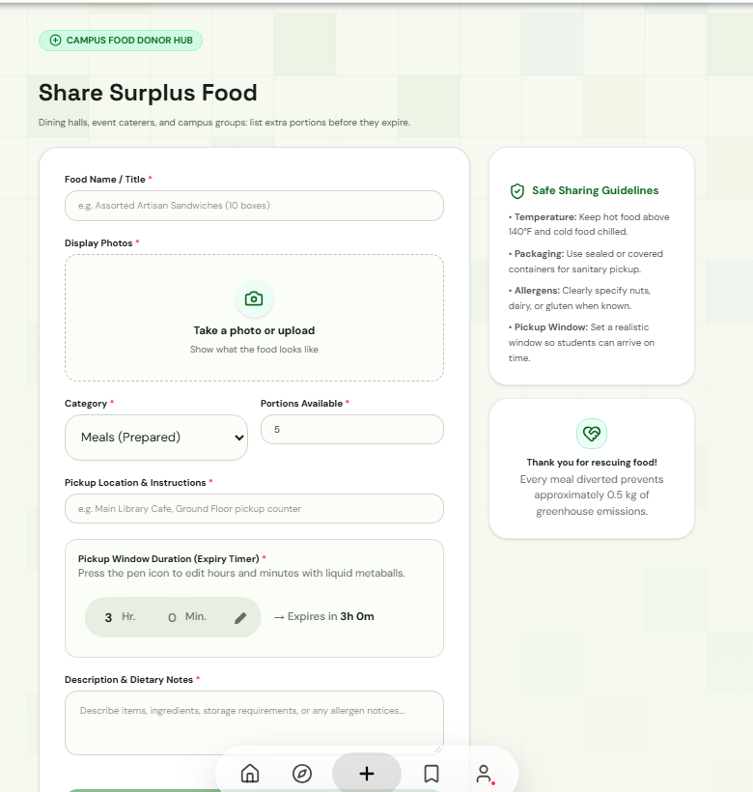
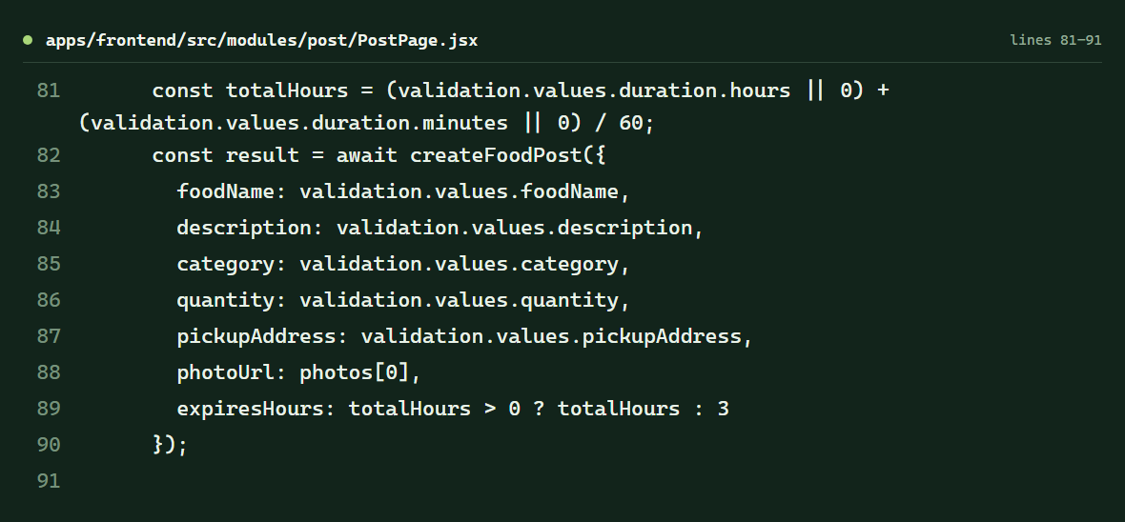
CHECKLIST ITEM 01 OF 07
Functions
A function groups the steps for one task.
IN THE APP
SOURCE CODE
Screen: /app/post
Source: PostPage.jsx, lines 81 to 91
PRESENTER CUE
Here, handleSubmit validates the draft, calculates the expiry, and calls createFoodPost.
Built-in demo capture. No post or claim was submitted while preparing this deck.
01
Notes:
A function gives related steps one name so the form can call them when needed.
In PostPage.jsx, handleSubmit validates the draft first. The shown excerpt converts hours and minutes into total hours, then passes the validated values to createFoodPost.
The screenshot shows the form but does not submit it.
Source: apps/frontend/src/modules/post/PostPage.jsx, lines 57 to 91.

Slide 3
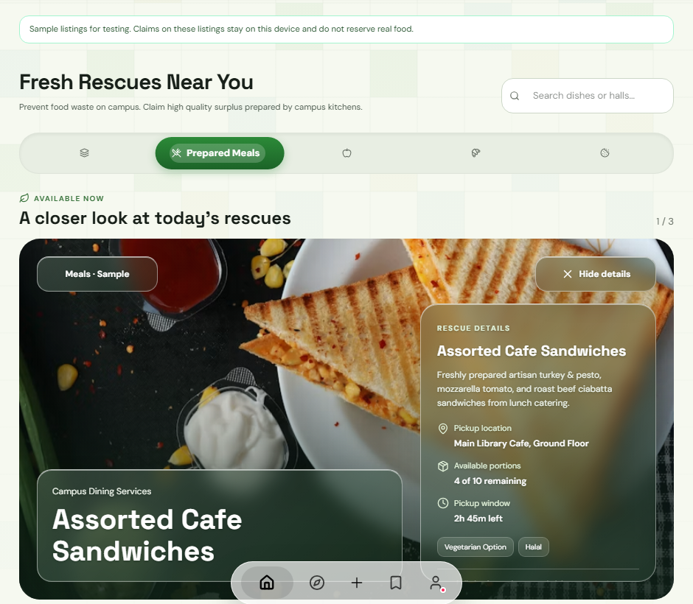
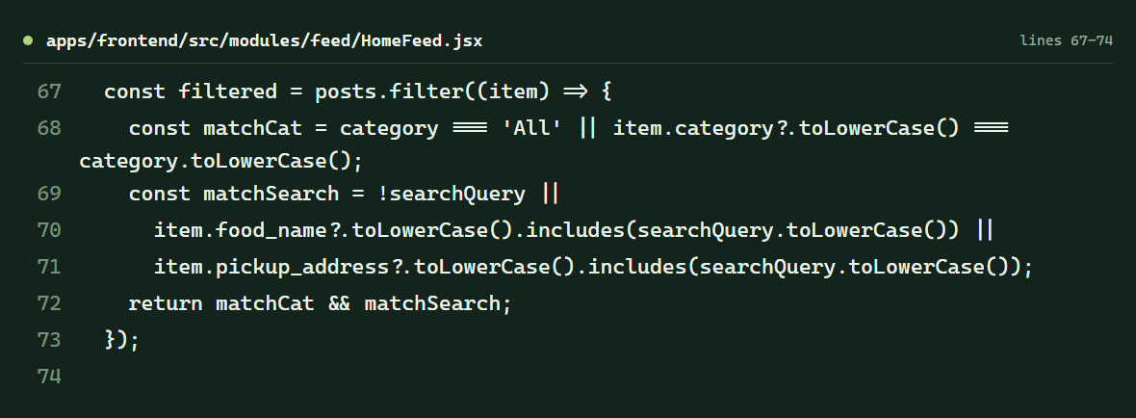
CHECKLIST ITEM 02 OF 07
Control structures
Control structures decide which items continue to the screen.
IN THE APP
SOURCE CODE
Screen: /app/home-feed
Source: HomeFeed.jsx, lines 67 to 74
PRESENTER CUE
A post stays visible only when it passes both the category test and the search test.
Built-in demo capture. No post or claim was submitted while preparing this deck.
02
Notes:
The filter uses boolean logic to decide which posts remain in the feed.
matchCat is true for the All category or when the post category matches. matchSearch is true for an empty search or when the food name or pickup address contains the search text. The final return requires both conditions with &&.
The screenshot shows the Prepared Meals filter selected. It only changes the visible results.
Source: apps/frontend/src/modules/feed/HomeFeed.jsx, lines 67 to 74.

Slide 4
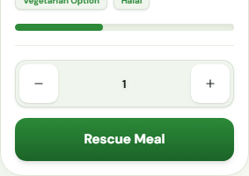
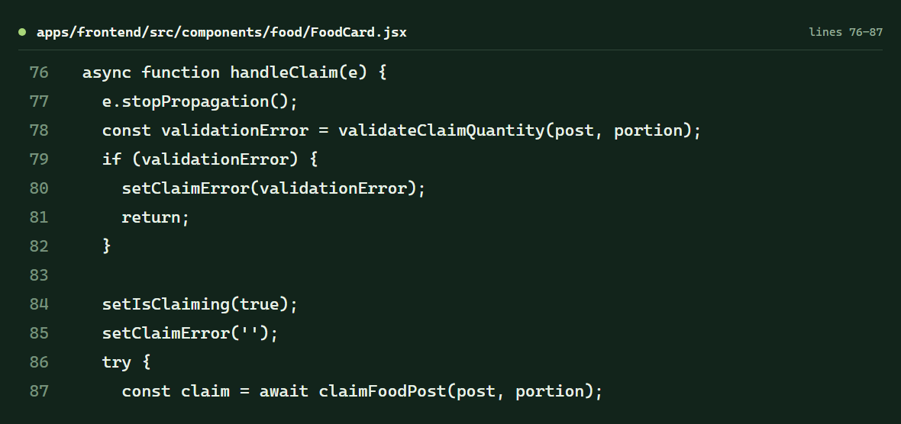
CHECKLIST ITEM 03 OF 07
Event handlers
An event handler connects a user action to program logic.
IN THE APP
SOURCE CODE
Screen: /app/home-feed
Source: FoodCard.jsx, lines 76 to 87
PRESENTER CUE
The claim control calls handleClaim, which checks the quantity before starting the claim request.
Built-in demo capture. No post or claim was submitted while preparing this deck.
03
Notes:
A button can call a function when someone clicks it. In FoodCard.jsx, onClick={handleClaim} connects the button to the handler.
The handler stops the click from bubbling, validates the selected portion, sets the loading state, and calls claimFoodPost. This capture does not click the button, so it does not create a claim.
The banner in the app says sample claims stay on this device and do not reserve real food.
Source: apps/frontend/src/components/food/FoodCard.jsx, lines 76 to 87 and 209 to 211.

Slide 5
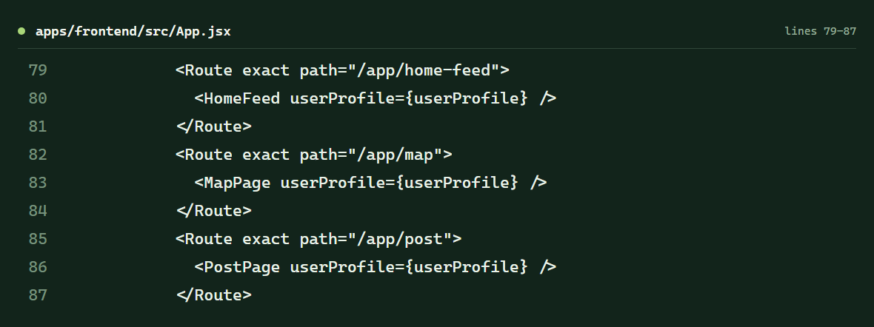
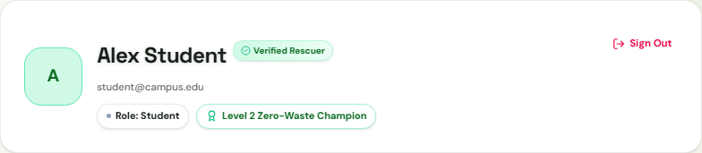
CHECKLIST ITEM 04 OF 07
Data passed between pages
Props let a parent component share data with a child page.
IN THE APP
SOURCE CODE
Screen: /app/profile
Source: App.jsx, lines 79 to 87
PRESENTER CUE
App passes userProfile into the screens, and the profile card reads its name, email, and role.
Built-in demo capture. No post or claim was submitted while preparing this deck.
04
Notes:
In React, a prop is data a parent component gives to a child component.
App passes the same userProfile object into several routes, including HomeFeed, MapPage, and PostPage. ProfilePage also receives this prop and uses its full_name, email, and role to fill the profile card.
The screenshot uses the built-in Student demo profile.
Source: apps/frontend/src/App.jsx, lines 79 to 92; apps/frontend/src/modules/profile/ProfilePage.jsx, profile card header.

Slide 6
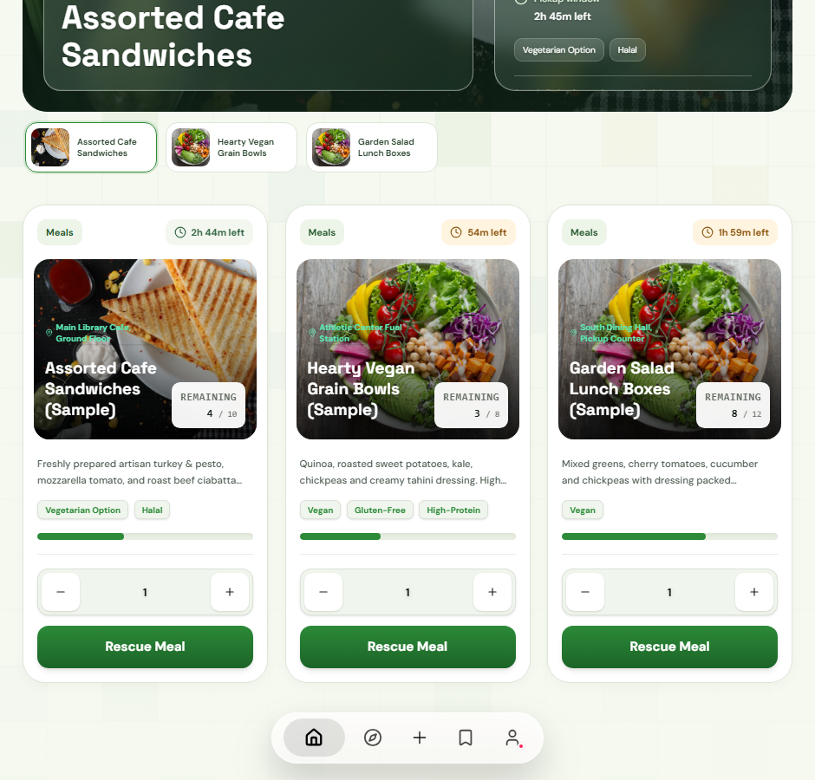
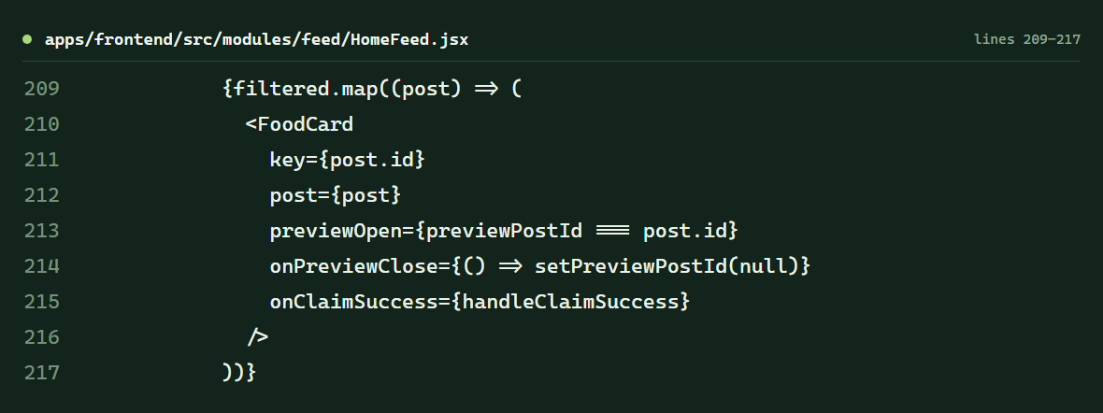
CHECKLIST ITEM 05 OF 07
Lists displayed
A list turns an array of posts into repeated interface elements.
IN THE APP
SOURCE CODE
Screen: /app/home-feed
Source: HomeFeed.jsx, lines 209 to 217
PRESENTER CUE
map renders one FoodCard per filtered post, while the post ID helps React track each item.
Built-in demo capture. No post or claim was submitted while preparing this deck.
05
Notes:
The feed stores posts in an array. The map method repeats the same FoodCard component for each post in the filtered array.
The key prop uses post.id so React can distinguish list items when results change.
All visible listings in this screenshot are marked as samples.
Source: apps/frontend/src/modules/feed/HomeFeed.jsx, lines 209 to 217.

Slide 7
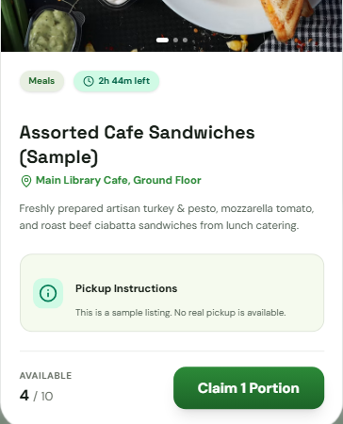
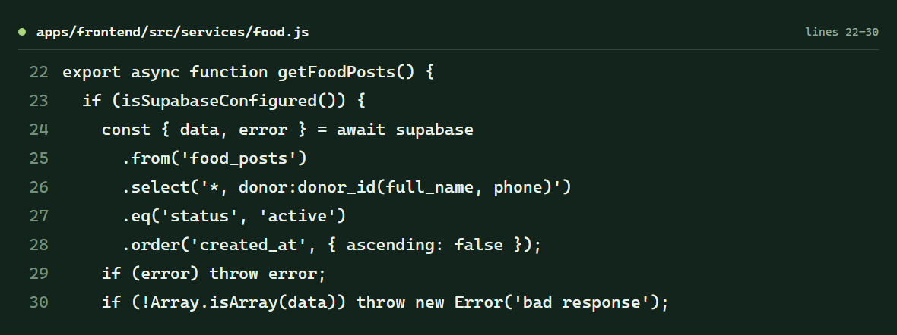
CHECKLIST ITEM 06 OF 07
Reusable services
A service separates data access from the screen that displays the result.
IN THE APP
SOURCE CODE
Screen: /app/home-feed
Source: services/food.js, lines 22 to 30
PRESENTER CUE
HomeFeed calls getFoodPosts; the service handles retrieving active listings and the demo fallback.
Built-in demo capture. No post or claim was submitted while preparing this deck.
06
Notes:
A service function keeps database or demo-data details outside the React page.
HomeFeed calls getFoodPosts when it loads. The service checks whether Supabase is configured and, when it is, requests active food_posts ordered by creation date. The service also contains the local sample-data path used by the demo.
The details dialog shows a sample listing that the feed loaded. No claim was submitted.
Sources: apps/frontend/src/services/food.js, lines 22 to 45; apps/frontend/src/modules/feed/HomeFeed.jsx, lines 35 to 42.

Slide 8
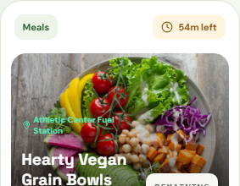
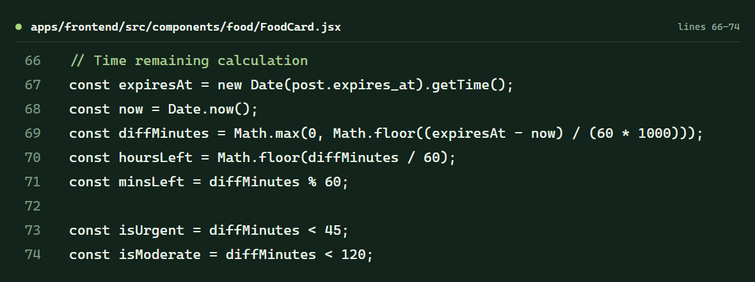
CHECKLIST ITEM 07 OF 07
Clear names and comments
Descriptive names and comments explain what a calculation is doing.
IN THE APP
SOURCE CODE
Screen: /app/home-feed
Source: FoodCard.jsx, lines 66 to 74
PRESENTER CUE
expiresAt, diffMinutes, hoursLeft, and minsLeft make the countdown logic easier to follow.
Built-in demo capture. No post or claim was submitted while preparing this deck.
07
Notes:
Clear names tell the reader what a value represents without needing to trace every operation.
The comment marks the time-remaining calculation. The variable names show the sequence: read the expiry timestamp, calculate the minutes remaining, then split that into hours and minutes for the interface.
The UI displays the result as a short time-left label.
Source: apps/frontend/src/components/food/FoodCard.jsx, lines 66 to 74.

