Slide 1
Hello World of Deep Learning: Recognition of MNIST
Qingguang Guan
Assistant Professor of Mathematics
School of Mathematics and Natural Sciences
University of Southern Mississippi

Slide 2
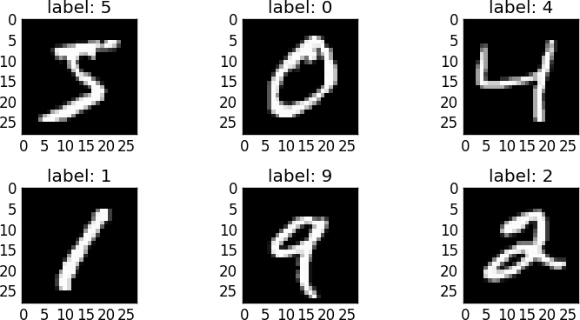
Introducing the MNIST problem
MNIST (Mixed National Institute of Standards and Technology database) is a large database of handwritten digits that is commonly used for training various image processing systems.
It consists of images of handwritten digits like these:
The MNIST database contains 60,000 training images and 10,000 testing images.

Slide 3
Example Problem - MNIST
Recognizes handwritten digits.
We uses the MNIST dataset, a collection of 60,000 labeled digits that has kept generations of PhDs busy for almost two decades. We will solve the problem with Python/PyTorch code.
We will show different neural networks achieve different accuracy.

Slide 4
Steps for MNIST
Understand the MNIST data
Softmax regression layer
The cost function

Slide 5
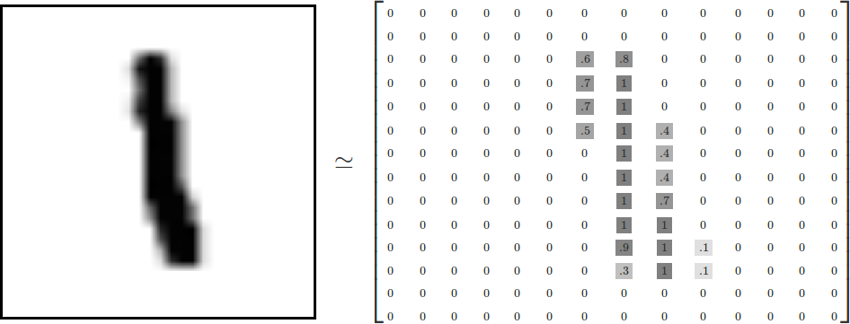
The MNIST Data
Every MNIST data point has two parts: an image of a handwritten digit and a corresponding label. We'll call the images "x" and the labels "y". Both the training set and test set contain images and their corresponding labels;
Each image is 28 pixels by 28 pixels. We can interpret this as a big array of numbers:

Slide 6
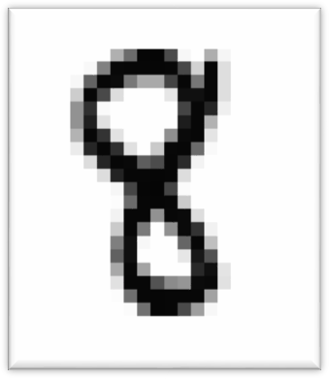
One Layer NN for MNIST Recognition
We will start with a very simple model, called Softmax Regression.
We can flatten this array into a vector of 28x28 = 784 numbers. It doesn't matter how we flatten the array, as long as we're consistent between images.
From this perspective, the MNIST images are just a bunch of points in a 784-dimensional vector space.
28x28
pixels
...

Slide 7
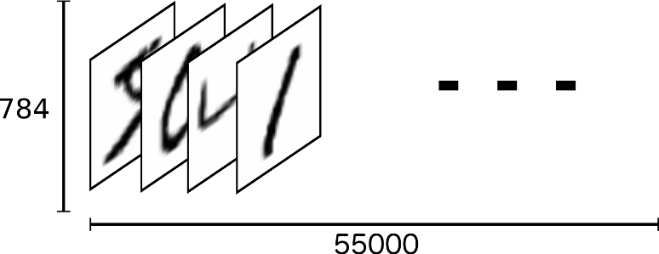


Result of the Flatten Operation
The result is that the training inputs become a matrix with 60000 rows and 784 columns.
Each entry in the matrix is a pixel intensity between 0 and 1, (after being normalized, divided by 255) for a particular pixel in a particular image.
60,000
60000
784

Slide 8


One-hot Vector
For the purposes of training, we set y (which is the label of one
picture) as "one-hot vectors“.
A one-hot vector is a vector has one entry as 1, all other entries as 0.
How to label an “8”?
[ 0 , 0 , 0 , 0 , 0 , 0 , 0 , 0 , 1 , 0 ]
What is the dimension of our y's matrix?
0 | 1 | 2 | 3 | 4 | 5 | 6 | 7 | 8 | 9
6
3
2
4
5
4
0 | 0 | 0 | 0 | 0 | 0 | 1 | 0 | 0 | 0
0 | 0 | 0 | 1 | 0 | 0 | 0 | 0 | 0 | 0
0 | 0 | 1 | 0 | 0 | 0 | 0 | 0 | 0 | 0
0 | 0 | 0 | 0 | 1 | 0 | 0 | 0 | 0 | 0
0 | 0 | 0 | 0 | 0 | 1 | 0 | 0 | 0 | 0
0 | 0 | 0 | 0 | 1 | 0 | 0 | 0 | 0 | 0
60,000 labels:
60,000
...
...
4
0 | 0 | 0 | 0 | 1 | 0 | 0 | 0 | 0 | 0
10

Slide 9



Softmax Regressions
Every image in MNIST is a handwritten digit between 0 and 9.
We want to assign each image the "probability” or “weight" for it being each digit.
For example, our model may see a picture as an 8 with 0.8
“probability” or “weight”, but there is 0.06 chance for it being a 4.
this is a“8”
Softmax Regression
0 | 1 | 2 | 3 | 4 | 5 | 6 | 7 | 8 | 9
0.04 | 0.02 | 0.01 | 0.01 | 0.06 | 0.03 | 0.01 | 0.01 | 0.80 | 0.01

Slide 10

2 steps in softmax regression - Step 1
Step 1: Add up the evidence of our input being in certain classes.
– Do a weighted sum of the input vectors.
Where z and b are two 1 by 10 vectors and x is a 1 by 784 vector. W is a 784 by 10 matrix.
z_{i} = ∑ _{j} W_{j,i} x _{j} + bi ; i=0,1,2,…,9; j=0,1,2,…,783

Slide 11


Matrix Representation of softmax layer
10 columns
^{w}0 , 0 ^{w}0 , 1 ^{w}0,2 ^{w}0,3
^{…w}0,9
^{…w}1,9
^{…w}2,9
^{…w}3,9
^{…w}4,9
^{…w}5,9
^{…w}6,9
^{…w}7,9
^{…w}8,9
broadcast
^{w}1 , 0 ^{w}1 , 1 ^{w}1,2 ^{w}1,3 ^{w}2 , 0 ^{w}2 , 1 ^{w}2,2 ^{w}2,3 ^{w}3 , 0 ^{w}3 , 1 ^{w}3,2 ^{w}3,3 ^{w}4 , 0 ^{w}4 , 1 ^{w}4,2 ^{w}4,3 ^{w}5 , 0 ^{w}5 , 1 ^{w}5,2 ^{w}5,3 ^{w}6 , 0 ^{w}6 , 1 ^{w}6,2 ^{w}6,3 ^{w}7 , 0 ^{w}7 , 1 ^{w}7,2 ^{w}7,3 ^{w}8 , 0 ^{w}8 , 1 ^{w}8,2 ^{w}8,3
…
784 lines
Y = softmax( X ⋅W + b)
x
x
x _{x}
X : 60,000 images, one per line, flattened
x
x
x
^{w}783,0 ^{w}783,1 ^{w}783,2
^{…w}783,9
What is the final dimension for X*W?
784 numbers

Slide 12
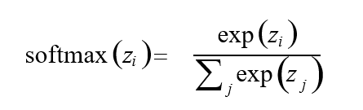
2 steps in softmax regression - Step 2
Step 2: Convert the inputs of final layer into "probabilities" or “weights” using the softmax function:
P_{i} = softmax (z_{i} )= softmax (∑ _{j} W_{i, j} x _{j} + b_{i} )
Here softmax is serving as an "activation" function, which is defined
as:

Slide 13
The softmax layer
The output from the softmax layer is a set of positive numbers which sum up to 1.
784 pixels
28x28
pixels
...
softmax
...
neuron outputs
0 1 2
9
exp(z_{i} )
softmax (z_{i} )=
∑
( )
exp z
j
j

Slide 14
Softmax on one image
The compact representation for “softmaxing” one input x
“Probabilities” | Image | Weights | Biases
P[1,10] | [1,784] | W[784,10] | b[ 1, 10 ]
P = softmax( x ⋅W + b)
applied on
each entry
matrix multiply

Slide 15
The Cross-Entropy Cost Function
For classification problems, the Cross-Entropy cost function works better than quadratic cost function.
We define the cross-entropy cost function for one pair of (x, y) by:
0 | 0 | 0 | 0 | 0 | 0 | 1 | 0 | 0 | 0
Cross entropy
“one-hot” encoded ground truth
C = −∑ y_{i} ⋅log(P_{i} )
i=0 to 9
should be a“6”
computed "probabilities"
0 1 2 3 4 5 6 7 8 9
0.01 | 0.01 | 0.01 | 0.01 | 0.01 | 0.01 | 0.90 | 0.01 | 0.02 | 0.01

Slide 16
Short Summary
How MNIST data is organized
X:
Flattened image pixels matrix
Y:
One-hot vector
Softmax regression layer
Output "probabilities" for each input
Cost function
Cross-entropy

Slide 17
Implementation in PyTorch
19

Slide 18
Few Words about PyTorch
PyTorch is an open-source deep learning framework for Python. It uses tensors, automatic differentiation, and the torch.nn module to build trainable neural networks. TorchVision adds common computer-vision datasets and transforms, including MNIST. In this section we will implement the MNIST classifier directly in PyTorch.
PyTorch + TorchVision
Tensors + autograd + datasets for MNIST

Slide 19
Introducing PyTorch
PyTorch programs usually define a model as an nn.Module, pass batches of tensors through the forward method, compute a loss, and update parameters with an optimizer. This style keeps the mathematics visible: tensors hold the data, autograd computes gradients, and optimizers such as SGD or Adam update the weights. See more at:
https://pytorch.org/tutorials/beginner/basics/quickstart_tutorial.html

Slide 20
Typical Code Structure
Load the dataset with torchvision.datasets.MNIST and DataLoader
Build the neural network with torch.nn.Module or nn.Sequential
Choose a loss function and optimizer
Train the model: forward pass, loss, backward pass, optimizer step
Evaluate predictions on the test set

Slide 21
Software Environment
What you will need:
Python 3.10 or later
PyTorch and TorchVision
Matplotlib or another visualization library
Install command for a CPU-only setup:
pip install torch torchvision matplotlib
For GPU/CUDA installs, use the official selector:
https://pytorch.org/get-started/locally/
Python downloads:
https://www.python.org/downloads/
Or Google Colab (We will use it)

Slide 22
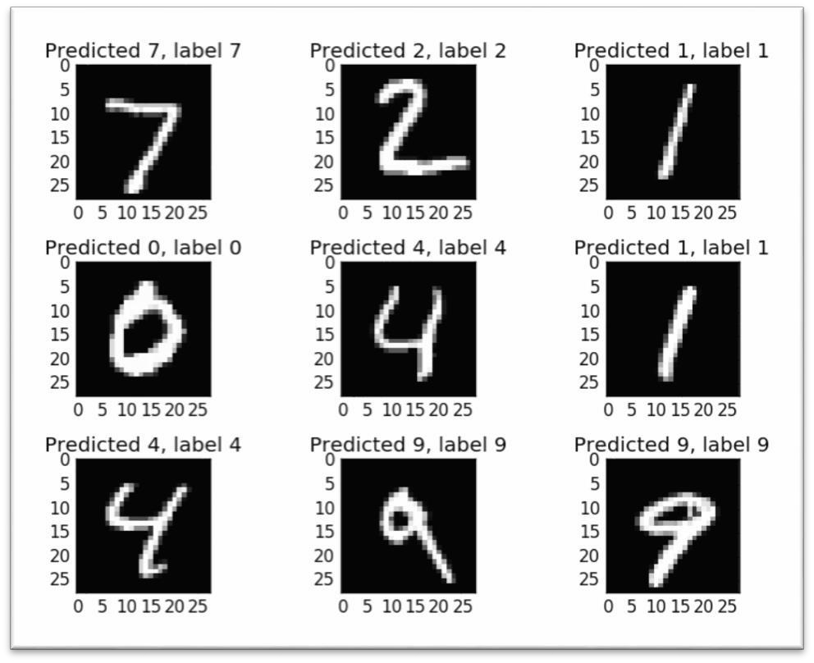
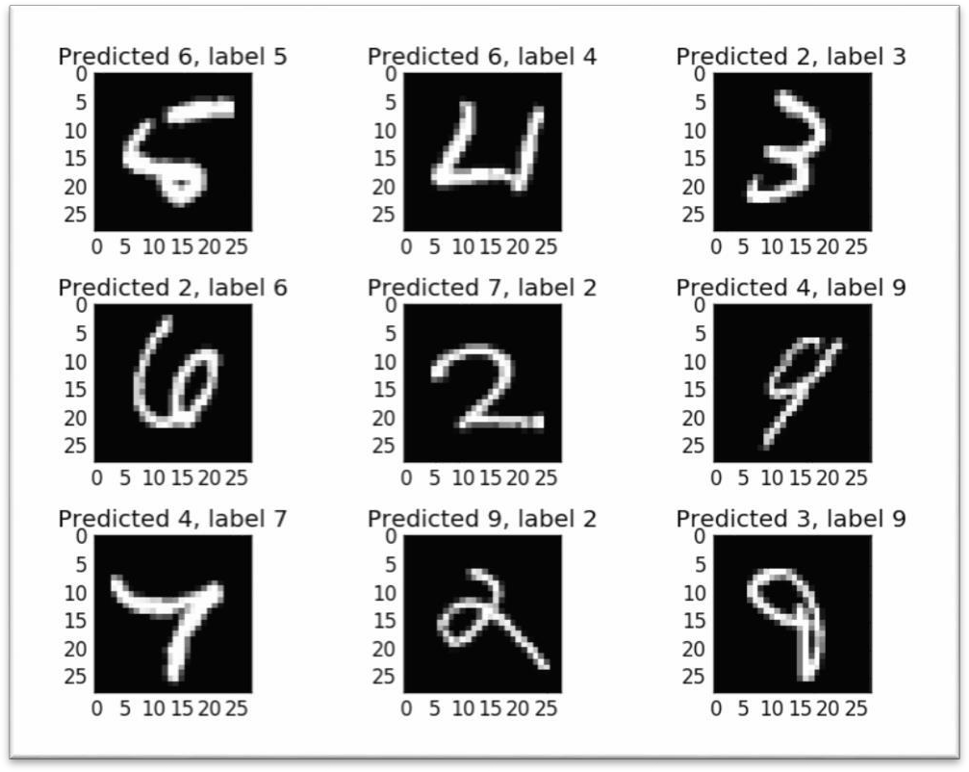
Review The PyTorch Predictions
Correctly classified
Incorrectly classified

Slide 23
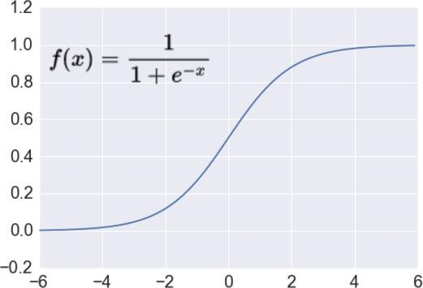












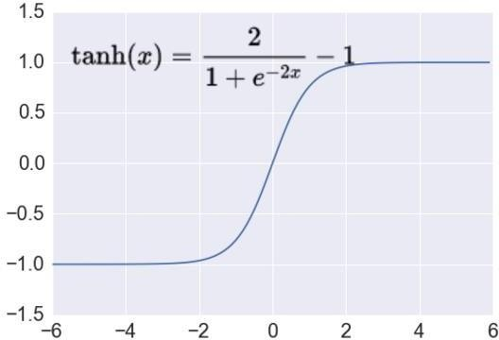













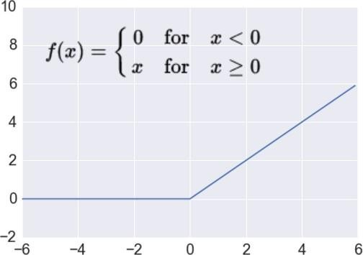
Adding More Layers?
Using a 5 fully connected layer PyTorch model:
sigmoid
200
100
60
30
tanh
10
softmax
0 1 2 ... 9
relu

Slide 24
Why Fully Connected Layers Are Limited
Such a network architecture does not take into account the spatial structure of the images.
- It treats input pixels that are far apart and close together as equally related.
- Spatial structure has to be inferred only from the training data.
Is there an architecture that directly uses local spatial structure?
Convolutional Neural Networks

