Slide 1



3º Encontro de Utilizadores QGIS Portugal
17-18 de Junho, 2016 – Porto
(Selection of) New features in QGIS 2.12 - 2.16

Slide 2
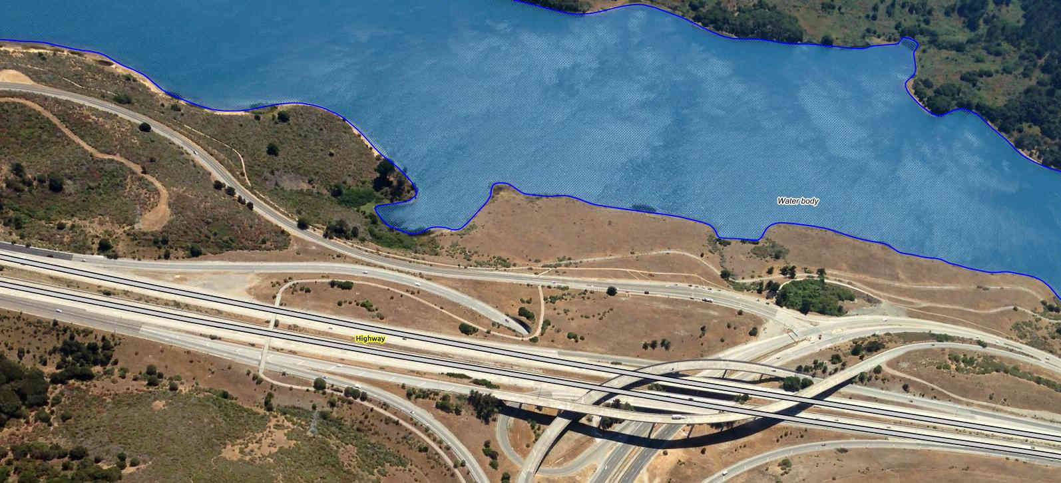
NaturalGIS
Active members of the QGIS development team and community
Contributors of the QGIS Processing toolbox
Main QGIS testers
Experienced QGIS trainers
Services based on FOSS4G
http://naturalgis.pt/

Slide 3
Credits
This presentation: Andreas Neumann (GIS-Fachstelle, Kanton Zug, Switzerland)
To all who paid for new features / bug fixing: QGIS-CH, QGIS-UK, SIGE, Uster, Morges, Vevey, Kt. Solothurn, Kt. Glarus, Kt. Zug, Kt. Basel Stadt, Land Vorarlberg, MEEM, DFAT/Inasafe, Alta ehf, GIS3W, Province Tuscany, Boundless, iTOpen, Sourcepole, Camptocamp, OpenGIS.ch, Norbit, Lutra Consulting, and many (many) more...
To all who developed the new functionalities: Nyall Dawson, Martin Dobias, Jürgen Fischer, Marco Hugentobler, Matthias Kuhn, Sandro Mani, Hugo Mercier, Even Rouault, Denis Rouzaud, Nathan Woodrow, Luigi Pirelli, Victor Olaya, Alexander Bruy, and many (many) more...

Slide 4
(Visual) Changelogs
http://www.qgis.org/en/site/forusers/visualchangelogs.html
http://changelog.qgis.org/en/qgis/version/2.10.0/
http://changelog.qgis.org/en/qgis/version/2.12.0/
http://changelog.qgis.org/en/qgis/version/2.14.0/
http://changelog.qgis.org/en/qgis/version/2.16.0/

Slide 5
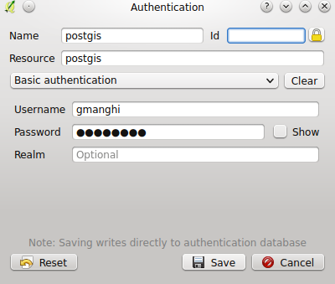
Security - Encrypted passwords
Integrated password manager with master password
Encrypted passwords stored in SQLite DB
Authentication with keys
Available for different providers:
PostGIS
WMS
WFS

Slide 6

Security - Encrypted passwords

Slide 7
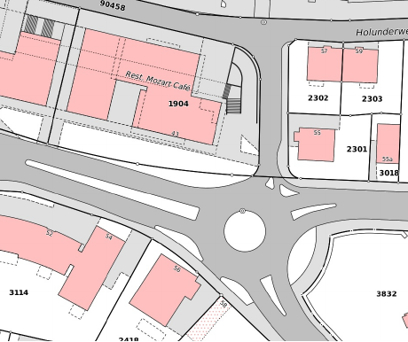
New geometry model
Circular Arcs, 3D, M-Values
possibility to display features with curved type
editing of curved geometry types, z/m-values
curve support in WKT and GML
Curve support in Geopackage (through OGR)

Slide 8
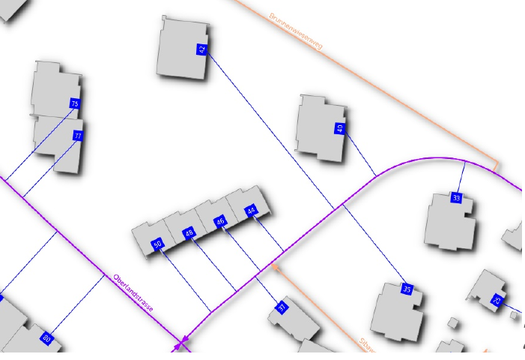
Live Layer Effects
Applies to all vector geometries of a layer
Chainable combination of
Source, Transform, Blur, Drop Shadow / Inner Shadow, Inner glow, Outer glow, Colorize
Combine with transparency and blend modes 2.10

Slide 9
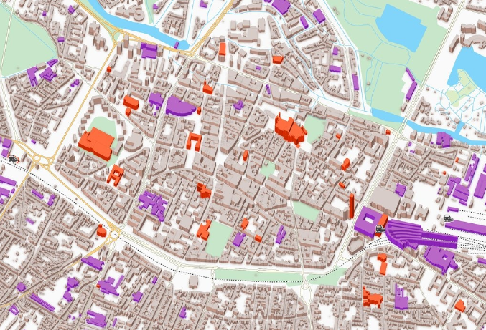
2.5D Rendering

Slide 10
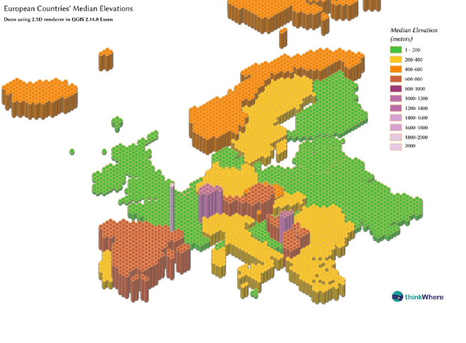
2.5D Rendering

Slide 11
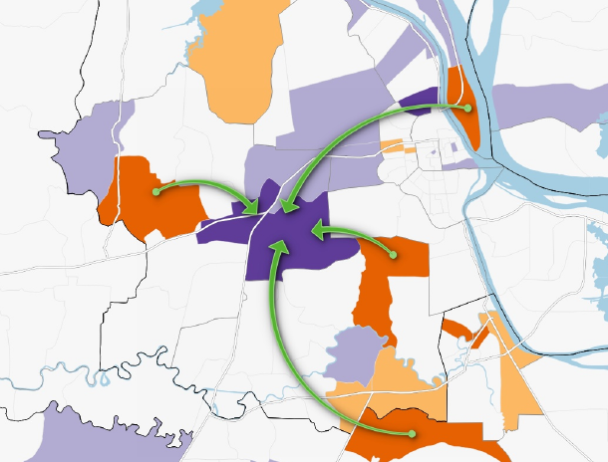
Curved Arrow Renderer

Slide 12
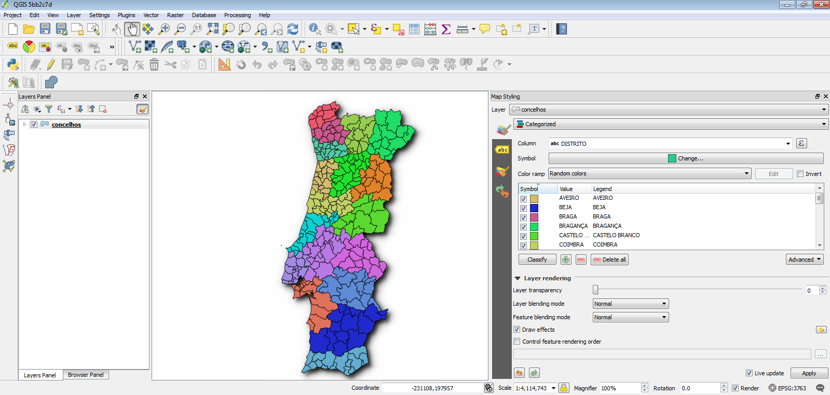
Map Styling and Labeling Dock: live updates!

Slide 13
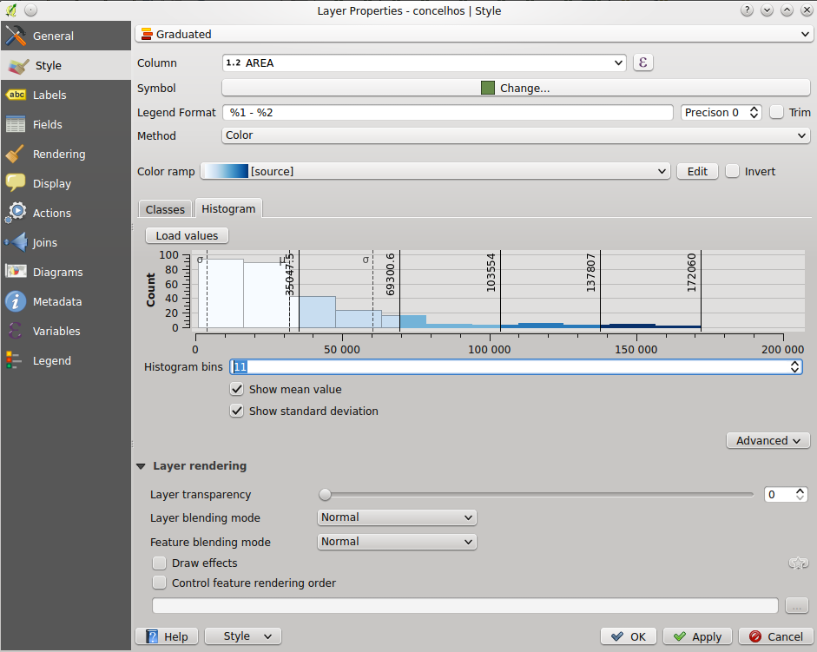
Graduated Renderer Histogram

Slide 14
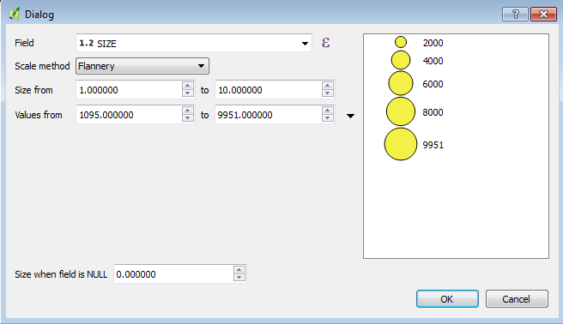
Scaled symbols improvements
Assistant for different scaling modes and mapping min/max to actual sizes
Legend in legend tree and print composer
Legend for components of diagrams

Slide 15
Labels Improvements
Rule based labels!
Data-defined Quadrant for point lables
Draw only labels in polygons, if label fits
Control priority of label obstacles
Avoid polygon borders (obstacles)
Obstacle only layers
Control label rendering order
Point labeling according to Krygier/Wood (2011): use “cartographic” priorities for positioning: top right, top left, bottom right, bottom left, middle right, middle left, top (slightly right), bottom (slightly left)
Consider actual rendered symbol size for labeling point features: apply rendered size to label distance - only available for “cartographic” positioning and consider symbol bounding box as obstacle

Slide 16
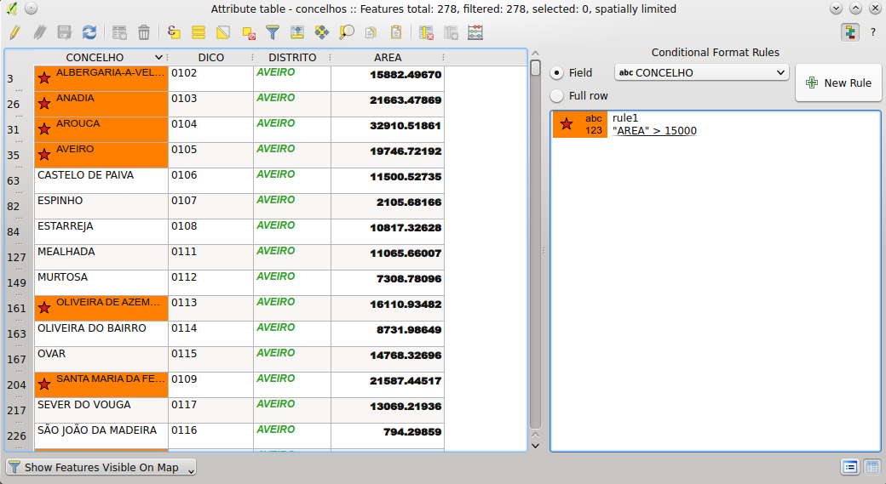
Attribute table improvements
Multi-Attribute Editing of Selected features
Conditional formatting
Multi-Attribute Search in Form View
Select Features or Filter table
Combine selection/filter rules from multiple fields
Add or remove from selection or create new selection
Filter with AND / OR

Slide 17
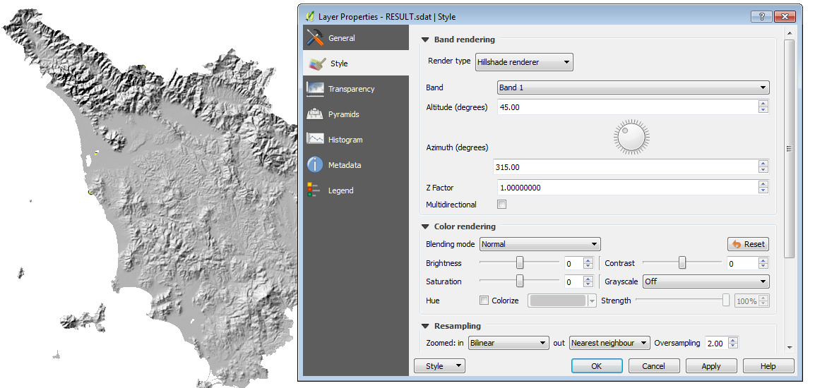
Raster symbology
Several general improvements
Quantile based classification for raster layers
Live hillshade renderer

Slide 18
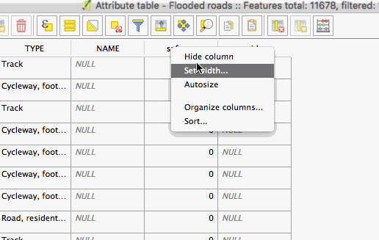
Attribute table improvements
Allow reordering the attribute table columns (via right click on field name header)
Allow adding a new column to trigger an action to the attribute table
Columns can be hidden from the attribute table (via right click on field name header)
QGIS now remembers the width of any resized columns

Slide 19
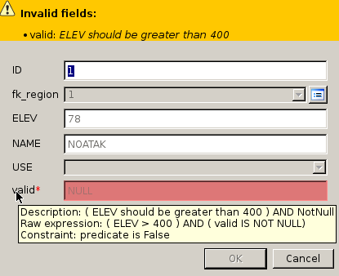
Widgets improvements
Constraints on widgets!
Line edit with auto-completer for ValueRelation edit widget
Relation Reference Widget with Drilldown
Relative path support in file widget, photo widget and webview widget
External Resource Widget (for linking file and web resources)
Client-side constraints on input widgets

Slide 20
WFS Client Overhaul
Version autodetection
On-disk caching of downloaded features
Background download and progressive rendering
WFS 1.1 and 2.0 support
WFS 2.0 GetFeature paging
Add provider tests
Support for WFS 2.0 joins
URI parameter with sql with SELECT / FROM / JOIN / WHERE / ORDER BY clauses
Handle DateTime fields
Enable "Only request features overlapping the view extent" by default (and memorize the settings)

Slide 21
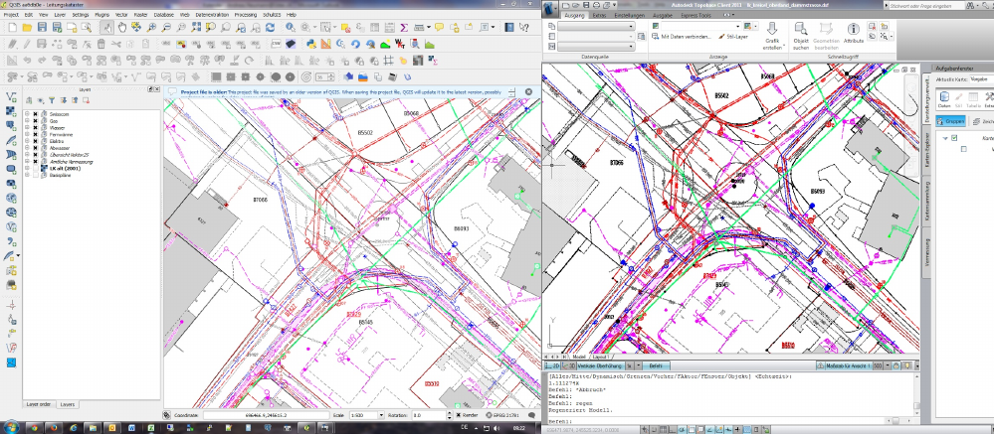
DXF Export Improvements

Slide 22
DXF Export Improvements
Export with our without symbology
Export everything or visible extent
Set scale for rendering rules and filters
Support of visibility presets
Support multiline text
Support solid fills
Support transparency
Support line offsets and units properly
Automatic conversion of simple and SVG symbols to DXF blocks
Use QGIS layer names, layer title or layer attribute to determine layer name

Slide 23
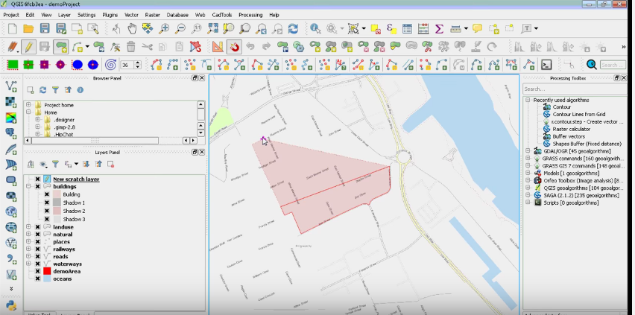
Vector editing
Autotrace digitizing function improved and in QGIS core, see
http://www.lutraconsulting.co.uk/products/autotrace/TraceDigitising
Extend linestring with reshape tool
Point Features: interactive editing of symbol offsets

Slide 24
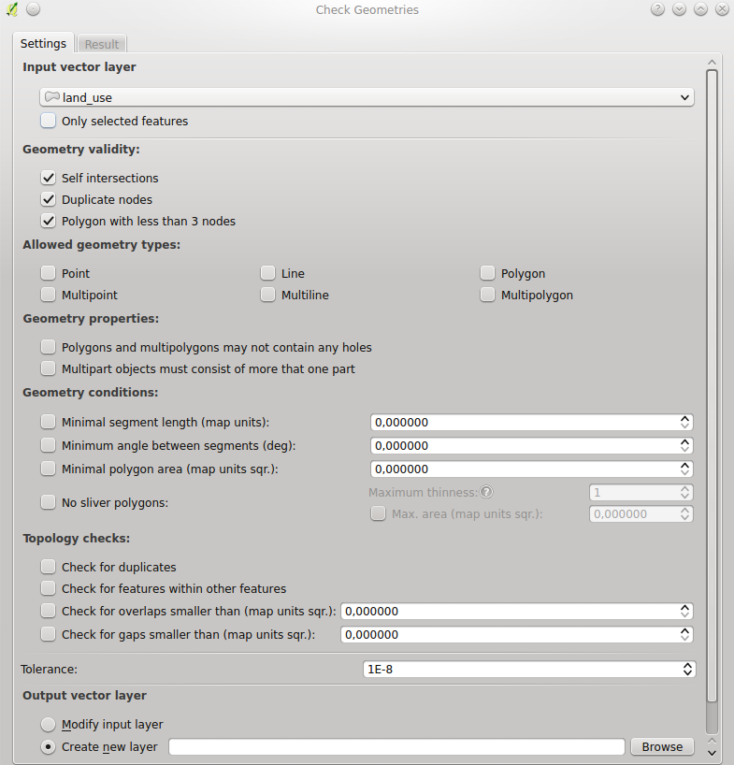
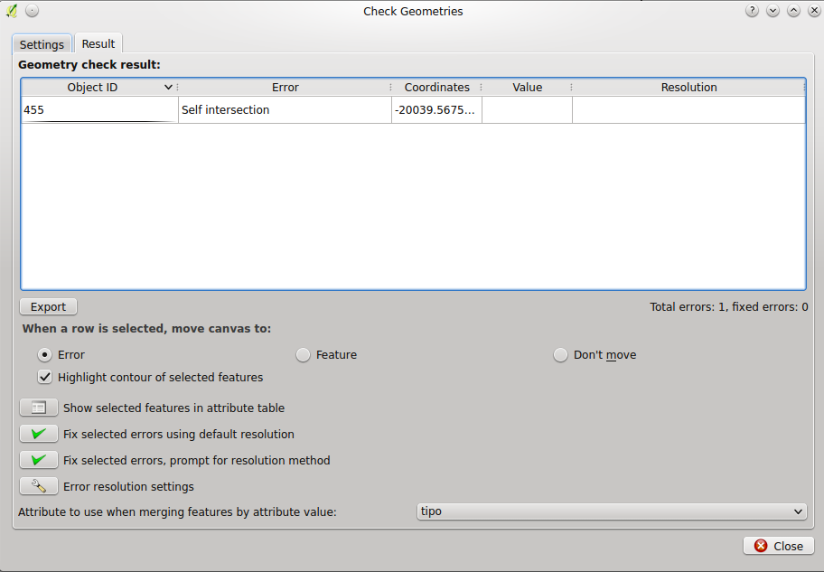
Geometry checker

Slide 25
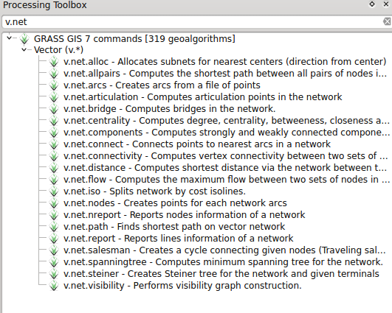
Processing
Models and tools as toolbars icons
Pre-filled tools
Added all the missing GRASS modules (i.*, v.net.*, etc.)
Several general improvements and bug fixes

Slide 26
And much more...
Save styles in MS SQL and Oracle databases
ArcGIS Map and Feature REST services
Control over attributes to export when saving a vector layer
DB Manager:
Support for Oracle connections
Multi-tab SQL windows
GDAL/OGR 2.* related improvements:
Better Geopackage support
Support for curves in more data providers (e.g. Geopackage, GML, Interlis, Postgis)
Support for reading and writing spreadsheet files (Libreoffice and Excel)
...

Slide 27



Obrigado!
@naturalgis

