Slide 1
System programing HW2

Slide 2
Goal
You will build an Dropbox-like system called CSIEBox in the following assignment, and now you will start with a fundamental functionality of CSIEBox in this homework.
We are going to synchronize the files and directories under local repository to server side.
You will need to run up multiprocess in this homework.

Slide 3
Socket
UNIX Network Communicate API
It's accessed as file descriptor, so you can communicate using read/write, or using socket's own recv/send API.
recv_message(), send_message() in hw2

Slide 4
Architecture
You will run up 2 process, csiebox_server and csiebox_client, and you need to use socket to communicate between their.
Csiebox_server : you can treat this as a Dropbox server. It need to monitor client’s local directory and sync file between local directory and server directory.
Csiebox_client : you can treat this as a Dropbox user.

Slide 5
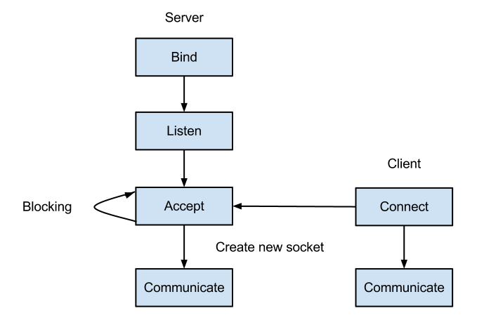
Architecture
Csiebox_server
執行port_register to bind port
Csiebox_client

Slide 6
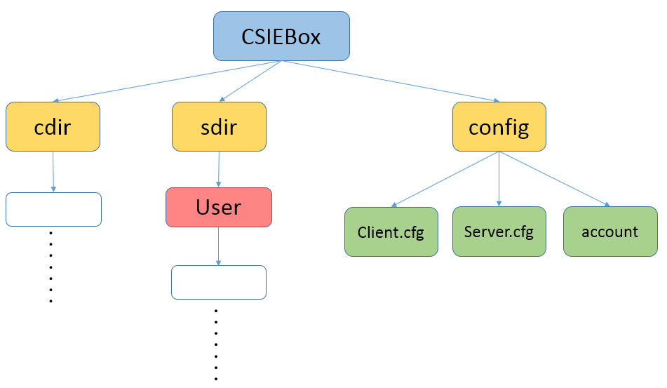
Architecture
So you can treat sdir as server side, cdir as client side in your MP2 directory.
All you need to do is sync file in client(cdir) to server(sdir).

Slide 7
Actions
To sync all changes, we define 5 actions of changes, which is login, sync meta, sync file, hard link, and rm.
We have build up 5 types header for each action, you need to use these header to communicate between server and client.
We also define the rules of each action, you need to follow this rules to build up your CSIEBox.

Slide 8
Five types of complete header
csiebox_protocol_login
csiebox_protocol_meta
csiebox_protocol_file
csiebox_protocol_hardlink
csiebox_protocol_rm
Each complete header has a common header
csiebox_protocol_header
All of headers are defined in csiebox_common.h.

Slide 9
Rules of protocol header
You need to follow the rules of 5 actions and use fixed protocol header, but you can modify others if you want.
In other words, the only things that you can't modify in HW2 is the rules of 5 actions and protocol header in csiebox_common.h

Slide 10
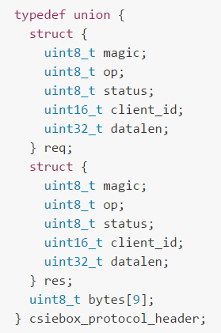
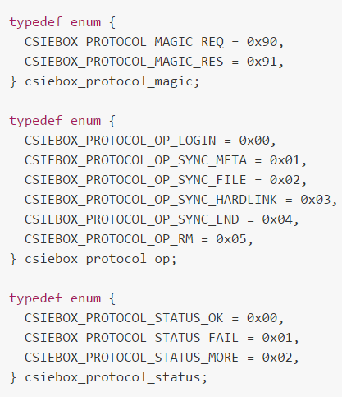
csiebox_protocol_header
magic
op
status
client_id
datalen

Slide 11
csiebox_protocol_header
Attribute Magic, defined for security purpose.
Attribute Op defines operation code.
Attribute Status defines return status.
Attribute Client_id defines the identification of client processes, which will be used in multiple clients scenario.
Attribute Datalen defines the length of optional attributes and will be used to identify the types of optional attributes.

Slide 12
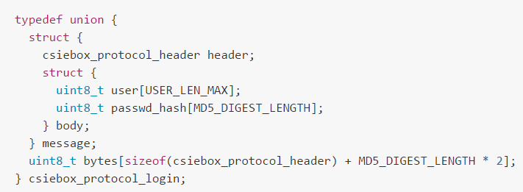
csiebox_protocol_login
Client sends user name and passwd_hash to server. If the user name and password matches, server returns OK in status field and client_id. Otherwise, FAIL is returned in status field.

Slide 13
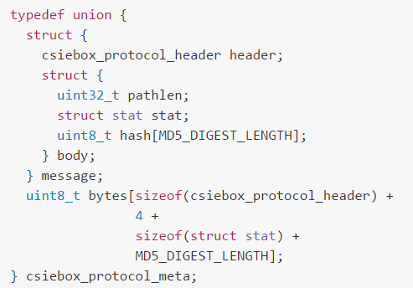
csiebox_protocol_meta
When file/dir's permission or group have been changed, client will send sync_meta request include file pathlen and meta stat to server followed by file/dir path.
Client send this header include file pathlen and meta stat to server, and followed by file path.

Slide 14
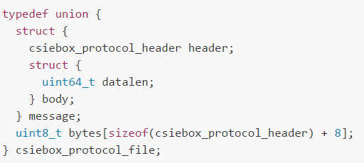
csiebox_protocol_file
Sync file session consists of 2 steps in this operation.
First, the client sends a sync_meta header which provides struct stat, file path length and file hash, and client sends file path to server followed.
Second, Server has to sync meta, and it checks the file hash, if file hash on client is different from that on server, the server returns MORE and the client will send file data to server. Otherwise, the server returns OK and terminates the session.

Slide 15
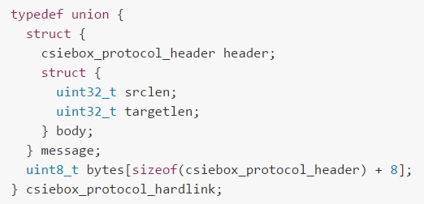
csiebox_protocol_hardlink
Client send this header include source path length and target path length to server, and followed by source and target path.
If a hard link is successfully created, server returns OK in status field. Otherwise, it returns FAIL in status field.
Hint: you can use lstat() to check Inode to determine either it is hard link or not.

Slide 16
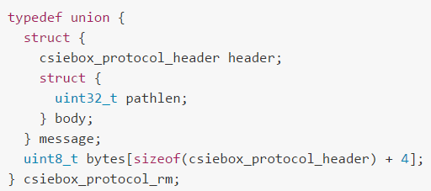
csiebox_protocol_rm
Client send this header include path length to server, and followed by file/dir path.
If the file/directory is successfully removed on the server, the server returns OK in status field. Otherwise, it returns FAIL in status field.

Slide 17
Requirement
Scan the directory
The process traverses/scans the local repository directory to find out the existed files and directories, and do the synchronization.
In this step, the process starts from the top of local repository and transmits all the files and directories to the server side. You will use the provided socket communication template to transmit the files.
However, you have to handle the operations for maintaining directories including creating directories, reconstructing soft/hard link on the server sides, etc.

Slide 18
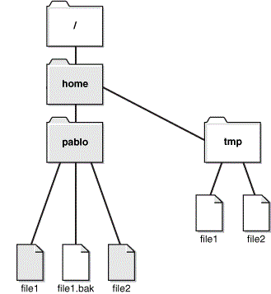
Requirement
Part1: Scan the local directory and sync(upload) to server
cdir
sdir

Slide 19
Requirement
Part2: Monitor the changes on files, directories, hard link, and soft link on local repository
To keep the file/directories to be up-to-date with the local repository, the process has to monitor if there is any change on files/directories.
You can use inotify API, which can monitor file system events, to learn the update and conduct corresponding operations.
Example program of using inotify API is available in the provided package, which is inotify_test.c.

Slide 20
Requirement
Note that you have to pay special attention on handling the changes on links.
In the case of symbolic link, you need to update the value of link instead of updating the content it points to. Even if the file which the symbolic link points to is out of the local repository, or it is a bad link, or there is a loop in the symbolic links, we should do the synchronization anyway.

Slide 21
Requirement
A hard link should be processed in 2 cases.
If it links to a file within the directory tree of local repository, it should remain to be a hard link on server side.
Otherwise, it should be treated as a regular file, rather than a hard link.

Slide 22
Grading
Total 10 points.
5 points for synchronizing existed files and directories between client and server.
(1 point) traverse directory tree: output the longest path on local repository to file longestPath.txt in service root directory.
(1 point) sync regular file
(1 point) sync directory
(1 point) sync symbolic link
(1 point) sync hard link

Slide 23
Grading
5 points for using inotify API, which can monitor file system update events and notify the process.
(1 point) handling Sync meta session
(1 point) handling Sync file session
(1 point) handling Rm session
(1 point) handling Hard link session
(1 point) handling mixed case, you will get point with the completely sync.

Slide 24
Due date
11:59PM, October 27, 2015.
5% of your credits will be deducted for every single day delay.
There is absolutely NO tolerance for plagiarism. Zero points for plagiarism.

Slide 25
Meaning of files
csiebox_client.c: this's the process to simulate client, you need to implement your code about client action in this file.
csiebox_server.c: this's the process to simulate server, you need to implement your code about server action in this file.

Slide 26
Meaning of files
hash.c: provide a build data structure, which can help you to manage the relation of inotify id and monitored dir path.
By inotify API, you can use wd = inotify_add_watch(inotify_fd, "/PathOfDir_YouWantToMonitor", IN_CREATE | IN_DELETE | IN_ATTRIB | IN_MODIFY) to add a monitor on a directory.
wd is the inotify id and /PathOfDir_YouWantToMonitor is the directory path.

Slide 27
Meaning of files
You can use put_into_hash(&(client->inotify_hash), (void*)inotify_path, wd) to store this relation.
Use get_from_hash(&(client->inotify_hash), (void**)&wd_path, event->wd) to retrive the monitored directory path by event->wd.

Slide 28
Meaning of files
connect.c, port_register.c, csiebox_common.c: connect between client process and server process.
inotify_test.c: a test program about inotify, you need to learn how to use it, and write an inotify system in csiebox_client.c.

Slide 29
Linux command in C language
getcwd: get current dir name.
opendir, readdir: opendir can open a directory, and readdir can read a dirertory. These functions can help you to traverse directory tree.
chdir: change working directory.
closedir: close a directory.
mkdir: make directories.

Slide 30
Linux command in C language
lstat: get file status. This help you to get metadata/inode information.
readlink: print resolved symbolic links or canonical file names.
symlink: symbolic link handling. (create sofylink)
link: call the link function to create a link to a file. (create hardlink)
rmdir: delete a directory.
unlink: call the unlink function to remove the specified file.

Slide 31

How to run server and client?
Modify server config file named server.cfg
Path: the path of server directory, named “sdir” in example
Account_path: the path of account file, which has account info
Server.cfg
account

Slide 32
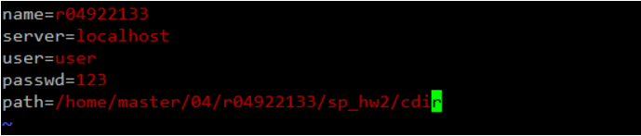
How to run server and client?
Modify client config file named client.cfg
Name: your account name, student ID in work station
Server: localhost
User
Passwd
Path: the path of client local repository, named “cdir” in example

