Slide 1
System Programming
Homework 5

Slide 2
TODOs
Monitor System
Daemonize

Slide 3
Monitor System
TA provide a web-based monitor system. You should use SIGNAL and FIFO to communicate with it.

Slide 4
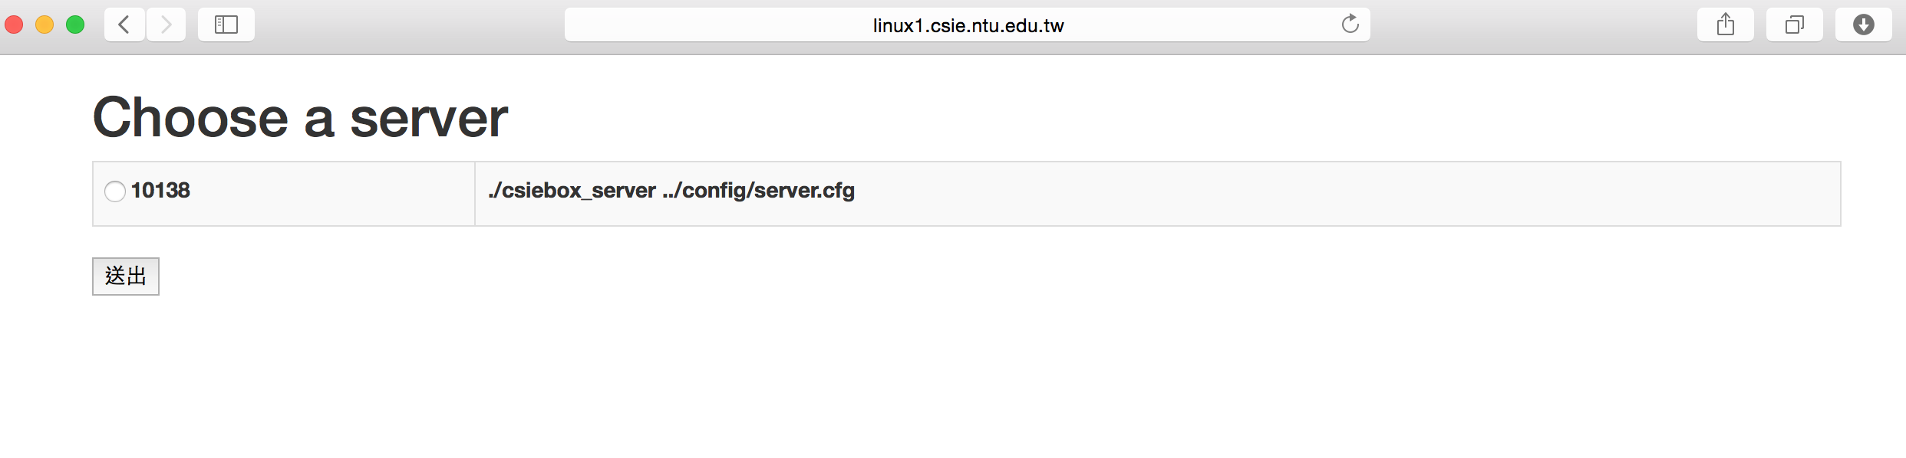
Monitor System

Slide 5
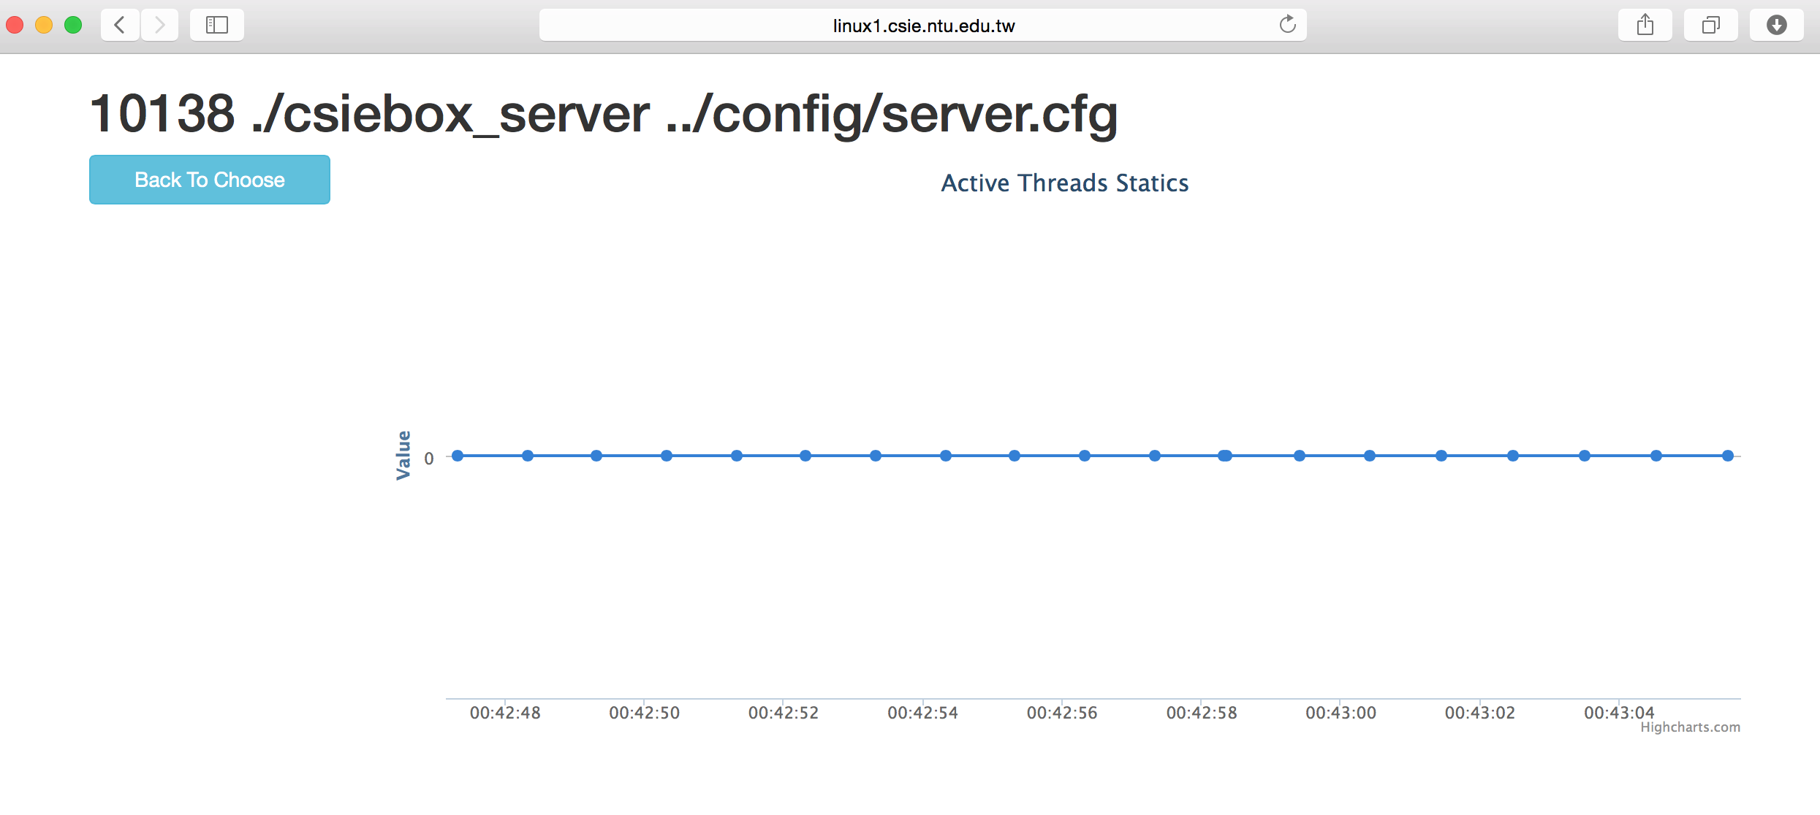
Monitor System

Slide 6
Run monitor system
$ bash
$ cd web
$ nodejs app.js (since nodejs has been installed on linux1~20 workstation, you can run directly.)
open browser: http://linux1~20.csie.ntu.edu.tw:[PORT]

Slide 7
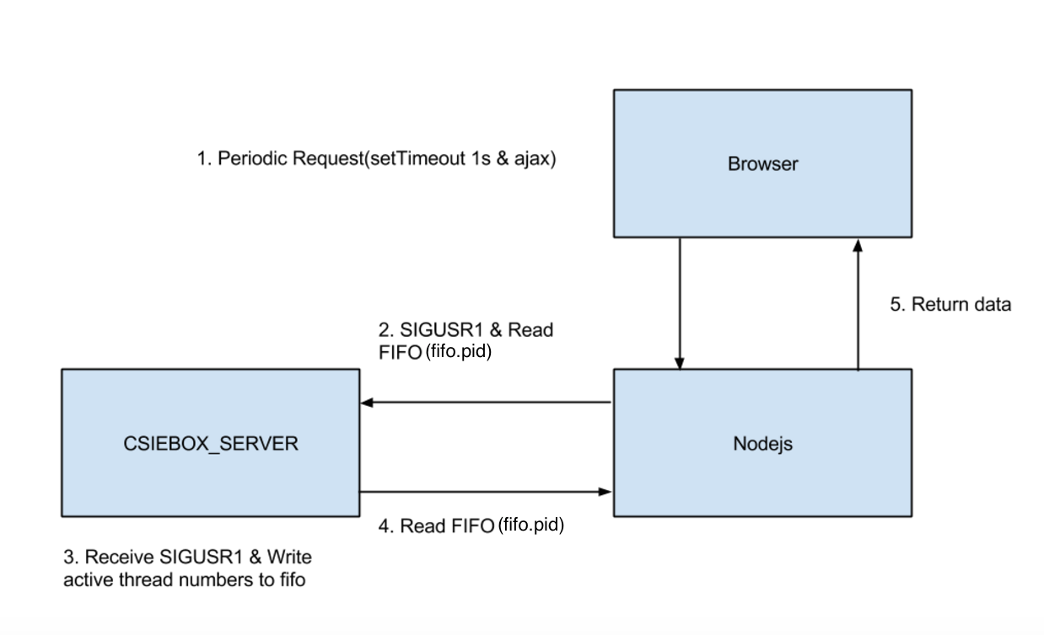
Architecture

Slide 8
TODOs
Add run_path=/nfs/..../b039XXXXXX /SP15MP5/run in server config
Create FIFO after server start, put in run_path with name “fifo.[pid]”
Handle “SIGUSR1” to write thread num
Handle “SIGINT” & “SIGTERM” to clean FIFO

Slide 9
Endian
Byte orders
The web system will accept Big-endian.
Before writing data, use htonl to convert it.
Moreover, please write exactly 4 bytes integer by using uint32_t instead of int

Slide 10
Daemonize
Make csiebox_server daemon.
There will be a pidfile which contain pid of current running process

Slide 11
Pidfile
Use for sending signal to process (stop/monitoring)
Put in run_path
Name: “csiebox_server.pid”
Pid will change during daemonization, and you should maintain this.

Slide 12
TODOs
Enable -d argument
./csiebox_server [config] [-d]
Daemonize
Update pidfile
Notice: Create FIFO after daemonize, because of pid change

Slide 13
TODOs
Enable -d argument
./csiebox_server [config] [-d]
Daemonize
Update pidfile
Use script to test start/stop
Notice: Create FIFO after daemonize, because of pid change

Slide 14
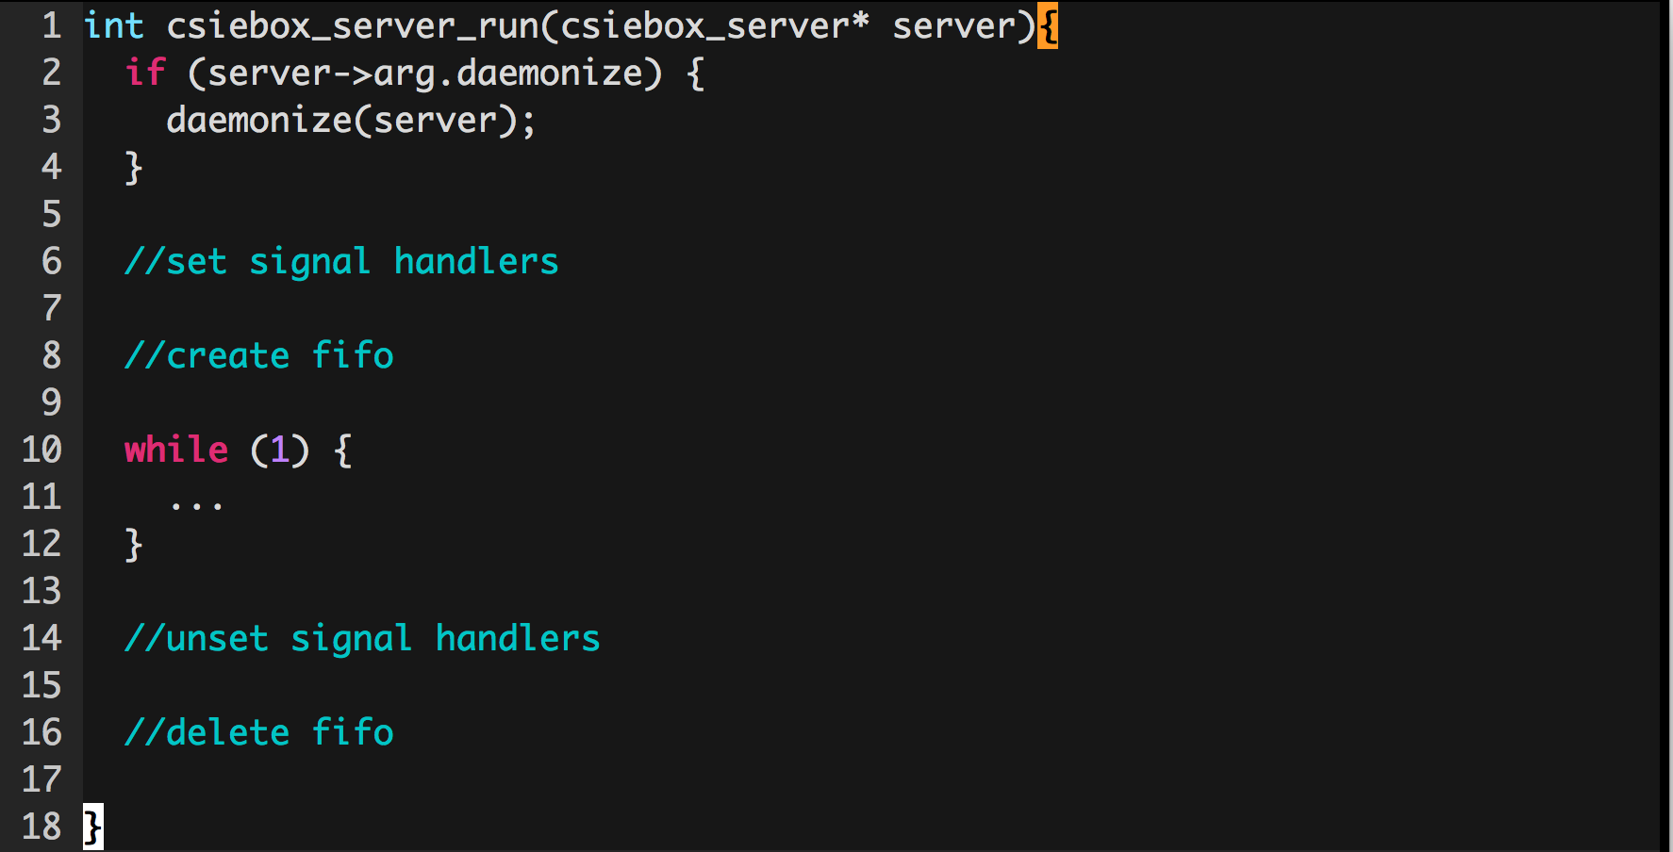
Structure

