Slide 1
Closing Speech

Slide 2
Contents
Key elements in a closing speech
Sample
Comparison between opening speech and closing speech
Expressions used in closing speech
Practice

Slide 3
Key elements in a closing speech
Key elements
Expressing thanks to keynote speakers, participants, moderator(s), organizer(s), and sponsor(s )
Reviewing or summarizing briefly what have been done at the conference
Evaluating the conference properly (achievements, significance, influences)
Announcing the closing of the conference
Extending invitation to the next conference

Slide 4
Sample: closing speech by an organizer
Ladies and gentlemen,
I am now, on behalf of the organizing committee, to give the closing speech.
I believe that our Conference is a great success. It went smoothly as scheduled. In these five days the Conference has covered so many important and complex problems in the field of XYZ both theoretical and practical. All the presentations were very illuminating and informative. And the heated panel discussions were stimulating and fruitful. Now with great joy and a reluctant mind to part, we get together again to declare that the Conference has drawn to a successful close.
It is our hope that the result of the Conference will carry the study of XYZ to a new stage. We all hope to maintain close contact and cooperation with each other in the field of future research work on XYZ.
Purpose of the speech
Review and evaluation
Significance and expectation

Slide 5
As the organizer of the Conference, I would like to express our sincere thanks to the members of the International Committee, the members of the organizing Committee, and the authorities of Nanjing University and Jiangsu Province for all their support and contributions to this successful Conference. Thanks are also extended to all the participants who came from over 30 countries and regions. Thank you for your attention to all our sessions and thank you for your stimulating questions.
Now, the Conference is closed. Let’s meet again in London in 2018.
Thank you.
appreciation
Announcement

Slide 6
Comparison between an opening speech and a closing speech
Opening speech
Closing speech
Purpose: mark the opening
Elements: welcome and appreciation
background introduction
theme
agenda
good wishes
Purpose: mark the closing
Elements: appreciation and summary
evaluation
expectation
invitation
closing

Slide 7
Expressions used in closing speech
Summarizing the achievements
We are now very close to the end of this International Conference which has achieved tremendous successes. More than 200 participants have come to Manhattan to discuss not only general questions about XXX but more concrete questions and problems and their possible solutions.
We have worked actively in the workshops these days, and our work has provided value not only to the resolution but also to the work of this Association in general.
I believe that our conference is a great success. It went smoothly as scheduled. In these five days the conference has covered so many important and complex problems in the field of biochemistry, both theoretical and practical. All the presentations were very illuminating and informative. And the heated panel discussions were very stimulating and fruitful.
Our conference has lasted three days. It has achieved tremendous successes. Eighteen scientists and scholars spoke at the conference. Many more aired their views freely at group discussions, which proceeded in a friendly and lively atmosphere. I benefited greatly by attending this conference.
In the past few days you have been addressing themes of paramount importance, and please allow me to express my admiration for and appreciation of your wisdom in these fields, since such wisdom is the basis for action.

Slide 8
Expressing the thanks
I would like to thank various people. First of all, the chairpersons for their efficient ways in which they handled their sessions. Second, the speakers for their excellent presentations. Third, the delegates for having been an excellent audience and having provided stimulating discussions. Last but not least, I would like to thank the companies for the financial support and cooperation we received in organizing and conducting this conference.
Let me congratulate you for the achievements of this conference. This was the result of very hard work by delegates under the very competent leadership of the chairman.
Thank SEU for hosting the conference. Thanks go to everybody who has contributed to the conference with reports and introductions. Thanks for the financial contributions to this conference from the city and all other organizations and a number of private sponsors.
As the organizer of the conference, I would like to express our sincere thanks to the members of the Organizing Committee, the authouities of Nanjing University and Jiangsu Province for all their support and contributions to this successful conference. Thanks are also due to all the participants who came from over 30 countries and regions.

Slide 9
Announcing the next conference
It is a privilege for me to announce that the next congress will be held in London in 2014.
I am proud to have the privilege to announce that the next International Conference on XX will be held in China in May 2014. We should welcome as many scientists as possible. We look forward to seeing you then.
And lastly, my friends, see you next yeat in Beijing, China for our next conference.
I look forward to seeing you again at the next conference two years hence in Nanjing in 2014. You will be warmly welcome there.
Let us meet again in Paris in 2014 at the next world congress of biomaterials.
Our next conference will be held in New York at our college. We will try our best to make the gathering another fruitful and pleasant one.

Slide 10
Announcing the closing of the conference and expressing good wishes
Ladies and gentlemen, you have my best wishes for your still greater achievements in your career. Now, I declare the conference closed.
I hope you will have a safe and peaceful journey home and offer to you my warmest best wishes. With these few remarks, I now declare the conference officially closed.
Now, the conference is closed. Let’s meet again in London in 2014.
I now have the duty and the honor to declare the conference officially closed. Good wishes to all of you.

Slide 11
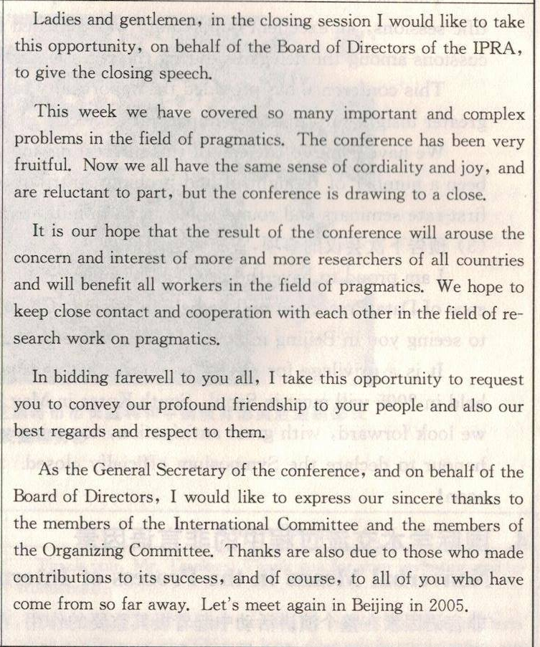
Practice
Work in small groups to discuss and figure out what are included in the closing speech on the left.
Purpose of the speech
Review and evaluation
significance and expectation
Best wishes
appreciation and invitation

Slide 12
Practice
We now have come to the end of the conference session about how to speak at different stages in an international conference. Suppose you are the course teacher and you are to close the session. What would you say?
Elements
Rehearsal

Slide 13
possible elements
Evaluation
Summary
Appreciation
Expectations/invitation
Declaration

Slide 14


