Slide 1


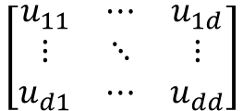












$$\left[\begin{aligned}u_{11} \\ ⋮ \\ u_{d1} \\ ⋮ \\ ⋮ \\ u_{d1} \\ ⋮ \\ u_{dd}\end{aligned}\right]$$
Flatten
$$\left[\begin{matrix}u_{11} & ⋯ & u_{1d} \\ ⋮ & ⋱ & ⋮ \\ u_{d1} & ⋯ & u_{dd}\end{matrix}\right]$$
…
Unitary matrix
(percept)
$$5×$$
Input layer
Output layer
…
Two-qubit DQN
$$16×6000$$
$$6000×2000$$
$$2000×2000$$
$$2000×2000$$
$$2000×2000$$
$$2000×\left|𝒜\right|$$
…
Three-qubit DQN
$$64×8000$$
$$8000×3000$$
$$3000×3000$$
$$3000×3000$$
$$3000×3000$$
$$3000×\left|𝒜_{t}\right|$$

