Slide 1
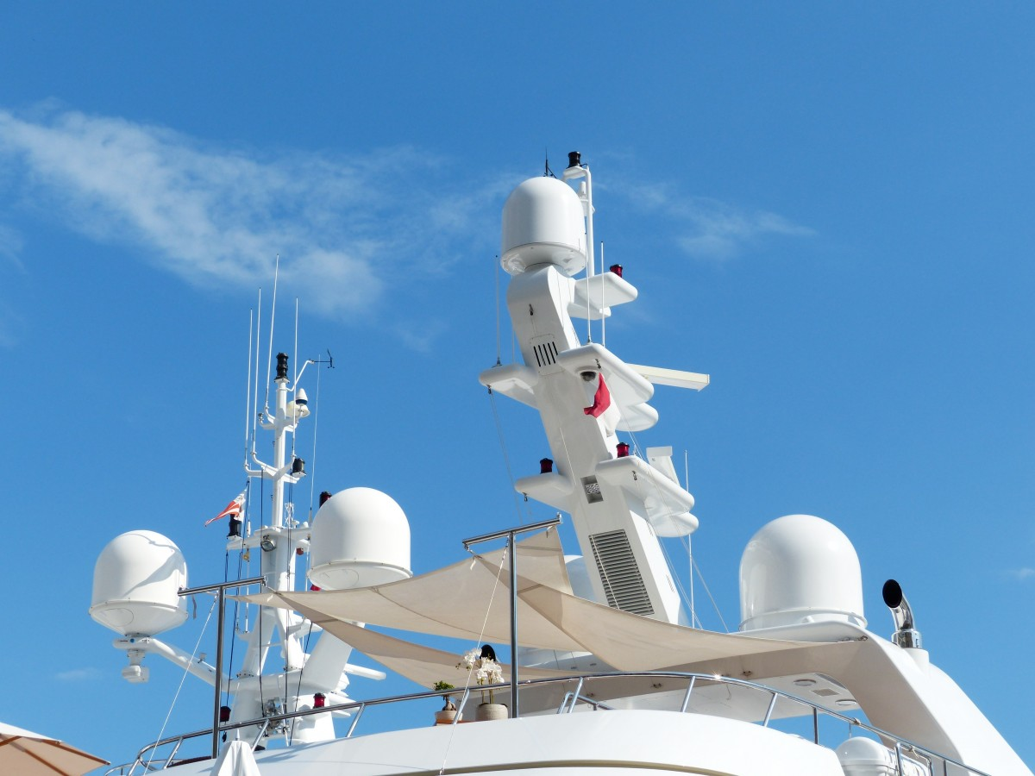








Intelligent radar that developed human-like time management skills
Qinghao Chen
Image source: https://research.csiro.au/iuu/case-studies/radar-harvesting/

