Slide 1
WHAT IS VUE

Slide 2
While I am studying vue, I have some questions/
Why do we use Vue.js? And Why do we use Vuex?
How do I connect to data in Vue.js?(Data fetching)
What is router in vue.js?
What is axios?
What is instance’s life cycle model?
What is Vuex?

Slide 3
What is Vue Life Cycle?
Create
Mount
Update
Destroy

Slide 4
What is Vue Life Cycle?
Create
Mount
Update
Destroy
Created
mounted
updated
beforeCreate
destroyed
beforeMount
beforeUpdate
beforeDestroy

Slide 5
What is Vue Router?

Slide 6
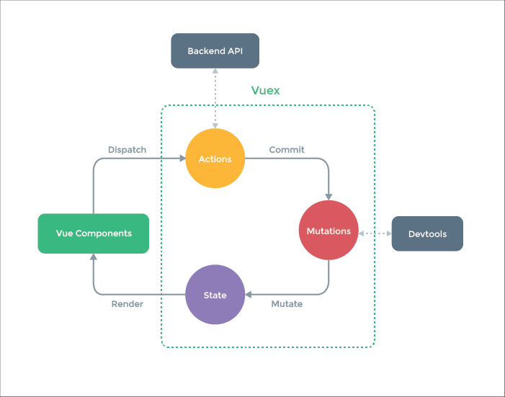
Vuex
Vuex is a state management pattern + library for Vue.js applications.

