Slide 1
CSS
Pan OS

Slide 2
CSS layout
CSS float
Flexbox
CSS Grid

Slide 3
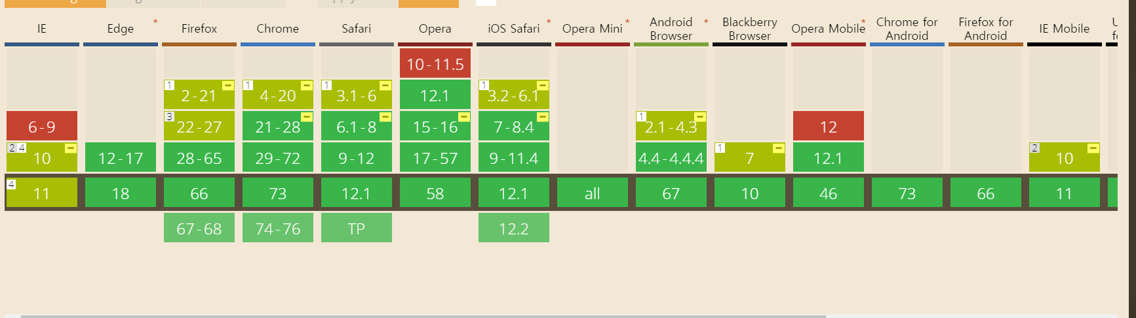
Flexbox

Slide 4
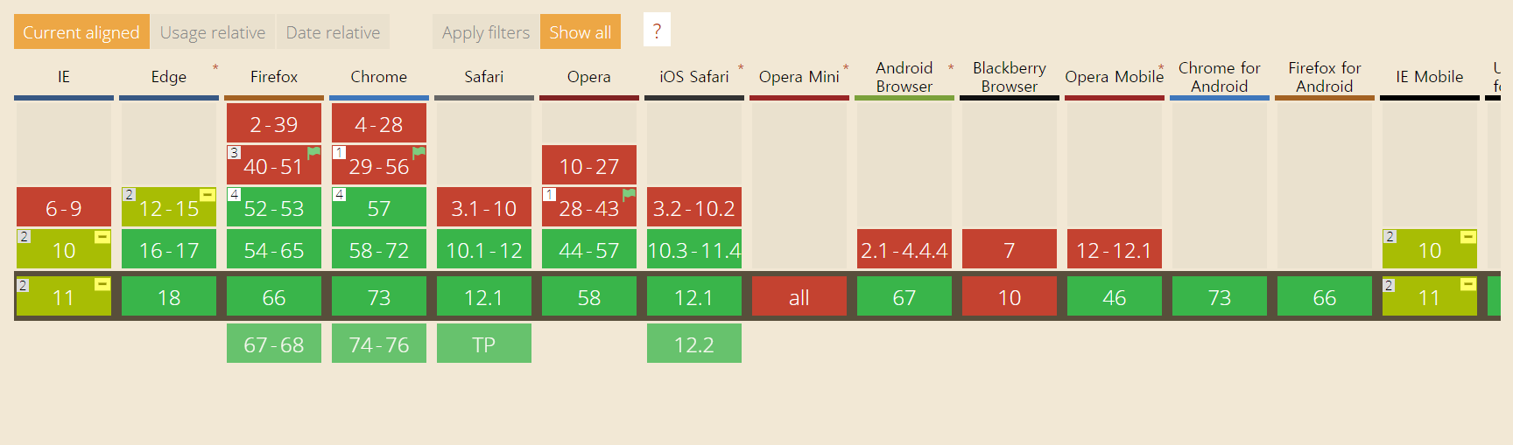
Grid

Slide 5
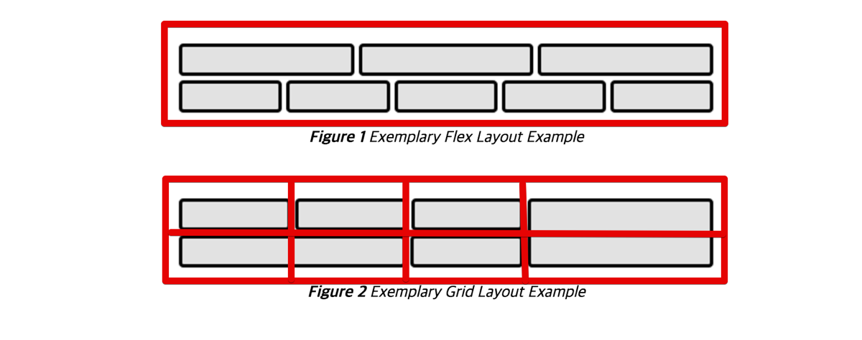
Flexbox VS Grid
http://www.usefulparadigm.com/2017/03/31/a-few-ways-to-make-a-grid-layout/
그림 출처: W3C CSS Grid Layout Module 명세

Slide 6
Grid

Slide 7
Grid

