Slide 1
CSS
Pan OS

Slide 2
CSS layout
CSS float
Flexbox
CSS Grid

Slide 3
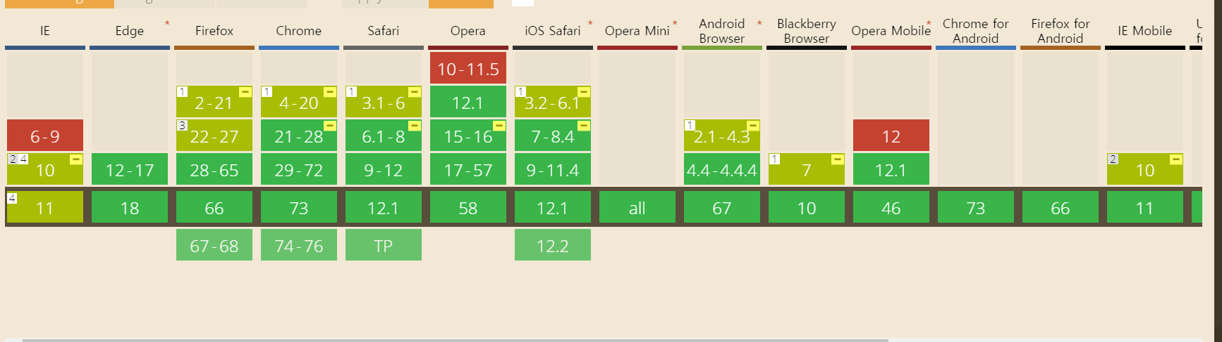
Flexbox

Slide 4
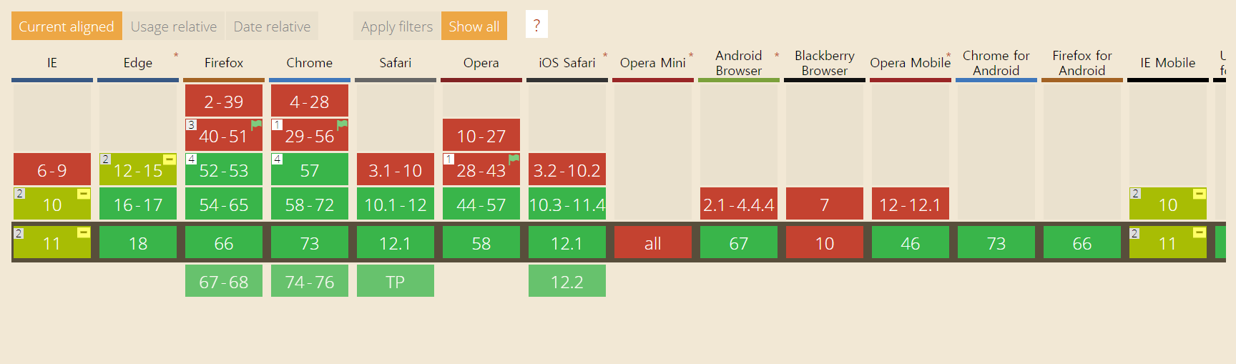
Grid

Slide 5
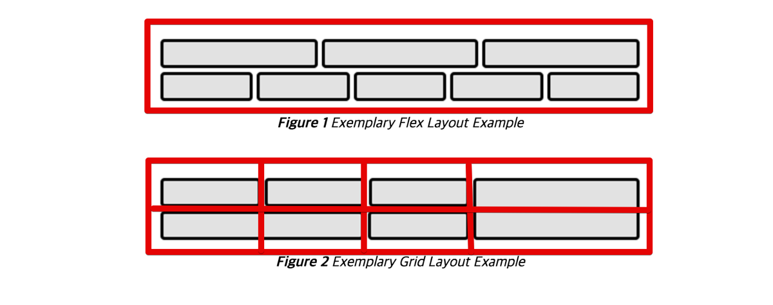
Flexbox VS Grid
http://www.usefulparadigm.com/2017/03/31/a-few-ways-to-make-a-grid-layout/
그림 출처: W3C CSS Grid Layout Module 명세

Slide 6



PAN Expedition - Log Ingester: UI - Dashboard
Click title to go to page
Simple match (contains)
Firewalls
Search
Logs
10.1.1.1
Rate Limited to 1 per second, Max 100
PAN 1
PAN 2
Confirm
10.1.1.1
PAN-OS 8.1
2348972 received
Start 100 days ago
Last received 2 sec
10.1.2.1
PAN-OS 8.1
123 received
Start 1 hour ago
Last received 2 sec
+
Syslog 10.1.1.1 2019/04/2 03:02:11 X, Y, Z
File 10.1.1.1 2019/04/2 03:02:11 X, Y, Z
Change color on detected firewalls that has not been confirmed by user yet
HA1 10.1.1.1 2019/04/2 03:02:11 X, Y, Z
Ingestion
Output
Change color on error condition such as connection error, or keep alive.
Syslog, Syslog-conn over UDP, TCP and Syslog-tls. A single syslog server is configured by default
Syslog
File
Port 514 No TLS
2348972 received Start 100 days ago Last received 2 sec
/User/log/ TLS
2348972 saved Start 100 days ago Last saved 2 sec
Splunk
HA1
Change color on error condition such as Splunk API error, connection error, or no activity for more than 1 day
10.3.1.2 Port 8089
2348972 received Start 100 days ago Last received 2 sec
10.5.1.2 Load Balanced
2348972 sent Start 100 days ago Last sent 2 sec
+
HA2
10.5.1.3 Connection Error
2348972 sent Start 100 days ago Last sent 2 sec
Splunk need query during setup. May use default query that is provided
Best Customer Experience

Slide 7
Container > window > bucket > item
CSS Frame(Flexbox version)
I spend lots time to find a frame.

Slide 8
CSS Frame(Flexbox version)
Firewalls
Search
PAN 1
10.1.1.1
PAN-OS 8.1
2348972 received
Start 100 days ago
Last received 2 sec
I spend lots time to find a frame.

Slide 9
Interactor에서 CSS 실행되게 하기

